Slide 1
Wisconsin Legislative Council Special Committee on Infant Mortality
Sept. 8, 2010
Kathleen Pritchard, Ph.D.
President and CEO,
Planning Council for Health and Human Services, Inc.
Project Director, Milwaukee LIHF Planning Process
kpritchard@planningcouncil.org

Slide 2
Goals of the Milwaukee LIHF Planning Process
Close the Black-White Gap in Infant Mortality in Milwaukee
Coordinate with existing social and medical programs
Increase public awareness
Leverage resources across all sectors
Build coalitions
Determine effective strategies to adopt
Create an action plan

Slide 3
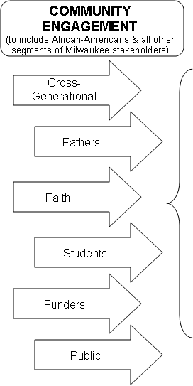
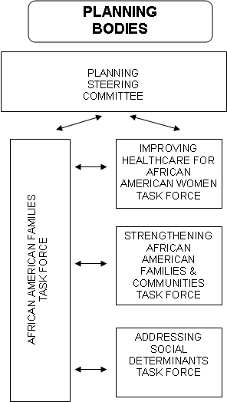
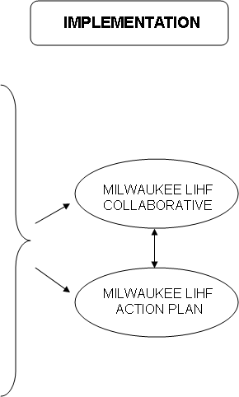
Milwaukee LIHF Collaborative Planning Process

Slide 4
Very early lessons
The racial disparity gap is unacceptable
People have been working on this for a long time
There is a need to broaden awareness of the scope and implications of the problem
Recognize that there is “magic bullet” or single approach to address this
We need to be informed by evidence-based practices without limiting innovation

Slide 5
Regional Differences
Wisconsin among the worst infant mortality rates in the United States
Nearly 3/4 of black infant deaths take place in Milwaukee
Milwaukee has the second highest rate of infant mortality in the state
In Milwaukee, an African American baby is 3 times as likely to die in first year of life as a white infant
The number exceeds the number of homicides annually
In 2008, the overall infant mortality rate for the City was 10.79
The rate for non-Hispanic blacks was 13.85
Notes:
P 30

Slide 6
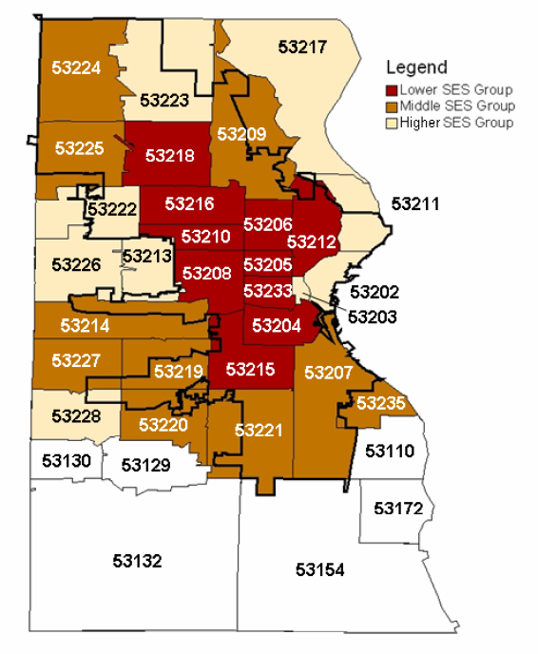
6 ZIP codes where rates are higher than the overall rate for African Americans across the City
2008 Mortality Rate | N from 1989-2008
53210--22.82 | 172
53224--20.49 | 60
53206--18.38 | 319
53212--16.17 | 195
53209--16.08 | 208
53208--15.23 | 181
53216--12.27 | 152
53218--10.90 | 153
53225 | 61
(CUPH 2010)
Notes:
P 31

Slide 7
Reduce Infant Mortality
Reduce low birth weight
Reduce financial barriers that limit access to care
Expand supply of prenatal care through more services and more culturally sensitive providers
Caution: increased eligibility does not necessarily improve access and improved access does not necessarily improve use
Notes:
P 31

Slide 8
More than proper prenatal care
Racism
Segregation
Unemployment
Inadequate housing
Education
Urban stress
Teen pregnancy
Intergenerational trends
Poverty
Social Isolation
Notes:
P 32

Slide 9
Change policies or programs
Increase the number of women and infants who have health insurance to avoid lack of, or late entry to prenatal care
Expand prenatal care through targeted outreach and interventions
Improve prevention and management of chronic diseases among pregnant women
Expand access to comprehensive reproductive health and family planning services – reduce unwanted and closely spaced pregnancies

Slide 10
Improve coordination of various efforts
Move beyond health
Recognize the critical role of male partners and family support
Replicate WPP model with recommendation to form a coalition, to allow for planning time, to target resources
Assure a community infrastructure to support healthy lives – food security, housing, safety, economic stability
Consider environmental factors – segregation, inadequate housing, community violence

Slide 11
Remove barriers to achieving work
Avoid silos services
Increase voice and ownership
Focus on solutions to reduce disparities
Build on family and community assets
Undertake bold initiatives
Assure adequate long-term funding

Slide 12
Take advantage of available resources including federal and private $$
Partner with others – United Way, the City Health Department, Foundations, and private donors (Women’s Fund, Donors Forum)
Connect to community efforts of:
home visiting
social support
breast feeding practices
women health policies
throughout the life course
0-3 programs
youth development programs
fatherhood programs
extended nutritional programs
safe and adequate housing
community-based doula programs
access to contraception
support high quality prenatal care
family friendly tax policies
livable wages
children’s preventative programs

