Slide 1
Wisconsin Legislative Study Council
Sheri Johnson, Ph.D.
Racism and Birth Outcomes
November 16, 2010

Slide 2
Objectives
Review C. Jones’ model of levels of racism
Discuss the relationship between racism and birth outcomes
Identify potential areas for policy consideration

Slide 3
Assumptions:
“Race” has been socially constructed
“Race” serves a strategy to hierarchically organize groups of people
Racism mediates access to goods, services and opportunities that are associated with health.

Slide 5
Racism
Institutionalized
defined as the structures, policies, practices, and norms resulting in differential access to the goods, services, and opportunities of society by “race.” Institutionalized racism is normative, sometimes legalized, and often manifests as inherited disadvantage.
Personally Mediated
Internalized
Jones CP. Confronting Institutionalized Racism. Phylon 2003;50(1-2):7-22.

Slide 6
US Policy and Race: Affirmative Action
Started in 1641: colonies begin to specify in law that rights to property, to ownership of goods and services and to vote were restricted by race and gender.
Expanded in 1790: restricted citizenship and applied only to “whites” and was not overturned until 1952.
Affirmative action has been in place for whites for 370 years, and 60 years for racial/ethnic minorities
Brown, M, Carnoy, M, Currie, E. Duster, T. Oppenheimer, B.,Schultz,,MM
Wellman, D Whitewashing Race: The Myth of a Color Blind Society 2003
University of California Press, Berkeley

Slide 7
How education shapes health
Educational attainment
Health knowledge, literacy & behaviors
Nutrition
Exercise
Drugs & alcohol
Health/disease management
HEALTH
Working conditions
Exposure to hazards
Control / demand imbalance
Stress
HEALTH
Educational attainment
Work-related resources
Health insurance
Sick leave
Retirement benefits
Other benefits
Work
Income
Housing
Neighborhood environment
Nutrition
Stress
Sense of control
Work-related factors
Health-related behaviors
Stress
HEALTH
Educational attainment
Social standing
Social & economic resources
Stress
HEALTH
Social & economic resources
Health-related behaviors
Family stability
Stress
Social support
Notes:
7

Slide 8
How income shapes health
Income represents resources and opportunities:
Medical care
Nutrition & physical activity
Housing and neighborhood conditions
Social support
Ways to reduce/buffer stress
Children’s education

Slide 9
Considering income and education is not enough: the impact of racism
Structural racism tracks people by race into different socioeconomic opportunities
Job opportunities
Educational opportunities
Options for where to live → schools, jobs, housing quality
In addition, living in a society with a legacy of discrimination can harm health through pathways involving stress
Not only overt incidents
Constant vigilance

Slide 10
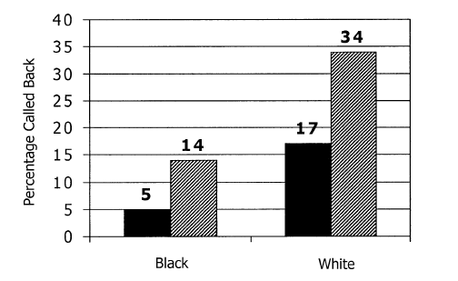
Race, Incarceration, and Employment
Without criminal record
With criminal record
Without criminal record
With criminal record
Source: Pager 2003

Slide 11
Undoing Structural Racism: Policy Options to Explore
Expand the Earned Income Tax Credit (Joint Center for Political and Economic Studies)
Expand job training programs (UW What Works)
Eliminate the distinction between single parent and two parent families in determining TANF eligibility (Joint Center for Political and Economic Studies)

Slide 12
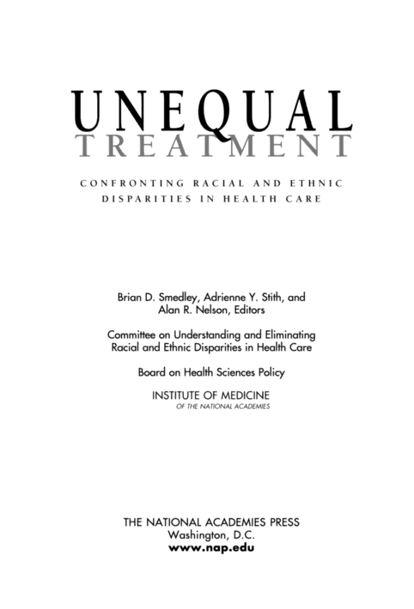
Notes:
But this is not news to anyone in this room. While attititudes and knowledge in the general public, when assessed using survey data, indicate that most Americans aren’t aware of the wide differences in health and health care quality by race/ethnicity, the data and evidence for those working in the field has been available for many years, and is best represented in the seminal work by the IOM.

Slide 13
Unequal Treatment
The majority of studies find that racial and ethnic disparities remain even after adjustment for SES and other healthcare access related factors. (see Kressin and Peterson 2001 and Gieger)

Slide 14
Unequal Treatment
Care process level variables may include bias or prejudice against minorities, greater clinical uncertainty when interacting with minority patients and beliefs or stereotypes held by the provider about the behavior of health of minorities (Balsa and McQuire, 2001, pg. 9)
Notes:
I’m going to focus more on this later, as it represents one pressure point in the health care delivery system where opportunity exists for improvement. IOM report certainly identifies many other points for potential intervention to improve health care disparities. But I want to highlight some of the findngs regarding the doctor patient relationship

Slide 15
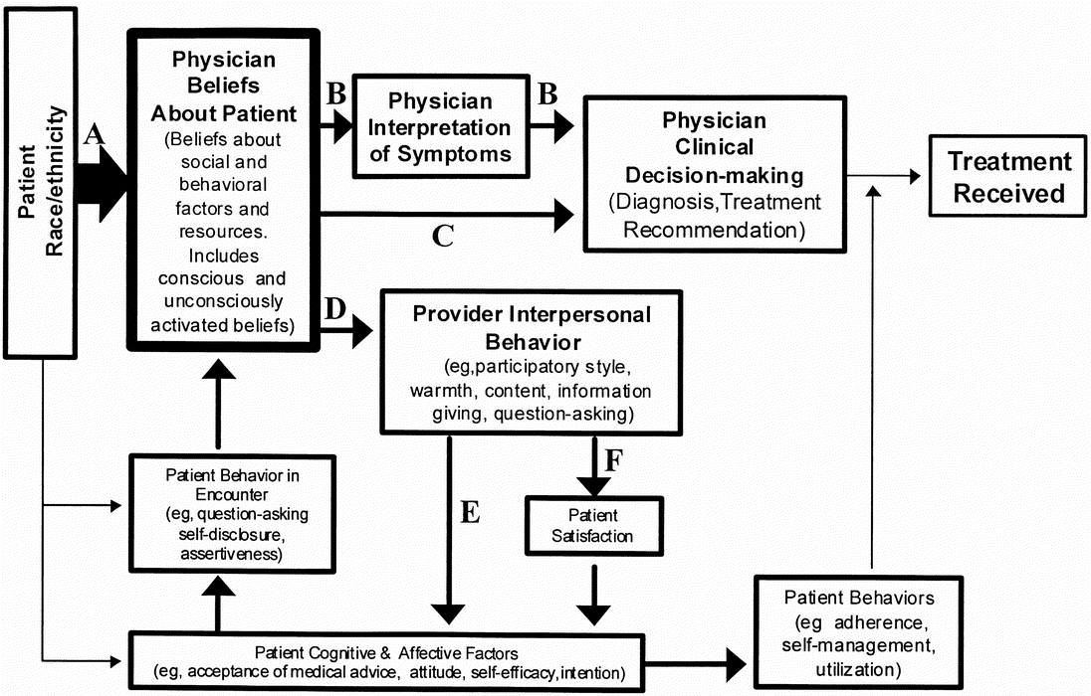
van Ryn, Michelle PhD, MPH Medical Care Issue: Volume 40(1) Supplement, January 2002,
Notes:
van Ryn, Michelle PhD, MPH Medical Care Issue:Volume 40(1) Supplement, January 2002, pp I-140-I-151Hypothesized mechanisms through which provider factors influence race/ethnicity disparities in treatments received

Slide 16
Being the “other” has negative health effects
Drawing on previous studies hypothesizing that experiences of discrimination increase the risk of pre-term birth and low birth weight
California birth certificate data used to determine the relative risk of poor birth outcomes by race, ethnicity and nativity for women who gave birth in the 6 months post 911 compared to the same six month period one year earlier.
The relative risk of poor birth outcomes was significantly increased for Arabic named women but not for any other groups Lauderdale, DS Demography , Volume 43-Number 1, February 2006: 185–201

Slide 17
Physicians Implicit and Explicit Racial Attitudes Sabin, Nosek, Greewald and Rivara, (2009) Journal of Healthcare for Poor and Underserved
Implicit (non-conscious) attitudes and beliefs are:
not readily recognized by individuals
can differ markedly from expressed beliefs
more closely related to nonverbal behavior
be present in the absence of intention to behave in a specific way

Slide 18
Explicit Attitudes
Explicit (self reported) attitudes are:
known to the individual
readily expressed on self report
predict verbal behavior

Slide 19
Explicit Racial Attitude Measure
What best describes you?
I strongly prefer White Americans to African Americans
I moderately prefer White Americans to African Americans
I like White Americans and African Americans equally
I moderately prefer African Americans to White Americans
I strongly prefer African Americans to White Americans

Slide 20
Methods
Volunteer test takers who accessed the public demonstration site and opted to complete the Race IAT
Data from visitors (N=407,277) during a 28 month period between 1/2004 and 5/2006
Self identified race/ethnicity, level of education, age, gender
N=2,535 of self identified MD’s

Slide 21
Results
Strong implicit preference for White Americans over Black Americans
among all test takers
among MD sub-sample
among other doctoral education recipients

Slide 22
Results (cont) Explicit “self report” measures
Effect size for the explicit attitude measure were approximately half as large as for implicit attitude measures
Except for AA MD’s
AA MD’s showed a strong preference for AA’s relative to Whites
Hispanic MD’s showed a relatively weak preference for Whites over AA’s
Notes:
IAT effect is calcuated as the standardized difference in mean response time on two key conditions of the IAT. The IAT D score ranges for -2 to 2 with zero indicating no relative preference between Whites and Blacks. A IAT D score that differs positively from zero indicates that it was easier, and the response was faster to White american and good than to Black American and good. Effect Size measure (Cohen’s D) was used to characterize size of effect for a large sample size/

Slide 23
Implications
MD’s implicit and explicit attitudes about race follow the same general pattern for preference for Whites
Implicit attitudes have predicted stereotyping behaviors more than explicit measures.
Clinical decision making may be affected by implicit, albeit unintentional attitudes and assumptions

Slide 24
Provider level changes
Enhance Provider Understanding of the Psychological Basis of Bias
Enhance Providers’ Confidence in their Ability to Successfully Interact with Socially Dissimilar Patients by promoting contact
Enhance Emotional Regulation skills specific to Promoting Positive Emotions
Increase Providers Perspective Taking and Affective Empathy
Improve Providers Ability to Build Partnerships with Patients

Slide 25
System Level Changes: Increase Diversity in Health Professions
White students within the highest quintile for student body racial and ethnic diversity, were more likely to rate themselves as highly prepared to care for minority populations than those in the lowest diversity quintile (61.1% vs 53.9%, respectively; P < .001; adjusted odds ratio [OR], 1.33; 95% confidence interval [CI], 1.13-1.57).

Slide 26
Undoing Personally Mediated Racism: Policy Options to Explore
Require continuing education for health care providers to reduce implicit bias
Increase investment in pipeline programs to promote diversity in health care profession training programs
Increase investment in health care delivery models that are community based and committed to cultural competence (eg FQHC’s, Community Health Workers, Birthing Centers)

