Slide 1
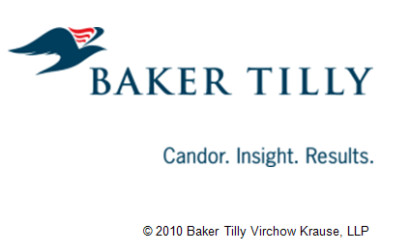
A Roadmap for Government Transformation
Local Government Services in Wisconsin - Reducing the Cost and Improving Effectiveness

Slide 2
Local Government Institute of Wisconsin
Founded in 2007 by:
“LGI will collaborate with others to find solutions for the efficient delivery and funding of local government services consistent with the needs of our citizen.”

Slide 3
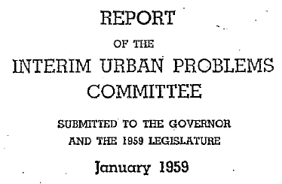
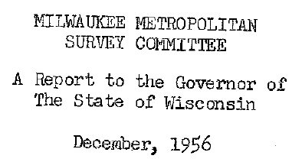
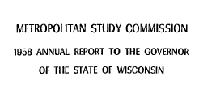
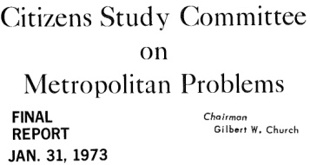
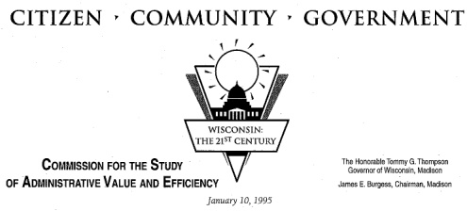
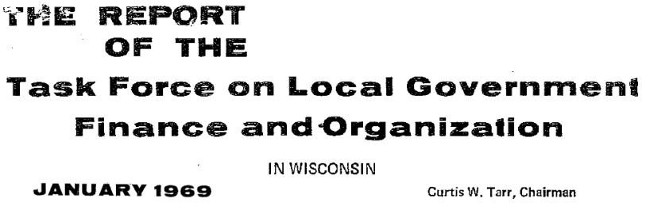
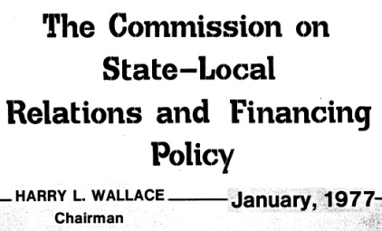
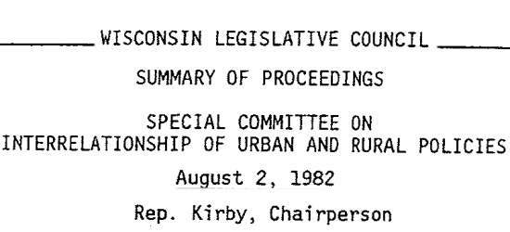
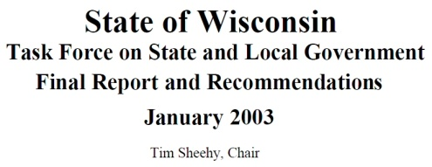
History of Local Gov Reform
Many reform efforts since 1955

Slide 4
LGI Report: A Roadmap for Government Transformation
First local government reform effort initiated by all local units of government working together
Findings and recommendations fully supported by the associations representing all local units of government
Study prepared by Baker Tilly under contract to LGI

Slide 5
Why?
The fiscal condition of local government is bleak and the prospects for the future are even bleaker – raising taxes or cutting service quality are not acceptable options
Many positive suggestions came out of previous studies that could have addressed the fiscal condition of local government, but few were implemented
Before more solutions are forwarded, we need to understand the barriers to adopting changes that will result in greater efficiency in service delivery
Notes:
88% of city finance officers believe their cities are less able to meet fiscal needs in 2009 than in previous years, and will be worse in 2010 and 2011

Slide 6
Fewer people in the workforce, less able to afford services
Population growth = increased demand for services
Declining economic conditions
No respite from expenditure increases
Aging population
Job growth occurring in low skill occupations
“Brain drain”
Health insurance
Salary increases
Pension expenditure growth
Ongoing capital replacement
Unfavorable Demographic Trends
Aversion to tax increases
Local Government Budget Pressure
Uncertainty over future federal and state aid
Flat local aid payments from state
Local Government & Business Community
Local Government
State & Local Government
Increase Revenue via Economic Growth
--------------------------
Economic growth requires value factors for businesses including impact on balance sheet and quality services
Reduce Services
---------------------
Wisconsin residents want government to play an active role in shaping a better community
Raise Revenues
---------------------
Tax increases are toxic
Spread Costs Across More Taxpayers
---------------------
Difficult, but feasible
Local Government Finance System Reform
--------------------------
Reform of local government revenue system requires leadership at both State and Local levels

Slide 7
Who Cares?
Every resident of the state – because everyone is both a taxpayer and a recipient of services from at least two local units of government – cost and quality of service matters to everyone
Our ability to deliver local government services effectively and efficiently impacts our State’s capacity for economic development

Slide 8
LGI Research Goals
 | Increased Efficiency of Delivery | Enhanced Alignment of Local to Regional Interests
Structure Changes | Determine whether having fewer local governments is truly more efficient than having more local governments | Understand how existing regional governmental organizations synthesize local and regional interest to get things done
Relationship Changes | Identify services that are proven to be delivered more efficiently through local government cooperative action | Recommend approach to facilitate definition of local v. regional interest
A key outcome was to identify common themes and actionable recommendations upon which four disparate partner associations could reach consensus

Slide 9
Isn’t The Problem Too Many Units of Government?
No - the consolidation or sharing of services between jurisdictions is a more important factor in reducing per unit service delivery costs than the number of local jurisdictions
Service sharing & consolidation, though difficult, is more easily achieved than the consolidation of units of government
Notes:
This is one of the key questions we wanted to answer with this study – we’ve heard this for years and it comes up in nearly every one of the commissions and task forces going back to the mid-’50’s

Slide 10
Cost vs Number of Jurisdictions

Slide 11
Which Services Are Suitable For Cooperative Action?
Suitability Factors Vary Across Services
Factor | Suitability
Association with Community Identity | Lower visibility eases consolidation
Geographic Scope of Delivery | Service works better on multijurisdictional level
Operating Costs | Service involves significant operating costs
Capital Costs | Service involves significant capital costs
Ratio of Line Staff to Customers | Service quality is not degraded by increased number of customers per staff
Geographic Limitations | Service is not limited by geographic factors
Service Delivery Requirement | Service is required by statute

Slide 12
What Does It Take for Success?
Factors Common to Every Successful Consolidation
Positive Impact on Services | Clear Fiscal Benefit
Trust | Leadership
Community Support | Shared Perception of Need
Notes:
We studied many many examples of local governments in Wisconsin that were able to successfully consolidate the delivery of one type of service or another. We found there were a combination of conditions that are necessary for successful initiatives.

Slide 13
Examples: Everest Metro Police

Slide 14
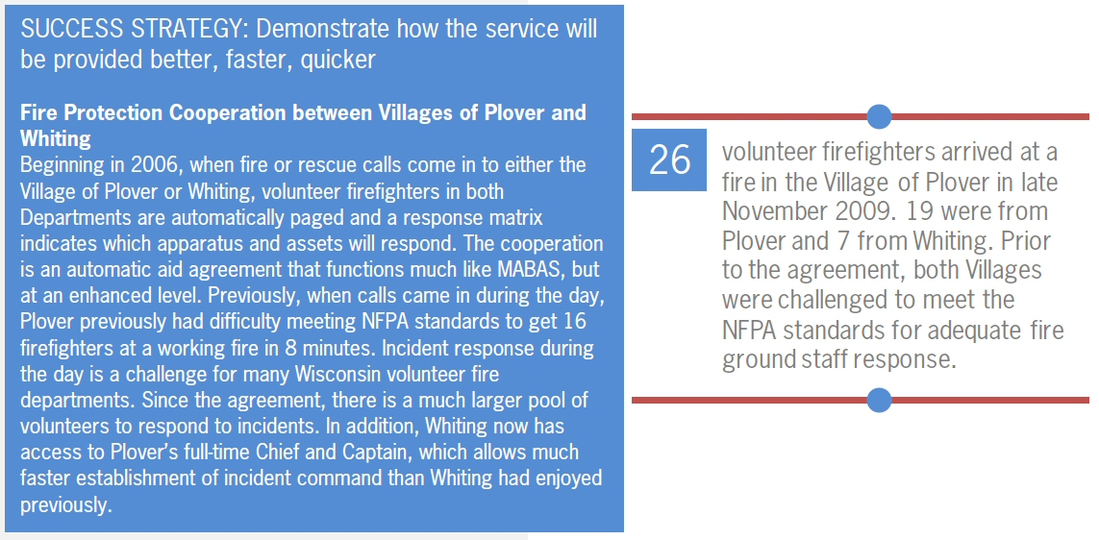
Examples: Plover & Whiting
SUCCESS STRATEGY: Demonstrate how the service will be provided better, faster, quicker
Fire Protection Cooperation between Villages of Plover and Whiting
Beginning in 2006, when fire or rescue calls would come in to either the Village of Plover or Whiting, volunteer firefighters in both Departments would be automatically paged and a response matrix indicated which apparatus and assets would respond. The cooperation is an automatic aid agreement that functions much like MABAS, but at an enhanced level. Previously, when calls came in during the day, Plover previously had difficulty meeting NFPA standards to get 16 firefighters at a working fire in 8 minutes. Incident response during the day is a challenge for many Wisconsin volunteer fire departments. Since the agreement, there is a much larger pool of volunteers to respond to incidents. In addition, Whiting now has access to Plover’s full-time Chief and Captain, which allows much faster establishment of incident command than Whiting had enjoyed previously.

Slide 15
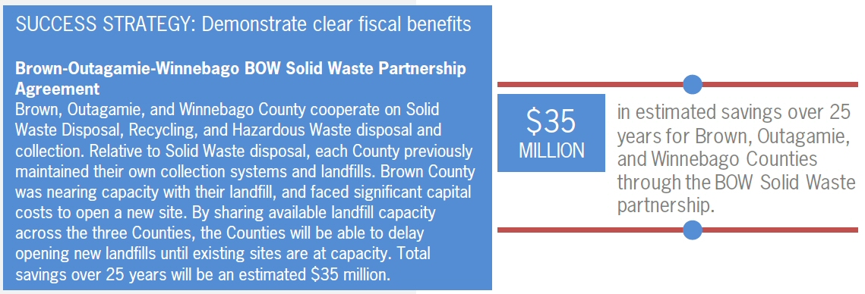
Examples: Brown, Outagamie & Winnebago Counties

Slide 16
Examples: North Shore Fire Dept.

Slide 17
Examples: Rock County/Beloit

Slide 18
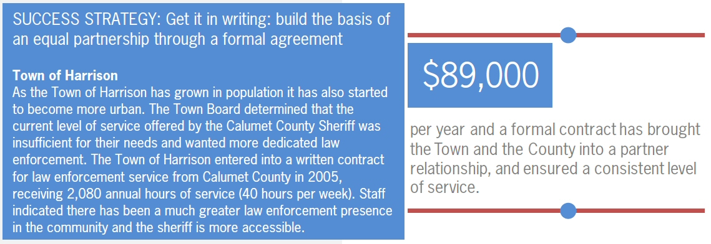
Examples: Town of Harrison/Calumet County

Slide 19
Examples: Town of Merton/City of Delafield

Slide 20
Examples: Waukesha Co. Dispatch

Slide 21
Examples: Onalaska

Slide 22
So Why Do We Need To Do More?
We found that it’s the “low-hanging fruit” that has been picked – even so, many of these successes required significant effort over a period of time to accomplish.
There are many more opportunities for greater service efficiency and effectiveness, but those goals will be difficult to achieve.

Slide 23
Complex & Unique Situations
Each service delivered by a local unit of government has a whole set of issues associated with it that impact the chances of successful sharing or consolidation.
Those factors are:
Community Identity
Operating Costs
Geography
Capital Costs
Service delivery requirements
Ratio of line staff to customers

Slide 24
Where Do We Go From Here?
LGI has targeted the following as priorities for State action:
Establish a Legislative Study Committee on Local Service Consolidation
Evaluate mechanisms to encourage regional distribution of resources and collaborative delivery of services across the region – regional tax base sharing & link to economic competitiveness
Legislature establish a capital fund to finance and incent service consolidation initiatives

Slide 25
Where Do We Go From Here?
Repeal or modify “maintenance of effort” laws which penalize local government for finding ways to deliver better services more efficiently

Slide 26
Where Do We Go From Here?
Actions local governments can take thru LGI and the associations:
Create a special forum at conferences to discuss successful examples of service sharing & consolidations
Establish a resource directory of successful examples of many types of joint service agreements and collect sample documents for how they were put together

Slide 27
Where Do We Go From Here?
Create a local government leadership forum to educate local government officials on the benefits and challenges of intergovernmental cooperation
Establish county or regional level collaboration councils to provide a structure for on-going dialogue, building trust and identification of opportunities

Slide 28
For More Information
Download the full report: www.localgovinstitute.org
Contact LGI:
Exec_dir@localgovinstitute.org
(608)831-1662

