Slide 1
Wisconsin Special Committee on Nanotechnology
I: Business and Job Growth through Partnerships
II: Potential for Development of Nanotechnology
Maliyakal John
WiSys Technology Foundation
October 26, 2010

Slide 2
Tech Transfer Offices for the UW System
WARF
UW-Madison
1925
~$2 billion
300-400 discoveries/yr.
~60 startup companies
$50-70 million/yr. to UW-Madison
UWMRF
UWM
2006
WiSys
2000
11/13 UW campuses
5 startup companies
UW-Milwaukee campus

Slide 3
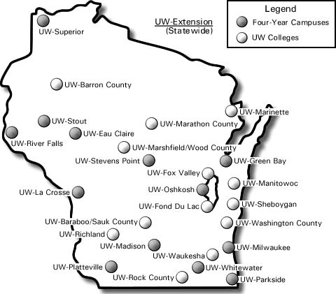
WiSys Reach:
Marshfield Clinic
BayCare Clinic
Aurora Health Care
A
A
A

Slide 4
Impact of WiSys Initiatives:
Business Growth
WiSys
Emerging Technology Centers
2008-
Wisconsin Small Company Advancement Program
2010-
Wisconsin Medical Entrepreneurship Foundation
2010-11

Slide 5
Successful Technology Transfer Starts with Marketable Product Ideas
Patient care needs &
opportunities
Product ideas from
faculty/students
Emerging Technology Centers
Medical Consortium
Small Company Program
Product ideas with near-term market potential

Slide 6
Examples of Emerging Technologies
Two startups
Nano-
technology
Medical
Technologies/
Devices
Two startups
Renewable
Energy
One startup
Interactive
Media
(Startups under consideration)

Slide 7
Nanotechnology Center for Collaborative Research and Development, UW-Platteville
- 6-10 student interns
- 3 high-paying jobs
Research
- Graphene manufacturing
Instrumentation
Applications
NCCRD
UW Platteville
- Honda Motor Company
- Cardinal Glass
- DSM Corporation* (Europe)
Collaborations
Forest Products Lab
UW-Oshkosh
UW-Stevens Point
UW-Madison
Columbia University
Startup Xolve Inc. was formed in 2008
Potential for ~$2 million private capital investment

Slide 8
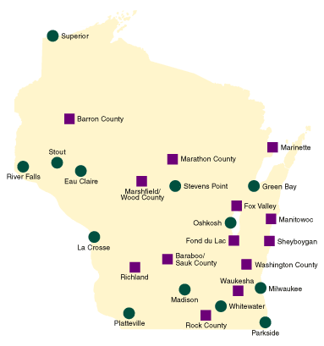
Emerging Technology Centers
UW-Stout
Discovery Center
UW-River Falls
Tissue and Cellular Innovation Center
Jul, 2009
Mar, 2009
UW-Stevens Point
Wisconsin Institute of
Sustainable Technologies
UW-Platteville
Nanotechnology Center for Collaborative R&D
Sep, 2010
Dec, 2008
Emerging Technology Research Centers Promote Specialized Research Expertise

Slide 9
Wisconsin Small Company Advancement Program
UW technical expertise
Company need for new product/process
WiSys
New market opportunity
Wisconsin business and job growth

Slide 10
Wisconsin Small Company Advancement Program
Engage the intellectual potential of the UW to
drive Wisconsin business growth
Meet unmet challenges of small companies
High-tech/high-value products
Student internships
Protect competitive advantages of company partners
$2 million in seed funds from state
Self-sustainable program

Slide 11
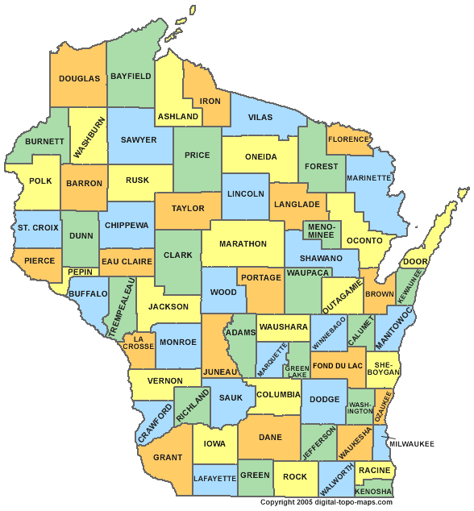
Statewide Participation in the Wisconsin Small Company Advancement Program
Botanic Oil Innovation Inc,
Spooner
Abba Makolin Waldron & Associates LLC, Neenah
Oshkosh Nanotechnology LLC, Oshkosh
Mensa Systems LLC, Menomonie
Xolve LLC*, Platteville
American Science & Technology Inc, Wausau
VibeTech LLC*, Sheboygan
Creative Culinary Solutions Inc, Hartland
Semba Biosciences Inc, Madison
* Project in final approval process

Slide 12
Developing Cutting-Edge Technologies
Biosensor
Supercapacitor
Paper mill waste into bioenergy
Recycled paper waste into high quality paper
Value-added products from cranberries
Mercury decontamination of fish
Vibration therapy*
Nanomaterial composites for industrial applications*

Slide 13
Medical Consortium
Engage underutilized
creative UW professionals
Identify profitable medical
innovation opportunities
Wisconsin Medical Entrepreneurship Foundation

Slide 14
Technical Expertise needed for Medical Technology Development
UW, Private industry
Computer-aided design, prototyping, electrical, mechanical, computer, chemistry and material sciences, animal models
Marshfield Clinic,
Aurora Health Care, BayCare Clinic
Knowledge of patient care needs & opportunities, clinical testing and trials, genetics, biosamples, electronic medical records
Wisconsin Medical Entrepreneurship Foundation
Marketable Medical Technologies

Slide 15
Summary
WiSys initiatives
Bring institutions together to create business growth and job opportunities
Engage large numbers of professional experts in developing next generation technologies and products for Wisconsin companies
Provide career opportunities for students

Slide 16
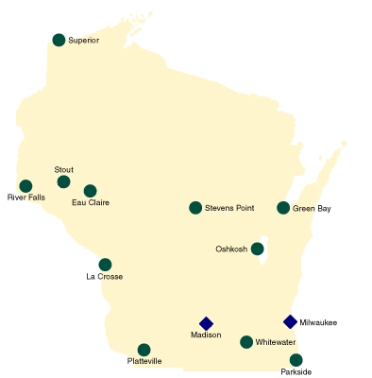
Active Research in Nanotechnology
UW-Stout
Marshfield Clinic
UW-River Falls
UW-Eau Claire
UW-Stevens Point
UW-Green Bay
UW-Oshkosh
UW-La Crosse
Aurora Health Care
UW-Madison
UW-Milwaukee
UW-Platteville
UW-Whitewater
UW-Parkside
21 Nanotechnology-related discoveries reported to WiSys (2007-09)

Slide 17
Nanotechnology: US vs. Wisconsin
82% of all new nanotechnology patents were issued after 1995
17,260 new discoveries* submitted to PTO since 1995
Only 159 reported from Wisconsin
WARF
WiSys
Kimberly-Clark
Promega Corp
Waukesha Electric Systems, Inc.
nPoint, Inc
Piezomax Technologies, Inc.
Menasha Corp
Ad-Tech Medical Instrument Corp
Platypus Technologies
GE Medical Systems
Curwood, Inc
Material Interface, Inc

Slide 18
Opportunities and Challenges
New industrial applications for existing nanomaterials
- Require research and testing
- Require university-company partnerships
New materials
- How to make and test
- How to apply
New process steps
- How to manufacture
- How to store and transport
- How to apply and maintain

Slide 19
Opportunities and Challenges
Safety
- Test and validate safety
- Disseminate safety information
Database
- Companies
- Types of technology/materials
Marketing
- Product opportunities
- Potential markets
Regulatory
- Collect relevant documents
- Contact information

Slide 20
Recommendations
Form a state registry
- Facilitate safety testing
- Disseminate information
- Facilitate collaborations
- Facilitate workshops
Designate a UW lab to conduct safety studies
- Modest budget requirements
- Companies to provide up to 50% of cost
Many companies are not aware of the potential of nanotechnology to enhance their existing products or
next generation products.

Slide 21
Recommendations
Designate an organization to facilitate Wisconsin’s nanotechnology growth
Develop a plan
Modest budget needs
Involve industry and university

