Slide 1
Financial Aid
A Student’s Perspective
www.santarosa.edu/adminserv/grants-moneyhand.jpg

Slide 2
Allowed Opportunity
Attend College

Slide 3
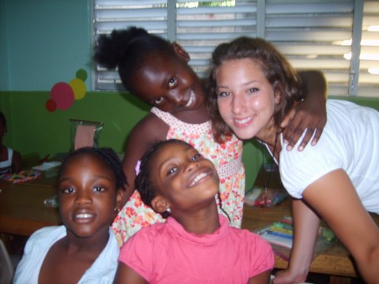
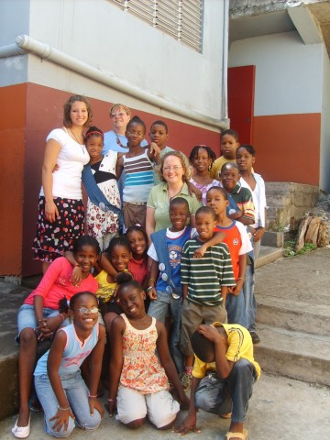
“Free” Time
Professional Development
Grenada
2008

Slide 4
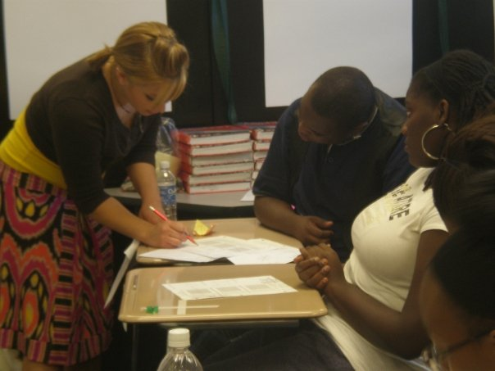
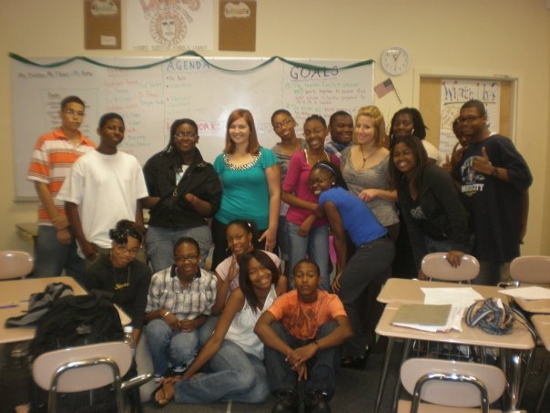
“Free” Time
Center for Urban Teaching
New York 2009

Slide 5
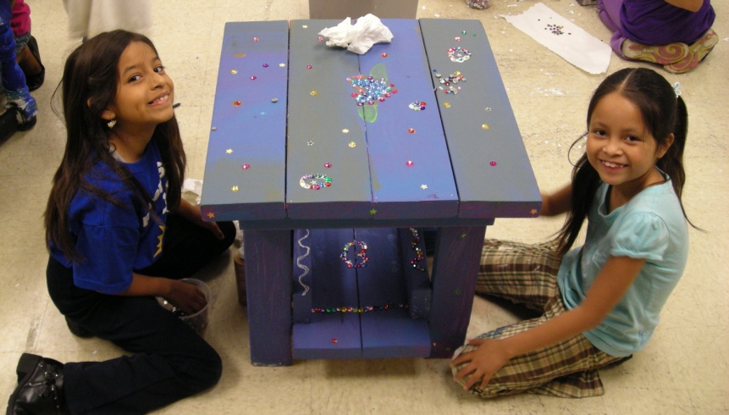
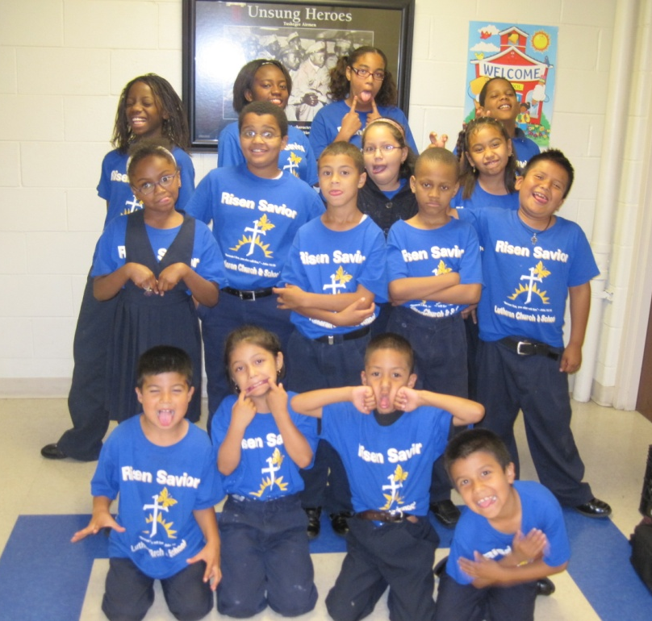
“Free” Time
Center for Urban Teaching
Wisconsin
2010

Slide 6
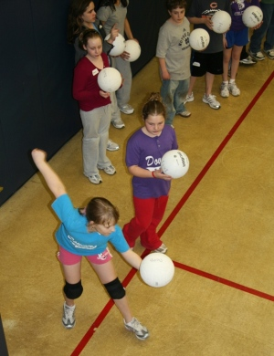
“Free” Time
Volunteer
Volleyball Coach
www.dgparks.org/Recreation/youth-athletics.

Slide 7
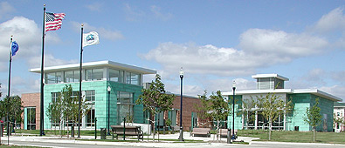
“Free” Time
Friends of Cudahy Library President

Slide 8
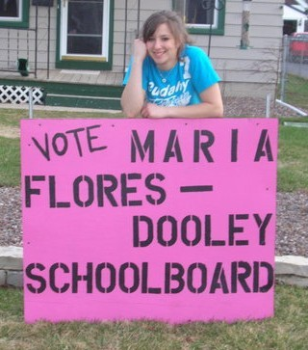
“Free” Time
School Board Director

Slide 9
Who I Am…
Positive Community Leader
School Board Director
Urban Teacher
Community
Volunteer
College Student

Slide 10
“Free” Time Invested
Positive Community Leader
School Board Director
Urban Teacher
Community
Volunteer
College Student

Slide 11
Financial Aid Impact
www.santarosa.edu/adminserv/grants-moneyhand.jpg

