Slide 1

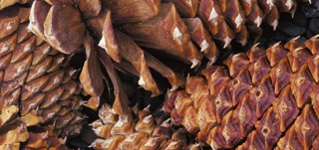
Forest Management and Economics
MFL Legislative Council

Slide 2
MFL Legislative Council
WHO IS PLUM CREEK
  Largest private landowner in WI with about 210,000 acres
  Largest landowner in US with 7 million acres in 18 states
  Virtually all of our land is enrolled within MFL
  Our land is designated open to the public

Slide 3
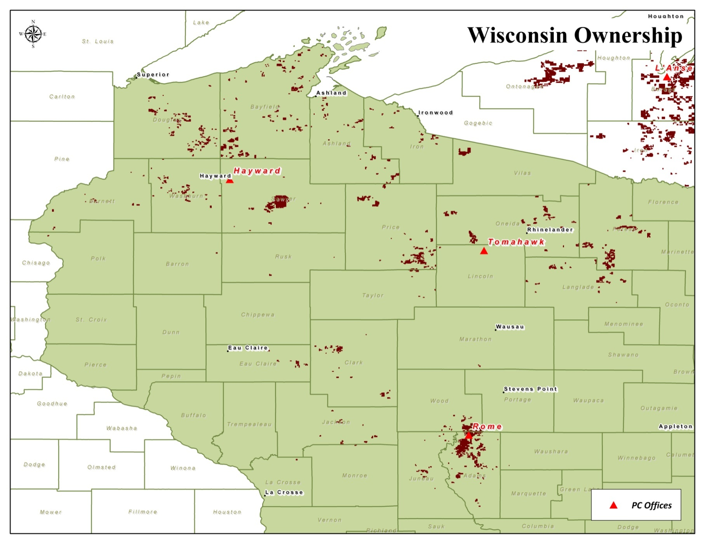
Lake States

Slide 4
MFL Legislative Council
WHY ECONOMICS ARE SO IMPORTANT
  WI is No.1 papermaking state
  Forest products industry employs 66,000 +
  Is the 2nd largest industry with $20 Billion of products annually
  MFL important contributor to that success
    Section 77.80, Stats.: The purpose of this subchapter is to encourage the management of private forest lands for the production of future forest crops for commercial use through sound forestry practices, recognizing the objectives of individual property owners, compatible recreational uses, watershed protection, development of wildlife habitat and accessibility of private property to the public for recreational purposes.
  MFL important to Plum Creek
  Is a reasonable, predictable, consistent tax that is important to running our business

Slide 5
MFL Legislative Council
Many reasons to own timber land, but economics significant
Large industrial owners have economic focus
      Timber ownership and management is capital intensive
      Forest investments are expected to provide a return
      Management activity is directed at tree growth and increasing product value

Slide 6
MFL Legislative Council
    Economic focus but with an environmental commitment
        SFI certification
        Environmental Leadership Program
        Karner Blue Butterfly, Kirtland’s Warbler
        Numerous Awards
    Not mutually exclusive

Slide 7
MFL Legislative Council
Net Present Value (NPV) drives decisions
  Need an adequate return to recoup the investment
  Time value of money
  Price: Marketing, Merchandizing, Cost Management
  Quantity: Silviculture Investments to Increase Growth, Thinning
  Time: Stand Establishment, Rotation Ages
  Discount Rate: Cost of Capital, Risk, Other Investment Options

Slide 8
MFL Legislative Council
PRICE: Marketing, Merchandizing, Cost Management
  Sort and sell to the highest value product
  Sell when the market is high
  Logistics
  New MFL requirements may come with a cost
    Tree Retention guidelines
    Invasives BMPs
    SMZ width increases

Slide 9
MFL Legislative Council
QUANTITY: Silviculture Investments to Increase Growth
  Matching the right species to the site
  Establishing fast growing plantations
  Biomass utilization
  Thinning
        Not just volume increase but value improvement too

Slide 10
MFL Legislative Council
Plum Creek Thinning Research
      Thinning methods and timing are critical
      Many Lake States plantations are overstocked, having followed early stocking guidelines tied to past product needs
      Focus on crown management instead of just thin from below

Slide 11

MFL Legislative Council
Thinning research results

Slide 12
MFL Legislative Council
Thinning research results

Slide 13
MFL Legislative Council
Thinning research results
Crown release provided a greater percentage of stems meeting the criterion for high value chip and saw bolts, and fewer lower value pulpwood sticks

Slide 14
MFL Legislative Council
TIME: Stand Establishment
  Regeneration to Merchantability as quick as possible
        Match species to site
        Obtain high quality seedlings
        Plant into well-prepared sites to minimize early competition effects on growth and survival
        Plant at a density that takes full advantage of site resources (fertility, moisture and light) without compromising individual stem growth
        WDNR has been receptive to this

Slide 15
MFL Legislative Council
TIME: Rotation Ages
  One of the greatest impacts to timber returns
  Landowner objectives and site sustainability should drive this decision
  WI is the only state out of the 18 in which we operate that regulates to specific rotation ages through MFL

Slide 16
MFL Legislative Council
Younger Rotations = Bad Stewardship?
  Karner Blue Butterflies
  Kirtland’s Warblers
  Young Aspen cover-type decreasing
    Ruffed Grouse and Woodcock
    Neotropical Songbirds
      95 of 187 species in the Midwest use young forest habitats
    Future Aspen Timber Availability – Huge economic impact in WI
  Biomass – Energy Independence
  Red Pine mortality in central sands sites beyond 50 years old

Slide 17
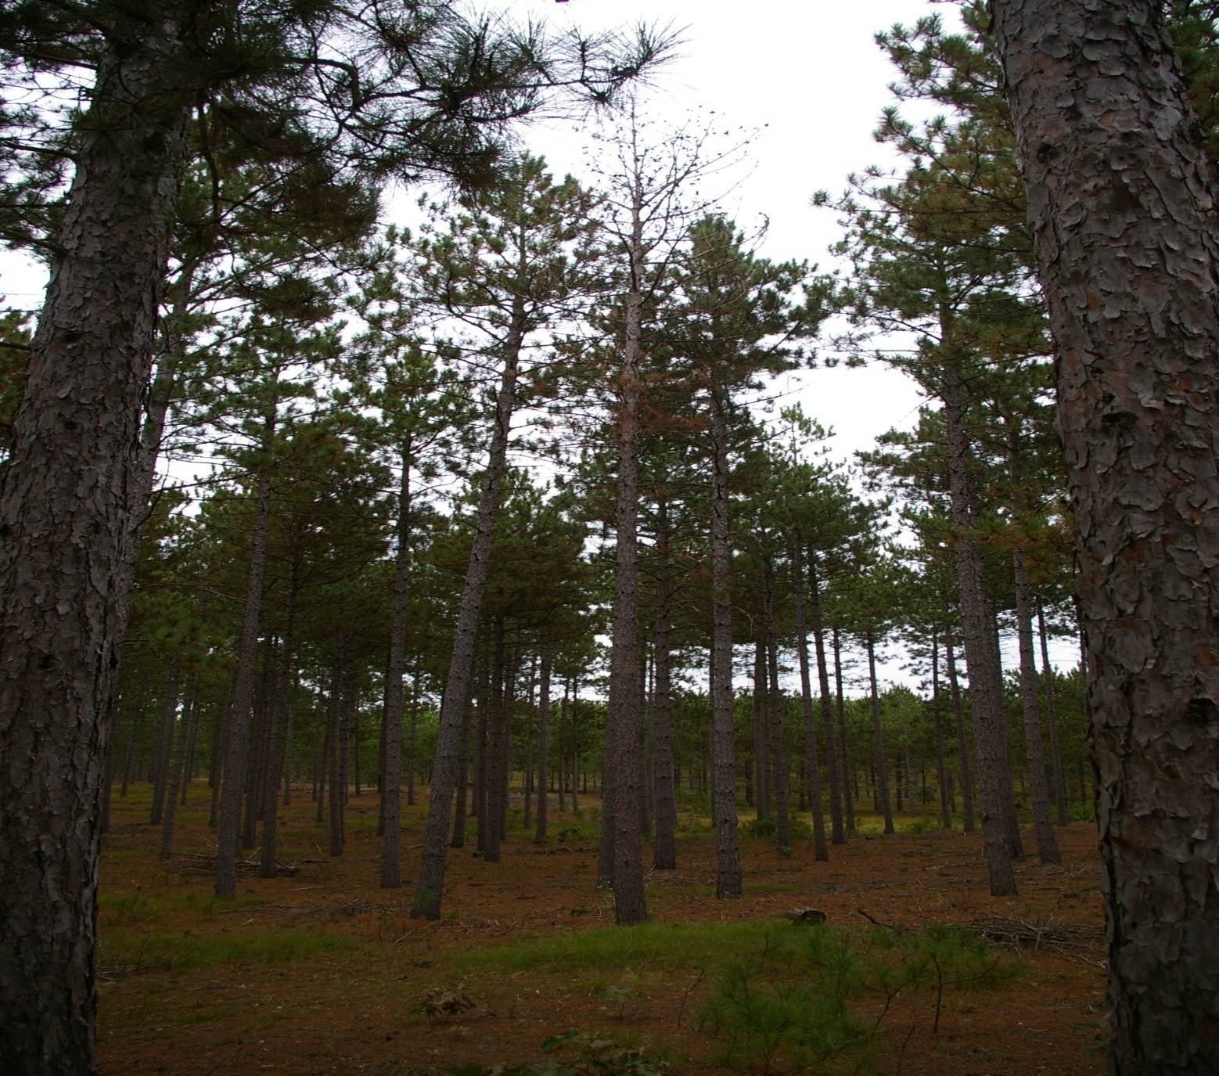
MFL Legislative Council

Slide 18
MFL Legislative Council
MFL is important legislation for the industry in WI
Economics needs to have a high consideration in forest management and in any potential MFL changes
Just relying on published research will not maximize the potential of our forests in WI
DNR partnership with industry, academia, and conservation groups holds the key
Questions

