Slide 1

Certifications at Gateway
Torque
Meter
Diagnostic
Leading to green jobs

Slide 2
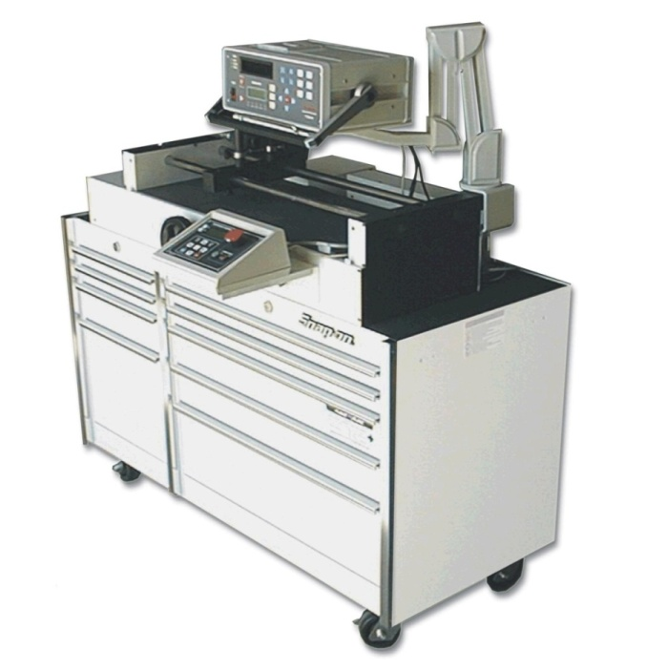
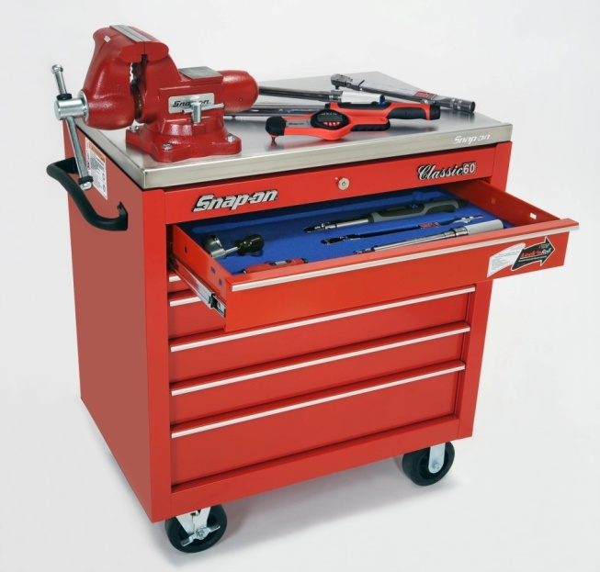
Torque Certification Work Stations
Torque Certification Centers
  Snap-on student stations
  Torque tester station
  Hytorc station
Developed for lab exercises
  Hands on
  Instruct, observe, test and certify
2

Slide 3
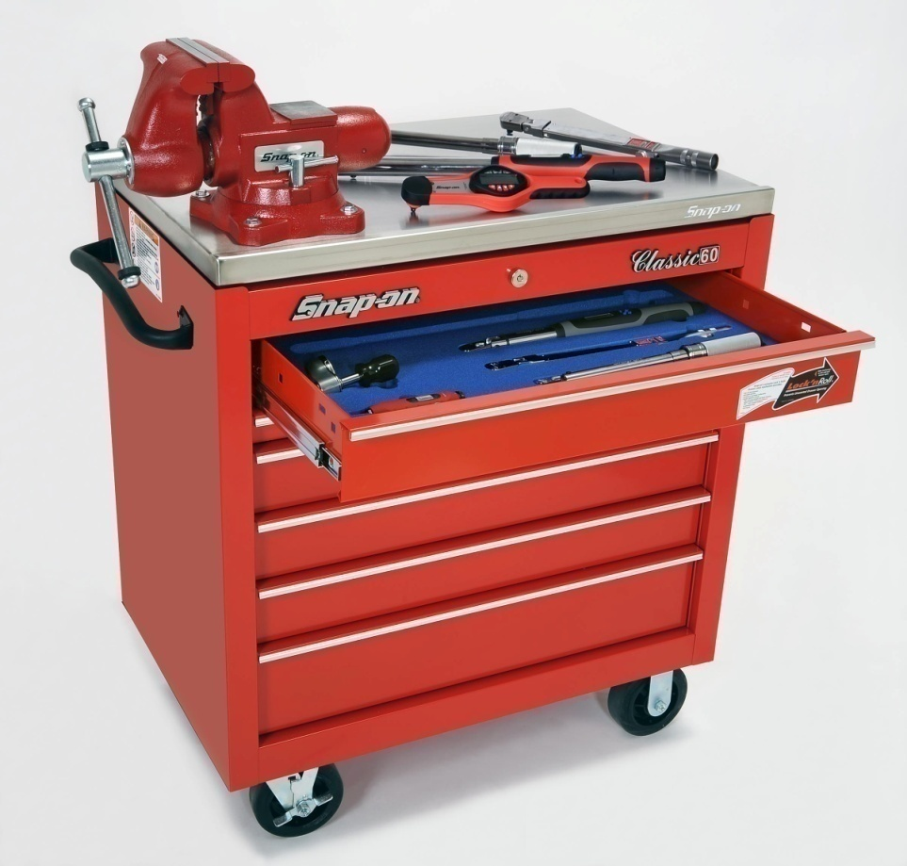
Training Benefits
Observed, supervised environment
Opportunity for students to practice with direct feedback
Lab exercises developed for student success
Certification done by schools
WETC
3
March 11, 2008
CONFIDENTIAL – DO NOT DUPLICATE
Nov 20 09
Notes:
3

Slide 4
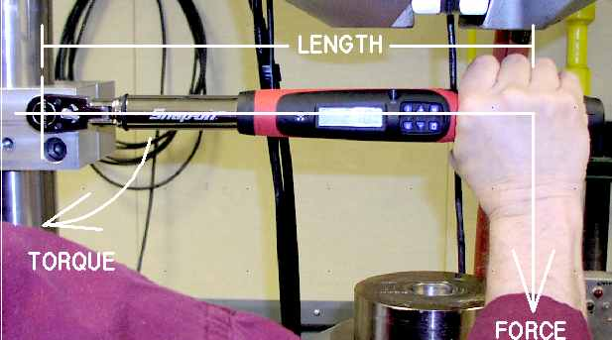
Torque Theory
WETC
Notes:
Here’s a real world example of the formula for torque.
Length times force equals torque.
Notice that the user’s hand is in the middle of the torque wrench handle.

Slide 5
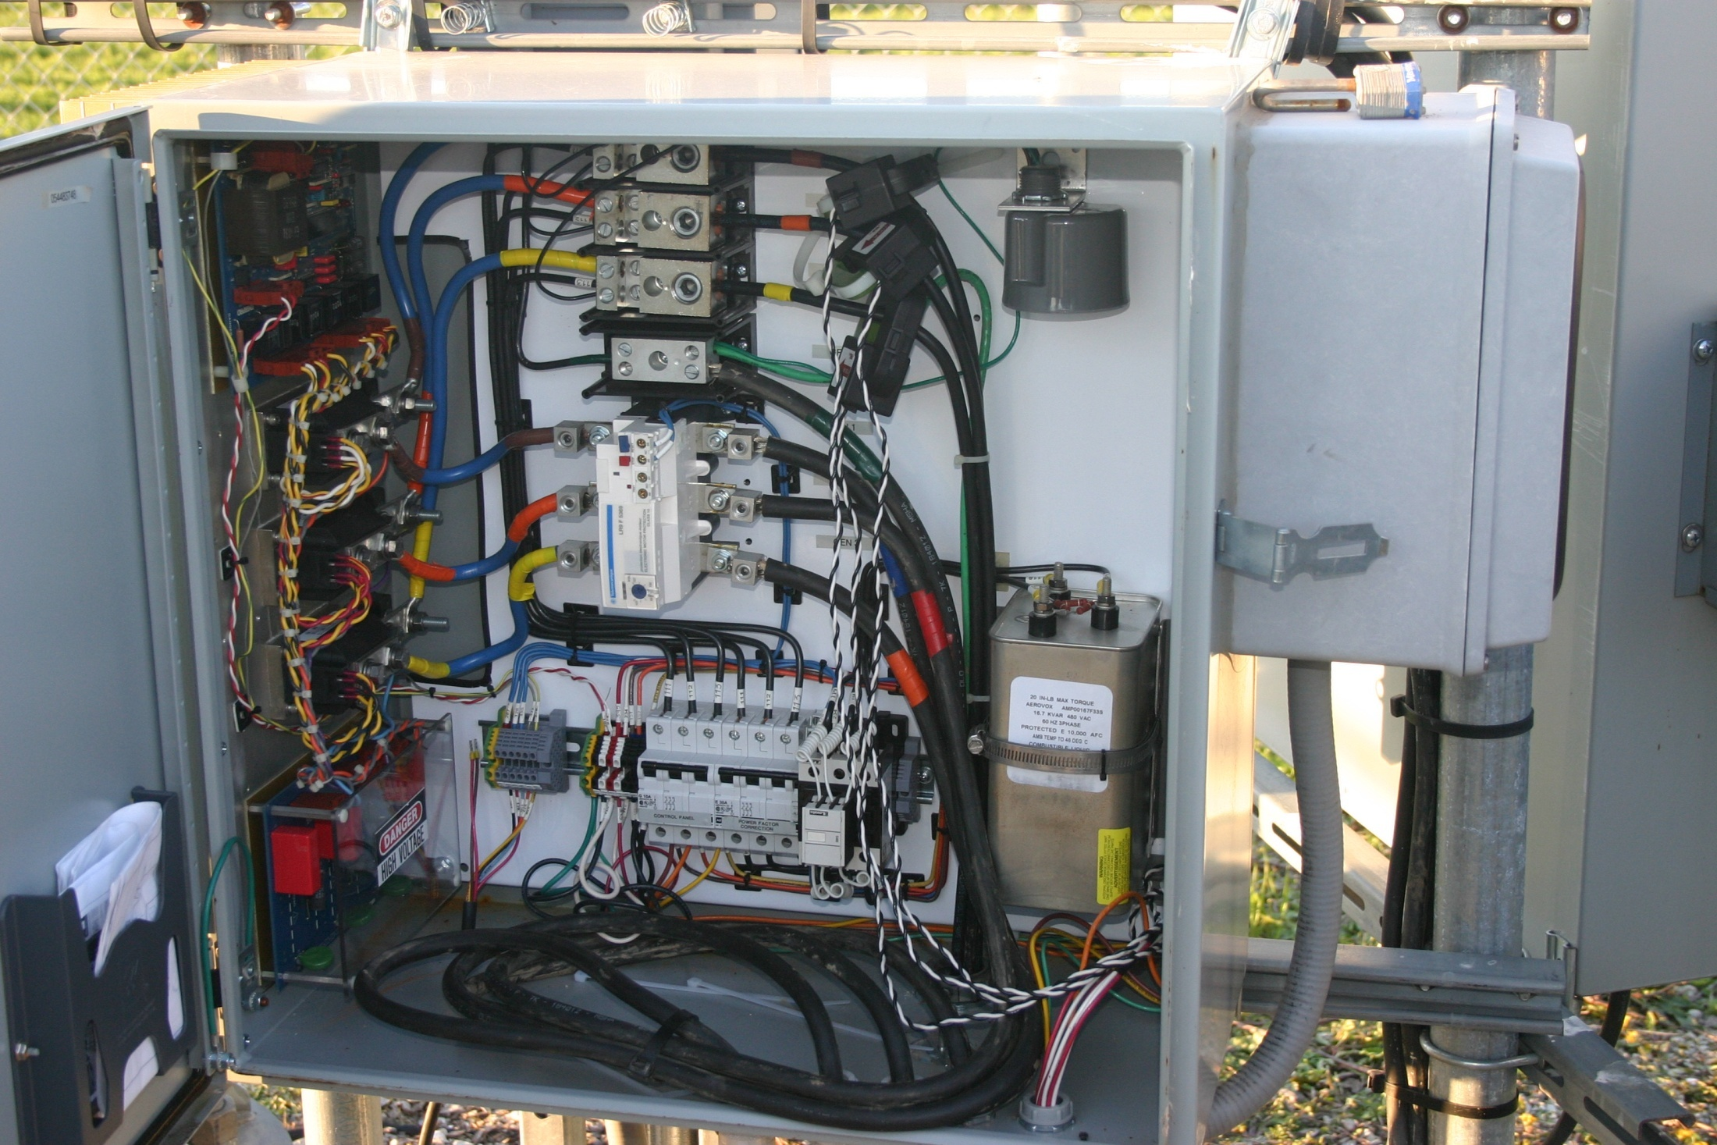

Slide 6


Slide 7


Slide 8
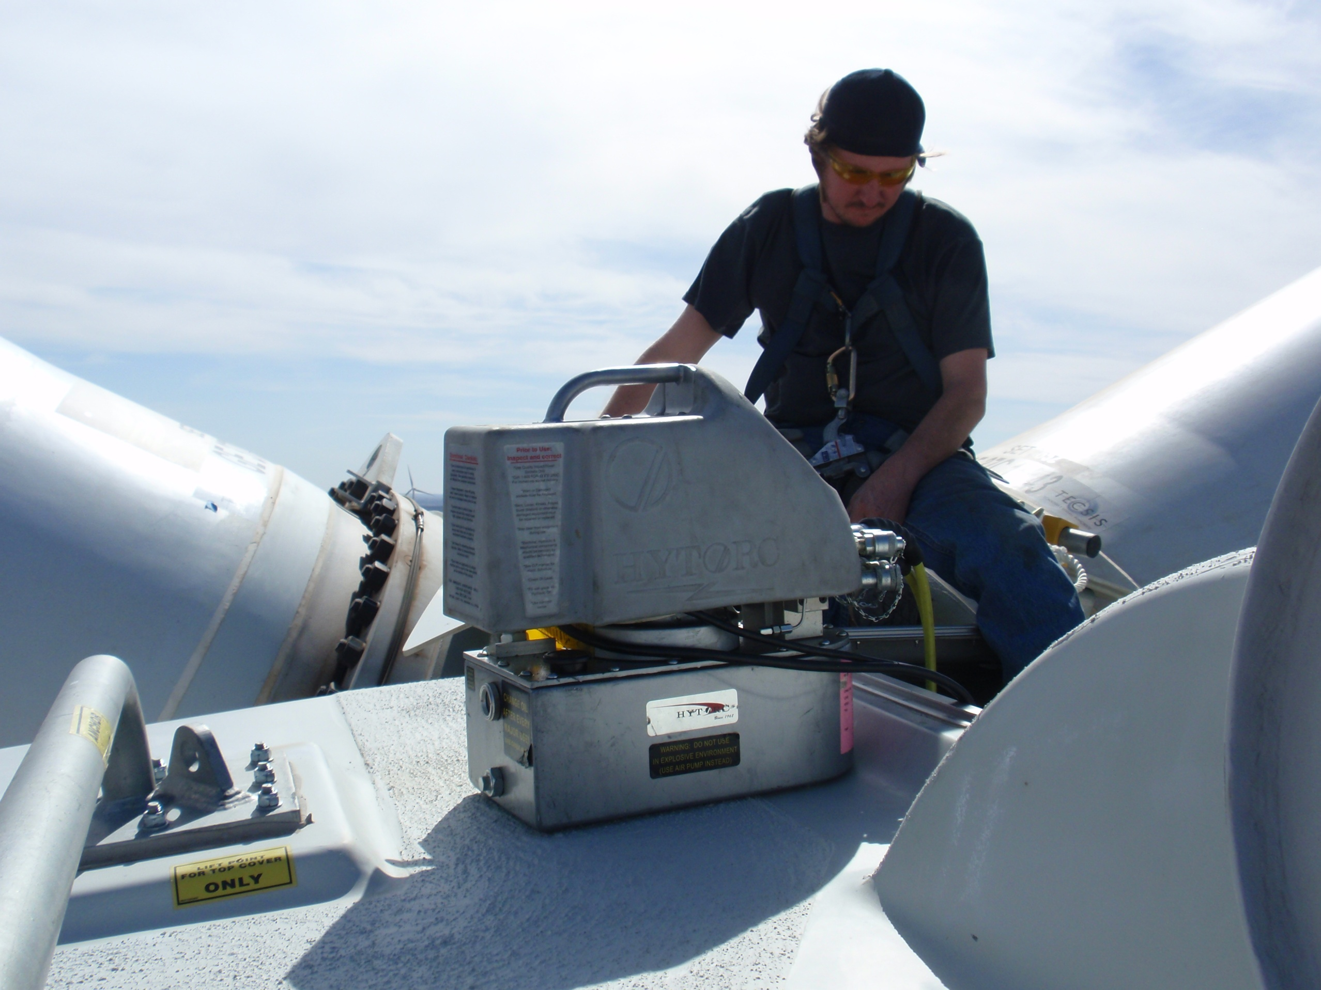

Slide 9
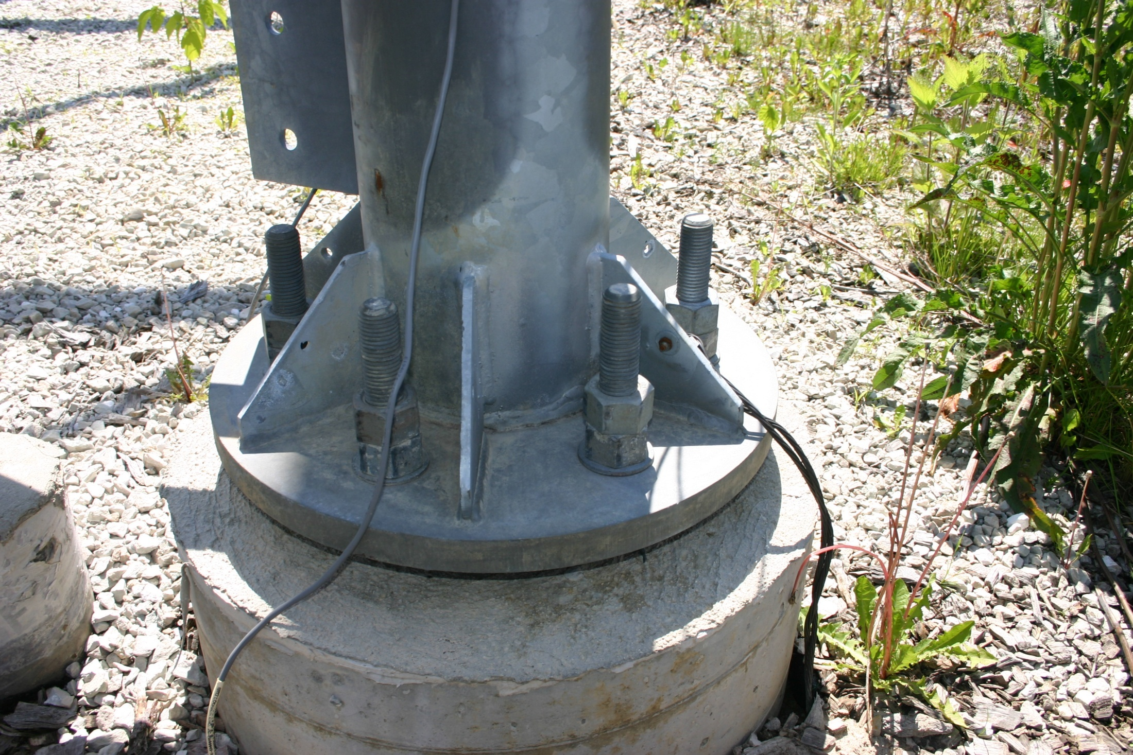

Slide 10
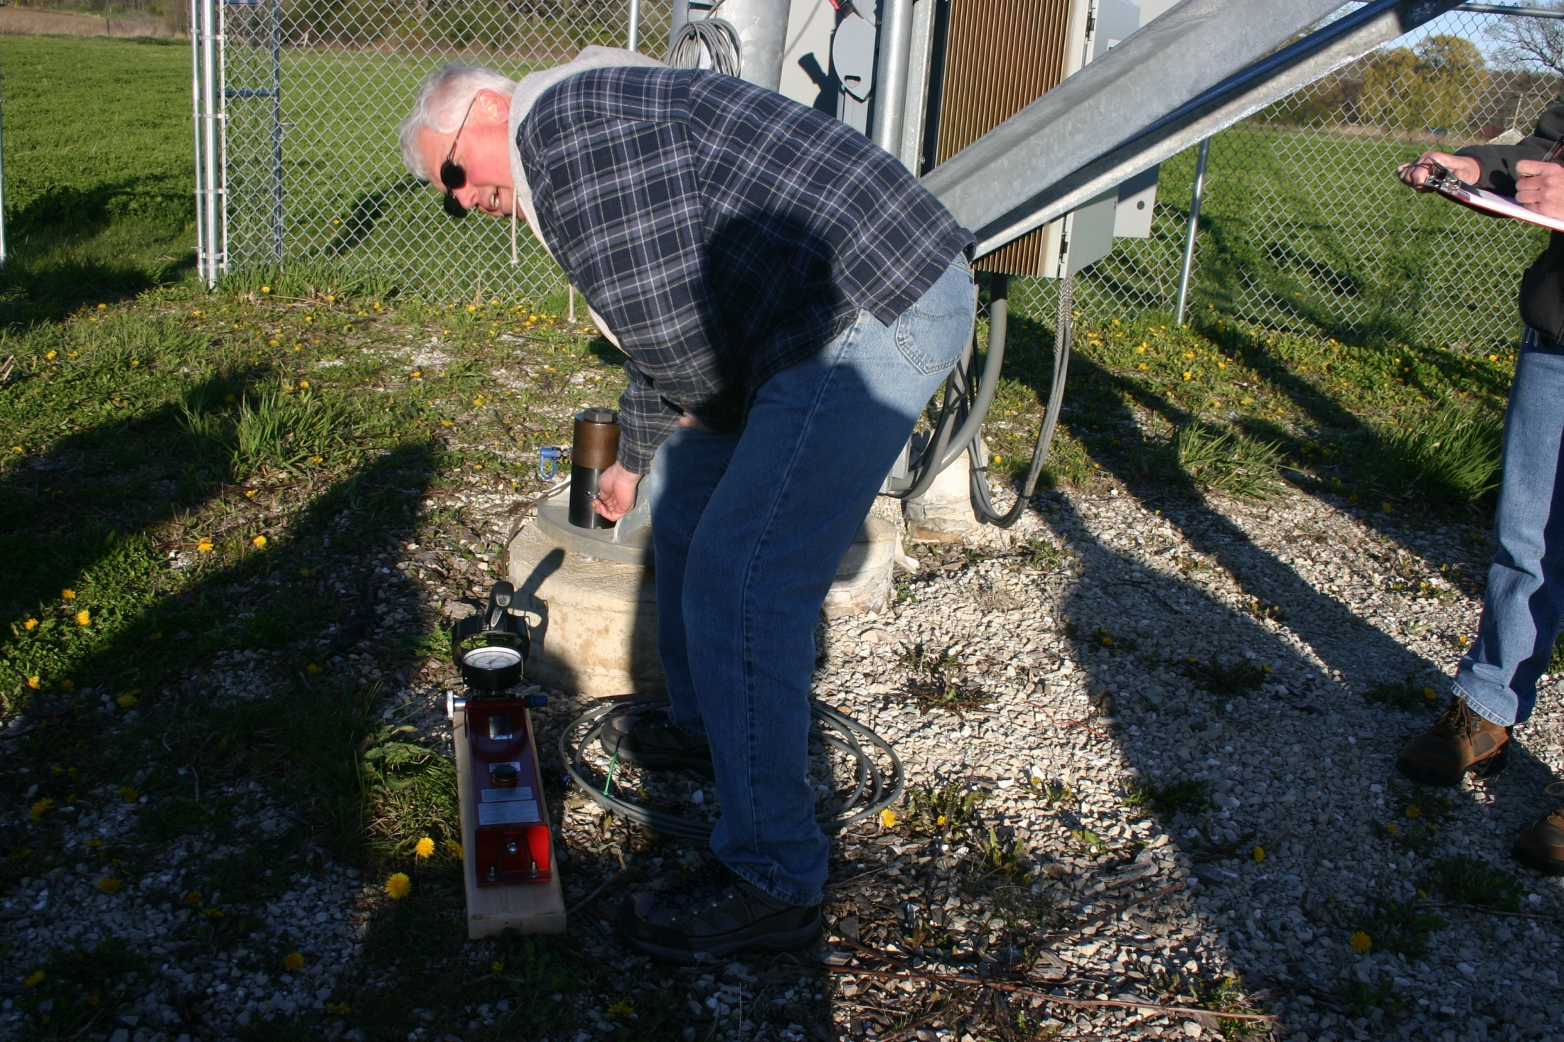

Slide 11
Clean Diesel
Adding clean technology Catalyst devices to current fleet
Updating APU units
Train students to install clean Diesel components and test proper operation
Up-date Diesel Hybrid applications skills

Slide 12
Types of Alternative Fuels
The U.S Department of Energy http(://www.eere.energy.gov/afdc/)
Recognizes seven types of alternative fuels:
Ethanol
Natural gas
Propane
Hydrogen
Biodiesel
Electricity
Methanol

Slide 13
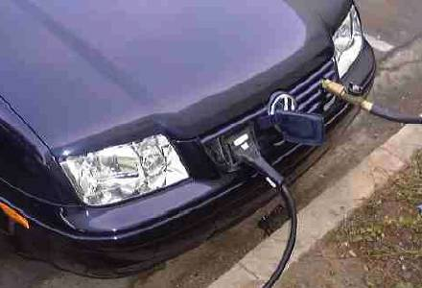
Tri-Fuel Vehicle
(Plug-in hybrid; gas; ethanol or CNG)
Notes:
13

Slide 14
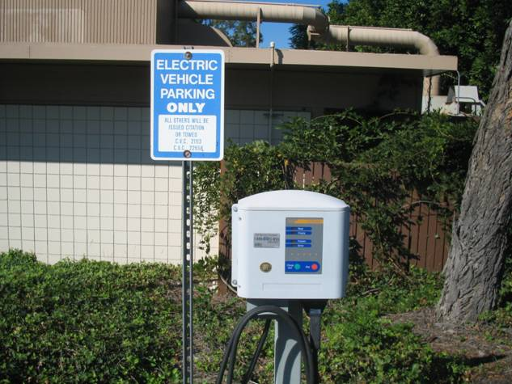
Electric Vehicles
Notes:
14

Slide 15
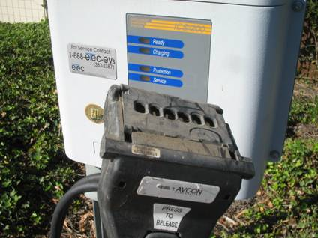
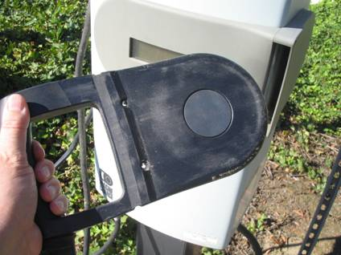
Two Types of Chargers
Notes:
15

Slide 16
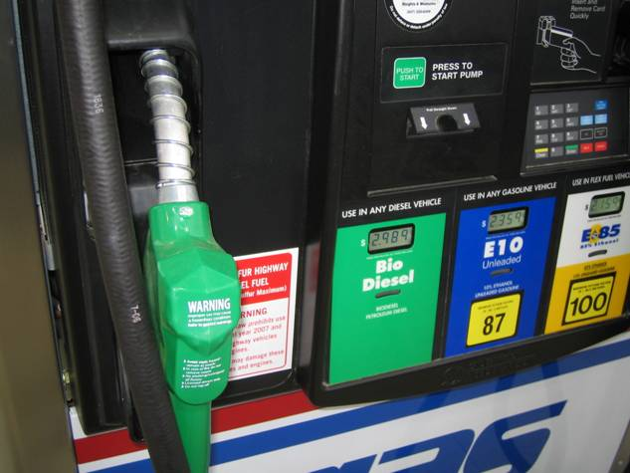
Biodiesel
Notes:
16

Slide 17
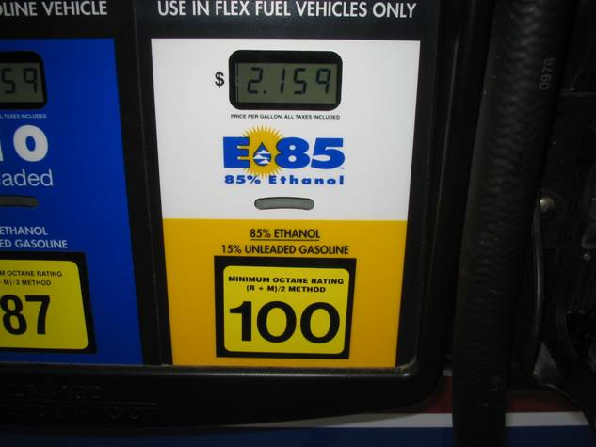
E85 Octane Rating
Notes:
17

Slide 18
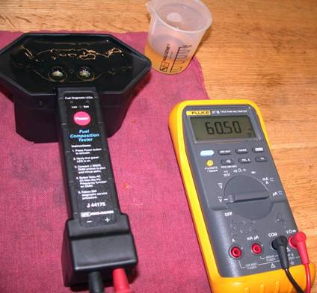
Using the tools
Record the AC frequency as shown on the meter and subtract 50 from the reading. (60.50-50.00 = 10.5). This number (10.5) is the percentage of alcohol in the gasoline sample.

Slide 19
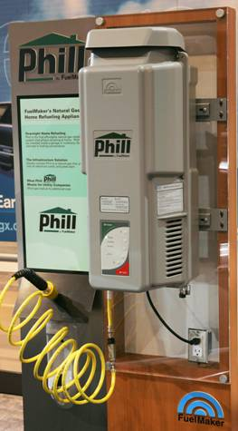
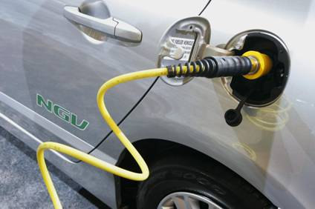
Fill up at Home
Notes:
19

Slide 20
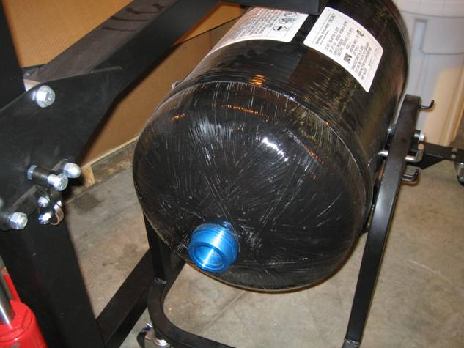
Honda CNG storage tank
Notes:
20

Slide 21
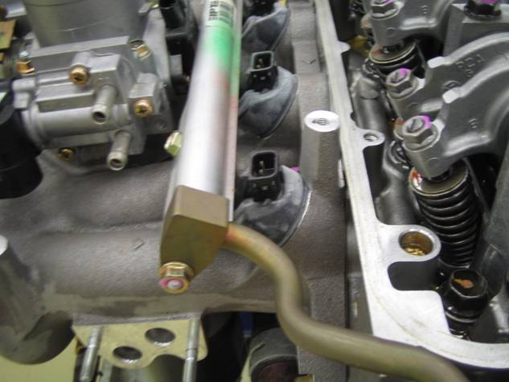
Honda CNG injectors
Notes:
21

Slide 22
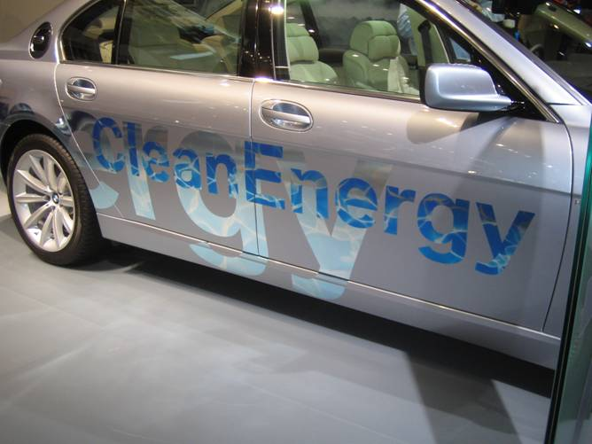
Hydrogen the Answer?
(BMW dual-fuel 7-Series)
Notes:
22

Slide 23
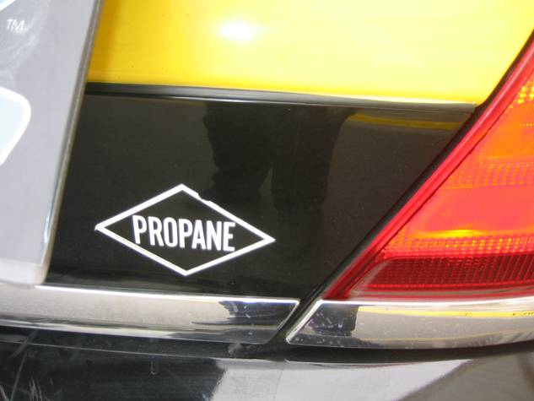
Propane
Notes:
23

