Slide 1
Adoption: Expectations, Adaptation, Insight, & Commitment
Pat Ann St Germain, MA, LPC
Healing Hearts Family Counseling Center, LLC

Slide 2
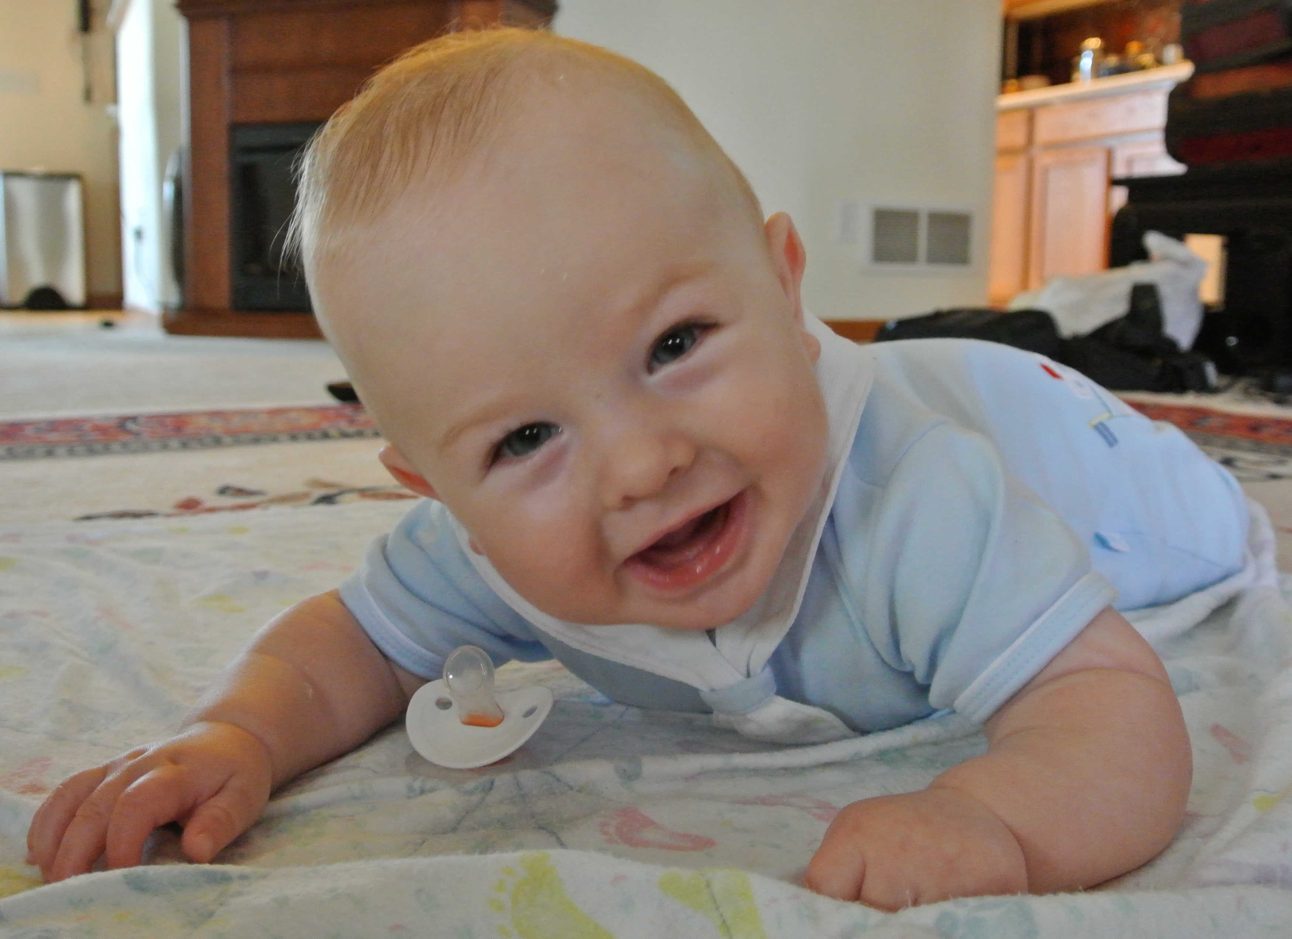
Expectations

Slide 3
7 Core Issues of Adoption
Loss
Rejection
Guilt/Shame
Grief
Identity
Intimacy & Relationships
Control/Gains
Deborah N Silverstein & Sharon Roszia 1982

Slide 4
What are the needs of a child while going through an adoption?
Trust
Safety
Security
Unconditional Love
Understanding/Empathy
Help Processing What is Happening
Help Processing How I Feel
Help Processing My Issues

Slide 5
What are the needs of parents while going through an adoption?
Support
Emotional
Parental
Therapeutic
Respite

Slide 6
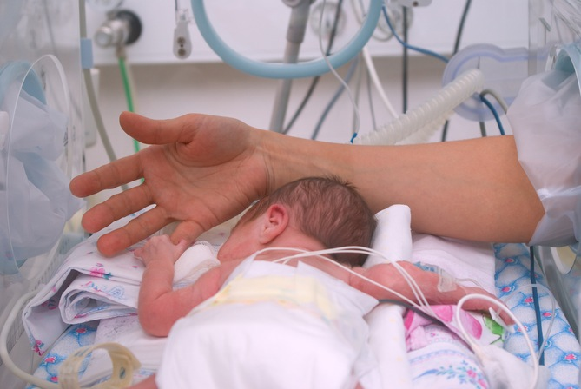
Adaptation

Slide 7
a·dapt
əˈdapt/
verb
verb: adapt; 3rd person present: adapts; past tense: adapted; past participle: adapted; gerund or present participle: adapting
make (something) suitable for a new use or purpose; modify."hospitals have had to be adapted for modern medical practice”
become adjusted to new conditions."a large organization can be slow to adapt to change"

Slide 8
Domains of Impairment
Attachment
Biology
Emotional Regulation
Dissociation
Behavioral Regulation
Cognition
Self-Concept
2009 Center for Family Development, Dr. Art Becker-Weidman

Slide 10
Examples of Issues
Prenatal Exposure to Alcohol/Drugs: Neurological Impairment
Underlying Sensory Integration Disorder
Primitive Reflexes
Auditory Processing
Visual Impairments
Executive Functioning
Mental Health

Slide 11
Insight

Slide 12
Fraiberg et al. (1975)
Described how the mother’s representations of her child can be so intensely colored by trauma and unmet needs from her own history that she cannot, in effect, “see” the child.
Such mothers experience difficulties in developing insight into the motives, thoughts, and goals underlying the child’s behavior and in responding empathically to the child’s signals and the emotional needs that underlie them.

Slide 13
Insightfulness Assessment
Positively insightful parents will have children with secure attachments
Assessment: Parents are shown several video segments of their child interacting with the parent and are asked about the child's thoughts and feelings during the segments.
Seeking information about insight into the child’s behaviors.Insight refers to the parent’s capacity to think about the motives that underlie the child's behavior AND accompany the motives with acceptance.
Insightful parents can discuss the positives and negatives without excessive criticism or defensiveness.

Slide 14
Positively Insightful Parent
One-Sided Parent
Disengaged Parent
Mixed Parent

Slide 15
Example:
If I have a belief about something - then I look for things to support my belief
….which means it’s true!

Slide 16
The parent capacity is most significant when addressing the issue of placement dissolution
Dr. Arthur Becker-Weidman 2014

Slide 17
Commitment

Slide 18
Parental Commitment Assessment
Higher levels of commitment = placement stability
Commitment is defined in this study as the extent to which the caregiver is motivated to have an enduring relationship with a particular child. The highly committed caregiver shows evidence of caring for this particular child, above and beyond caring for children more generally.
Expected to ensure child’s welfare even at his or her own peril, whereas the low-committed caregiver would not.
This Is My Child: Differences Among Foster Parents in Commitment to Their Young Children
Mary Dozier and Oliver Lindhiem Child Maltreat 2006; 11; 338 DOI: 10.1177/1077559506291263

Slide 19
Interview Questions
Describe your child. What is his personality like?
Did you ever wish you could raise ___?
How much would you miss ____ if he had to leave?
How do you think your relationship with ____is affecting him right now?
How do you think your relationship with ____will affect him in
long term?
6. What do you want for _____ right now?
7. What do you want for ____ in the future?
8. Is there anything about ____ or your relationship that we’ve not
touched on that you’d like to tell me?
9. I’d like to end by asking a few questions about your
experience as a foster parent: how long, how many, how many
do you currently have, how many children are living in your home?

Slide 20
During an interview, the caregiver is asked how he/she would feel if the child left his/her care
Commitment rated on 5 point scale
Higher levels of commitment indicated greater likelihood of placement stability
Lack of committed caregivers = greater impairments across domains. Behavioral and biological dysregulation
Without a committed caregiver, no chance for survival and no chance for attachment

Slide 21
Informed about child’s issues (education)
Reaching families sooner (support)
Earlier identification of issues
Qualified professionals partnering with the family

Slide 22
What causes disruption?

Slide 23
While the issues adopted kids face are important, parent capacity is more important and more salient to the questions being raised.
Dr. Arthur Becker-Weidman 2014

Slide 25
What do we do?
Better assessment of parental capacity
Parental Commitment Assessment
Parental Insightfulness Assessment
More training about the different types of parenting needed
Importance of parental history influencing their capacity to implement that new style
Adult Attachment Interview (as part of home study)
More intensive post-placement supervision to focus on parental capacity

Slide 26
Expectations - Parental Capacity
Parental Commitment
Parental Insightfulness
Unresolved Issues of the Parents
Mental Health Issues of Parents
Lack of Support
Lack of Services
Dozier, M, Grasso D, Lindhiem, O, & Lewis, E (2007) “The role of caregiver commitment in foster care,”
in D. Oppenheim & D. Goldsmith, (Eds.) Attachment Theory in Clinical Work with Children. NY: Guilford.

Slide 27
Our concerns
Families find us when it is
too late
Key time is lost for brain development and change
Some damage is almost irreparable
Earlier intervention could have saved the family
We are creating a screener with Post Adoption Resources

Slide 28
When Dissolution Happens, the 7 Core Issues of Adoption are Magnified for the Family and Child

Slide 29
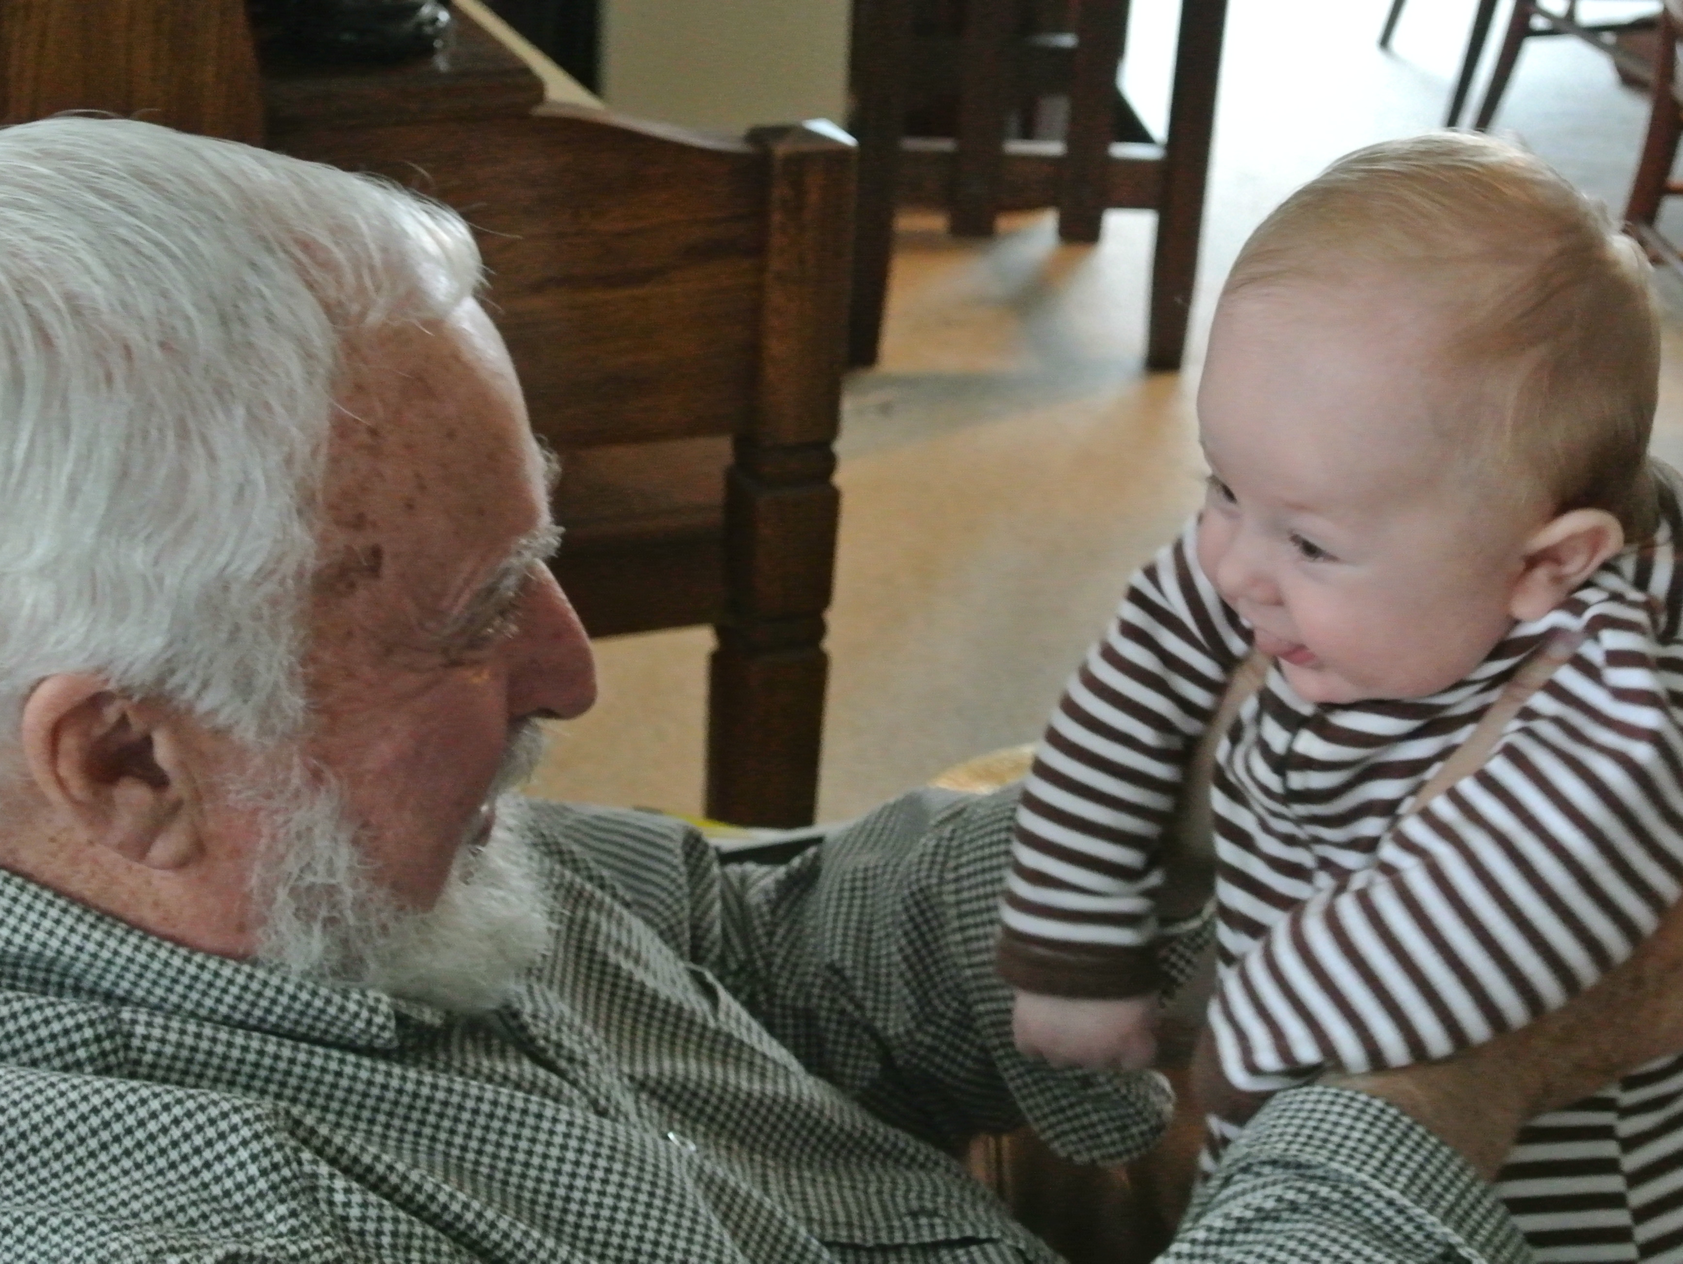
What makes families successful?

Slide 31
Resources
Becker-Weidman, Dr. Arthur, 2009 Center for Family Development
Dozier, M., Grasso, D., Lindheim, O. & Lewis, E. (2007). “The role of caregiver commitment in foster care,” in D. Oppenheim & D. Goldsmith, (Eds) Attachment Theory in Clinical Work with Children. NY: Guilford.
Fraiberg, S., Adelson, E., & Shapiro, V. (1975). Ghosts in the nursery: A psychoanalytic approach to the problems of impaired infant-mother relationships. Journal of the American Academy of Child Psychiatry, 14, 387-421.
Oppenheim, D. , Koren-Karie, N., & Sagi, A. (2001). Mother’s
empathic understanding of their preschoolers’ internal experience:
Relations with early attachment. Internal Journal of Behavioral
Development, 25, 16-26.

Slide 32
Oppenheim, D. & Koren-Karie, N. (2002). Mother’s Insightfulness Regarding Their Children’s Internal Worlds: The capacity underlying secure child-mother relationships. Infant Mental Health Journal, 23(6), 593-605.
Silverstein, Deborah N & Sharon Roszia, 7 Core Issues of Adoption,Adoptive Families 1999

