Slide 1
Eau Claire County Mental Health Court
Sheila A. Malec, MSW, CAPSW
Coordinator, Eau Claire County Mental Health Court
Eau Claire County Department of Human Services

Slide 2
Mental Health in the Adult Criminal Justice System
Since the deinstitutionalization of mental health institutions in the late 1950s and 1960s with the invention of Thorazine, the shift from mentally ill people receiving primary care in institutions or in the community to jails and prisons, has increased exponentially (PBS, 1997).
It is estimated that the rate of persons in the criminal justice system that have a diagnosable mental illness is 3 to 6 times higher than the general population (SAMHSA, 2011).
72% of mentally ill people in jail and prisons also have a co-occurring disorder with an alcohol or drug use diagnosis (SAMHSA, n.d.).
Treatment options for mentally ill persons have traditionally been nonexistent in the criminal justice system and inmates with mental health issues have typically been viewed as “a problem.” (Osher & Taxman, 2011).
95% of women and 89% of men in the criminal justice system have been victims of trauma, compared with about 8% of the general population (SAMHSA, n.d.).

Slide 3
The Criminalization of the Mentally Ill
Who are we serving?
Advocacy groups for the mentally ill have been looking for alternatives to incarceration for mentally ill offenders for decades, after deinstitutionalization did not go as planned.
Mental health courts have developed since the 1990s and have been modeled after Drug Courts but with modifications to take the individual into account; mental illness is not as black and white as sobriety.
Studies suggest that offenses fall into 3 broad categories:
  Crimes committed as a “byproduct of mental illness”: disorderly conduct, loitering, criminal trespass, etc.
  Economic crimes to survive: retail theft, prostitution, panhandling, etc.
  More serious offenses: robbery, assault, burglary, homicide, sexual crimes, etc. (The Sentencing Project, 2002).

Slide 4

History of the Eau Claire County Mental Health Court
The EC County MHC has been in existence since 2008; however it was imbedded into the Community Support Program, an intensive outpatient psychiatric program.
The problems?: having a forensic program intertwined with an outpatient clinic was troublesome at times. Also, WI Chapter DHS 63 governs CSPs in WI and has restrictive diagnostic criteria – thus, people that needed services could not get into the MHC.
People were falling through the cracks but then the County received a grant from SAMHSA in 2011 and this expanded our court to serve more people. In January 2013, the expanded MHC took it’s first participant.
47 people have been served in our court to date, with 22 (48%) of those served in our expanded court.
The acceptance of TAD grant funding has brought about the “violent offender” definition and restriction. Moving forward, there would be limitations to the types of offenses our court would be able to take.

Slide 5

Treatment Courts: Assessment and Needs
All prospective participants to a treatment court are assessed and go through a triage process.
The Triage Team meets weekly and includes members of the Office of the Public Defender, the WI DOC, the District Attorney’s Office, a private bar attorney representative, a member of the Sheriff’s Department, and 3 of the 4 court coordinators.
Currently, Eau Claire County has a Drug Court, a Mental Health Court, a Veteran’s Court, and a family drug court called AIM Court (Alternatives to Incarcerating Mothers.)
The triage process includes input from the referral form and any other information a member of the team may have to determine which court coordinator would take the lead on a referral.
The COMPAS “Correctional Offender Management Profiling for Alternative Sanctions” and other alternative screenings are conducted on a prospective participant.

Slide 6
Treatment Courts: Assessment and Needs, cont.
Other alternative screenings include screening for trauma, criminal thinking, drug & alcohol use, stage of change, and mental health.
Clinical records are also gathered as applicable by the lead coordinator to determine the best fit or match for a prospective participant.
It is important to note that lead coordinators may change in this process as more information on a referent is gathered.
The coordinators look for what treatment is needed and the availability of treatment in the community, prior to recommending a person for a treatment court.

Slide 7
Eau Claire County Mental Health Court
2013 Data
What everyone wants to know: Does this work?
As we have only begun the expanded court in January of 2013, we have not graduated a participant from this new model of the MHC yet; however……we know the following:
  21 participants were served during the calendar year of 2013
  In the year prior to admission to our court the 21 participants had 2041 days of jail
  During the year of 2013 that number reduced to 1049 days, decreasing by 51% for that same population.
  We are still gathering data on people that have left our court for the year of 2014.

Slide 8
What we do know….
We can see a difference in some numbers but defining the true impact will take time.
We do know that participants are being served in the least restrictive environment and have mental health treatment available to them, sometimes for the very first time.
Please listen to our participant stories and find out what they feel the difference is in their lives because of participation in a mental health court.

Slide 9
References
Osher, F., & Taxman, F. (2011, February). Understanding criminogenic needs: Untangling the role of mental health and substance abuse. Council of State Governments Justice Center. Retrieved from http://www.nationalreentryresourcecenter.org/documents/0000/0999/Taxman_Osher.pdf
PBS: Frontline (1997). Deinstitutionalization: A psychiatric "Titanic.“ Retrieved from http://www.pbs.org/wgbh/pages/frontline/shows/asylums/special/excerpt.html
Substance Abuse and Mental Health Services Administration (2011). Mental and substance use disorders among adult men on probation or parole: some success against a persistent challenge. Retrieved from http://www.samhsa.gov/data/2k11/MentalDisorders/MentalDisorders.htm
Substance Abuse and Mental Health Services Administration (n.d.). Co-occurring disorders in criminal justice settings: Screening for trauma in criminal justice settings. Retrieved from http://www.samhsa.gov/co-occurring/topics/criminal-justice/trauma.aspx
The Sentencing Project. (2002). Mentally ill offenders in the criminal justice system: An analysis and prescription. Retrieved from http://www.sentencingproject.org/doc/publications/sl_mentallyilloffenders.pdf

Slide 10
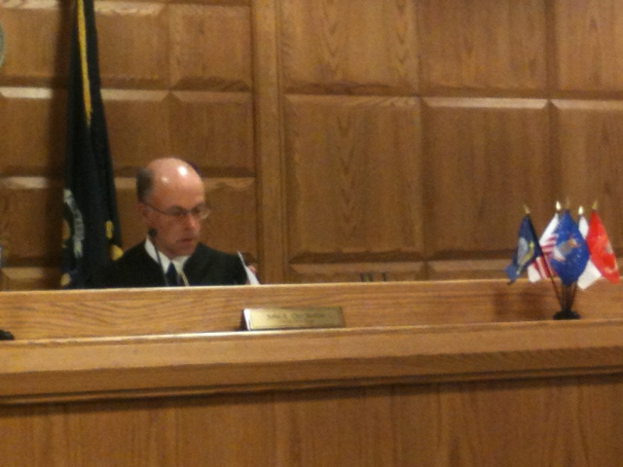
How can we IMPROVE treatment courts statewide?
Annie Levknecht
Alternative Treatment Coordinator
Outagamie County
Offender Services
July 22, 2014

Slide 11

Efforts for Stakeholders
Collaboration
Time
Standards/Benchmarks
Evaluation/Outcomes

Slide 12


Collaboration
State
  Networking
  Training
  WATCP
  Office of Court Operations
  Shelly Cern
National
  Networking
  NADCP
  Carolyn Hardin
    Implementation, Technical Assistance, Sustainability
  NDCI
  Publications
  Training
Local
  Stakeholders
  Divisionalization
  Funding
  Networking
Notes:
“Building an effective organization is ultimately a matter of meshing the different subcultures by encouraging the evolution of common goals, common language, and common procedures for solving problems. It is essential that leaders recognize that such cultural alignment requires not only cultural humility on the leader’s part, but skills in bringing different subcultures together into the kind of dialogue that will maintain mutual respect and create coordinated action” (Schein, 2010).

Slide 13
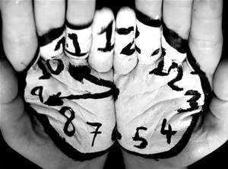
Time
Develop policies/procedures with team
  Outagamie Veterans Court took 6-7 months meeting with team stakeholders prior to going “live” with participants.
  Outagamie County Mental Health Court met for 6-8 months prior to submitting the BJA grant and another 4-5 months before implementation occurred.
Ensure streamlining before accepting participants
Attend training
Reflect and recommit with team members
Train new team members

Slide 14

Standards/Benchmarks
Wisconsin Association of Treatment Court Professionals
  State Standards
  Examples:
  Court appearances
  Dosage hours
  Urine tests
  Jail days used

Slide 15

Evaluations/Outcomes
Assessment of the Need for the Program
Assessment of Program Design and Theory
Assessment of Program Process and Implementation
Assessment of Program Outcome/Impact
Assessment of Program Cost and Efficiency
(Rossi, Lipsey, & Freeman, 2004)

Slide 16
Question/Answer
Thank you.
Reference
Schein, E. H. (2010). Organizational culture and leadership (4th ed.). San Francisco, CA: Jossey-Bass.
Rossi, P., M. Lipsey, & H. Freeman (2004). Evaluation: A Systematic Approach (7th edition). Thousand Oaks, CA: Sage Publication.

