Slide 1
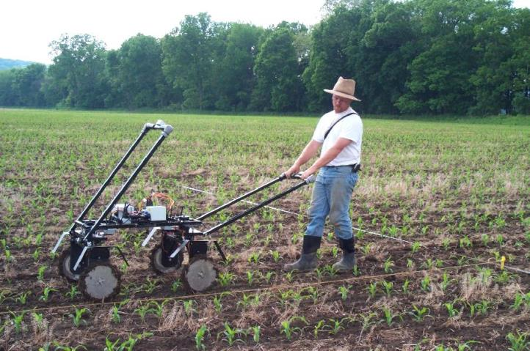
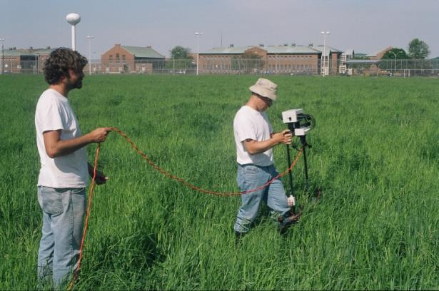
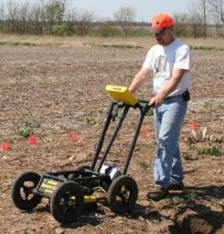
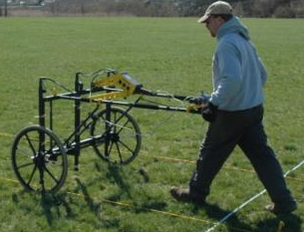
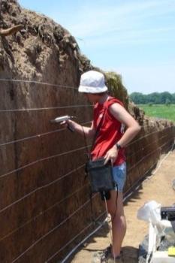
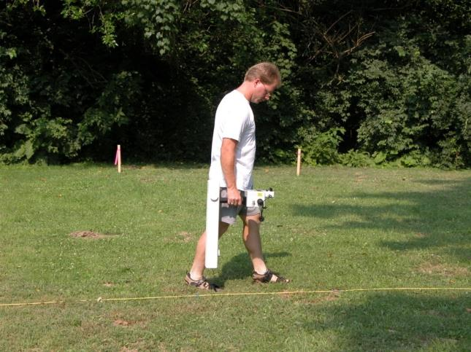
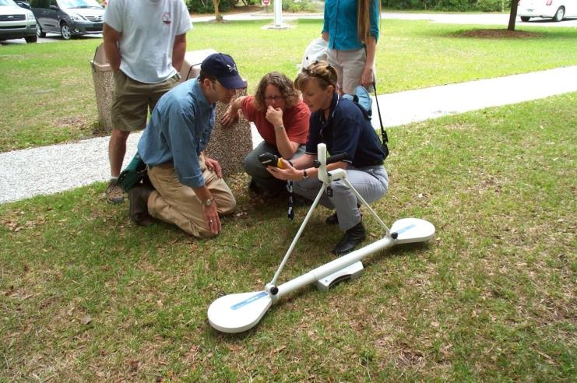
Geophysical Remote Sensing in Archaeology and Its Application
to the Detection of Graves
Jarrod Burks, Ph.D.
Ohio Valley Archaeology, Inc.

Slide 2
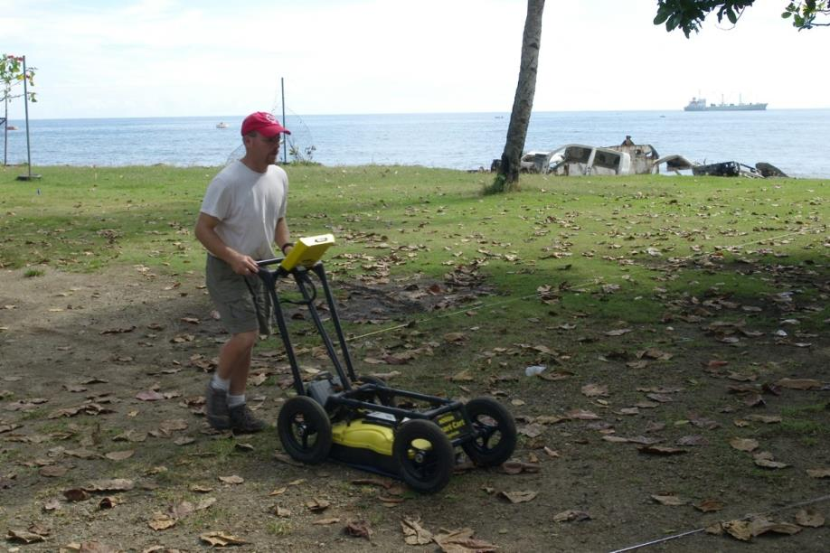
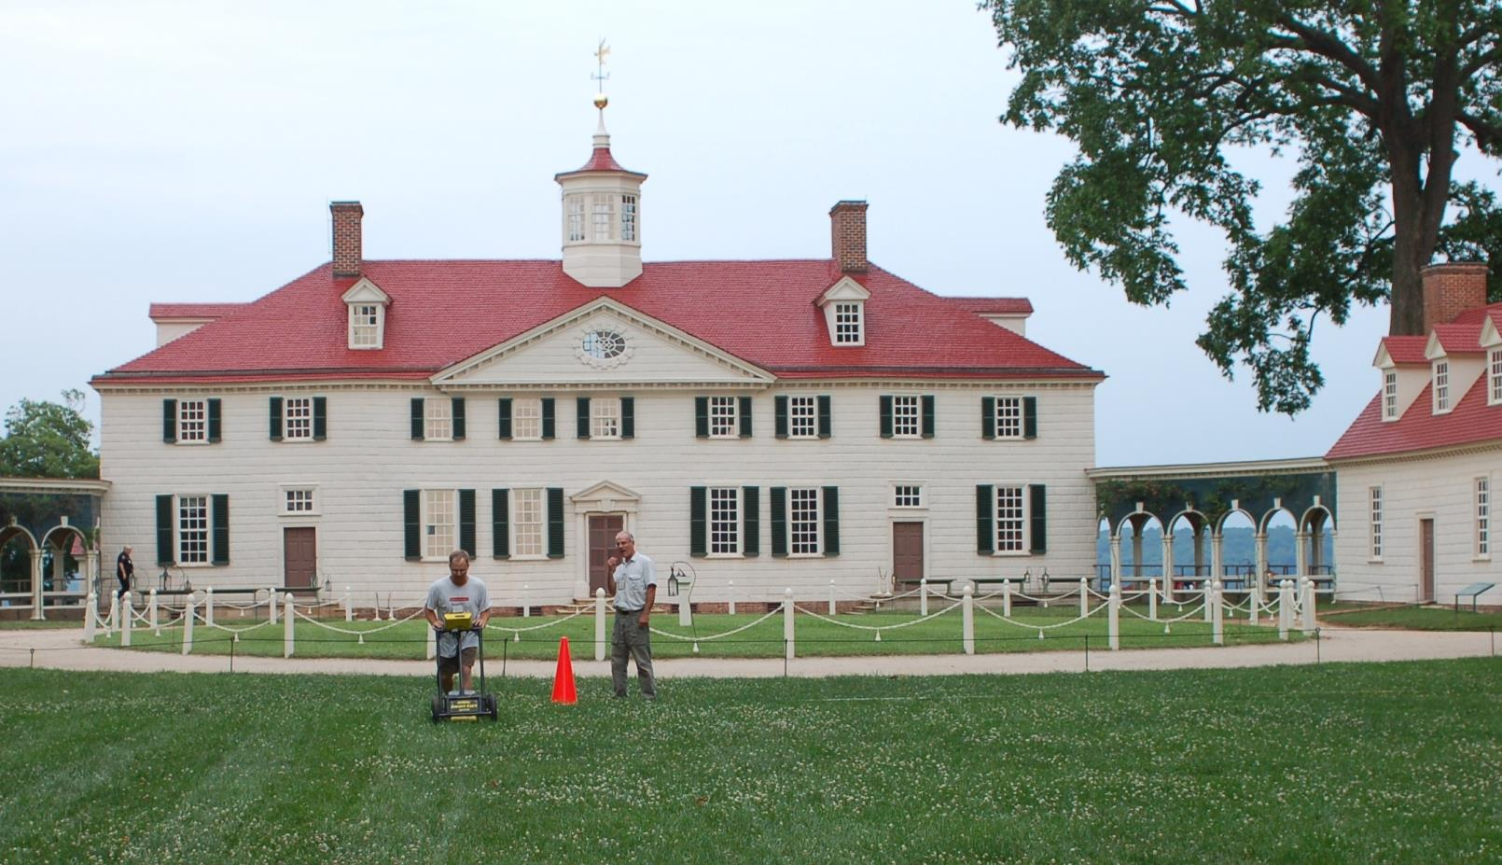
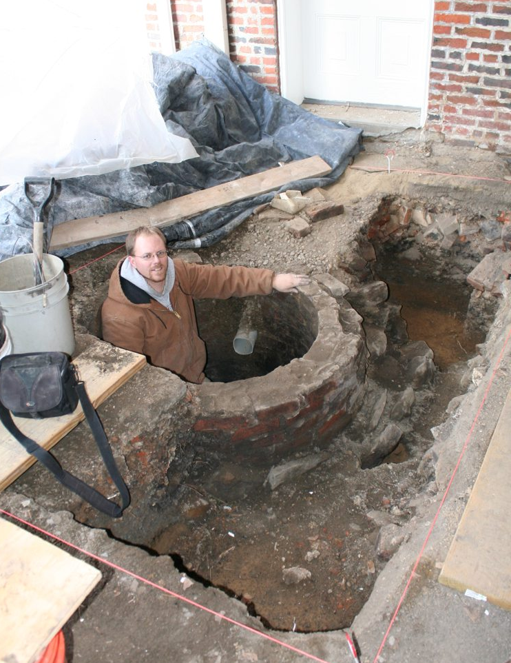
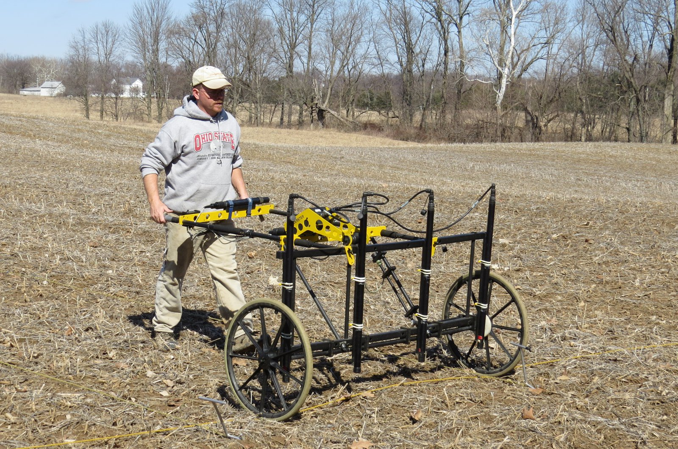
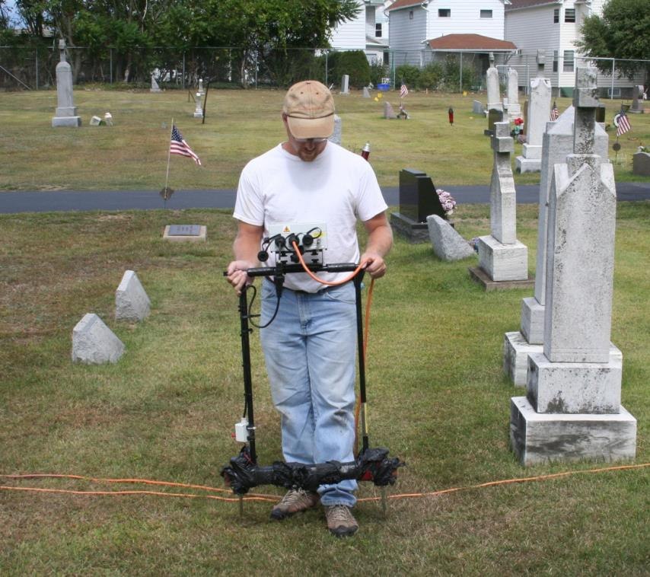
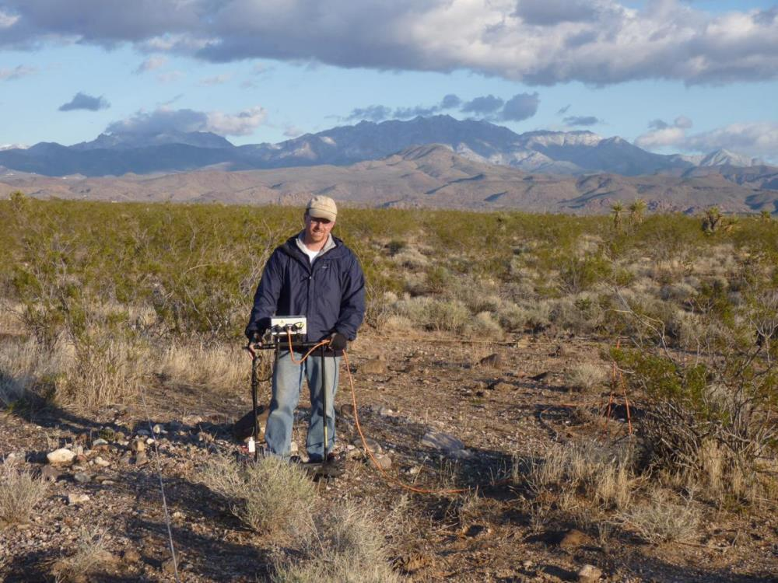
Guadalcanal, Solomon Islands
My Day Job….
McCook House
Carrollton, OH
Mount Vernon, VA
Duryea, PA
Kingman, AZ

Slide 3
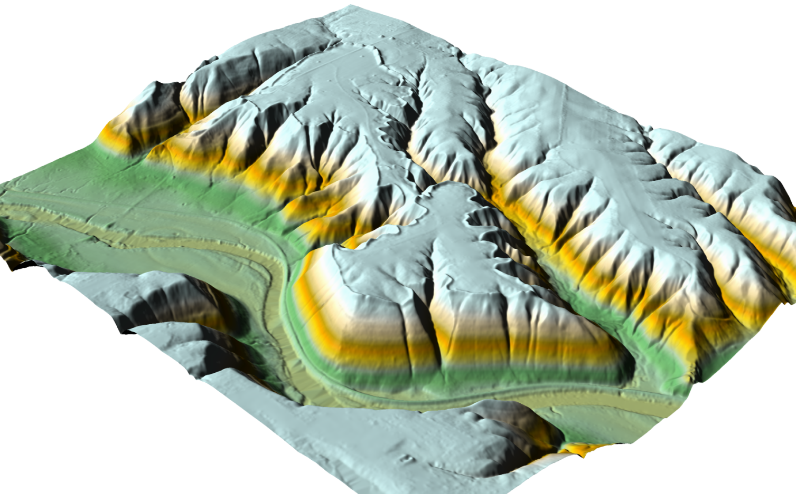
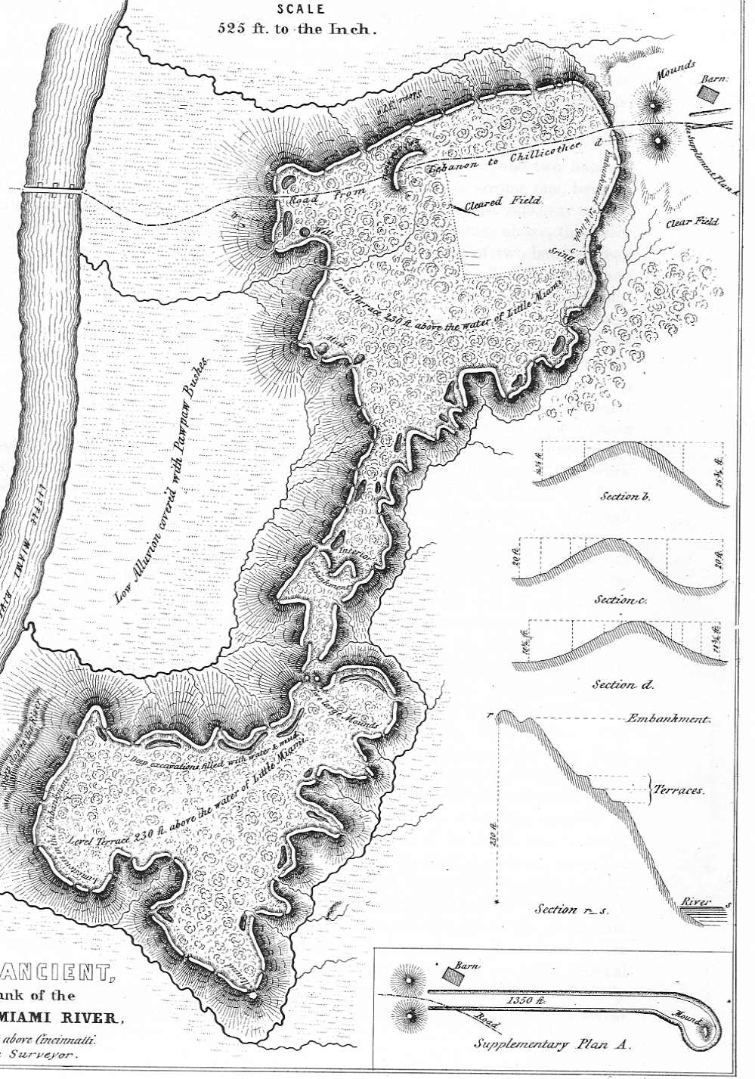
LiDAR-based
Digital Terrain Model
Fort Ancient
Hopewell Earthwork
Southern Ohio

Slide 4
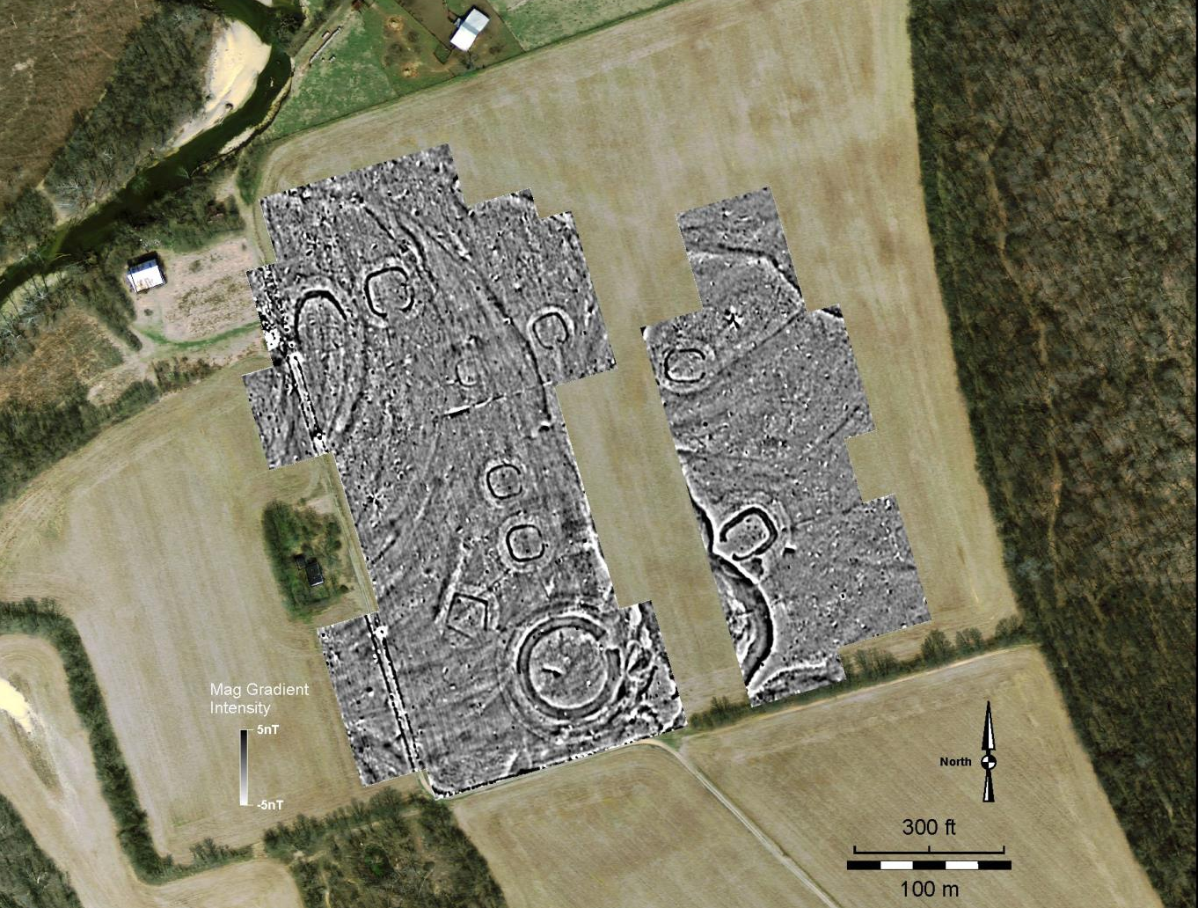
Magnetic Gradient
Data
Steel Group
Southern Ohio
Hopewell (c. A.D. 100)
ditch and embankment
earthworks

Slide 5
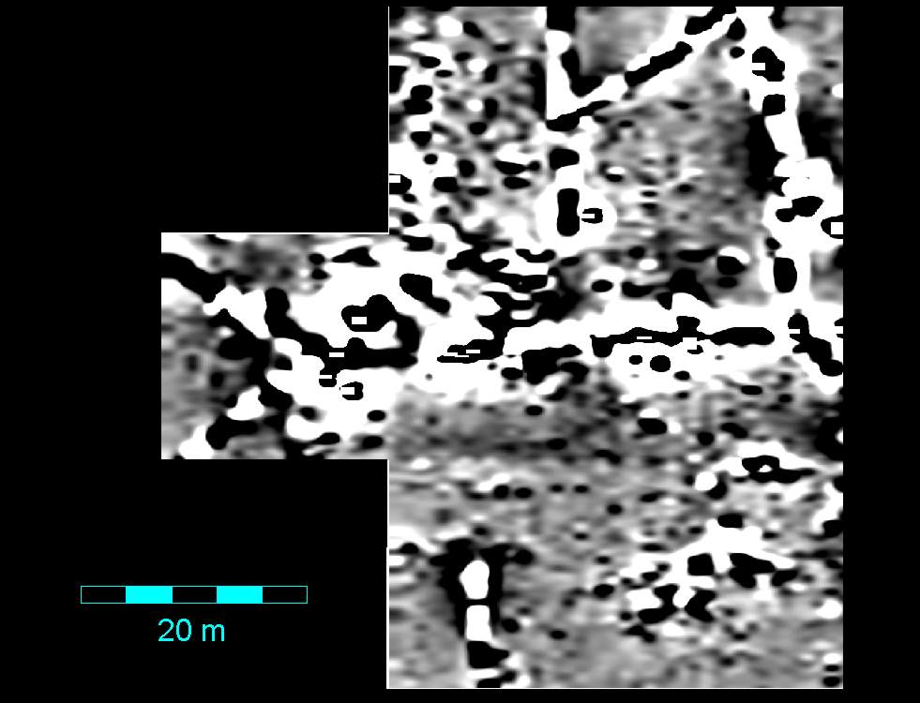
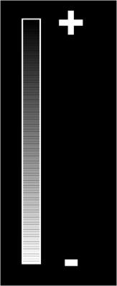
Magnetic Gradient Data
…less obvious results
19th Century Hotel and Club House
Middle Bass Island, Lake Erie, Ohio
?
5nT
-5nT

Slide 6
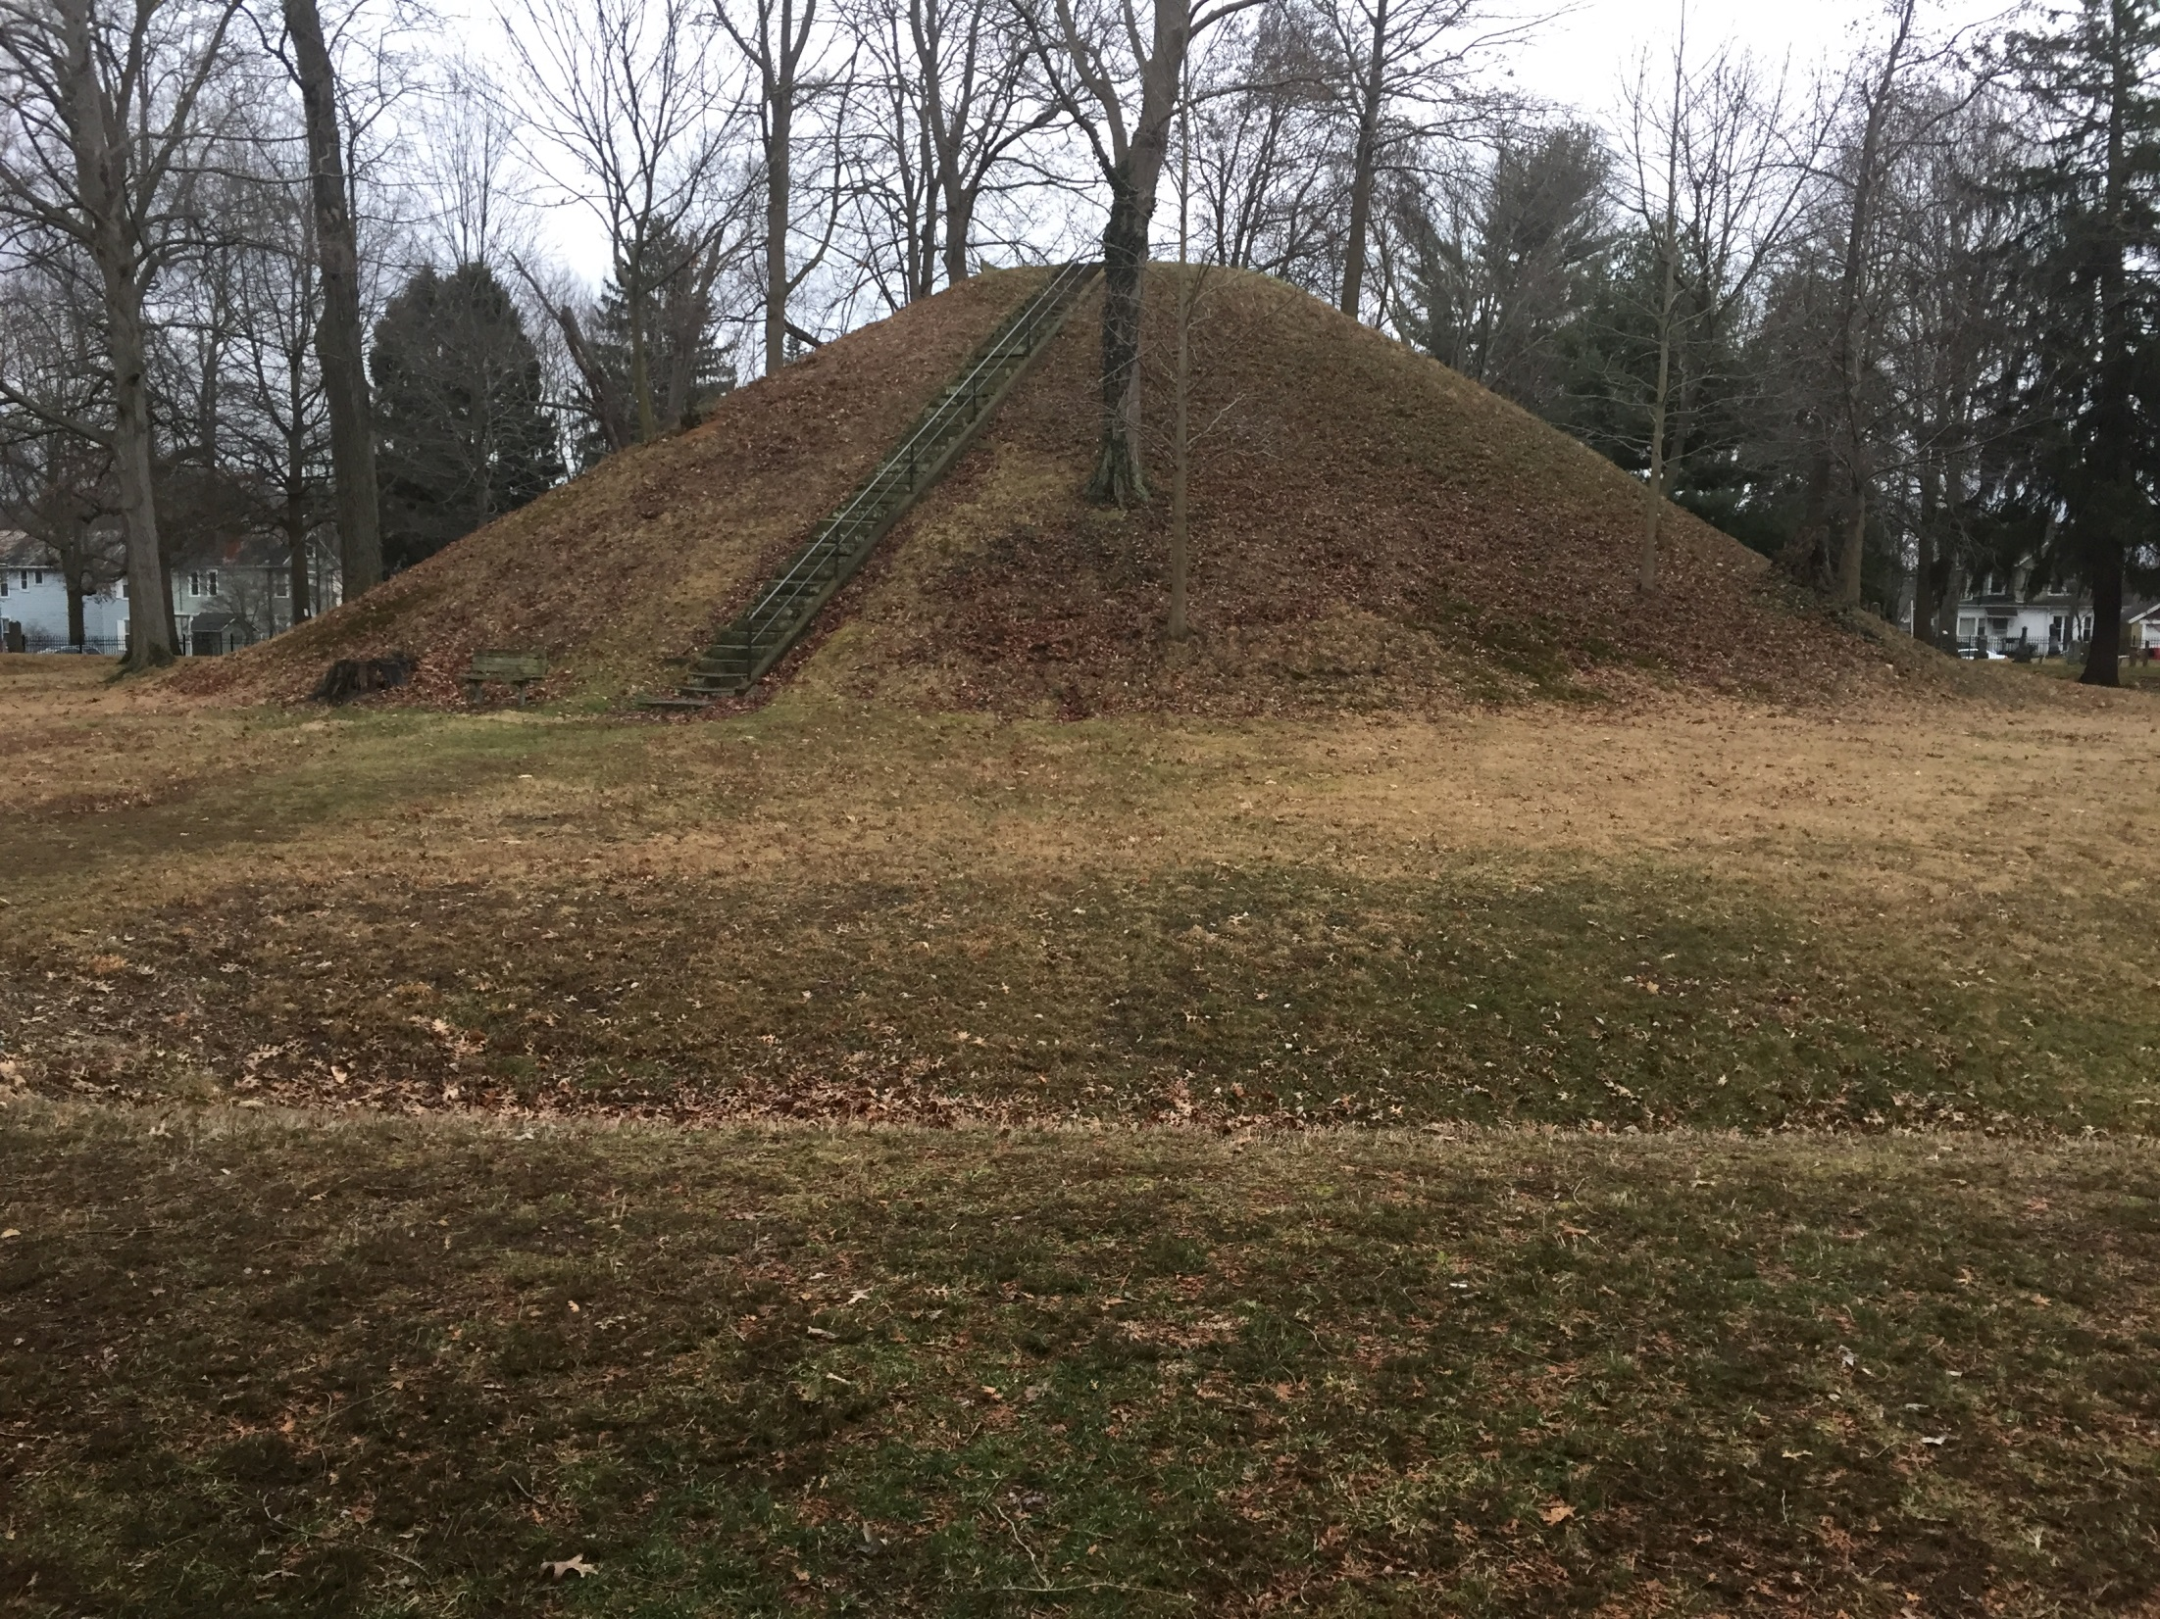
Objectives
Develop basic understanding of geophysics and archaeology
Briefly explore how various instruments work and what they detect
See examples of different instrument results in cemeteries and at OH and WI mound sites
Sum up with expectations for geophysical surveys at WI mound sites

Slide 7

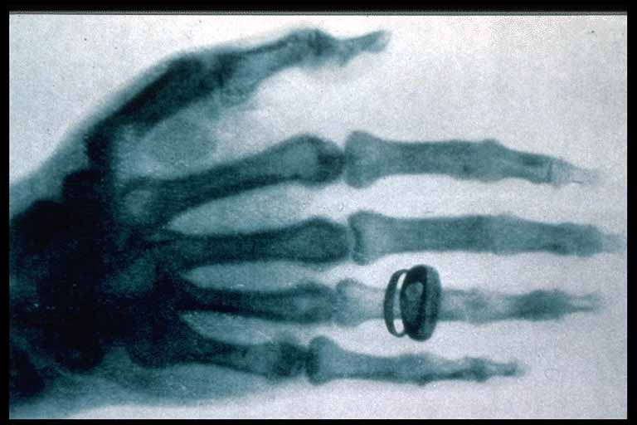
What is Archaeological Geophysics?
-Detect properties of things (hopefully archaeology) at ground surface or below,
primarily to create image/map
-Data collected at surface & down 3-6 feet (generally)
-Fast…cover large areas
-Non-Destructive (no digging!)
In effect, doing geophysics today is like taking an X-ray of the ground. The challenge is interpreting the results!
Archaeogeophysics
Geophysics a.k.a.
Remote Sensing
Archaeological
Prospecting

Slide 8
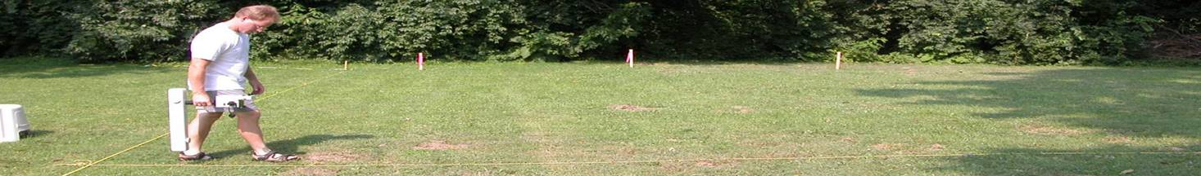
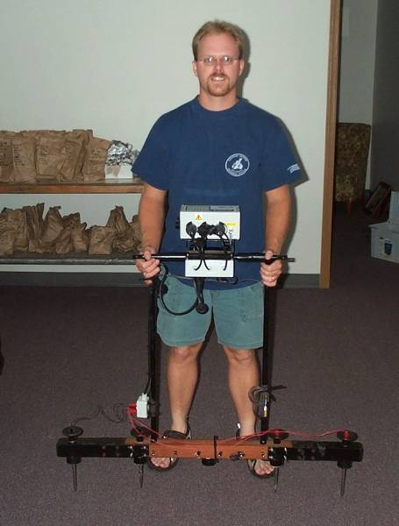
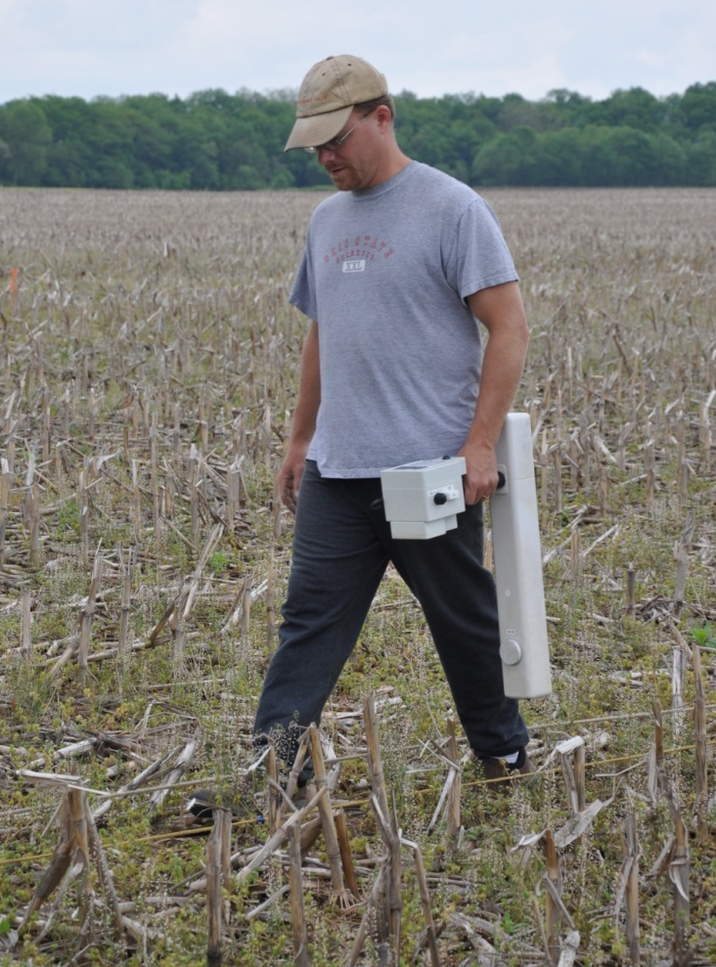
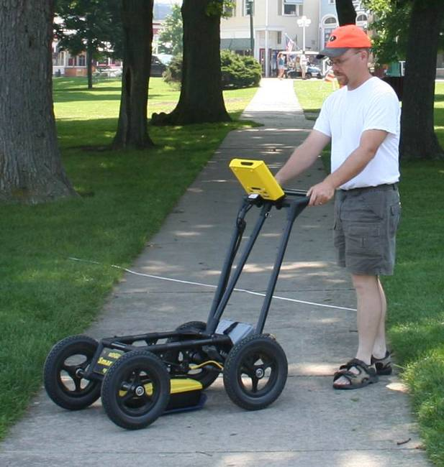
Electrical
Resistance Meter
Geophysics Instruments
for Archaeologists
Magnetometer
Detects: hard features (foundations), 3D data, depth
Detects: soil moisture differences in earthworks, roads, foundations
Detects: Burned earth, midden filled features, iron objects
Ground Penetrating Radar (GPR)

Slide 9

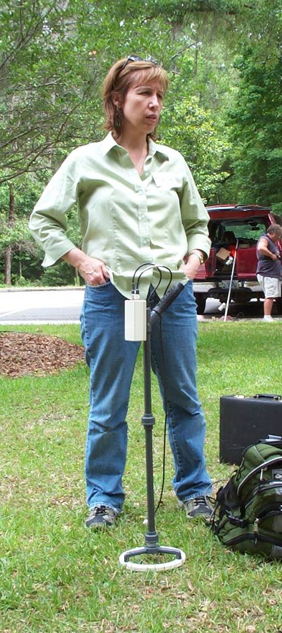
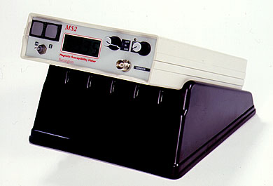
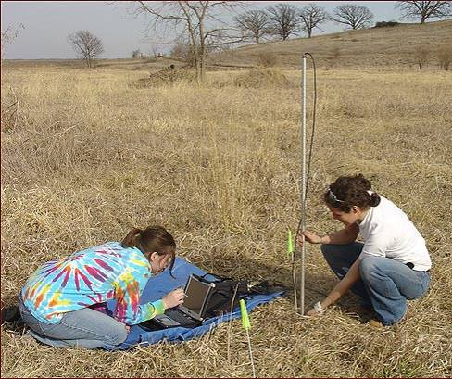
Geophysics Instruments
for Archaeologists
Conductivity Meter
Magnetic Susceptibility Meter
Detects: material’s ability to be magnetized. Midden, buried topsoil.
Detects: similar to resistance—soil moisture differences.

Slide 10

Some Concepts

Slide 11
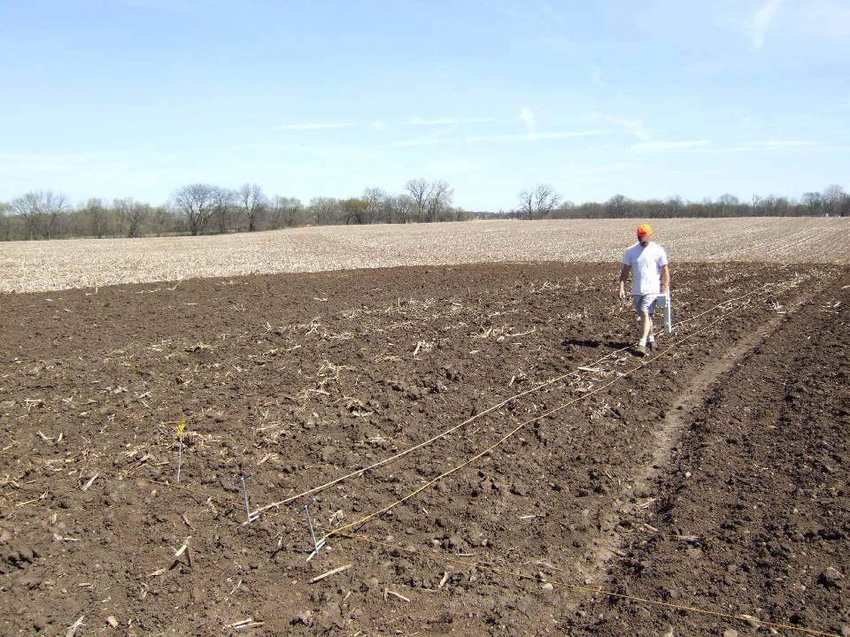
Concepts:
Surveying: collecting data
Survey Block
Transects/
Traverses
Readings or Samples
per meter

Slide 12
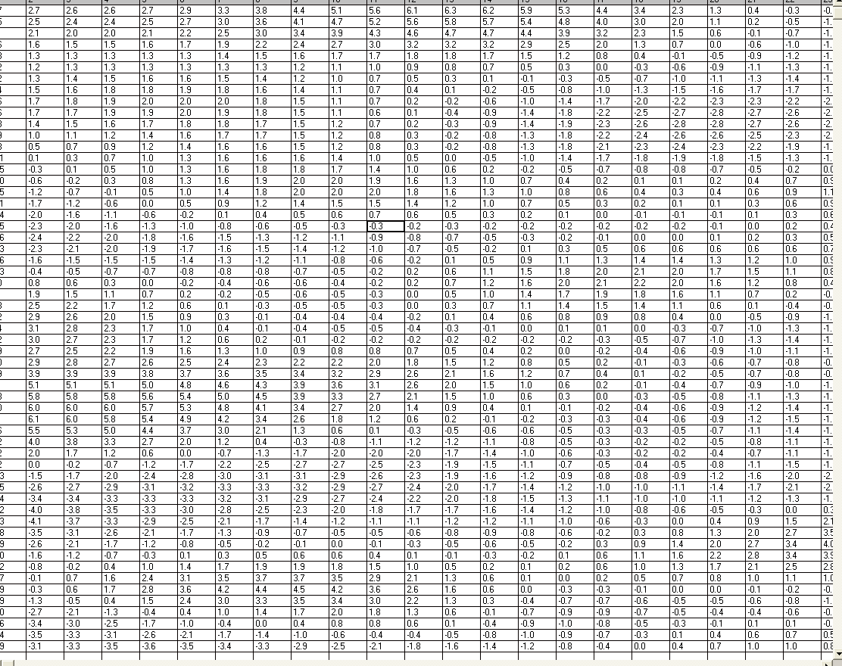

Slide 13
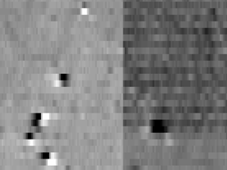

Slide 14
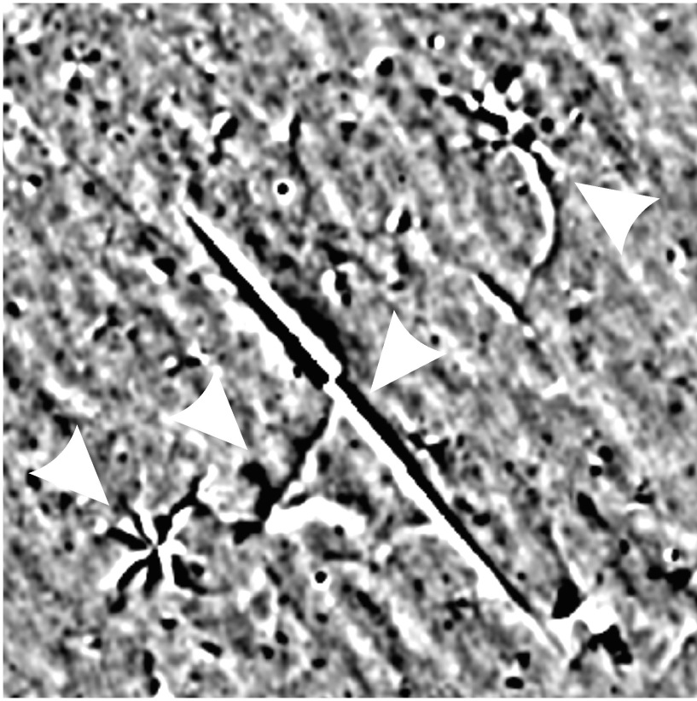
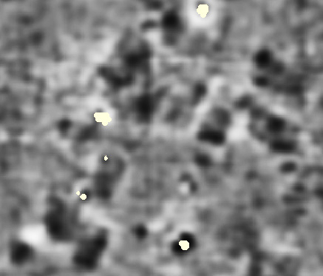
Concepts:
Anomaly
Anomaly = discrete area with geophysical
values distinct from its surroundings
Lightning strike mag anomalies
Archaeological features sometimes appear as unusual readings
But lots of other things produce anomalies! = equifinality

Slide 15
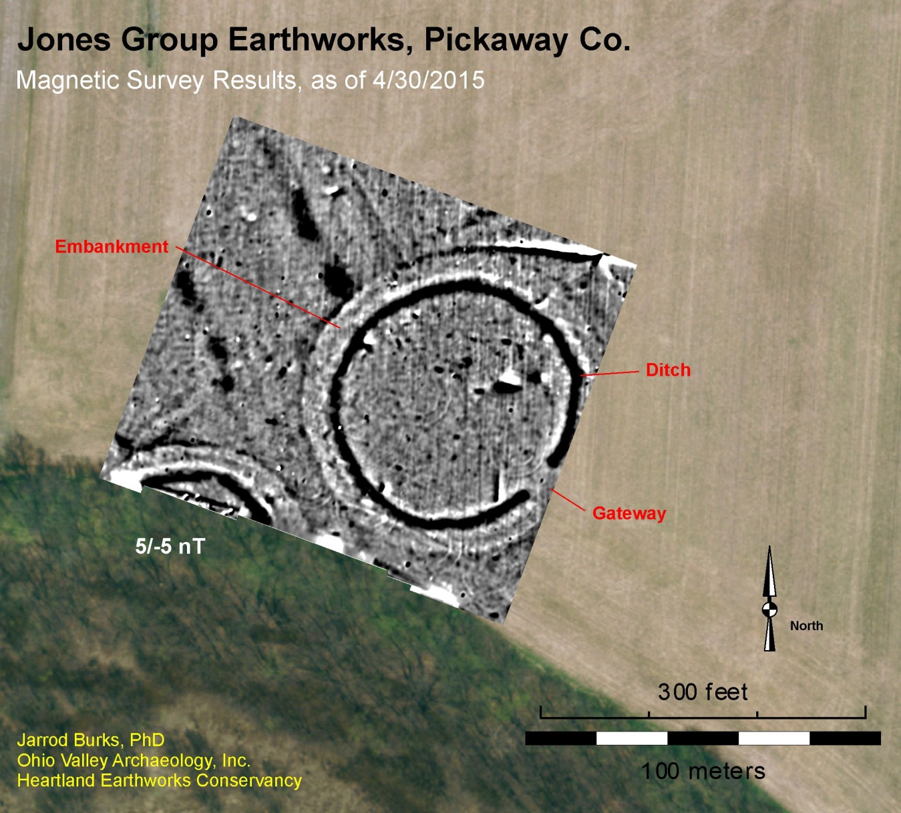
Concepts:
-To be detected, archaeology must differ
geophysically from its surroundings
Contrast
Geophysical Contrast

Slide 16
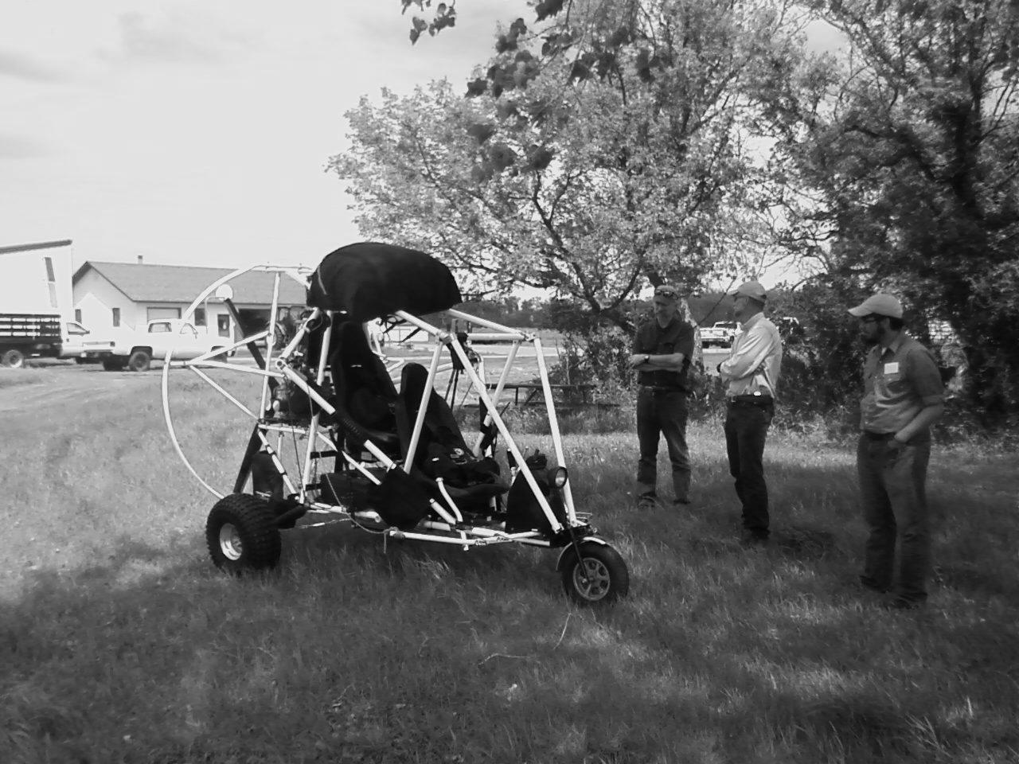
Image Contrast

Slide 17
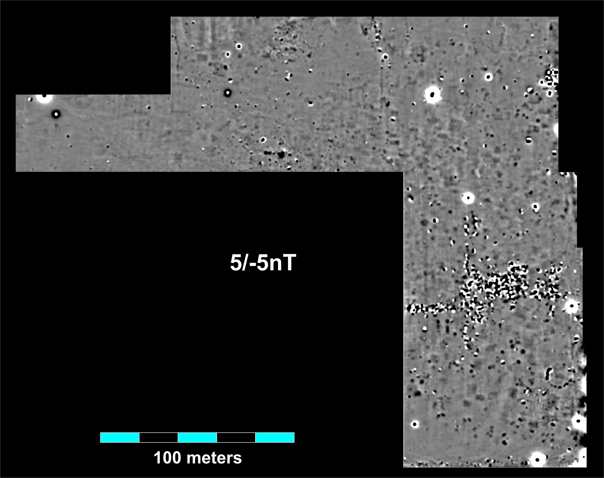
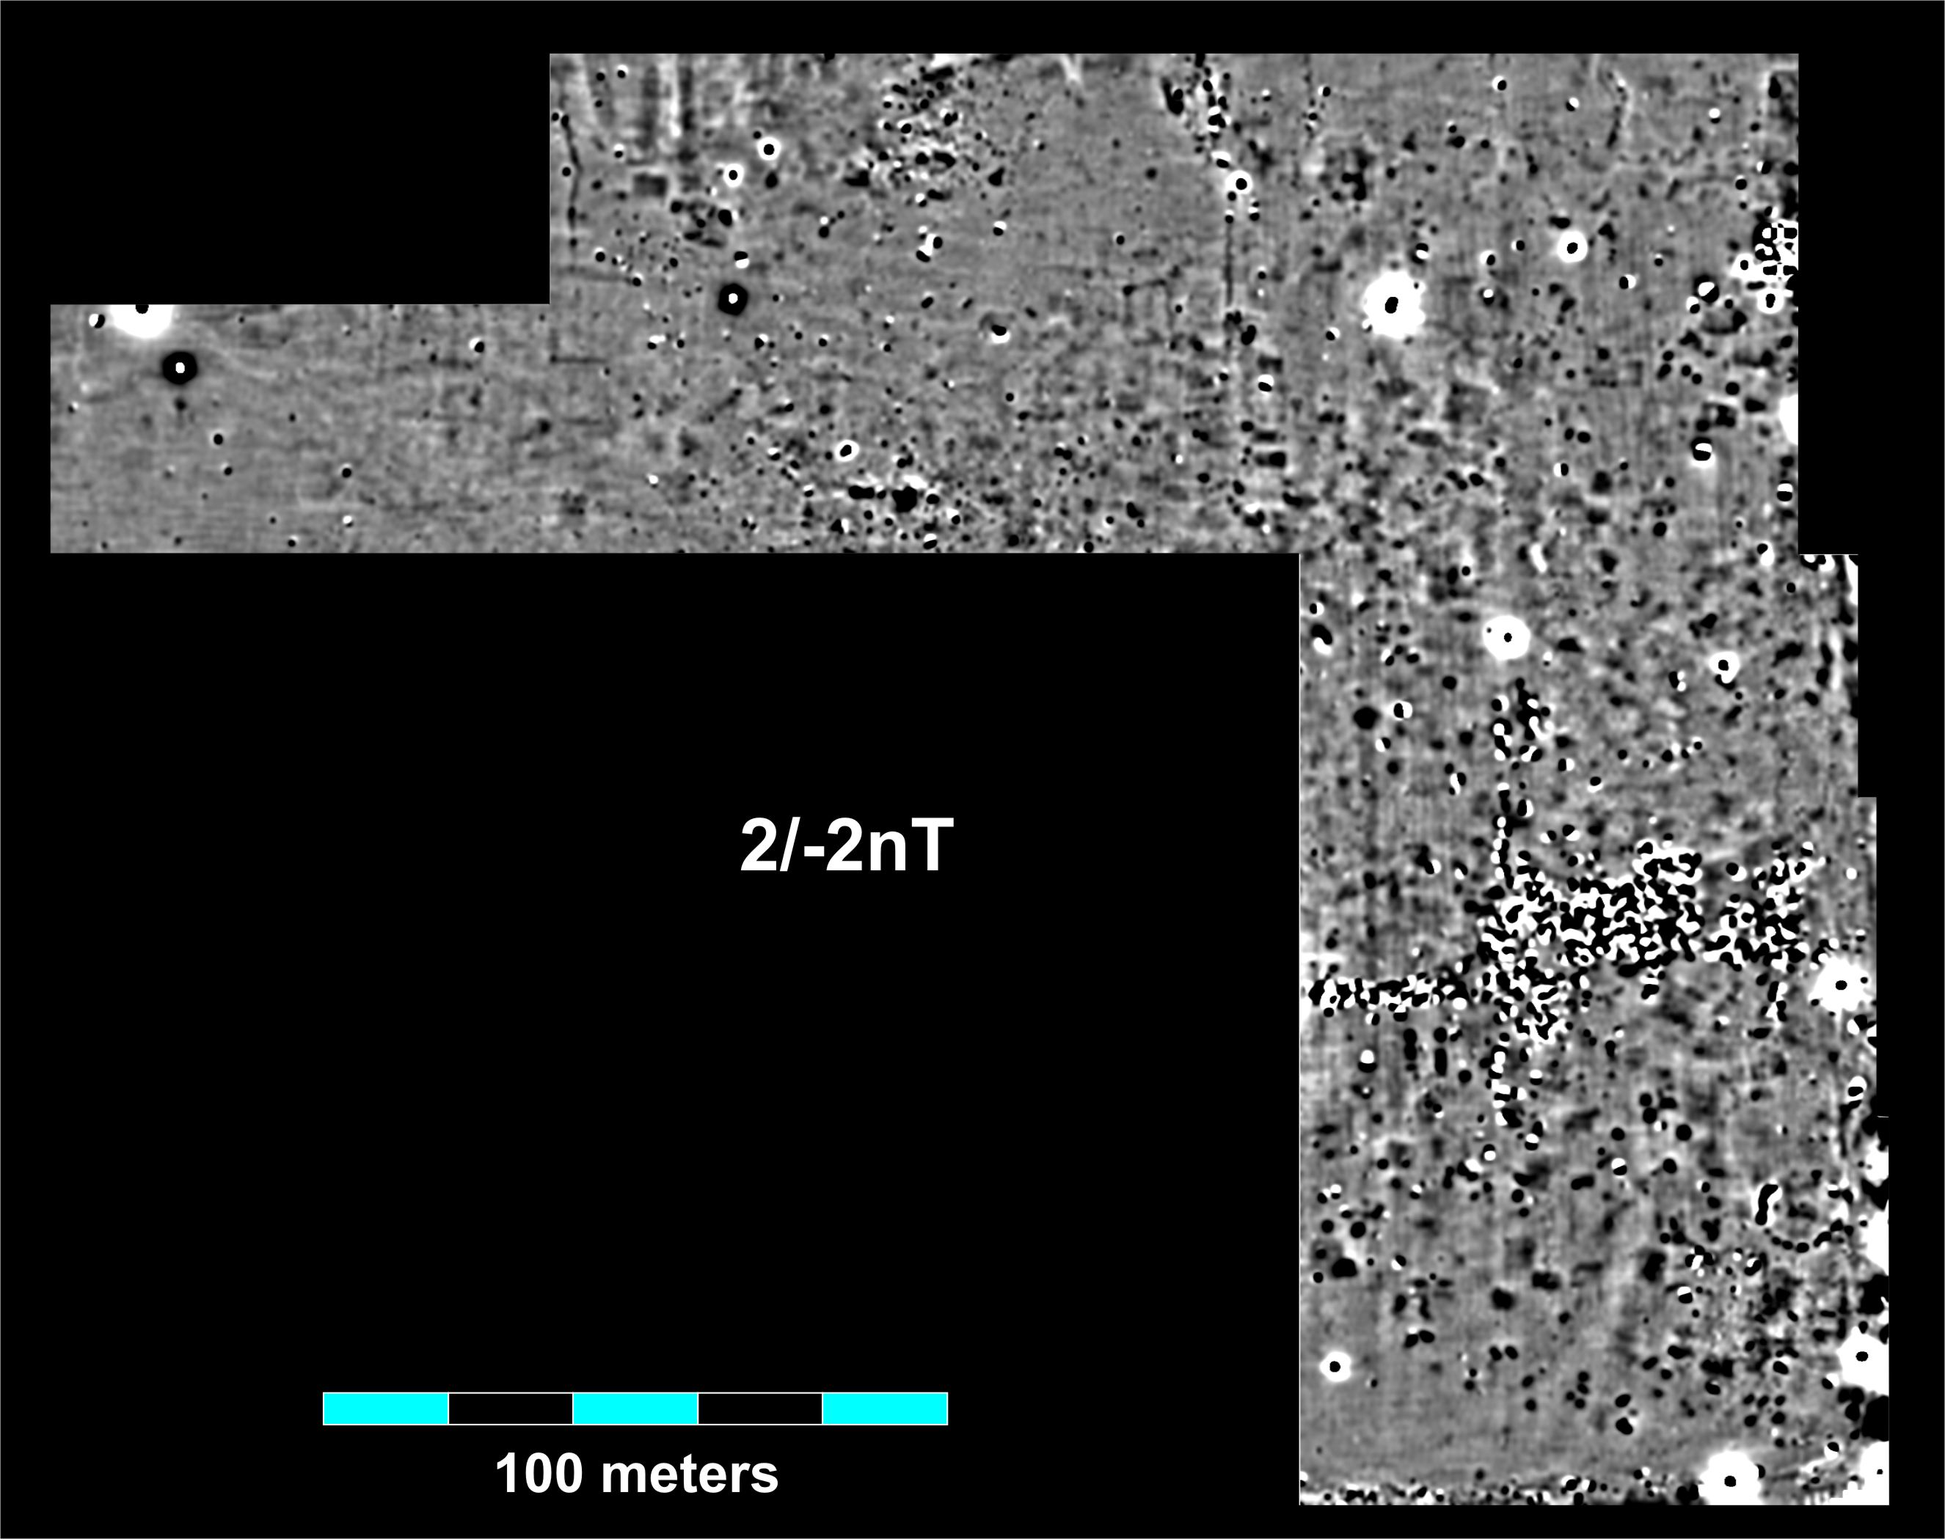
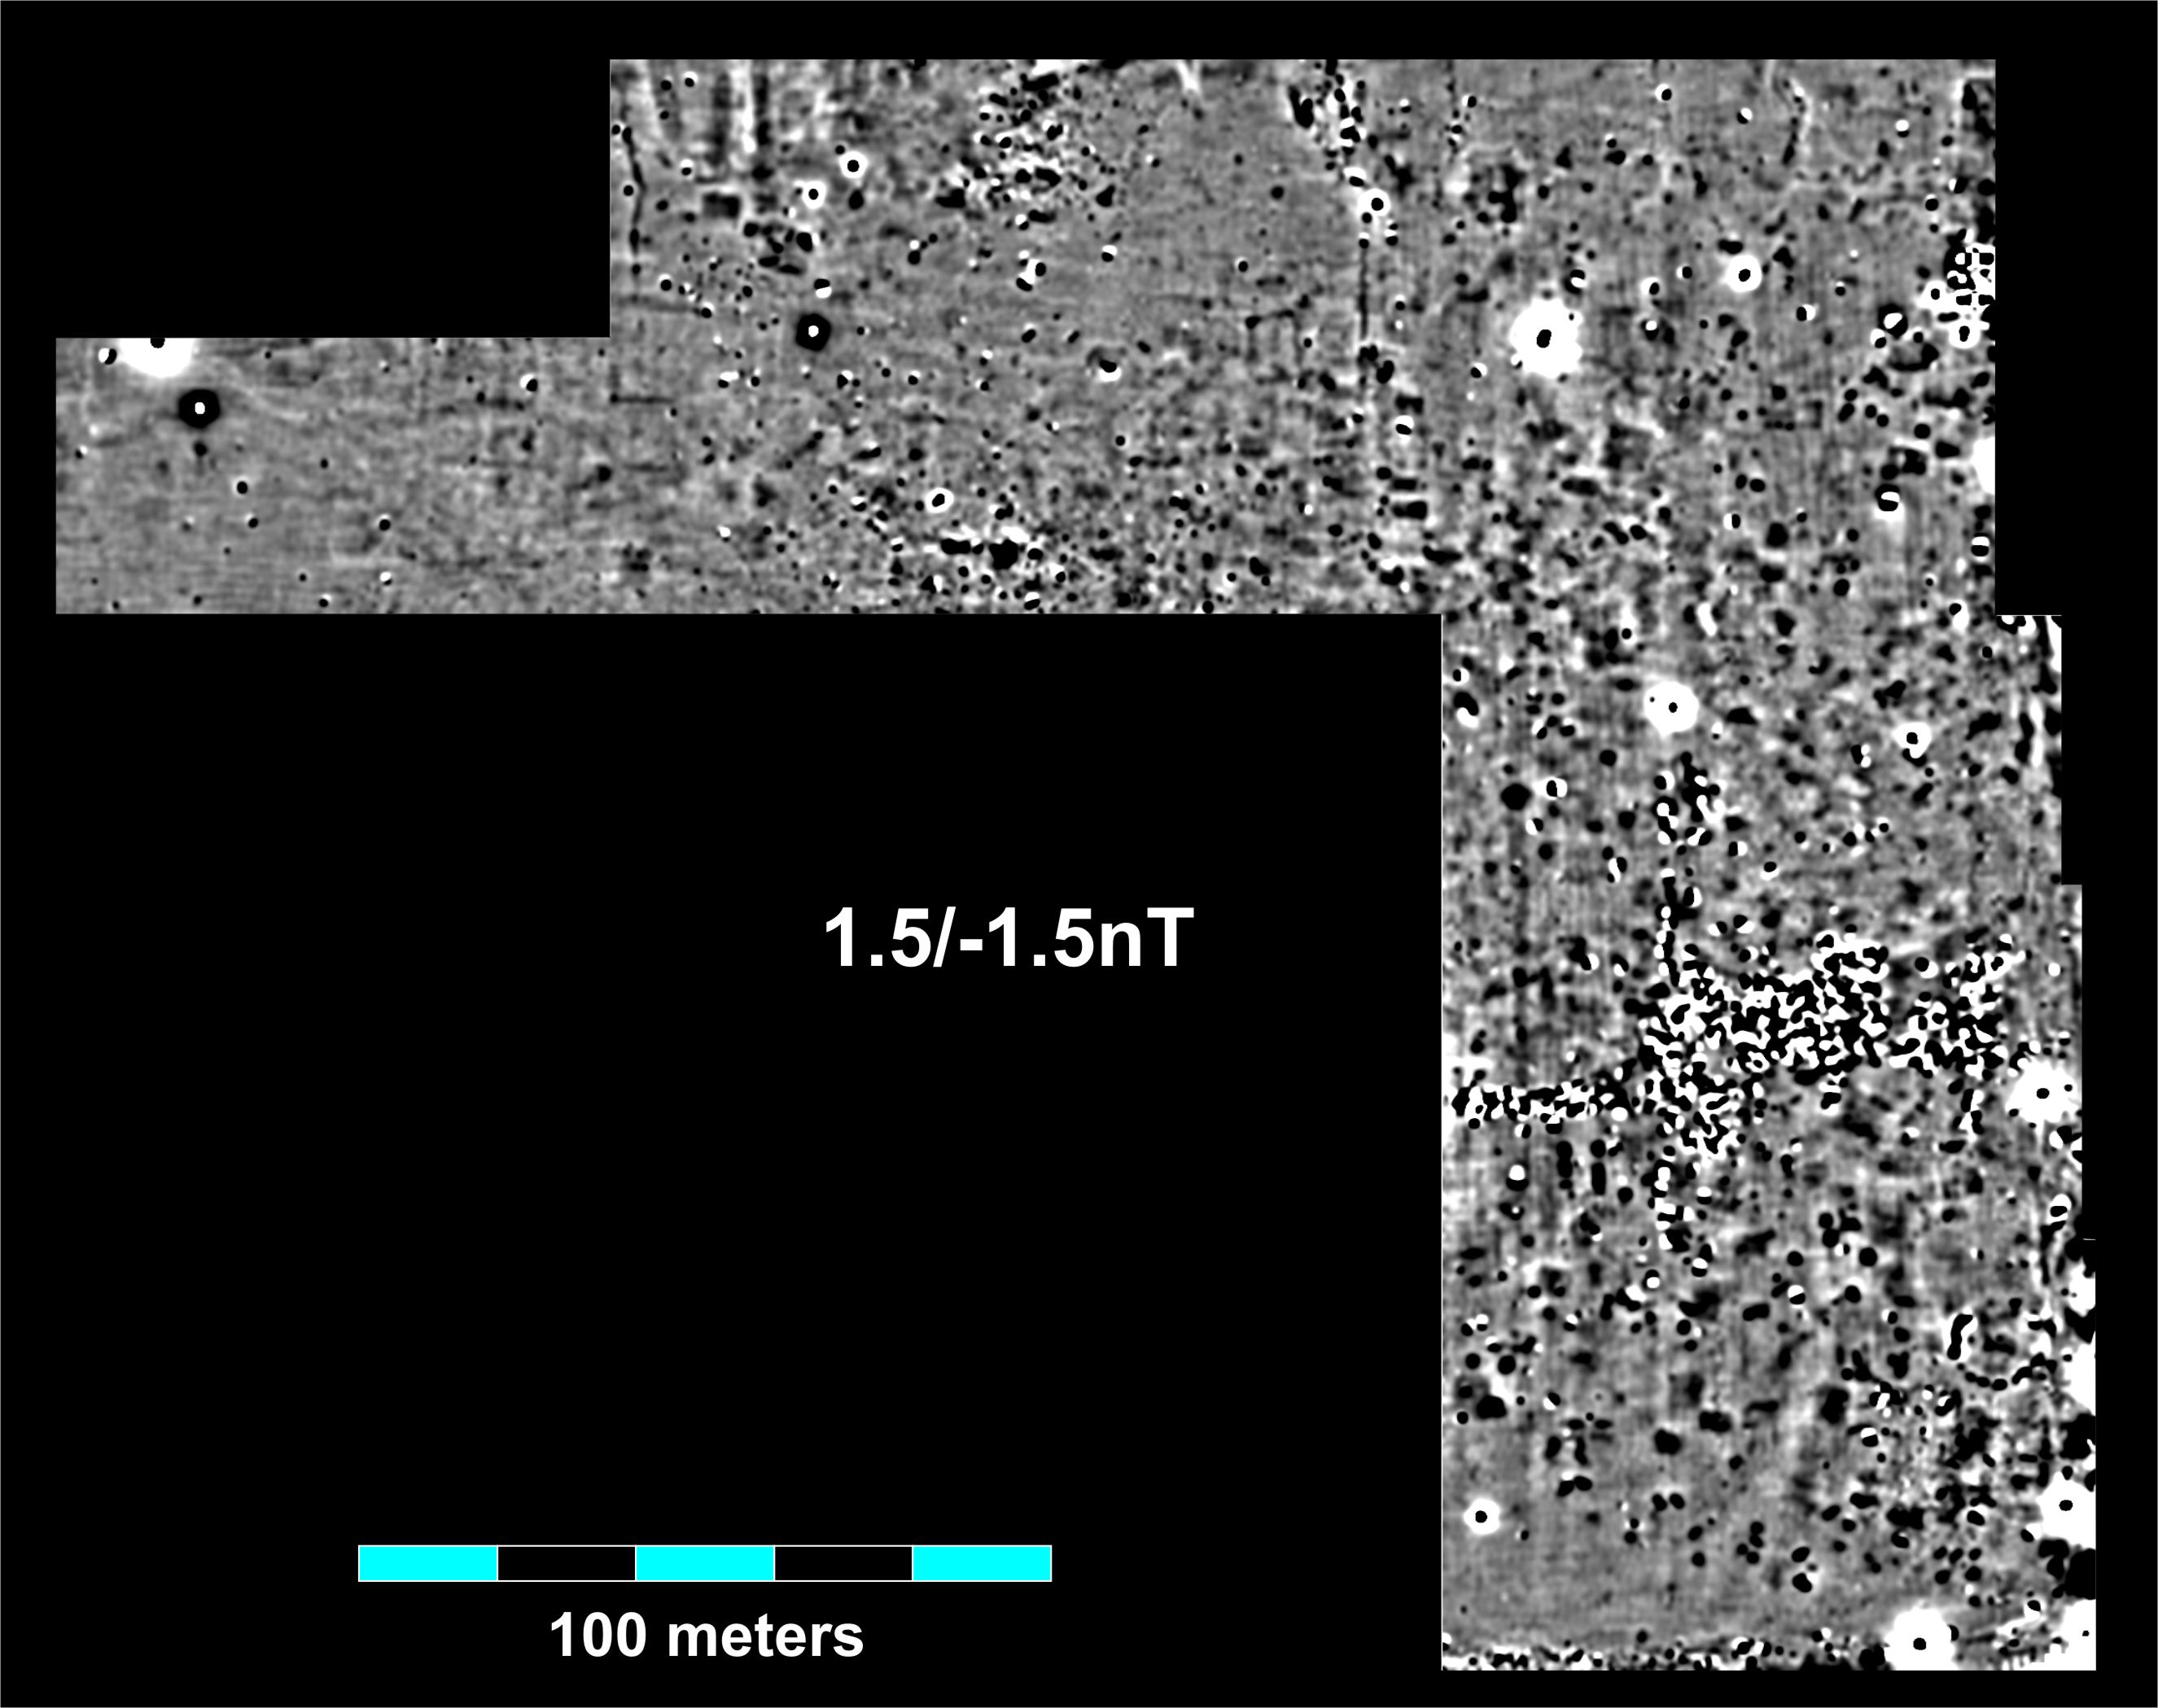
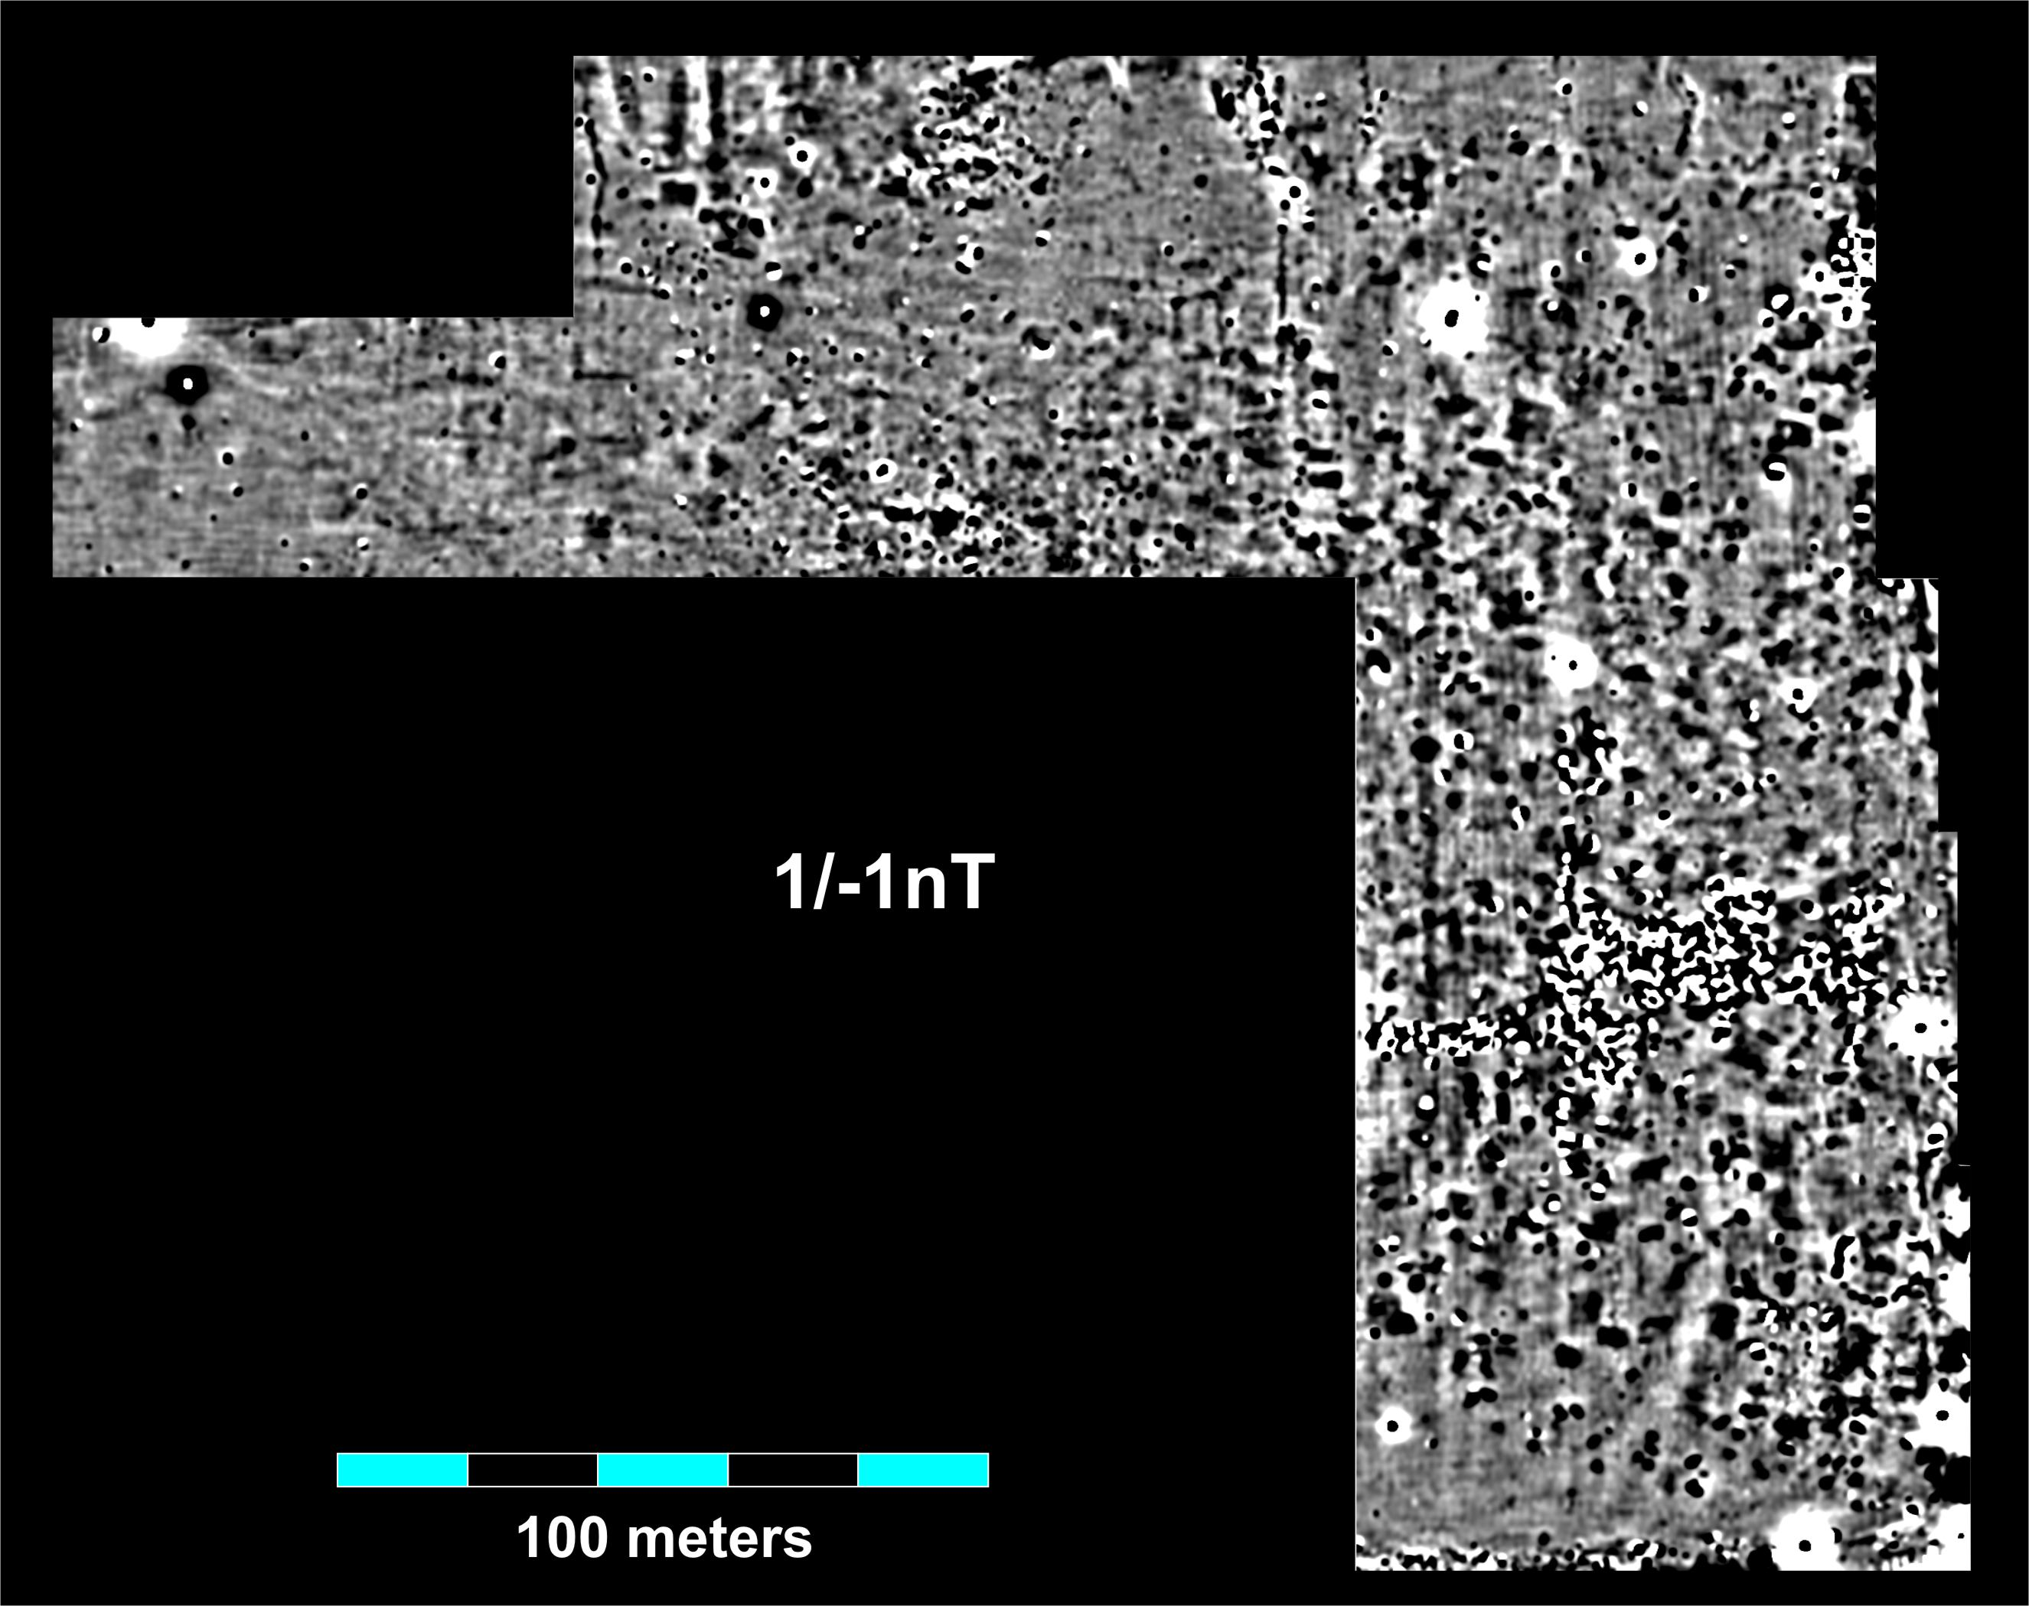

Image/Data
Contrast
Cahokia
Merrell Tract
Magnetic Gradient Data

Slide 18
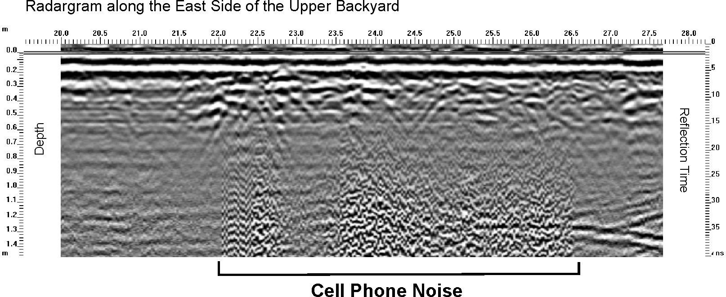
Concepts:
Noise and Clutter
Noise = “Random” or unwanted variability in your data from the sensor,
operator, or the site conditions

Slide 19
Concepts:
Noise and Clutter
Clutter = discrete anomalies not of archaeological interest

Slide 20
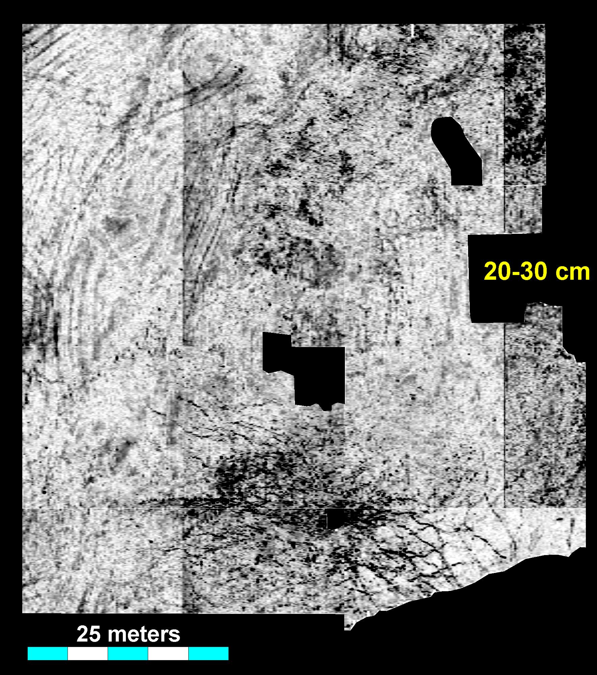
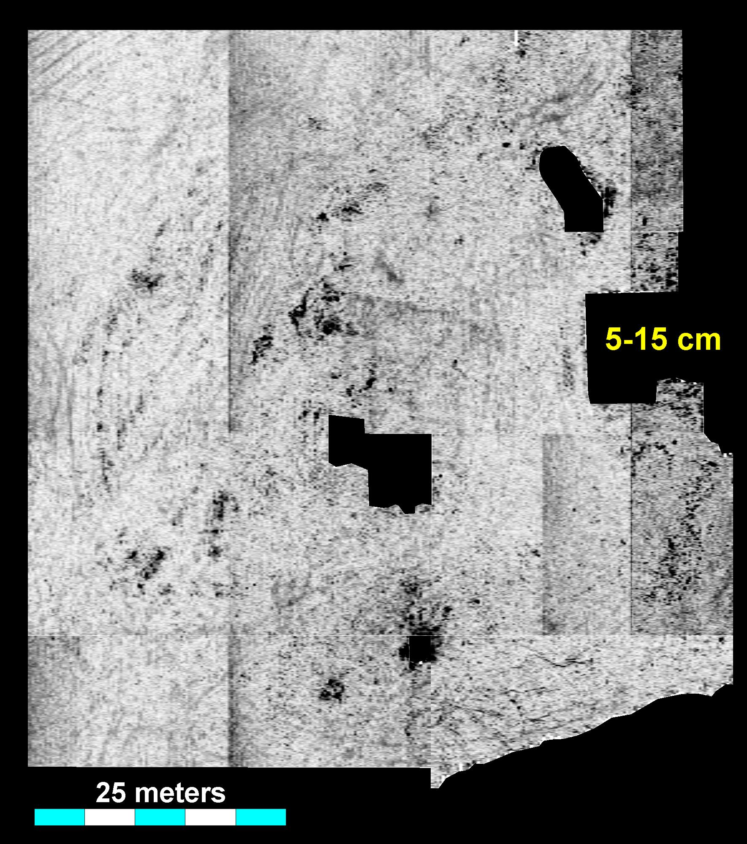
Radar Amplitude
Slice Maps
Clutter: roots

Slide 21
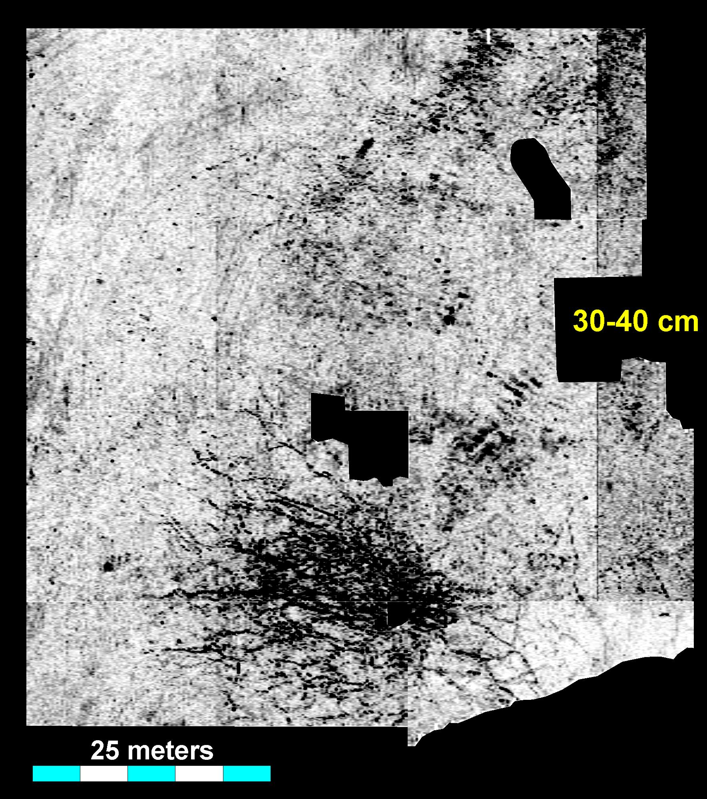
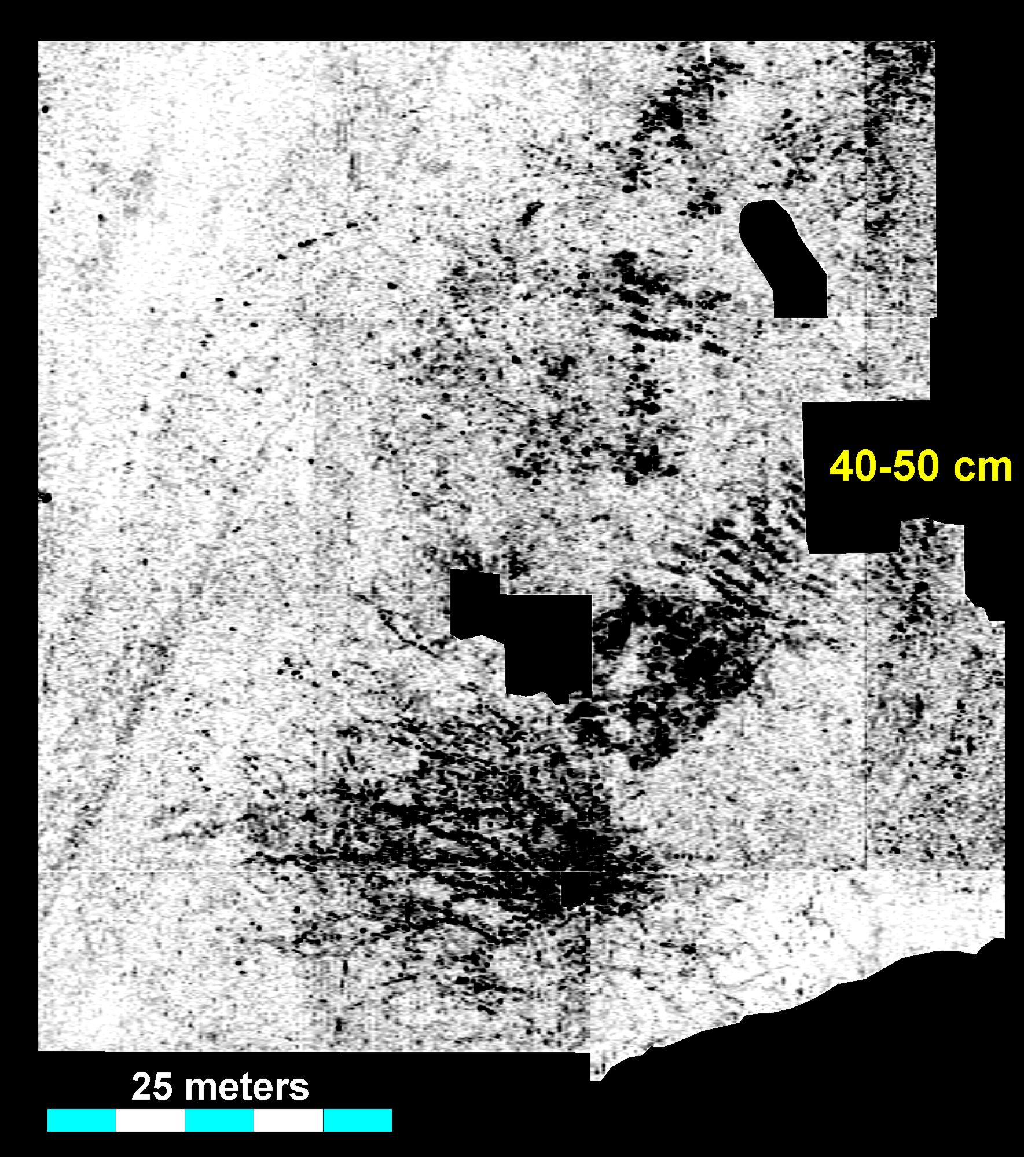
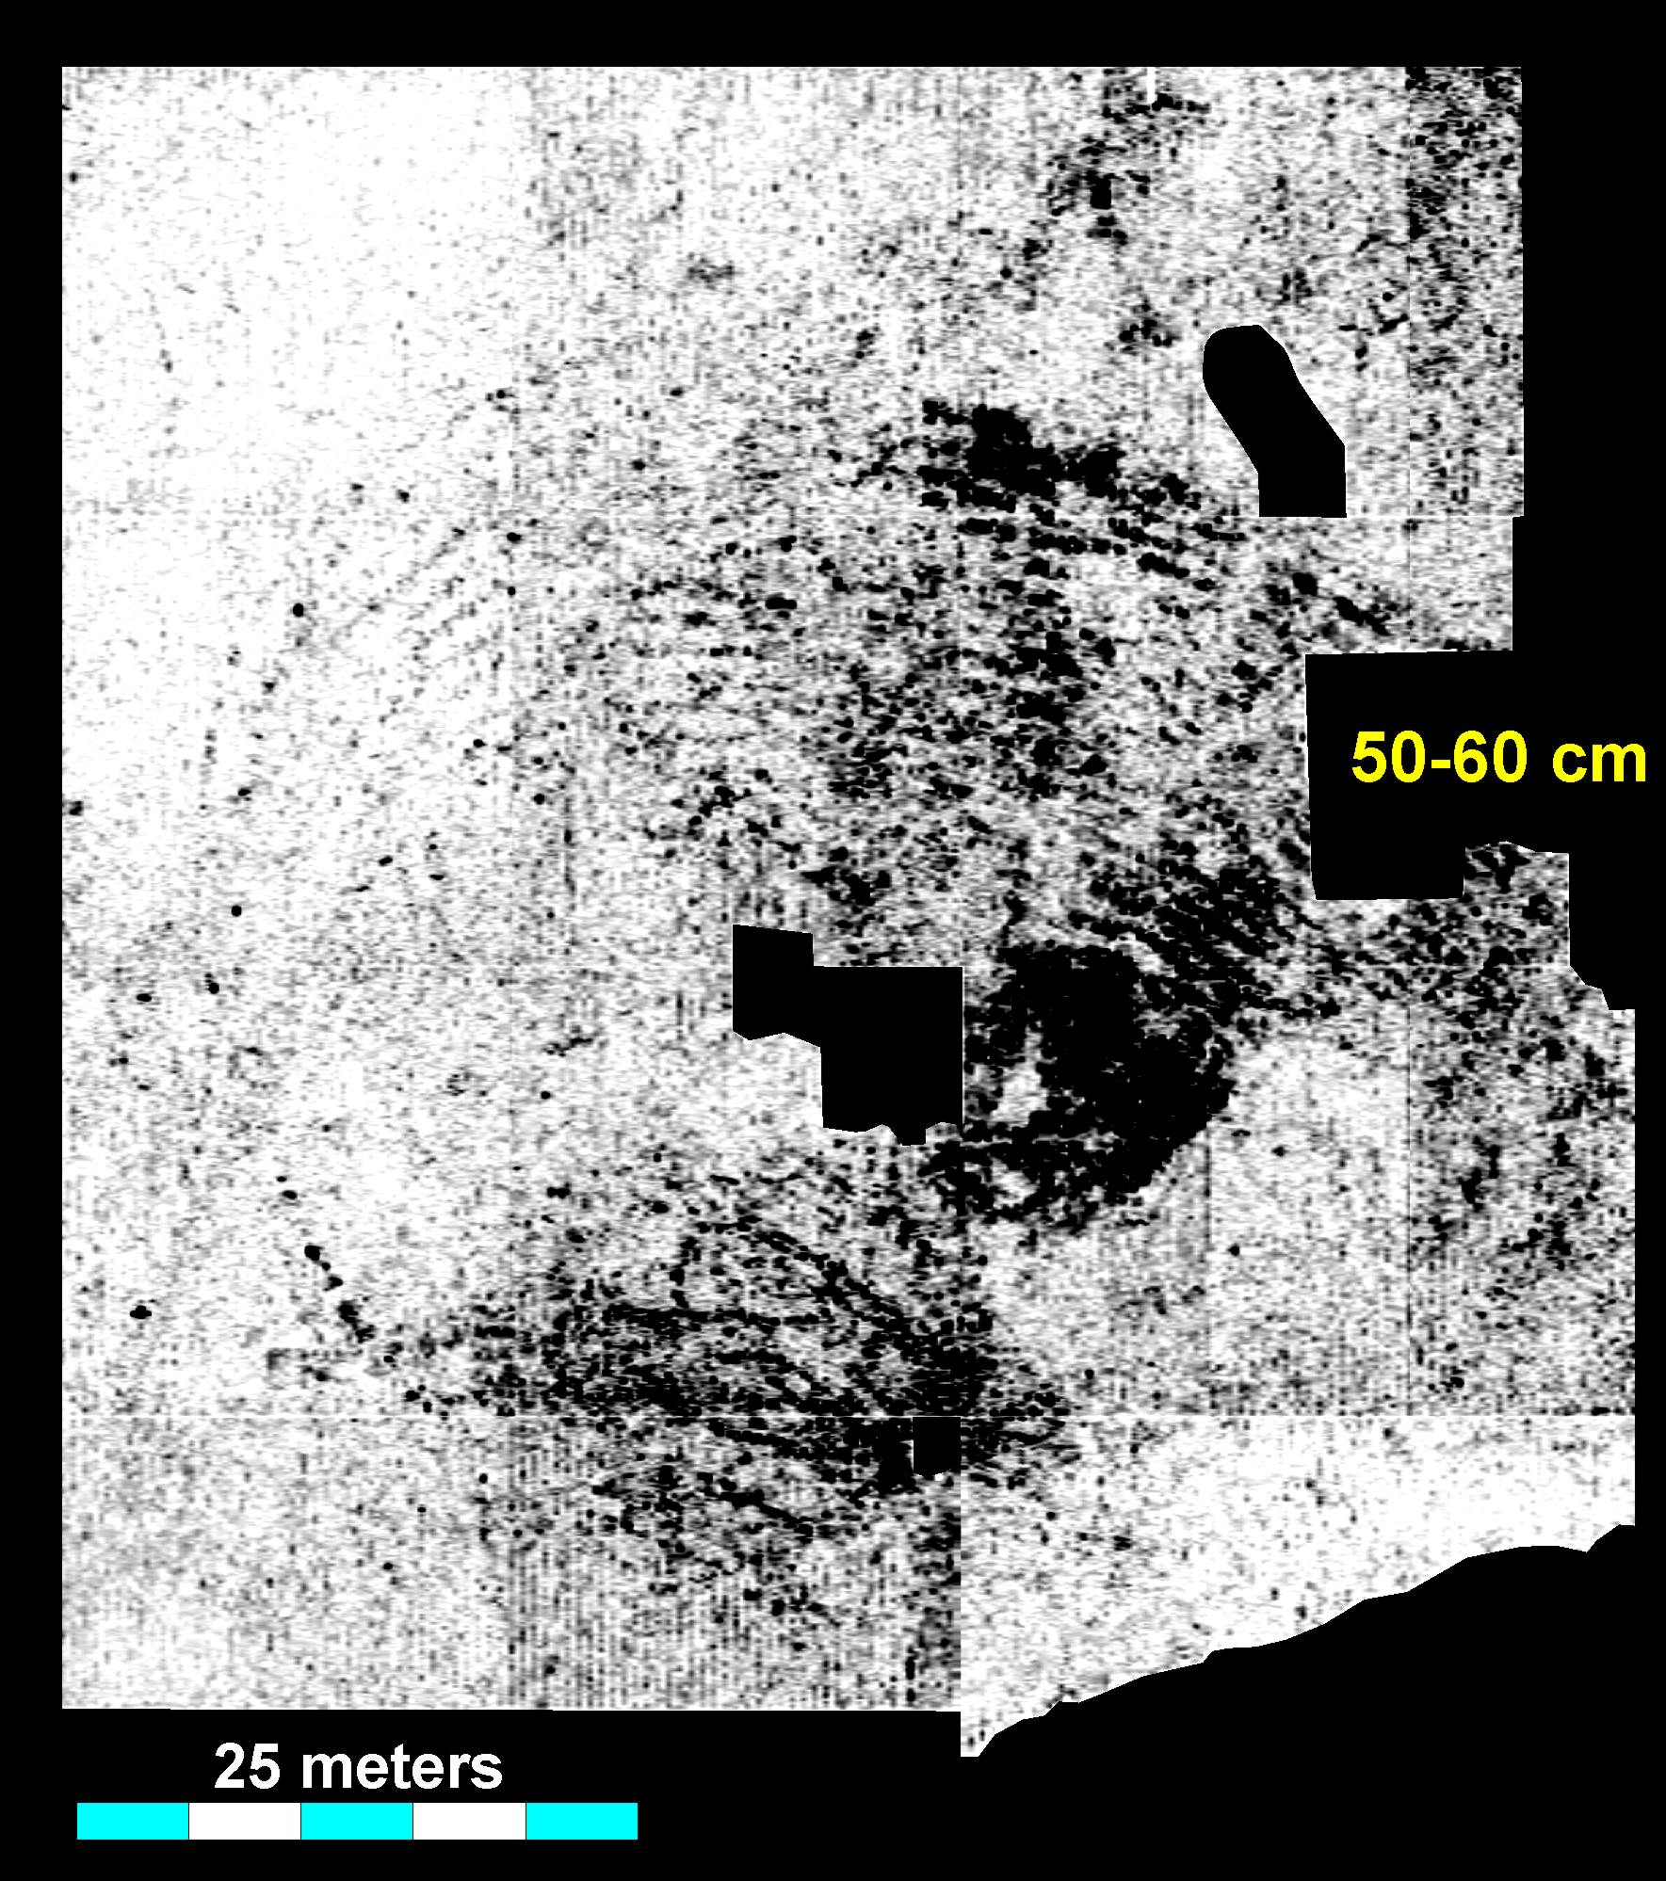
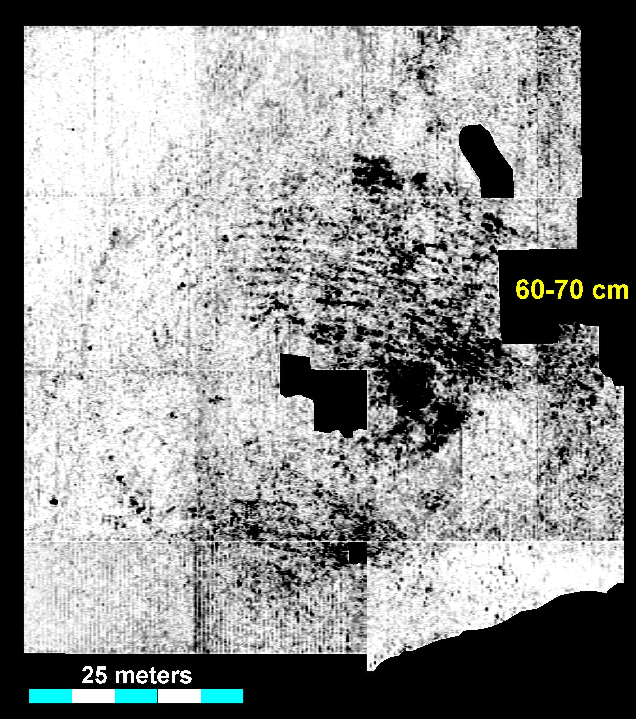
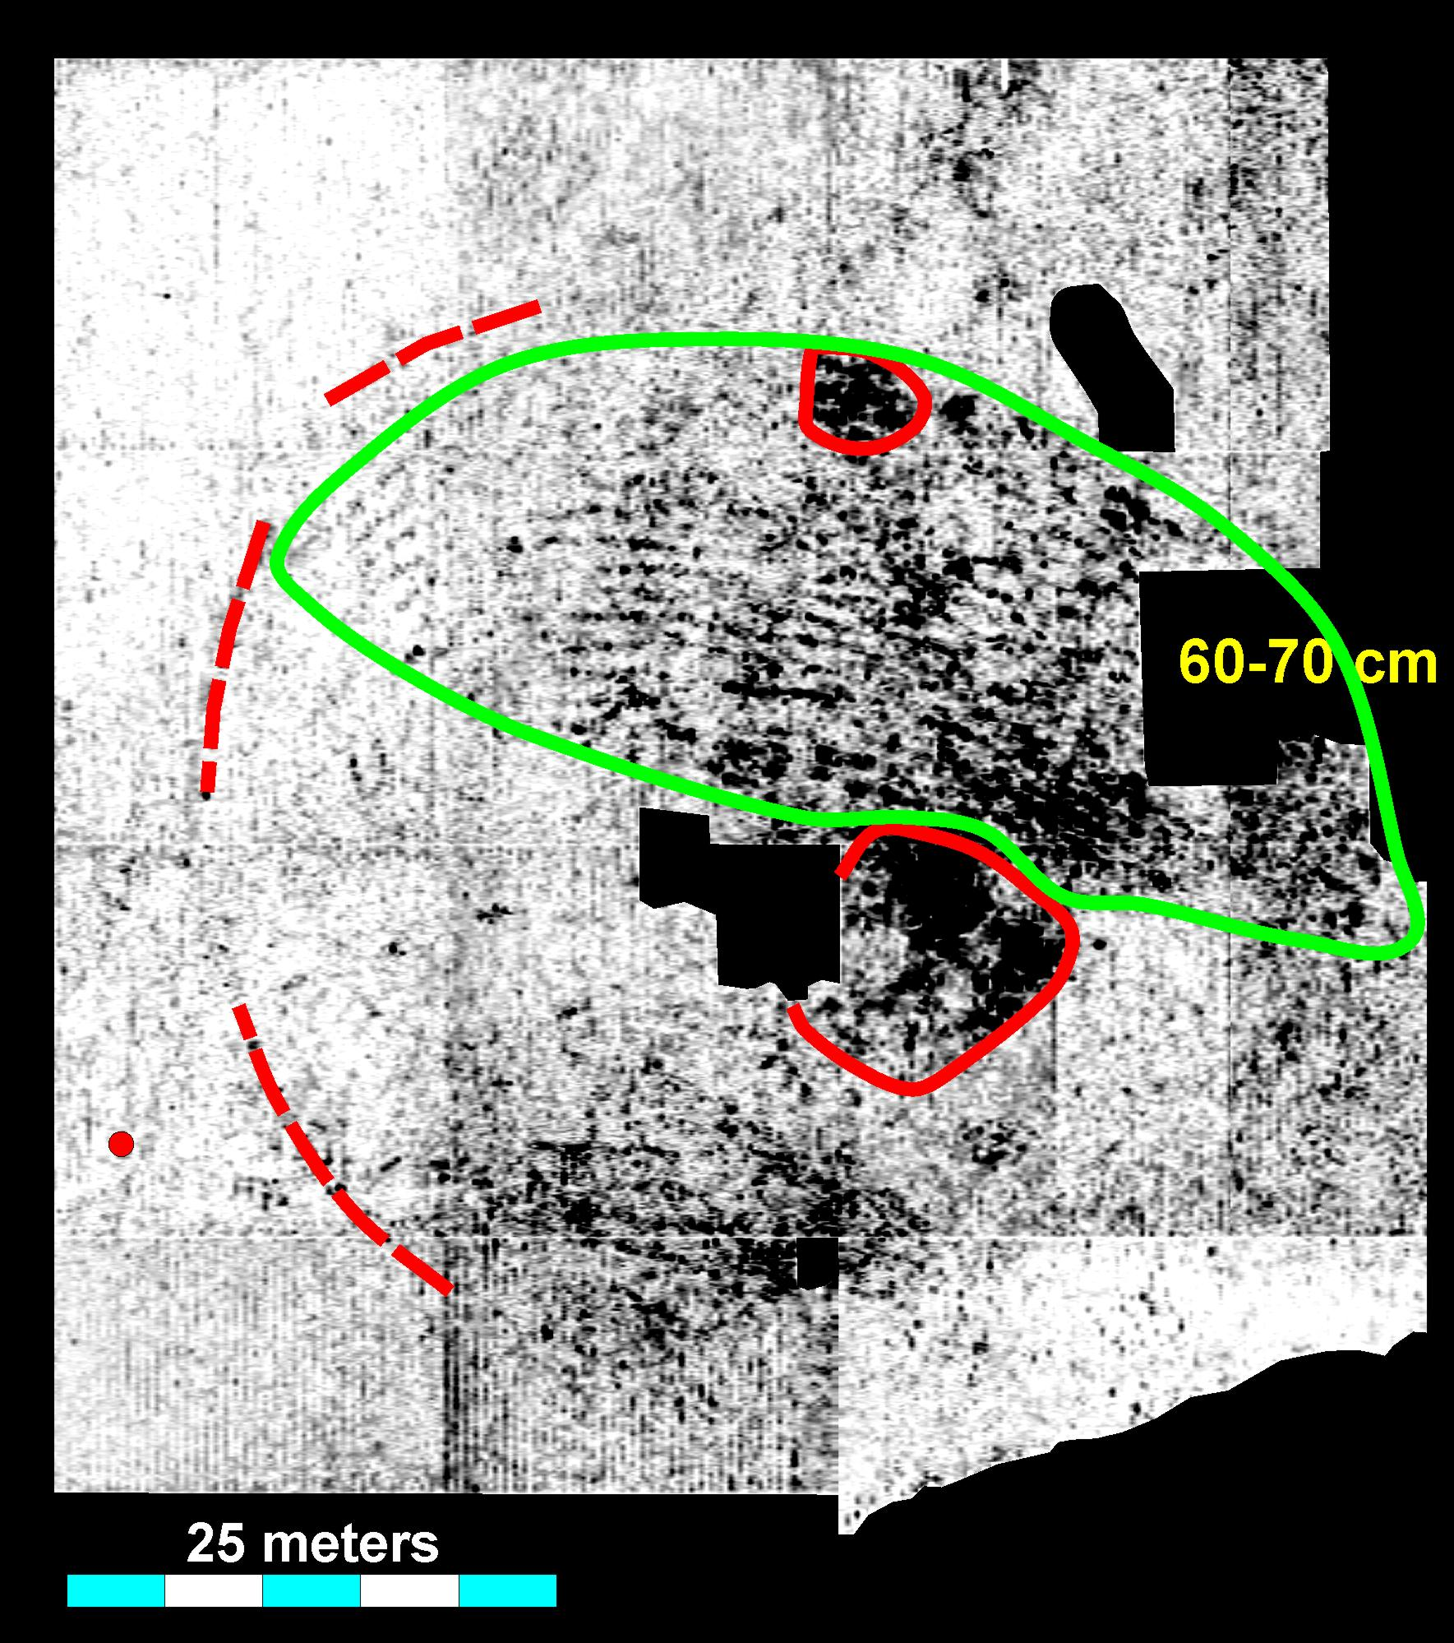
Clutter
Noise

Slide 22
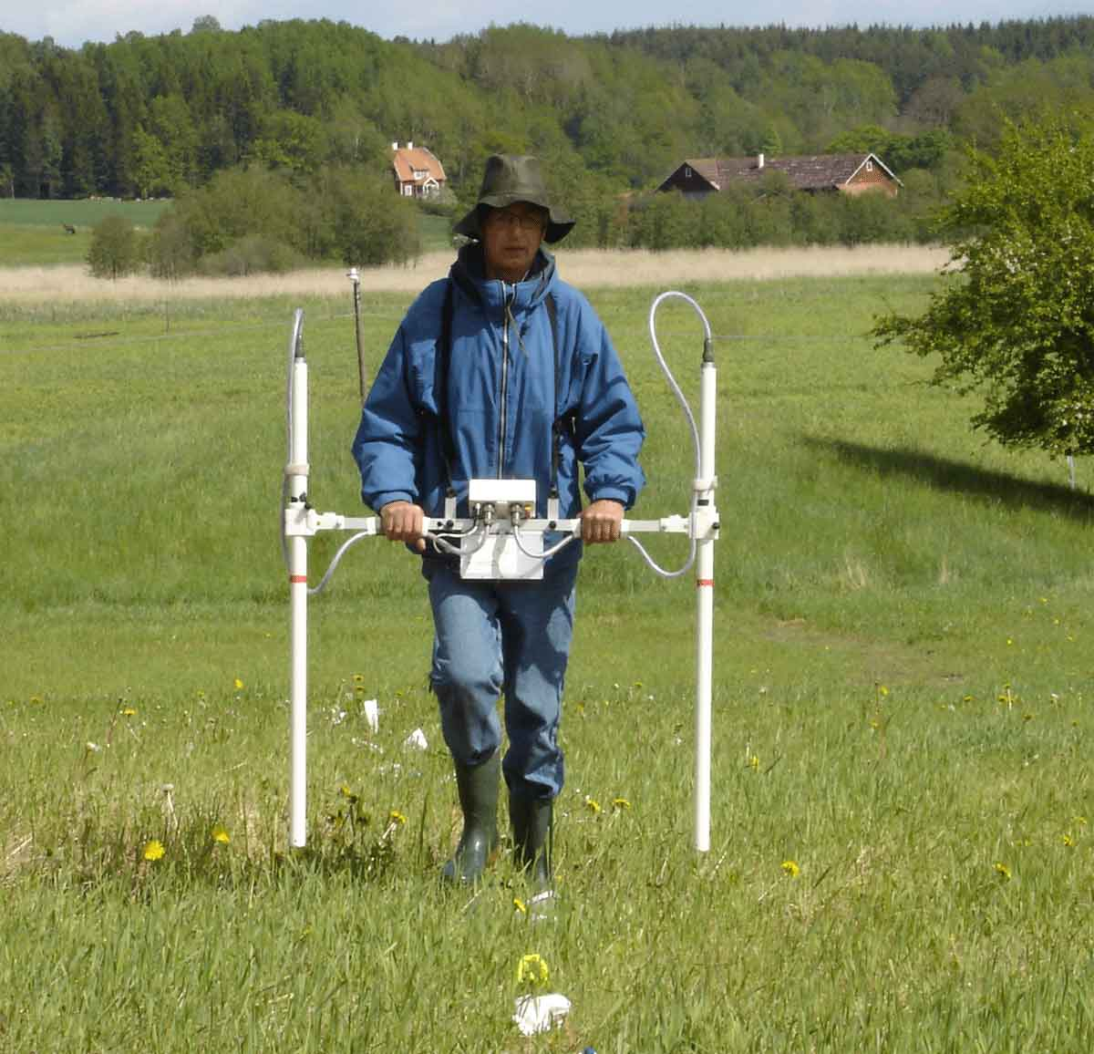
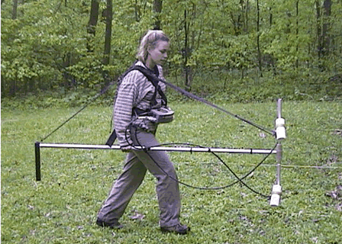
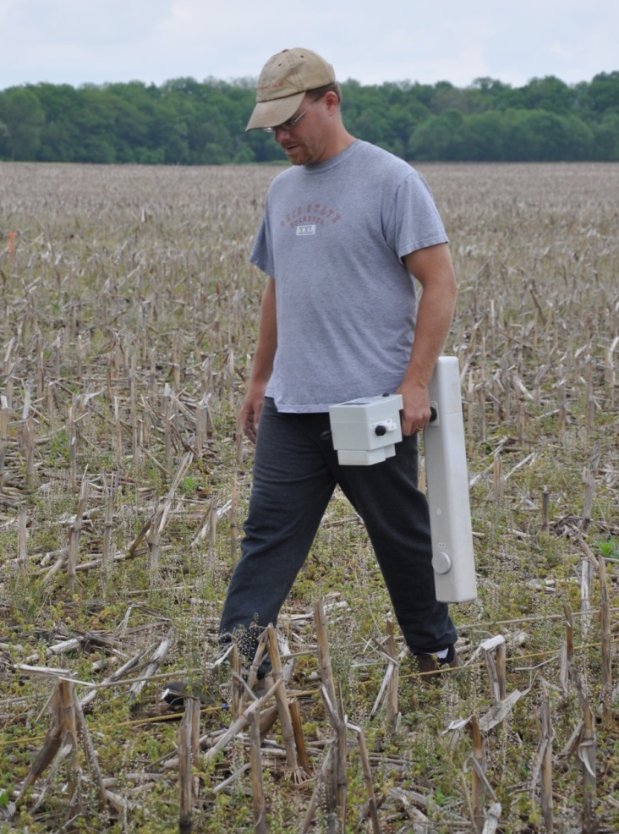

Magnetometers

Slide 23
Magnetometer Components
-Fluxgate Gradiometers: Most Common for Archaeology
Control Unit
& Battery
Sensors

Slide 26
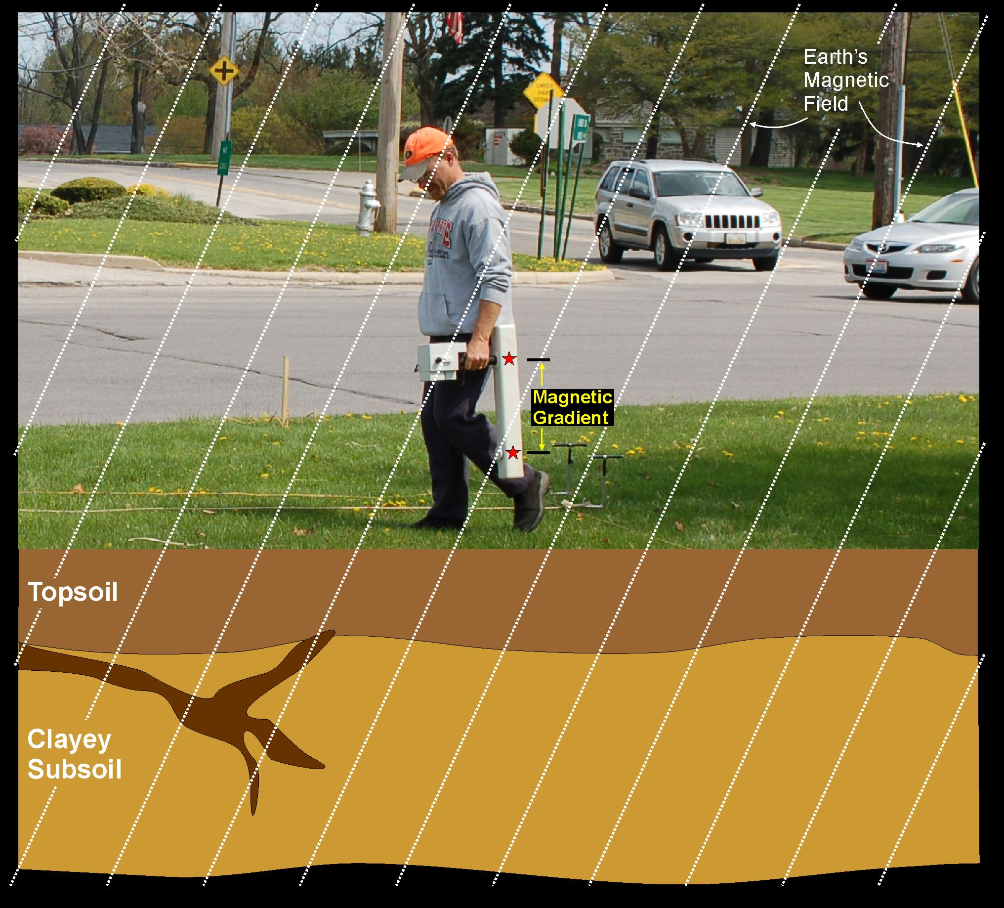
Reading=0 nT

Slide 27

Reading=100+ nT

Slide 28

Magnetic Gradient
Reading=0 nT
More magnetic
Topsoil
Less magnetic
Subsoil

Slide 29
Magnetic Gradient
Reading= -2 nT
Topsoil
burrow
Subsoil

Slide 30

Reading=+4 nT
Topsoil
Subsoil

Slide 31

Reading=+12 nT
Topsoil
Subsoil

Slide 32
Survey Conditions and Summary: Magnetometry
Works good for:
- Thermal Features: hearths, earth ovens, burned structures
- Buried Pits with topsoil or midden: trash pits, storage pits, burials
- Iron objects
- Magnetic Rocks: e.g., volcanic/igneous building stone
Works good in:
- Open Areas, or Woods
- All seasons
- Rain or shine!

Slide 33



Slide 34

Magnetic Data
Lots of Unknown
Magnetic Anomalies

Slide 35


Slide 36

Typical Cemetery
Columbus, OH

Slide 37


19th Cent. Cemetery
Parkersburg, WV

Slide 38

Modern Cemetery
early 1900s

Slide 39

Hopewell Settlements
ca. 1700 years old

Slide 40


Slide 41


Slide 42

Hopewell Mound Group
Squier and Davis c. 1846

Slide 43

Hopewell Mound Group
Shaded Relief Map
LiDAR Data (2006)

Slide 44


Slide 45

Aiken Mound Group
Magnetic Data

Slide 46


Beloit College Mound Group

Slide 47



Slide 48
Magnetics Summary
Good at detecting burned features and pits filled with topsoil/midden
Can detect unburned graves, recent and ancient, but its rare—conditions must be right
A good tool for studying mound sites

Slide 49




Ground-Penetrating Radar

Slide 50

Control Unit
Battery
Odometer
Antenna

Slide 51


Slide 52




Radargrams
How it Works
Antenna
Trace
Soil
Type 1
Wiggle Trace
Soil
Type 2
??

Slide 53

Hyperbola
antenna
A function of time and
expansion of energy
Shape determined by
velocity of survey medium

Slide 54

What does stuff look like in the ground?
Example: Reflections that are not always right below the location where they are recorded
Source: Dean Goodman

Slide 55

Vtench: multiple reflections can cause butterfly patterns
Source: Dean Goodman

Slide 56

Pithouse Floor
Source: Dean Goodman

Slide 57


400 MHz
900 MHz

Slide 58


Slide 59


Chestnut Level Church/Cemetery, Eastern Ohio

Slide 60








Chestnut Level Church/Cemetery, Eastern Ohio
Radar Amplitude Slices
20 meters

Slide 61


Duryea, Pennsylvania
Graves Cut through Reflective Material

Slide 62


Slide 63


Slide 64


Slide 65


Franklinton Cemetery
est. 1799
Church in cemetery: construction began 1811, destroyed 1813

Slide 66









Ground-Penetrating Radar
2 cm thick slices

Slide 67


Headstone Base

Slide 68


Slide 69

Aiken Mound Group
Ground-Penetrating
Radar Data

Slide 70

Beloit College
Mound Group
Radar Slice Map

Slide 71

Beloit College
Mound Group
Radar Profile Analysis

Slide 72
Ground-Penetrating Radar Summary
Good at detecting hard targets—rocks/gravel/sand in silty or clayey soil
Can detect modern graves well, and many 19th century graves
Mound sites are challenging, and ancient graves near impossible, but mound floors and distinct fill can be detected. ** rock capped graves detectable

Slide 73


Electrical Resistance Survey in Archaeology

Slide 74


Slide 75



Ground Surface
Electrical
Resistance
Meter
Control Unit, Data Logger &
Power
Cables and plugs
Electrodes

Slide 78


Slide 79

Aiken Mound Group
Electrical Resistance
Data

Slide 80



Slide 81
Electrical Resistance Summary
Good at detecting soil moisture differences
Can detect mound footprints when mag and radar cannot
Unlikely to detect individual graves

Slide 82

Is Geophysics Useful for Detecting Graves
at Wisconsin Mounds?
Yes-Maybe
To Remember
Geophysical surveys detect anomalies, not graves
(2) Many graves, especially ancient graves, may not be detectable
*** Lack of anomalies is not proof of lack of graves
(3) More than one type of instrument should be used in mound surveys
(4) Geophysics results are a place to start, not end an investigation

