Slide 1
Wisconsin Department of Corrections – Presentation on Recidivism Reduction Strategies
Legislative Council Study Committee on Reducing Recidivism and Removing Impediments to Ex-Offender Employment

Slide 2
DOC Presenters
Silvia R. Jackson, DOC Reentry Director
Holly Audley, Evidence-Based Program Manager
Lars Brown, Reentry Disabilities Coordinator
Ray Woodruff, Reentry Employment Coordinator
Megan Jones, Director of Research and Policy

Slide 3
Objectives
Scope of the Issue
History of Reentry in DOC
Becky Young Appropriation
Evidence-Based Strategies and Interventions
Mental Health Initiatives/OARS/DOES
Integrating Corrections and Workforce Strategies
Education and Vocational Training
Recidivism
Results First

Slide 4
Overview of DOC Reentry Initiatives
Silvia r. jackson
Doc reentry director

Slide 5
Scope of the Issue
National
6.85 million adults (or 1 in 36) in the United States under some form of active correctional supervision
70 million adults (or 1 in 3) in the US with a criminal record
Wisconsin
67,000+ under correctional supervision in the community
22,000+ incarcerated in Wisconsin Department of Corrections (DOC) institutions
8,500 – 9,000 DOC inmates released each year in WI
74.9% of all released inmates served less than 3 years in prison (2014)
Source: Bureau of Justice Statistics, “Correctional Populations in the United States, 2014,” (Dec. 2015)

Slide 6
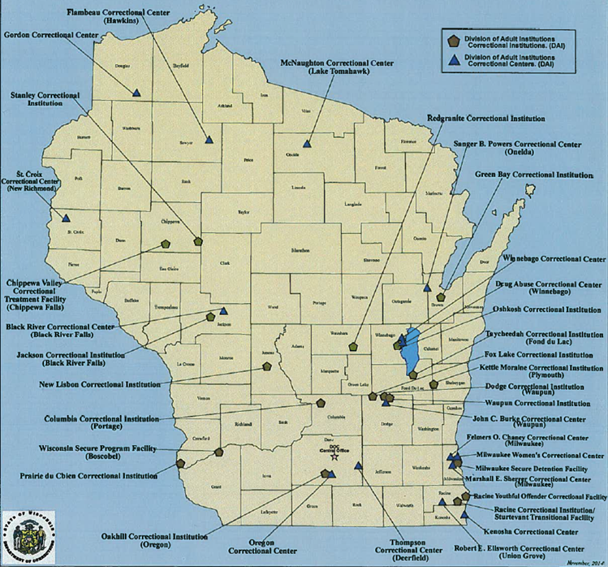
Wisconsin DOC operates 37 adult correctional institutions and facilities

Slide 7
What is Reentry?
Reentry promotes offender success from admission through discharge applying evidence-based practices (EBP) designed to reduce recidivism.
Reentry in Wisconsin emerged as a Priority in 2005 through a Strategic Planning process with the Center for Effective Public Policy.
DOC established the Reentry Director position in 2007, followed by 7 Reentry staff members.

Slide 8
Reentry in DOC
Reentry Unit
Organizationally situated in Secretary’s Office
Provide technical assistance, training and funding to support reentry practices across all 4 DOC Divisions and with local community service providers
Reentry Executive Team
Created to collaboratively guide policy decisions around Reentry
Comprised of 4 Division Administrators, Reentry Director, Research and Policy Director, Victim Services Director, Assistant Deputy Secretary, Select Reentry Unit Staff
Follows a Reentry Business Plan

Slide 9
Reentry Business Plan Priorities
Assessment
Risk/Need assessment using COMPAS
Case Management
Consistent case management: A Unified Case Plan that flows across the offender lifecycle
Evidence-Based Services
Interventions, Programs, and Services are aligned with EBP
Target Medium/High risk
Programs are targeted toward medium and high risk offenders, addressing criminogenic need
Continuous Quality Improvement
Assessment fidelity
Supervisory oversight & support
Corrections Program Checklist

Slide 10
Becky Young (Appropriation 112) Funds
In 2009, Act 28 created the Becky Young Community Corrections: Recidivism Reduction Community Services appropriation
$10.2 Million annually provide programming to promote successful offender reentry
Reentry Unit provides oversight in the use of funds throughout adult divisions
Becky Young Recidivism Reduction Fiscal Year 2015 Report

Slide 11
Becky Young Program Overview
ACA/Medicaid
AODA Relapse
Cognitive Behavioral Programs
Community Corrections Employment Program (CCEP)
Community Partnership Outreach Program (CPOP)
Community Services Project (Goodwill Industries)
County Jail Recidivism Programs
DOES Project
DOT State IDs
Employment Specialists
Logic Model Development
Northpointe/COMPAS
OARS Program
Pre-Treatment Services
Staff Training
Transitional Outreach Program (TOP)
Windows to Work
University of Cincinnati Corrections Institute (UCCI) Technical Assistance/Training

Slide 12
Becky Young FY 2015 Expenditures

Slide 13
Evidence-Based Strategies and Interventions
Holly Audley
Evidence-based program manager

Slide 14
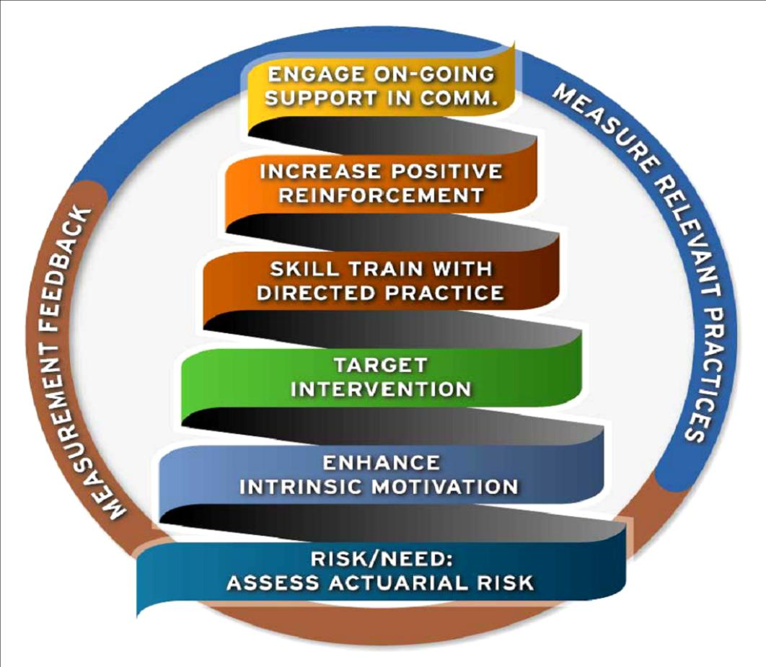
National Institute of Corrections Principles of Effective Intervention

Slide 15
Principles of Effective Intervention
RISK
WHO
Deliver more intense intervention to higher risk offenders
NEED
WHAT
Target criminogenic needs to reduce risk for recidivism
RESPONSIVITY
HOW
Use CBT approaches
Match mode/style of service to offender
FIDELITY
HOW WELL
Deliver treatment services as designed

Slide 16
WI-DOC Implementation Efforts
Family and Community Partnerships
Rewards and Sanctions
Thinking For a Change
Program Prioritization based on Risk and Need
Motivational Interviewing
COMPAS

Slide 17
WI-DOC Implementation Efforts
Data Collection
Reporting and Observation

Slide 18
The University of Cincinnati Corrections Institute (UCCI) Technical Assistance and Support to WI-DOC
The Corrections Institute at the University of Cincinnati is committed to the dissemination of best practices to communities, facilities, and agencies seeking to change offender behavior.
UCCI works with federal, state, and local governments, and with the private sector and professional organizations, to promote effective interventions and assessments for adult and juvenile offenders.

Slide 19
Evidence-Based Program Standards Design and Implementation
Evidence-Based Cross-Divisional Teams Convened in 2013:
Cognitive-Behavioral Programs
Substance Abuse Treatment Programs
Sex Offender Treatment Programs
Collaborative Standards Development— Internal and External Partners—2-Year Commitment
Gap Analyses and Implementation Plans Drafted
Communication of Standards and a Phased/Tiered Approach to Cross-Divisional Alignment

Slide 20
Evidence-Based Program Standards are necessary to achieve the following objectives:
Increase the effectiveness and consistency of service delivery throughout WI-DOC
Carefully consider fiscal and human resources
Identify subordinate goals, objectives, and outcomes to form the basis of policy and procedure
Guide curriculum development and implementation
Identify offender risk, needs, and responsivity factors
Maximize service benefit by ensuring a continuum of care
Utilize evidence-based practices to continually improve program quality and effectiveness

Slide 21
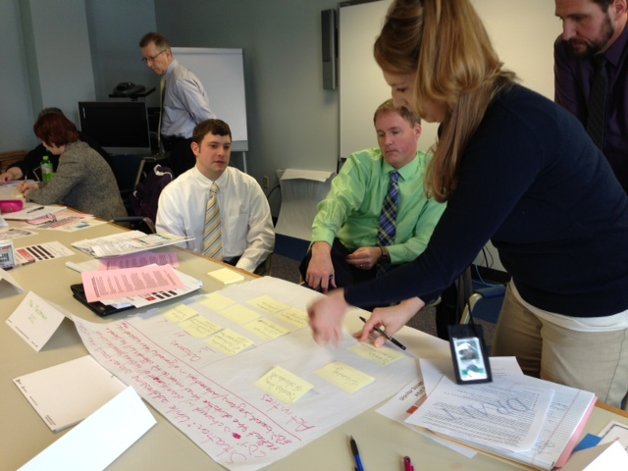
What do EBP Standards Include?
Evidence-Based Program Standards reflect best practice in the following areas:
Assessment and Placement
Continuum of Care
Curriculum Criteria
Staff Credentialing and
Professional Development
Clinical Supervision
Quality Assurance

Slide 22
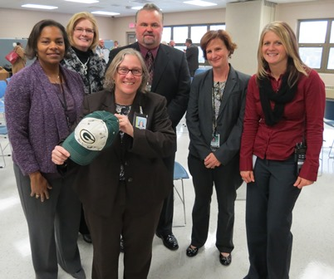
University of Cincinnati Corrections Institute (UCCI) and WI-DOC Partnership
EBP Model Program Development at the Drug Abuse Correctional Center Earned Release Program—Generalized to Five Additional Sites Statewide
Model Redesign Subcommittees:
Assessment
Curricula
Scheduling
Behavior Management Systems
Training and Quality Assurance
Technical Assistance, Coaching, and Mentoring from UCCI Staff
Evidence-Based Correctional Program Checklist Evaluations (CPCs)
Training Opportunities

Slide 23
Overview of the Evidence-Based Corrections Program Checklist (CPC)
Developed from the Correctional Program Assessment Inventory (CPAI; Gendreau and Andrews)
Based on the “what works” literature
based on evidence (i.e., meta-analytic reviews)
based on the collective experience of authors
Based on the results of over 500 evaluations and three large outcome studies conducted by UCCI

Slide 24
Purpose of the CPC
To evaluate the extent to which correctional treatment programs adhere to the principles of effective intervention
To assist agencies with improving and developing the services provided to offender populations
To evaluate funding proposals as well as external service contracts
To stimulate research on the effectiveness of correctional treatment programs

Slide 25
CPC Dimensions and Domains
CPC Dimensions
Capacity – evaluates the ability of the program to consistently deliver effective programming
Content – assesses the degree to which a program adheres to the principles of effective intervention
CPC Domains
Leadership and Development (Capacity)
Staff Characteristics (Capacity)
Quality Assurance (Capacity)
Offender Assessment (Content)
Treatment Characteristics (Content)

Slide 26
Advantages of the CPC
Applicable to a wide range of programs
Based on empirically achieved principles
Provides a measure of program integrity
Provides a measure of program quality
Results can be obtained quickly
Identifies strengths and weaknesses of program
Provides recommendations for program improvement
Can be used for “benchmarking”

Slide 27
Mental Health Initiatives
Lars brown
Reentry disabilities coordinator

Slide 28
Opening Avenues to Reentry Success (OARS)
Joint partnership between the:
Department of Corrections
Department of Health Services
Pre- and Post-prison release program providing:
Intensive Case Management
Psychiatric Treatment
Housing
Criminogenic Needs
Participants enroll six months prior to release and can remain for up to two years in the community

Slide 29
OARS Participant Criteria
Must be referred by a staff member and meet the following:
Minimum of six months of supervision upon release
Serious mental health treatment needs (DOC MH-2)
Moderate or high risk to reoffend
Releasing to an OARS Region (county of residence)
Motivation and willingness to engage in treatment
Voluntarily consent to participate in the OARS Program

Slide 30
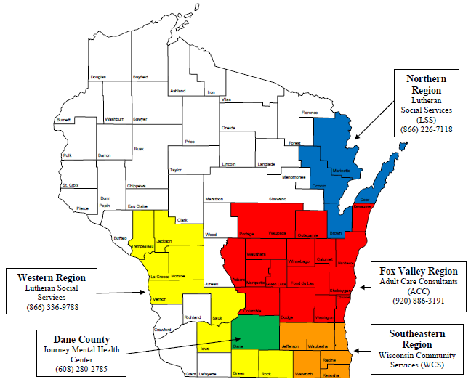
Scope of the OARS Program
FY2015 OARS
Participation
99 Average Daily Population
147 Participants Served
Northern and Western Regions expanded
37 Counties total with the addition of Dane in FY16

Slide 31
Gradual Expansion of the OARS Program
FY2011
Began OARS Pilot Program with 23 Counties
Served a total of 88 participants
FY2013
Added Northern Region-Brown and Door Counties
Served 140 participants in the post-release phase
FY2015
Expanded Northern Region-Oconto and Marinette
Added Western Region-9 Additional Counties
FY2016
Added Dane County (37 Counties total)
Projected service to 160 participants post-release

Slide 32
Recidivism: One, Two, and Three Year Follow-Up Periods

Slide 33
Disabled Offenders Economic Support (DOES) Project
Criteria
Legal Action of Wisconsin Services
Mental Health Diagnosis
Intellectual Disability
Health Services Unit access on-site
Social worker referrals
Intake Interview
Client Retainer
SSI/SSDI application and advocacy
EBD/BC+ application assistance
Additional services may be provided based on individual needs

Slide 34
FY2015 DOES Project Data

Slide 35
DOES Project Benefits
DOES Project
Social Security Administration
64.2 percent success rate (FY 2015)
58 percent of applicants receive benefits at release, 42 percent require advocacy in the community
34.8 percent success rate for disabled beneficiaries
Benefits can take a year or longer to award (no data available from SSA on wait times)

Slide 36
BadgerCare Plus Application Assistance
DHS/DOC MOU
Beginning January 20, 2015, all inmates have the opportunity to apply for BC+ prior to release
Applications are submitted via telephone on the 20th of the month prior to the month of release
Social workers screen caseloads for those that may need additional assistance
In 5 facilities, 3 contracted paralegals from the DOES Project facilitate applications full-time

Slide 37
Integrating Corrections and Workforce Strategies
Ray Woodruff
Reentry Employment Coordinator

Slide 38
What are the Predictors of Recidivism?
“The Big Four” Criminogenic Needs
Anti-social Cognition
Anti-social Companions
Anti-social Personality or Temperament
Family and/or Marital
Criminal Behavior
“The Lesser Four” Criminogenic Needs
Employment
Substance Abuse
School/Education
Leisure
Source:
Andrews, Donald A. (2007), “Principles of Effective Correctional Programs”, in Motiuk, Laurence L. and Ralph C. Serin (2007). Compendium 2000 on Effective Correctional Programming. Correctional Service Canada.

Slide 39
What is the Employment Factor?
People who are employed and earning higher wages soon after release from incarceration less likely to recidivate
Individuals who receive correctional education less likely to recidivate and more likely to obtain employment
Training and Employment Opportunities
Recidivism, Corrections Costs, and Unemployment
Income Tax and Sales Tax Revenue
Sources:
Visher, Christy, Sara Debus, and Jennifer Yahner. 2008. Employment After Prison: A Longitudinal Study of Releasees in Three States. Washington, DC: Urban Institute.
Davis, Lois M., Robert Bozick, Jennifer L. Steele, Jessica Saunders, and Jeremy N.V. Miles. 2013. Evaluating the Effectiveness of Correctional Education: A Meta-Analysis of Programs That Provide Education to Incarcerated Adults. Washington, DC: Bureau of Justice Assistance.

Slide 40
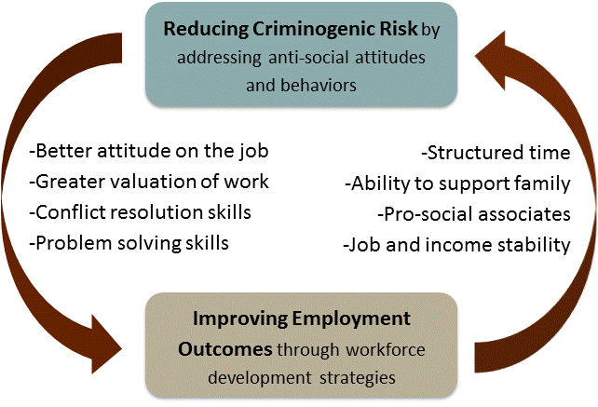
Integrating Corrections and Workforce Strategies
Source: Council of State Governments Justice Center

Slide 41
Integrated Reentry and Employment Strategies Pilot Project
Two national pilot sites selected (Milwaukee, WI; Palm Beach County, FL)

Slide 42
Resource-Allocation and Service-Matching Tool
Source: Integrated Reentry and Employment Strategies: Reducing Recidivism and Promoting Job Readiness, 2013

Slide 43
Preparation for Release
74.9% of all released inmates served less than 3 years in prison (2014)
Evaluation and Planning
COMPAS validated risk/need assessment
Treatment Programming
Cognitive Interventions, Anger Mgmt., Domestic Violence, Substance Abuse
Education
GED, HSED
Vocational Training
Career Technical Education
Inmate Jobs, Work Release

Slide 44
Career Technical Education
24 areas of study across 17 institutions
Auto Detailing
Auto Maintenance
Baking
Barbering/Cosmetology
Braille Transcription
Building Maintenance and Construction
Cabinet Making/Cabinetry
Commercial Bakery
Computer Assisted Drafting
Computer Help Desk
C-Tech (Cable Laying)
Custodial Service
Dental Lab Tech
Electrician
Food Service/Culinary Arts
Horticulture
Institution Food Production
Machine Tool Operations
Masonry
Motorcycle, Marine, Outdoor Products
Office Assistant/Aide
Office Software Applications
Printing
Welding

Slide 45
Post-Release
Community Corrections Employment Program (CCEP)
Job Development/Placement, OJT, Training, Work Experience
Windows to Work
Technical College Partnerships
Gateway Technical College
Milwaukee Area Technical College
Madison Area Technical College

Slide 46
Windows to Work
Collaboration with Wisconsin’s 11 Workforce Development Boards (WDB)
Each WDB contracted to provide, or subcontract to provide, program at selected state correctional institutions or county jail facilities in each workforce development area
4 county jail programs and 16 DOC programs (in 12 facilities)
Pre- and post-release program designed to address criminogenic needs that can lead to recidivism
Enrollment occurs 3-9 months prior to release with classroom training in core curriculum content areas, continues approximately 12 months following release

Slide 47
Windows to Work, FY2015
Employment

Slide 48
Recidivism – Windows to Work
DOC defines recidivism as: following an episode of incarceration with the DOC, to commit a criminal offense that results in a new conviction and sentence to DOC custody or supervision.
DOC defines reincarceration as: following an episode of incarceration with DOC, an admission to prison within a specified follow-up period for either a revocation, a revocation with a new sentence, or a new sentence.
Only moderate- to high-risk individuals are eligible for Windows to Work. DOC is working to develop a comparison group in order to measure the full impact of the program.
Release Year | Eligible Participants | One-Year Recidivism Rate | One-Year Reincarceration Rate | Two-Year Recidivism Rate | Two-Year Reincarceration Rate
2011 | 64 | 10.9% | 6.3% | 23.4% | 25.0%
2012 | 121 | 16.5% | 13.2% | ---- | ----
This data does not include participants in jail programs or who may have enrolled in the program while in the community.

Slide 49
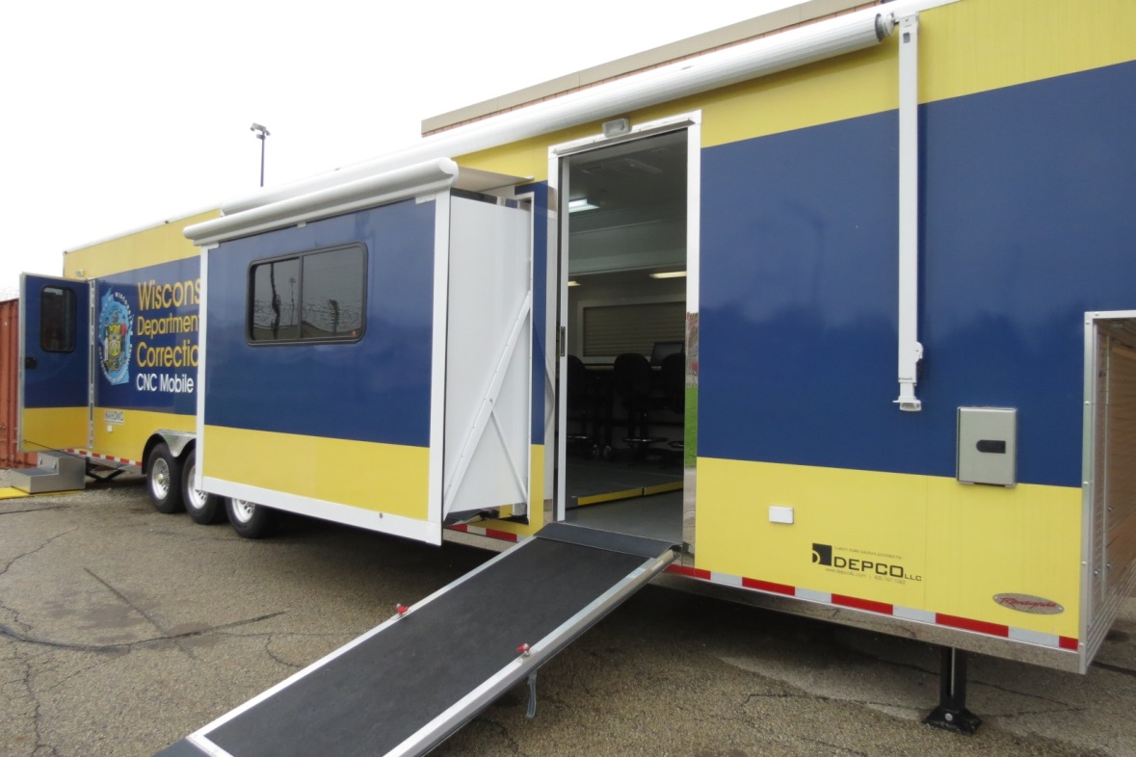
DOC Computer Numerical Control (CNC) Mobile Lab
Collaboration between DOC, Gateway Technical College and DWD to offer an accelerated 13-credit CNC technical education certificate program for DOC inmates at Racine Correctional Institution

Slide 50
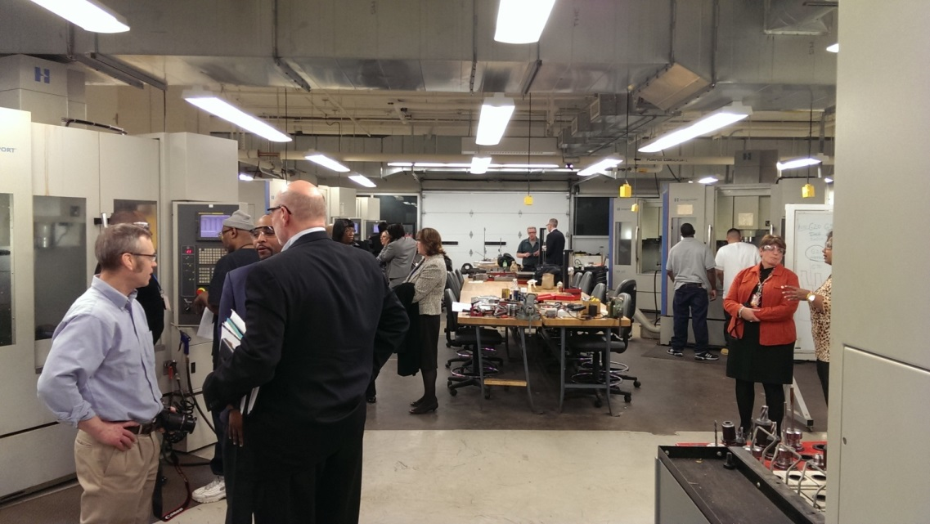
Milwaukee Area Technical College (MATC) CNC Project
Collaboration between DOC, MATC, and DWD to offer an accelerated 14-credit CNC technical education certificate program for DOC inmates (and offenders) at MATC

Slide 51
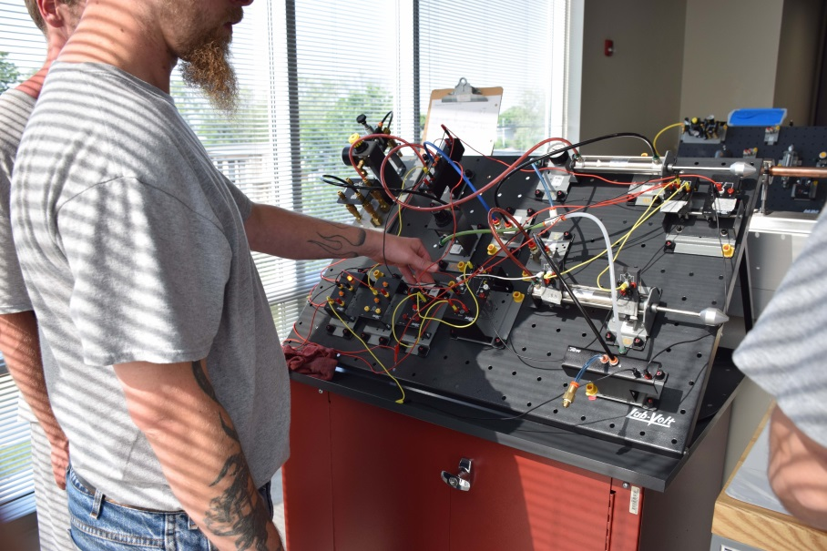
Industrial Maintenance
Industrial Maintenance Essentials: Fluid Power & Metal Processes Specialized Training Academy
Collaboration between DOC, Madison College, Workforce Development Board of South Central Wisconsin
11 college credits in 12 weeks (finished 6/2016)

Slide 52
Recidivism and Results First
Megan jones
Director of research and policy

Slide 53
Primary Domains for Measuring and Reporting Recidivism Rates
Timeframe when the subject has an opportunity to engage in a recidivism event. Can be variable (6 months, 1 yr, 2 yr, 5yr, etc…).
Follow-up Period
Starting
Point
Date
? Question ?
What is the recidivism rate for….
Recidivism Event
No Conviction Re-Arrest
No Conviction Re-Arrest & Charged
No Conviction Jail Confinement
No Conviction Prison Confinement
Conviction Fine and/or Jail
Conviction Probation
Conviction Jail/Probation
Conviction Prison
Placement on Probation
Discharge from Supervision
Release from Prison
Gender/Age/Offense..
Program Completion..
Geographic Area, etc…
BY
Notes:
53

Slide 54
Recidivism To commit a criminal offense resulting in a new conviction and sentence to the Wisconsin DOC.
WI DOC recidivism rates represent the number of persons who have recidivated divided by the total number of persons in a defined population.
The offense date is the date of the recidivism event.
All recidivism rates are based on only Wisconsin offenses that have resulted in court dispositions that include custody or supervision under the WI DOC.
Notes:
54

Slide 55
Calculating the Recidivism Rate
Follow-up Period
(1 year, 2 years, and 3 years)
Starting
Point
End
Point
Release from Prison
Offense
Date
EXAMPLE
€

€
€


€
€
€

€
€
€
€
€
€
Follow-up Period
€
€
€
€
1 year
“The Cohort”
During the follow-up period, 2 offenders commit a new offense
10 offenders released from prison in 2005
Recidivism Rate
2 ÷ 10 = 20%

Slide 56
Recidivism Rates

Slide 57
Recidivism Rate x Gender
3-year
2-year
1-year
Year Released from Prison

Slide 58
Recidivism Rate x Age at Release
3-year
2-year
1-year
Age:
20-24
25-29
30-34
35-39
40-44
45-49
Avg N:*
1,645
1,621
1,285
1,179
1,001
651
2000-2009 Releases

Slide 59
Months to Recidivism (3-year follow-up)
25%
within
4½
months
50% within 11½ months
75% within 21 months

Slide 60
Recidivism Rate x Release Type

Slide 61
Wisconsin Results First Initiative

Slide 62
What is Results First?
Pew-McArthur initiative to enhance evidence-based policymaking
Provides tools and technical assistance to conduct comprehensive cost-benefit analysis of social programming
Return on investment estimates can be used to identify and invest in policies/ programs that are most cost effective

Slide 63
Progress to Date
Creation of Wisconsin Adult Criminal Justice Program Inventory
Categorizes Wisconsin adult criminal justice programs intended to reduce recidivism and supported by research
Cost of recidivism analysis
Cost-benefit analysis of DOC’s Earned Release Program
Return on investment from recidivism reduction and saved prison bed days

Slide 64
Next Steps: Cost-Benefit Analysis
DOC Primary Programs
Cognitive Behavioral Therapy
Alcohol and Other Drug Abuse (AODA) Treatment
Anger Management
Sex Offender Treatment
Domestic Violence
Specialty Court Programming
Drug Court
Mental Health Court
DUI/OWI Court
Treatment, Alternatives and Diversion (TAD) Programs

Slide 65
Next Steps: Statewide Use of the Model
Department of Health Services
Department of Children and Families
Department of Public Instruction
Department of Justice
Counties (juvenile justice)

Slide 66
Questions?
Silvia R. Jackson
Reentry Director
Wisconsin Department of Corrections
608-240-5015
Silvia.Jackson@wisconsin.gov
http://doc.wi.gov

