Slide 1
Milwaukee Area Technical College’s Commitment to
Educating and Training of
Incarcerated individuals and Ex-Offenders
President Dr. Vicki J. Martin
October 19, 2016
2016 Legislative Council Study Committee on
Reducing Recidivism and
Removing Impediments to Ex-Offender Employment

Slide 2
MATC Promise
Free tuition and fees for direct-from-high school students
Address middle-skills gap
3,100 applicants
1,200 applicants enrolled this fall
1,100 applicants for 2017

Slide 3
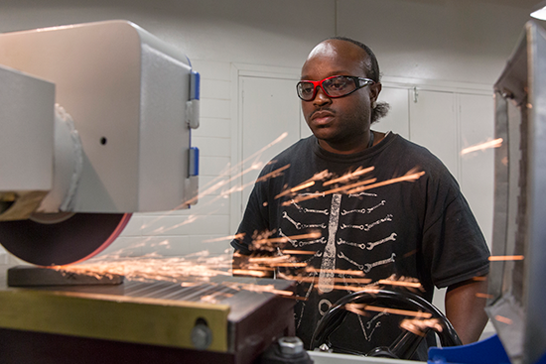
Blueprint for Prosperity
Funded by Wisconsin Fast Forward grant
56 students completed 14-week CNC training in 5 cohorts
Local hiring employers include Snap-on, Harley-Davidson, Goodwill Industries, Patrick Cudahy

Slide 4
Right Path Program
Children of parents incarcerated or on parole/probation
Break cycle of incarceration
Aged 18-25
Have not completed high school GED, HSED
35 students enrolled in 2 years

Slide 5
Second Chance Pell Pilot Program Goals
Provide postsecondary, occupational, developmental, GED and college readiness courses
Identify “offender friendly” employers
1,000+ students have earned MATC credits through Incarcerated Individuals Program

Slide 6
Wisconsin Technical College System and
Wisconsin Department of Corrections
WTCS members to provide technical training and occupational education services fo individuals supervised by the Department of Community Corrections (DCC) and participating in Community Corrections Employment Program (CCEP)
Accelerated training programs; employer-driven curriculum/instruction; mutually-agreed upon course offerings

Slide 7
Proposed Outreach to Ex-Offenders
Replicate our Veteran student support services
Create “one stop” access to transitional services and resources
Comprehensive wraparound services
Academic support and tutoring
Career planning
Job placement assistance
Soft skills training
Mentoring
Housing
Transportation
Mental health resources
Driver’s license recovery

Slide 8
How You Can Support
Mandatory pre-release education and training for high-demand, middle-skill jobs
Mandatory participation in career exploration and planning before release
Transition coordinators for pre- and post-release counsel
Engagement of state’s business owners in expanding employment opportunities for ex-offenders
Require connecting with educational institution a condition of release
Explore sentencing leniency for first-time offenders who enroll at a Wisconsin technical college
Legislative support for budget items

Slide 9
Questions?

