Slide 1
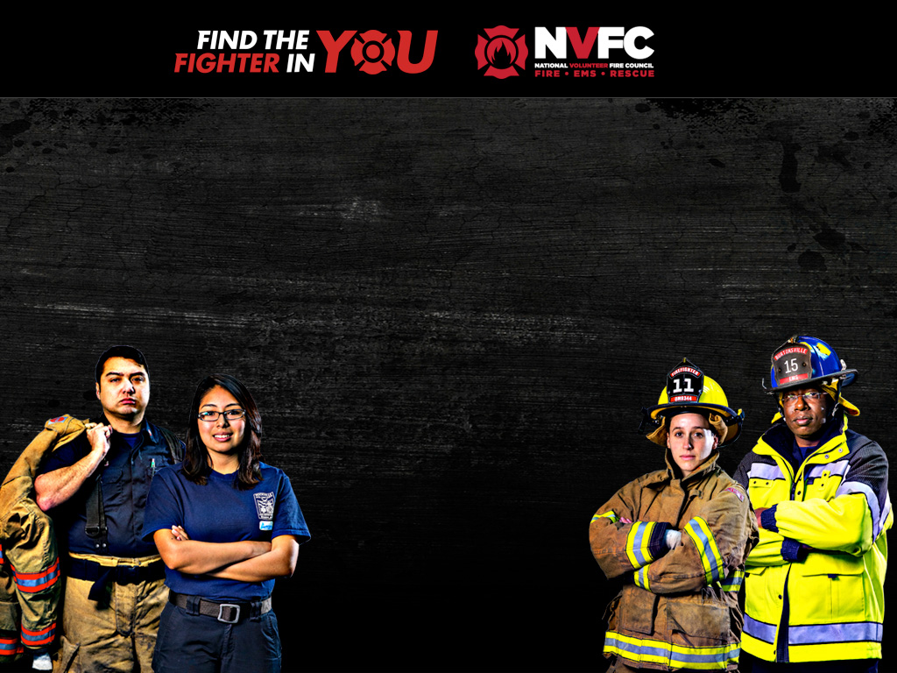
VOLUNTEER
Emergency Services Recruitment and Retention
Presented by:
Dave Finger
National Volunteer Fire Council
Notes:
My name is David Finger and I am the Chief of Legislative and Regulatory Affairs for the National Volunteer Fire Council (NVFC). I want to thank this committee for inviting me here today to speak to you about volunteer firefighter and EMT recruitment and retention.

Slide 2


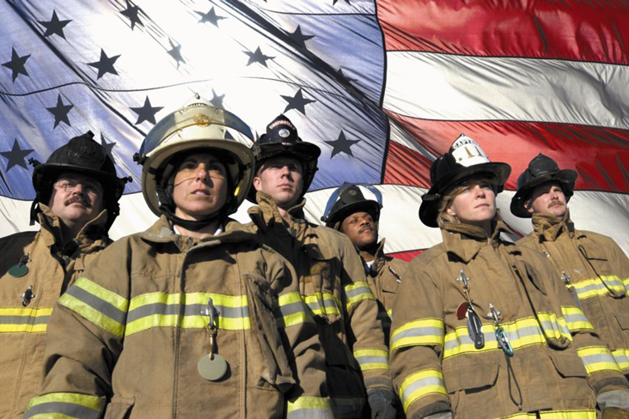
About Us
The National Volunteer Fire Council (NVFC) is a non-profit membership association representing the interests of the volunteer fire, EMS and rescue services.
www.nvfc.org
Discussion Topics:
Volunteer Staffing Data and Trends
How to Recruit Based on Market Research
Recruitment and Retention Challenges
Notes:
The NVFC represents the nation’s volunteer fire, EMS and rescue services. Our primary form of membership is state associations, with the Wisconsin State Firefighters Association being our member here in this state.
I’m going to break my presentation into three parts. First I’m going to go through some charts and data to build a picture of volunteer staffing nationally and how it compares with staffing here in Wisconsin. Second I’ll talk about the results of some market research that the NVFC did in 2014 to help us develop our national volunteer firefighter recruitment campaign. Finally, I’ll talk a little bit about the challenges that we at the NVFC see to volunteer recruitment and retention and what we think government can do to be helpful.
I’ve brought handouts that include these PowerPoint slides, but also have some charts and graphs that were too big to embed in the slides. I’d encourage you all to follow along on paper and to go ahead and ask questions if you have them as I move through the presentation, rather than waiting until the end.

Slide 3
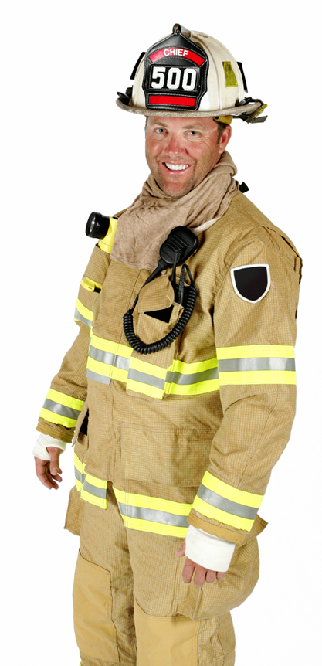
The Value of Volunteers
85% of fire departments nationally are all or mostly volunteer
All or mostly volunteer departments protect 36% of the population nationally
In Wisconsin 93.4 percent of departments are all or mostly volunteer
Compared to national trends:
  Small FDs are more likely to be all-volunteer
  Medium-sized FDs are more likely to be mostly-volunteer
  Large FDs are more likely to be all-career
U.S. Fire Department Profile 2014 National Fire Protection Association, Quincy, MA, January, 2016.
Notes:
There are roughly 800,000 volunteer firefighters in the United States. There are close to 20,000 all-volunteer fire departments and 5,580 mostly-volunteer fire departments in our country. So about 26,000 of our nation’s fire departments are all and mostly volunteer, out of approximately 30,000 fire departments total.
All- and mostly-volunteer departments make up 85 percent of our nation’s fire departments and protect roughly 36 percent of the population. Essentially volunteers are clustered mainly in smaller jurisdictions. In Wisconsin the percentages track fairly closely with the national data, as you can see from the handout. There are three notable differences in how fire departments in Wisconsin are staffed compared to how fire departments nationally are staffed: fire departments in communities with populations of 10,000 or fewer residents are more likely to be volunteer in WI, departments in communities with populations of 10,000-25,000 are more likely to be mostly-volunteer and departments in communities with population of 25,000 or more are more likely to be all-career.

Slide 4
The Value of Volunteers
Nationally, services donated by volunteer firefighters save localities around $139.8 billion each year
Direct expenditures on local fire protection in 2013 were $44.2 billion
Volunteers serve in communities where the cost of providing fire protection is highest due to economies of scale
The Total Cost of Fire in the United States. National Fire Protection Association, Quincy, MA, March 2014.
U.S. Bureau of the Census, Governments Division
Notes:
According to the National Fire Protection Association, or NFPA, the cost of replacing all volunteer firefighters with career personnel would be nearly $140 billion. By contrast, in 2013, according to the U.S. Census, there was $44.2 billion spent on local fire protection services throughout the country. So volunteers account for 76 percent of the value of fire protection services rendered but only protect about 36 percent of the population. How does that work? Well, essentially, volunteers serve in communities that cannot take advantage of economies of scale, and consequently the per-resident cost of providing emergency services is astronomical.

Slide 5
The Value of Volunteers
NFPA Survey of Fire Departments for U.S. Fire Experience, 2014
Notes:
I think this slide puts it into context. What the graph shows is the number of residents per pumper truck by community size and the handout has another graph for non-pumper trucks that is even more lopsided. I’m not here to talk about the cost of fire trucks but you could substitute “pumper” with any fire department resource and the graph would look pretty similar. This is really just a way of showing how much farther fire department resources can be stretched in larger, more densely populated communities. You can see here that in communities with one million or more residents there are more than 30,000 people for each pumper. In communities with 2,500 or fewer residents there are about 800 people per pumper. As communities get larger, and especially as populations are more densely clustered, the number of people who can be protected by a single pumper truck goes up. The more people you have living closely together, the easier and cheaper it is to provide those people with emergency services because you have more pockets to dip into to pay for everything, and more people can be protected with the same amount of equipment.
This is the challenge that smaller communities have. With a small tax base to draw from they have difficulty paying for new equipment and apparatus, they typically don’t have money to pay for training that isn’t either delivered in-house or available for free, and they can’t afford to pay career staff. To cope with this smaller communities tend to make due with older or used equipment and they use volunteers. The silver lining is that because small communities typically have a much lower call volume than large communities this model generally works fine as long as you have enough volunteers. So in a nutshell that is why volunteer recruitment and retention is so important, especially in smaller communities. If you lose your volunteers you lose your ability to provide emergency services protection without significantly increasing taxes in communities that don’t have a large tax base to begin with.

Slide 6
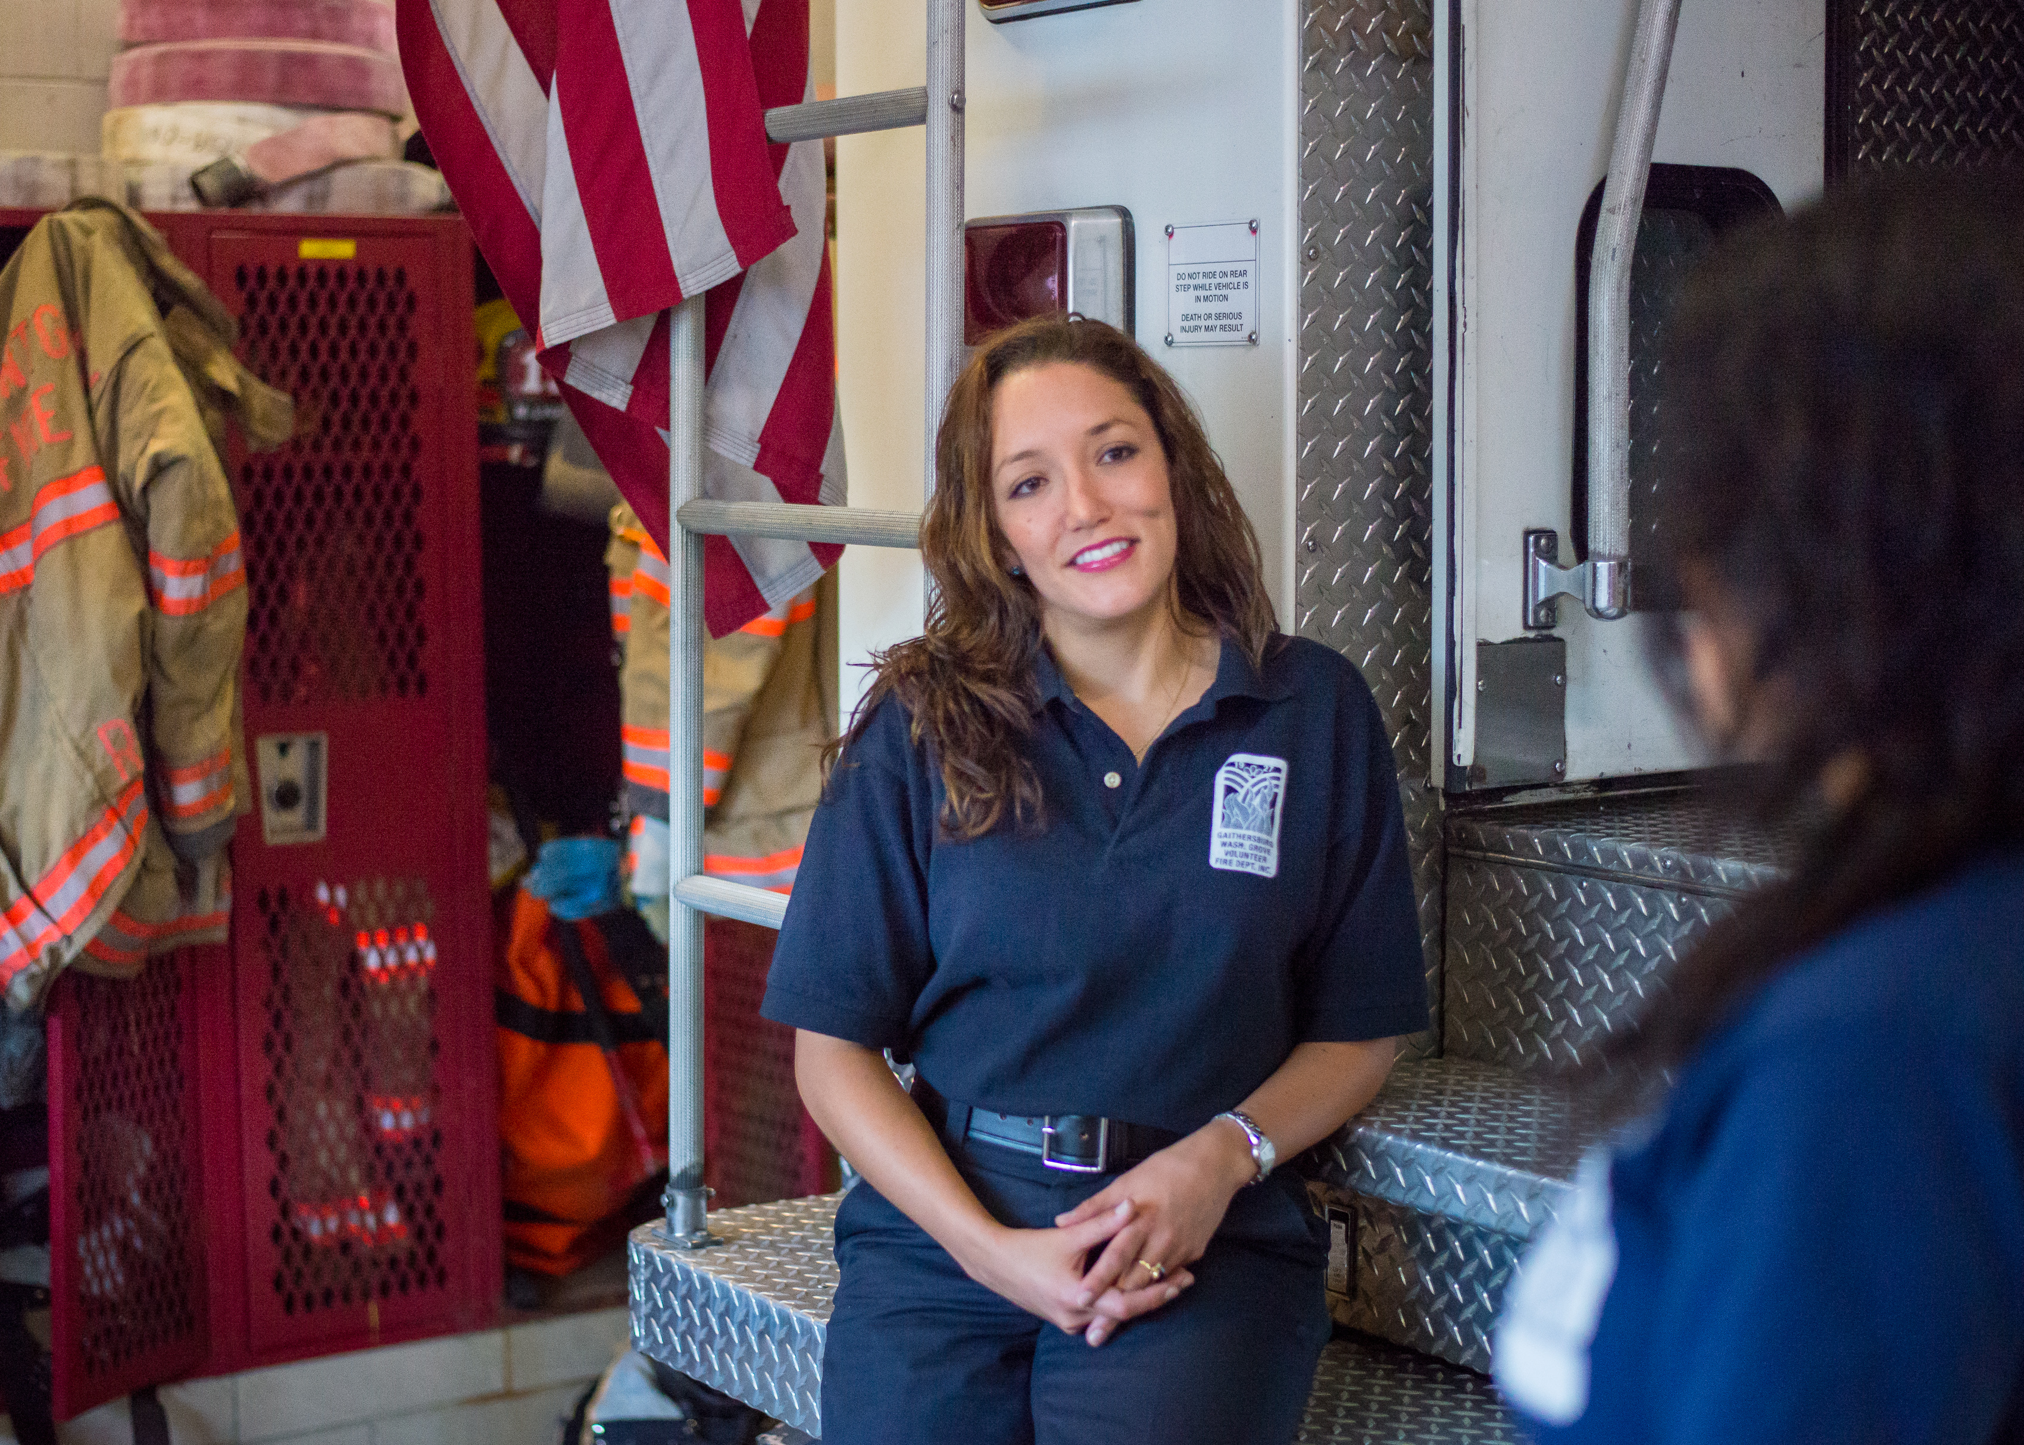
Volunteer Staffingr
Since 1983 the number of volunteer firefighters in the United State has declined by nearly 100,000, or roughly 11 percent.
Approximately 40 percent of that decline happened since 2008. The number of volunteers decreased precipitously from 2008 to 2011 but has increased every year since.
Generally speaking it is not the case that volunteer firefighter losses are being offset by an increase in the number of career firefighters.
While the number of volunteers has gone down some, the average age of volunteer firefighters has gone up significantly.
Notes:
As we look at volunteer firefighter numbers nationally, you can see from the handout that the number of volunteers has gone down by about 100,000 since 1983. A lot of that decrease happened between 2008 and 2011, but we’ve actually bounced back a bit since. I would note that since the mid-1980s the number of volunteer firefighters has been going back and forth around the 800,000 level. There is a slight downward trend in the overall numbers, but as I’ll discuss in a second, the overall numbers only tell part of the story.
One thing that I do want to address is that, although there has been a significant increase in career staffing over the past 30 years, it is not by and large the case that volunteer losses are offset by increases in career staffing. The increase in career staffing are mainly a response to increases in call volume. As fire departments respond to more medical, hazardous materials, rescue and other types of incidents, call volumes go up and departments hire career staff. There are departments that have transitioned away from volunteers, mainly in more populous areas, but in smaller communities where the overwhelming majority of volunteers serve, when career firefighters have been hired it has typically been to supplement the volunteers, not to displace them.
The real problem with volunteer shortages is not necessarily that there are fewer firefighters but that the firefighters are much older, on average, than they used to be. This is especially true in communities with populations of 2,500 or fewer residents, which generally speaking do not have the resources to pay career staff or the call volume to necessitate career staffing. You can see from the chart that between 1987 and 2014 the number of firefighters under the age of 40 serving these small communities is down by more than 100,000, while the number of firefighters over the age of 50 is up by almost 50,000. Obviously this is not sustainable. Especially if you look at the trend since 2000 among firefighters in the 30-39 and 40-49 age cohort. There simply are not enough people coming through the ranks to replace all of the people nearing retirement age.
Another point to note is that as the core of these departments age a lot of them are only able to perform limited duties on the fire ground. NFPA did a national fire department needs assessment survey last year and while the report has yet to be published I can tell you they found that there are more than 100,000 firefighters being used in a limited duty capacity. These folks are doing everything from rehab to driving apparatus to the scene to assisting with communications and incident command on the fire ground. But if we have 800,000 volunteer firefighters in the United States, but 15 percent of them aren’t able to perform interior attack on a fire or perform various other duties in the hot zone on the fire ground, our staffing capacity is substantially less than the topline number suggests.
So, staffing capacity is reduced and based on the demographic trends it looks like the situation is about to get worse. Why are so many departments struggling?

Slide 7
Challenges
Fewer recruits coming in
Young people leaving town for work opportunities
More 2-income families makes volunteering harder to do
Demanding training requirements take more time and money
Leadership challenges & necessary culture change
More volunteers retiring
Though the mission is hard, it is not impossible.
Notes:
There are three basic issues that are intertwined and collectively put pressure on volunteer fire departments: a lack of people, a lack of time and a lack of money. Young people are increasingly leaving rural areas for work. Sometimes this means they move, which means that they aren’t around to volunteer. Even if they still live in a rural community, if they are commuting to work they aren’t around for daytime, weekday responses and they have less availability in the evenings for training. We also have a lot more households in which all adults present are working, which makes arranging for childcare more difficult.
So there are fewer people with less time available in the communities that rely on volunteers the most. Colliding with this is the fact that training and certification requirements have gone up substantially in recent decades. There have been significant advances in equipment and tactics for fighting fires, but to take advantage of that requires a significant investment in more training. Fire departments respond to a much wider range of incidents today than they did in the past, all of which requires additional training.
Another consequence of people and jobs leaving rural areas is that the tax base is shrinking, even as the cost of running a fire department has increased. Fire trucks and protective gear cost more because of upgrades. Departments need to have specialized equipment to respond to different types of incidents. Small departments have a variety of coping methods, including using older equipment longer, obtaining used equipment – especially vehicles – and doing more private fundraising. Again, a lack of time, lack of people and lack of money, and it is all interrelated.
Now, these are significant challenges. They do not have to be overwhelming, but in order to keep up you need to have community support and great leadership. The good news is that there are thousands of fire departments across the country that have the right kind of leadership and support in place to succeed. Many departments are doing innovative things to recruit and retain staff, providing outstanding service at a fraction of the cost of a career agency. The issue is, there are some 26,000 all and mostly volunteer fire departments in the United States. Many serve communities that, as I discussed earlier, are losing young people and tax base to urban and suburban areas. How many of these communities are going to have political leadership willing to provide adequate financial support to the fire department? How many communities will have a fantastic leader with enough free time to run the department on a volunteer basis? What you have in many of these departments are dedicated, talented folks who are doing the best that they can with not enough time, people or money. Their heart is in the right place and generally speaking they do a pretty darn good job with the limited resources available to them, but the challenges are growing and a lot of these departments simply need help.
With that in mind, the NVFC in 2014 received a grant from the Federal Emergency Management Agency to develop the first national firefighter recruitment campaign. What we wanted to do was develop resources that would be simple for local fire departments to use to boost their own recruitment efforts. The campaign launched last December, but before we even started developing it we did market research to learn more about how departments recruit staff now and what prospective recruits are looking for so that we could calibrate our materials accordingly.
•Fewer recruits coming in, more retiring
•More 2-income families making lending one out for volunteer service harder
•Many young people leaving town for work opportunities
•More demanding training requirements that require even more time and money
•Asking volunteers for more of their time, when they have less time to give.
•Leadership challenges, especially as increasing diversity in fire departments – lots of cultural changes
BOTTOM LINE: Business as usual of inviting family and close friends to join isn’t getting you the numbers you need
It’s hard – times are changing. But, it’s not impossible.

Slide 8
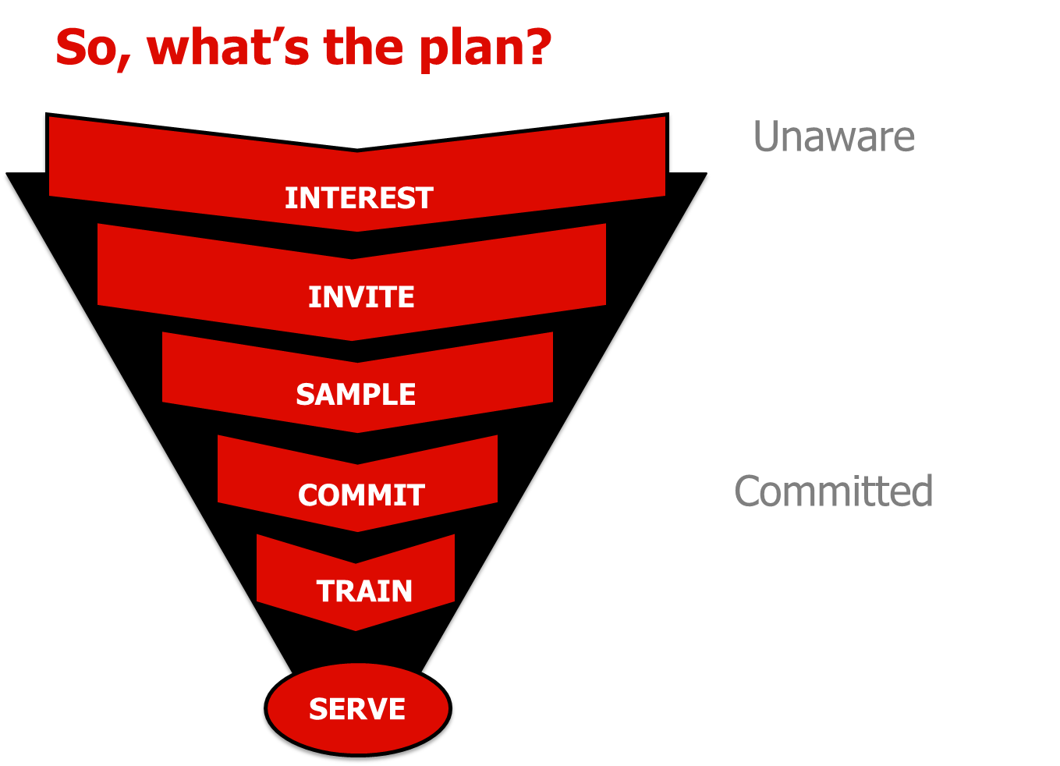

Notes:
One thing that we learned is that recruitment is a process. Our research revealed that there are 5 phases of recruitment.
We also learned that there are a large number of people who are potentially interested in volunteering but they either don’t know that volunteers are needed or don’t see themselves as a fit for the volunteer fire department. The challenge for agencies is identifying those people, inviting them to learn more about the department, showing them how they can fit in the department, and after people commit helping them get trained and acclimated so that they can eventually serve.
This is not easy. First of all, this is a significant culture shift for many volunteer fire departments. Years ago, when much of the leadership of today’s volunteer fire service was just breaking into the ranks, volunteer fire departments mostly put out fires and served as a sort of community hub. Recruitment and retention wasn’t really an issue because training requirements were lower, call volume was less and there was a certain status and satisfaction that went along with serving your community as a volunteer firefighter. To the extent that departments engaged in recruitment at all it was typically done through informal social networks – essentially, the family and friends of existing department members. Departments still serve as community hubs and there are still positive associations with being a volunteer firefighter, but as training and response requirements have increased, that is no longer enough on its own to incentivize folks to join. Relying on informal social networks to attract people leaves departments with a much smaller pool of potential recruits to draw from than they need to be successful. So we really wanted to emphasize the importance of going out and trying to reach the entire community.

Slide 9
There is Interest!
Notes:
When we surveyed potential recruits (aka the general public) we found that about 30 percent of men and 27 percent of women were either definitely or possibly interested in becoming a volunteer firefighter. Since women only represent about ten percent of volunteer firefighters in the United States, the fact that they are only slightly less interested in serving than men suggests that there is significant potential for growth by targeting recruitment messages at women. Interest levels were highest among young adults, and were also slightly higher among racial minorities than among white respondents. One challenge that fire departments face in attracting all of these demographic groups – women, young people and racial minorities – is that you need to go outside of existing social networks to reach them.
We also discovered that about 1 in 5 people would be interested in volunteering for the fire department in a non-operational capacity, for instance by fundraising or doing fire safety education. Departments can use nonoperational volunteers to free up firefighters to focus on operational tasks.

Slide 10
What do these audiences want?
Sense of Accomplishment & Belonging
A Way to Be Of Service
A Personal Invitation
|
Notes:
Another thing that we learned is that most people join the volunteer fire service for the same reasons. They want to have a sense of accomplishment and belonging, they want to find a way to help other people, and they want a personal invitation. This last piece is extremely important. The feedback we got from people was loud and clear that sometimes all that is standing in between an interested individual and their joining up is a personal invitation – a feeling of being personally called to serve.

Slide 11
Phase 1: Interest

Slide 12


What’s Missing?
Easy ways for departments to:
Build awareness about needs & opportunities
Find the people interested in volunteering
Easy ways for interested individuals to:
Search & find opportunities to volunteer locally
Connect with the right people at a local department
Notes:
Something else that we discovered was that there is a real disconnect between departments needing volunteers and people being aware that they are needed. In some cases people didn’t even know that their fire department was staffed by volunteers. In other cases people didn’t realize that the department needed volunteers. In other cases people didn’t see themselves as a fit for the department, or weren’t sure what volunteer firefighters even do. The NVFC’s Make Me a Firefighter campaign includes tools that make it easy for departments to build awareness about needs and opportunities, and make it easy for interested individuals to connect with those opportunities.

Slide 13
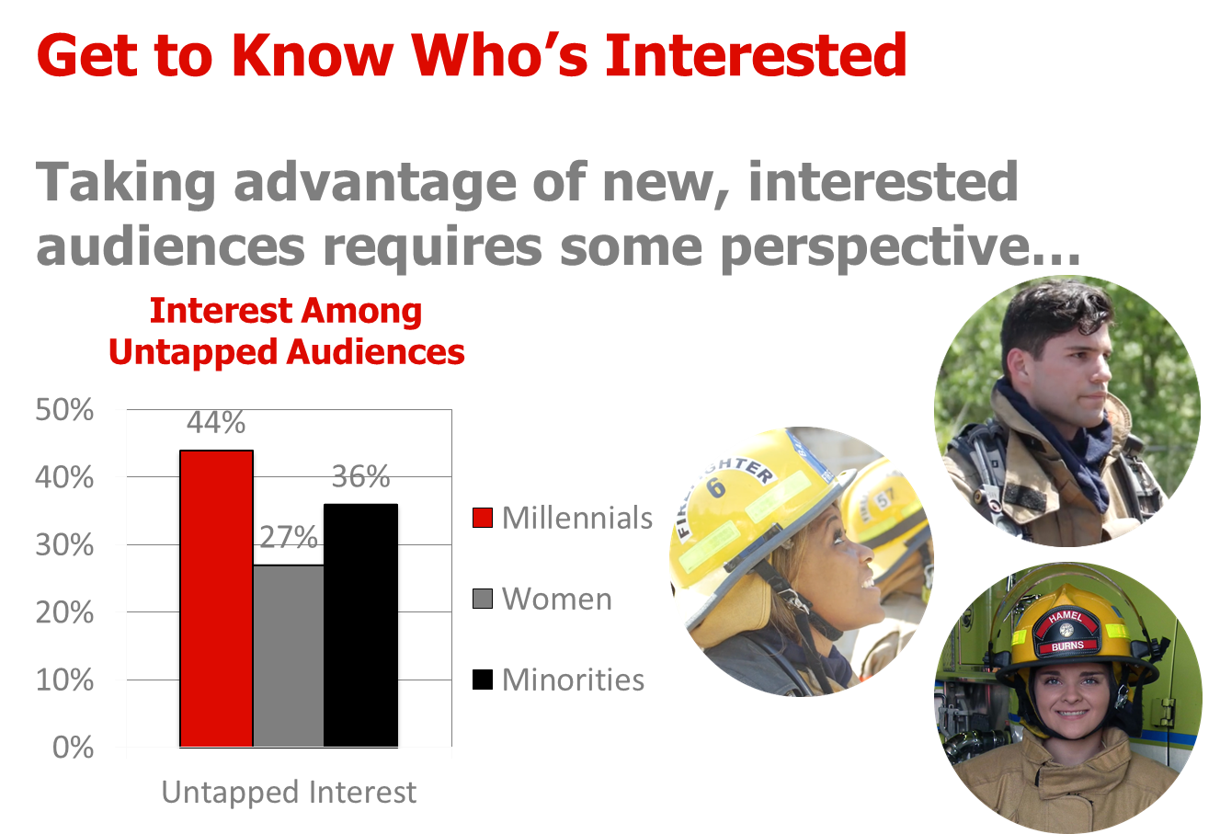
Notes:
I know that diversity is a buzzword that a lot of people like to throw around. Depending on the setting diversity can mean a lot of different things. For the volunteer fire service, it means maximizing the human resources that are available to you. A volunteer fire department is by definition community-based. The human resources that at your disposal are the people living in or near your response area. This can be a real problem, particularly as rural populations age and shrink. We created tools to help departments with outreach to younger, female and minority populations in the Make Me a Firefighter campaign because what we discovered was that departments were doing a better job of maximizing outreach to white, older and male populations in their communities. The point here isn’t that you need more racial minorities in your fire department or you need more women or young people in your fire department. The point is, if there are demographic groups in your community who are not represented in your department, your department is missing out. Maybe you have a good mix of men and women in the department but most of them are older: then you need to target young people. Maybe you have a good mix of older volunteers and millenials but they are all men: then you need to target women. If your community is all white there is no point in targeting racial minorities. The point is not diversity for the sake of diversity, but rather maximizing your human resources potential based on who lives in the community.

Slide 14
Phase 2: Invite

Slide 15
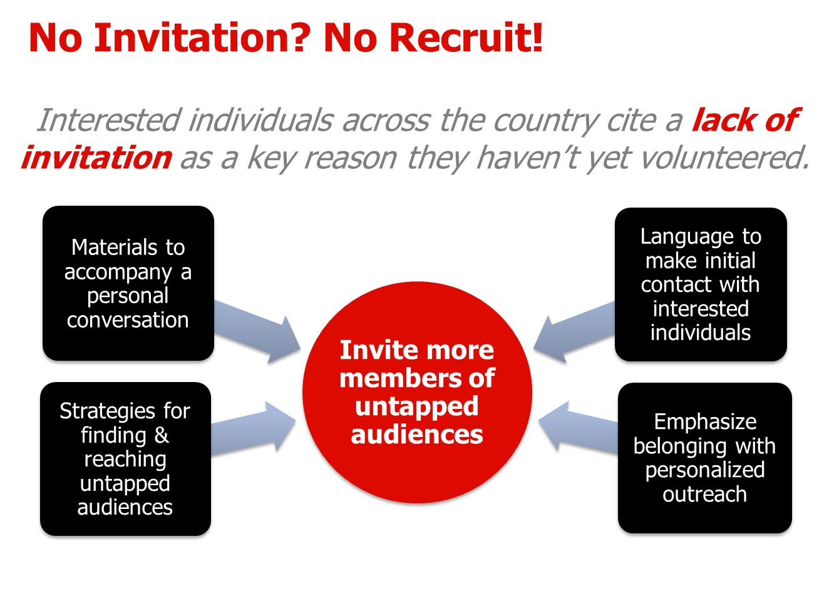
Notes:
Most people don’t just walk into a fire department and say “Sign me up!” Another aspect of the Make Me a Firefighter campaign is giving departments strategies for how to draw people in. The more personal the invitation, the better, but a good start is an invitation to an event — whether a family and friends event at the firehouse, a casual meet and greet with other volunteers, or a sampling event. The idea is to tap into the prospective recruit’s desire for a sense of personal accomplishment and pride, and prospect of belonging among a team of people who would have their back. Making them feel called to serve is key.

Slide 16
Phase 3: Sample

Slide 17
Getting From Being Invited to Applying
Do I have what it takes? Can I do this job?
Will I fit in with other volunteers?
What do volunteers do? What does the day-to-day look & feel like?
What are the expectations for training? Volunteering? Service?
Many who are interested may have unanswered questions that can’t be resolved from a conversation alone.
Sometimes, all it takes is a taste of the opportunity to help them see themselves as the right fit.
Notes:
So once you’ve identified folks who are interested and invited them in, how do you motivate them to actually complete an application? What we found was that sometimes all it takes giving them an opportunity to see how they fit in with the department. Our research revealed that some of the key barriers to moving people from being interested to actually applying, are fears that they don’t have what it takes -- the skills, the physique, uncertainties about what all is involved with being a volunteer firefighter, what would be expected of them, or how the application process works.
Our campaign encourages departments to take the guesswork out for prospective recruits by giving them a taste of what the department does and how the team dynamic works. Sharing personal stories about concerns that department members had when they were in the recruit phase, and how they overcame them.

Slide 18
Phase 4: Commit

Slide 19
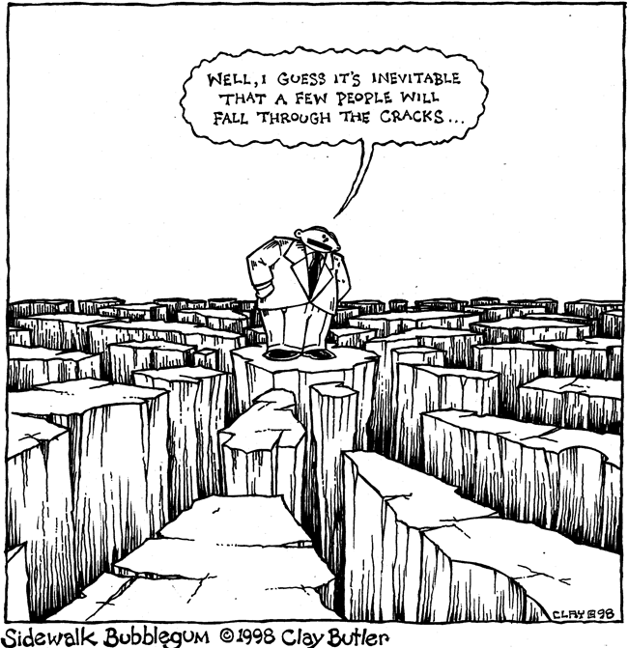
Prospects Drop Through The Cracks
Managing and tracking prospective and new recruits over time can be challenging, and prospects can fall through the cracks.
Prospective volunteers need to hear from you – to retain their interest over time, and to be assured that you’re still interested in them.
Notes:
We heard loud and clear that prospective recruits need follow-up to retain their interest, they need to be assured that you’re still interested in them. Individuals we interviewed mentioned infrequent recruitment as a barrier to joining -- that they got the impression that they could either “join or don’t join” and that it didn’t matter that much to the department. Look, folks want to feel like they are making a difference. Joining the department, going through the training, becoming a firefighter, this is a really big deal to them, and they aren’t completely sure what they are getting into. The department needs to really make them feel valued so that they push through in those moments where maybe they start to have doubts or where it feels overwhelming.
So staying in touch with and following up with prospective recruits, especially when there are long lapses in time between recruitment activities, is essential. This can be challenging to manage and track, and the Make Me a Firefighter Campaign makes that easier using SalesForce software so that the department can log all interactions with prospective recruits to make sure that they don’t go too long between contacts.

Slide 20
Phase 5: Train

Slide 21
Training can be engineered for success.
The reality is you have competitors for time and interest.
Make training fun, interesting, and flexible:
Break up training to allow for other responsibilities.
Alternate more ‘hands on’ trainings, with ‘less fun,’ yet essential modules.
Treat new recruits well. Don’t run them off.
Try mentoring or buddy systems to create friendships.
Acknowledge achievements & dedication… and the learning curve.
Lend support and encouragement.
Notes:
Training can be a serious barrier to keeping new recruits. It’s important to set expectations so volunteers understand what is required of them. It’s also important to make training events fun and to be innovative in order to combat boredom. Here’s what we learned in our research:
What we heard in interviews is that it helps with retention if departments make training fun, interesting and flexible. While this isn’t easy, and it many departments feel that shouldn’t be part of the focus when the business of being a firefighter is so serious, but the reality in the volunteer service is that there are many things competing for people’s time and interest.
Breaking up training in a way that allows people who are juggling other responsibilities to make it work with their schedule, is one successful approach. Also, offering fun breaks in the midst of less interesting (but essential) training modules.
Treating new recruits well from the minute they enter the door and throughout training, is a factor in retaining them. This is not boot camp or pledging a social club. New recruits should not have to earn their stripes before they are treated with respect. The ultimate goal is keeping volunteers committed to the department, especially if trying to attract a more diverse set of volunteers.

Slide 22
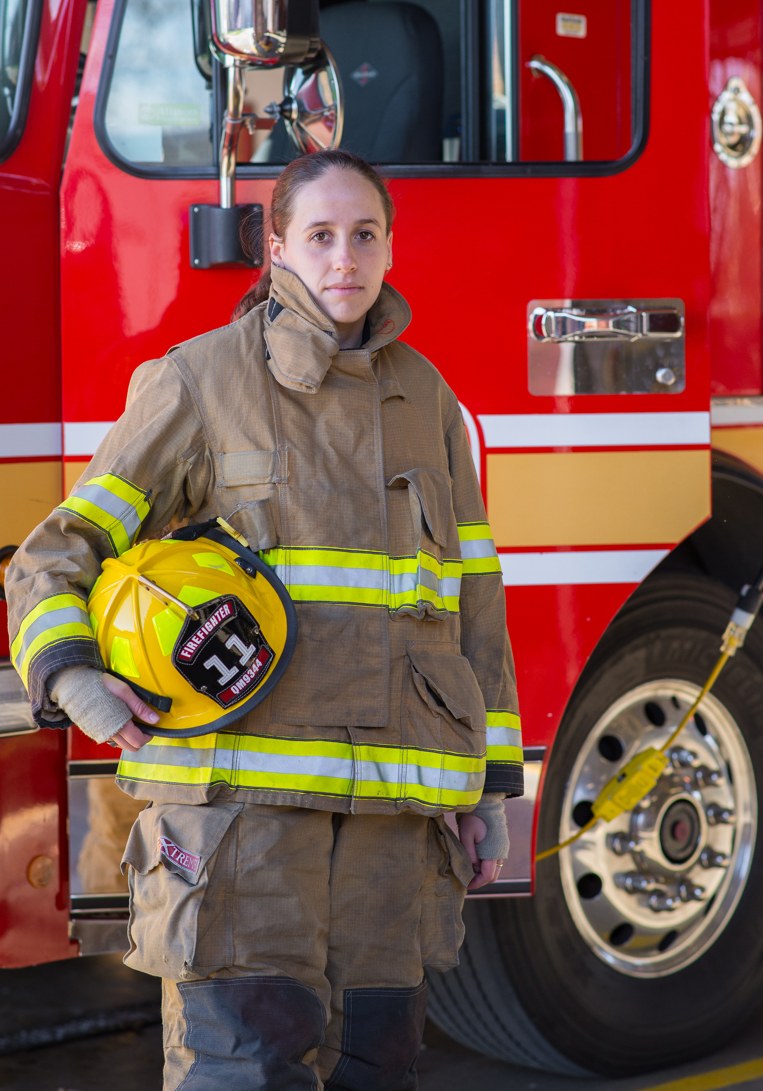
Retention
Similar to recruitment, need to show people appreciation and make them feel valued.
Retention is critical. It takes so much time, energy and money to recruit people, you need to keep them around!
Leadership is the number one reason that people who leave a department cite for why they left.
As the demands on volunteer firefighters have increased many communities have responded by providing benefits.
Notes:
That is a lot of information on recruitment, which again, is the focus of the NVFC’s Make Me a Firefighter campaign. I also want to talk a little bit about retention. With both retention and recruitment, a lot of the issues are the same. Showing appreciation for people, making them feel part of a group, being responsive to their concerns, etc. Retention is probably even more important than recruitment if you are going to put the time and energy into recruiting people, training them and equipping them you want them to stay with the department as long as possible. On average a volunteer firefighter donates services worth approximately $18,000 annually to the department that he or she serves, and it costs approximately $8,000 to train and equip a new recruit. Departments that have too much turnover among their volunteer staff will waste a lot of good time and money trying to replace personnel.
The number one PREVENTABLE reason that people give for leaving a department essentially boils down to leadership. People don’t feel valued. They feel like the demands are too high. They don’t get along with the other firefighters. They don’t feel like they are being listened to. They aren’t getting what they want to out of the experience. Obviously sometimes things just don’t work out and people have to go their separate ways, but in departments with great leadership these sorts of issues crop up far less.
One of the tools that many departments use to bolster retention efforts is providing benefits. These come in many forms, from non-monetary – awards banquets, donated goods and services from the community, fire department clothing – to stipends, per-call payments and retirement plans. The most important thing to keep in mind with benefits is that they are primarily a way of demonstrating that the services donated by the volunteer are appreciated. The other thing I’d say about benefits is that volunteers generally do not view them as compensation, but rather as a form of reimbursement. Being a volunteer firefighter or EMT costs money. Most volunteers respond to calls in their personal vehicles and do not get reimbursed for gas or wear and tear. They have to pay for the boots they wear to training and the clothing they wear under their turnouts. If they miss work for a department activity they may have to take vacation time or lose pay. There are all sorts of things that add up over time and, combined with all of the training and response activity that is required, can lead people to quit volunteering. Benefits are a way to make volunteers whole so that they don’t feel like they are being taken advantage of or that they can’t afford to continue volunteering.
I think benefits is a good segue to talking about some things that states do to help departments with recruitment and retention. Maryland, South Carolina and Louisiana provide income tax rebates to volunteer fire and EMS personnel. New York, Connecticut and Alaska authorize local governments to reduce property tax levies on volunteer fire and EMS personnel. Many states will waive or reduce fees (vehicle registrations, hunting licenses, etc.) for volunteer firefighters. I’m not aware of data that demonstrates how effective benefits are. You tend to see benefits in places – whether it is a state or a local jurisdiction – that have a strong volunteer fire service already, and those places tend to maintain relatively high staffing levels. Is it the chicken or the egg? I will say incentives have become increasingly common in recent years because the demands of the job have increased. When you are asking someone to spend so much time training and responding and even fundraising, and when doing all of those things actually cost the volunteers money out of their own pockets, getting even a little something back can be a huge morale boost.
I know here in Wisconsin the state matches local contributions into length of service award programs, or LOSAPs. LOSAP is a fantastic retention tool, because the volunteer gets a little more money contributed into their account for every year that they serve and by the time they retire it adds up into a nice nest egg. So it really does incentivize people who join and are in the department for 2 or 3 years to stick around for 2 or 3 decades, which is exactly what we need more of. One thing I would say about the LOSAP program here, and I think this applies to benefits generally, when it is up to local entities to contribute their own money in order to participate, some departments won’t be able to afford to buy in. The really small, remote communities that are probably struggling the most with recruitment and retention just don’t have the money to do this. So if you want to get them involved you have to be creative. Is there a way for really small communities to receive some sort of state LOSAP funds without having to contribute, or maybe with a lower matching requirement? There is some federal funding available. The SAFER grant program provides grants to fire departments to establish benefits programs. The LaFarge Fire Department in Wisconsin received a SAFER grant a few years ago that allowed them to start a LOSAP for their members.
In addition to benefits, there are other things that states can do to help bolster recruitment and retention of volunteers. As far as recruitment goes, that really has to happen at the local level. But given that one of the major barriers to recruiting new volunteers is a lack of public awareness about the fact that so many fire departments are looking for volunteers, I think that some sort of statewide marketing campaign could be very effective. We’ve had some state associations that received SAFER grants and were able to use some of the money for statewide marketing targeting areas that rely heavily on volunteers. New York’s campaign added 20,000 new volunteer firefighters throughout the state. In Florida they increased the number of certified volunteer firefighters by more than a third. I think there is definitely a role that states can play in helping to connect interested people with volunteer opportunities.
One of the most important things that states can do to help with retention is to make sure that volunteer fire departments have access to free and convenient training and certification services. Most volunteer fire departments recognize the importance of training and want to train, but if it costs money or their people have to travel a long distance to participate it may not be feasible. Having a state fire training agency that is responsive to the needs of the volunteer fire service makes a big difference. The easier that states can make it for local agencies to get their volunteers properly trained and certified, the easier it will be for those agencies to get new recruits to go through the training program.
My understanding from talking to our WI members is that the state training agency here works pretty well with the voc-tech schools to deliver training throughout the state for firefighters and fire officers. One thing that I do think would be helpful for the state to provide would be leadership training opportunities. I mentioned earlier, and I know that this committee has been discussing, how quality leadership is such an important component of having a successful recruitment and retention program. I think making training on how to manage people, how to be an effective leader, how to recruit and retain volunteers, could be a really valuable thing. I also think that offering volunteer fire chiefs guidance on how to run a fire department, how to deal with budgeting and finances, how to work with elected officials, how to implement a new training program, how to implement a health and safety program, how to establish a succession plan so that the department continues to have strong leadership into the future, could be all really useful. A lot of volunteer fire chiefs are so focused on managing emergency operations and making sure that they keep up with national consensus standards, but there is a lot that goes into leading a fire department beyond dealing with operations. So I really think that working with the volunteer service to figure out what sort of leadership/nonoperational training they need and then making it available could be a great thing.
Now, having said that, one of the challenges that you run into is whether or not people have time to take advantage of that sort of training. Remember earlier I talked about lack of time, people and money being interrelated. A lot of these departments you have volunteers who are scrambling to respond to emergencies, train, recruit new staff, do all the little day-to-day things that fire departments have to do, and then on top of that a lot of agencies ask their volunteers to be fundraisers. Hosting meals, community events, bake sales, etc. Its more time that volunteers have to spend and its really not a very efficient way of paying for fire protection services. Everyone benefits from the services, but you have local government often only paying a portion of what the service costs, and relying on volunteers to go out in the community and fundraise to make up the rest of the difference. So the department is using their people and time to raise money. In a sense you’re robbing Peter to pay Paul, because yeah you have the money now but your firefighters could have spent that time training, or responding or at home with their families relaxing. There are obvious limitations for smaller communities in how much money they can raise based on the size of their tax base, but I think it is really important for communities to have the flexibility to provide funding to local fire departments so that they don’t have to turn their volunteer firefighters into fundraisers.

Slide 23
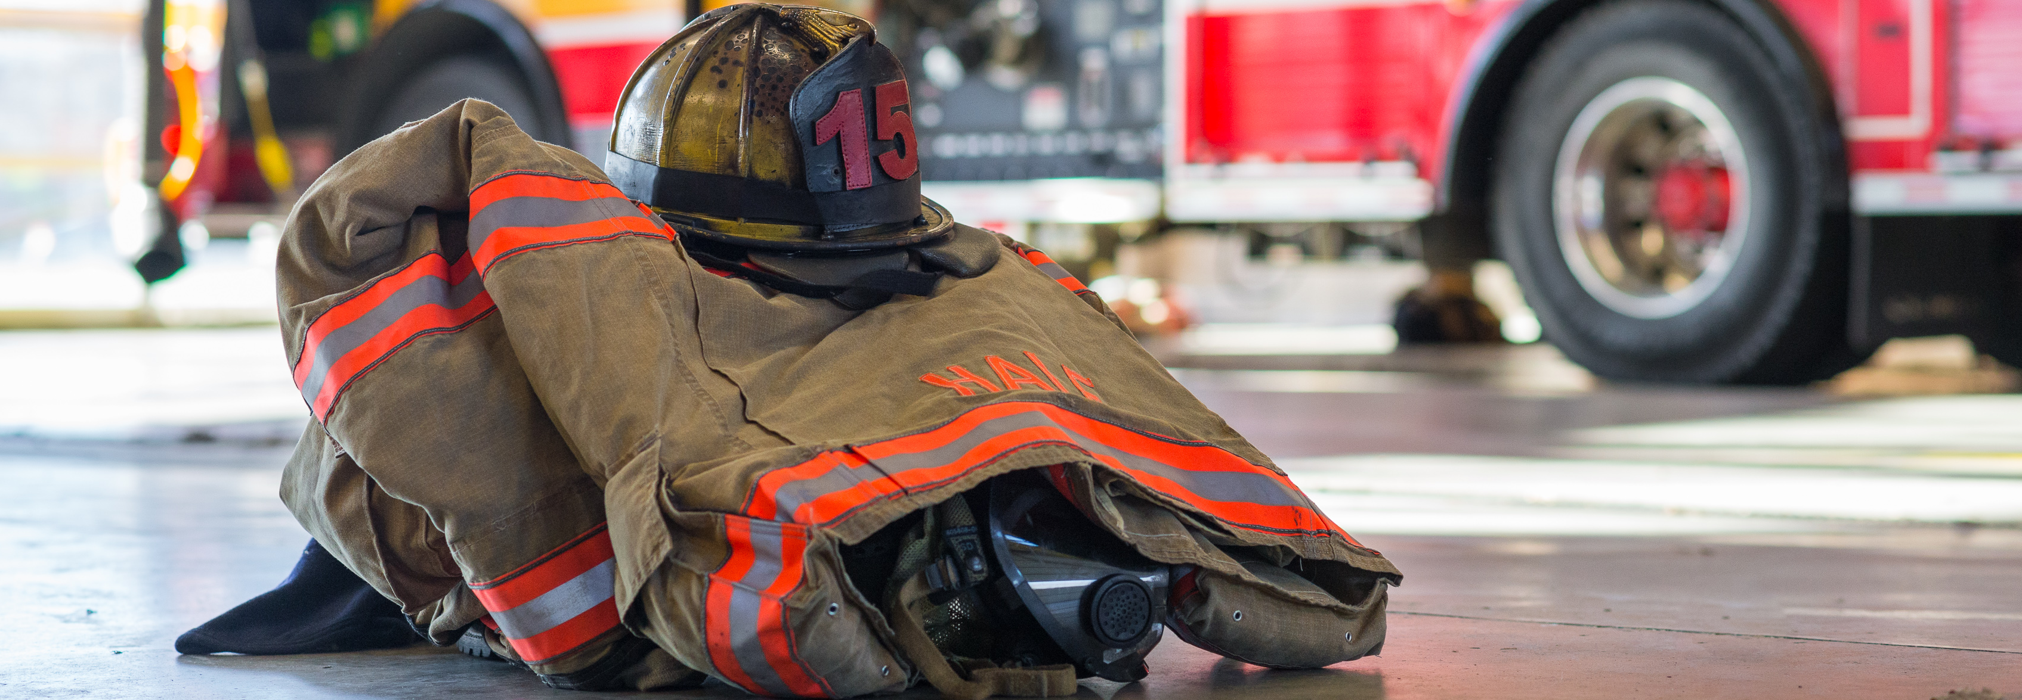
Benefits
Benefits can be monetary or non-monetary.
Primarily a way to demonstrate appreciation.
Helps offset the cost of being a volunteer.
Many states also offer benefits.
Notes:
These come in many forms, from non-monetary – awards banquets, donated goods and services from the community, fire department clothing – to stipends, per-call payments and retirement plans. The most important thing to keep in mind with benefits is that they are primarily a way of demonstrating that the services donated by the volunteer are appreciated. The other thing I’d say about benefits is that volunteers generally do not view them as compensation, but rather as a form of reimbursement. Being a volunteer firefighter or EMT costs money. Most volunteers respond to calls in their personal vehicles and do not get reimbursed for gas or wear and tear. They have to pay for the boots they wear to training and the clothing they wear under their turnouts. If they miss work for a department activity they may have to take vacation time or lose pay. There are all sorts of things that add up over time and, combined with all of the training and response activity that is required, can lead people to quit volunteering. Benefits are a way to make volunteers whole so that they don’t feel like they are being taken advantage of or that they can’t afford to continue volunteering.
I think benefits is a good segue to talking about some things that states do to help departments with recruitment and retention. Maryland, South Carolina and Louisiana provide income tax rebates to volunteer fire and EMS personnel. New York, Connecticut and Alaska authorize local governments to reduce property tax levies on volunteer fire and EMS personnel. Many states will waive or reduce fees (vehicle registrations, hunting licenses, etc.) for volunteer firefighters. I’m not aware of data that demonstrates how effective benefits are. You tend to see benefits in places – whether it is a state or a local jurisdiction – that have a strong volunteer fire service already, and those places tend to maintain relatively high staffing levels. Is it the chicken or the egg? I will say incentives have become increasingly common in recent years because the demands of the job have increased. When you are asking someone to spend so much time training and responding and even fundraising, and when doing all of those things actually cost the volunteers money out of their own pockets, getting even a little something back can be a huge morale boost.
I know here in Wisconsin the state matches local contributions into length of service award programs, or LOSAPs. LOSAP is a fantastic retention tool, because the volunteer gets a little more money contributed into their account for every year that they serve and by the time they retire it adds up into a nice nest egg. So it really does incentivize people who join and are in the department for 2 or 3 years to stick around for 2 or 3 decades, which is exactly what we need more of. One thing I would say about the LOSAP program here, and I think this applies to benefits generally, when it is up to local entities to contribute their own money in order to participate, some departments won’t be able to afford to buy in. The really small, remote communities that are probably struggling the most with recruitment and retention just don’t have the money to do this. So if you want to get them involved you have to be creative. Is there a way for really small communities to receive some sort of state LOSAP funds without having to contribute, or maybe with a lower matching requirement? There is some federal funding available. The SAFER grant program provides grants to fire departments to establish benefits programs. The LaFarge Fire Department in Wisconsin received a SAFER grant a few years ago that allowed them to start a LOSAP for their members.
In addition to benefits, there are other things that states can do to help bolster recruitment and retention of volunteers. As far as recruitment goes, that really has to happen at the local level. But given that one of the major barriers to recruiting new volunteers is a lack of public awareness about the fact that so many fire departments are looking for volunteers, I think that some sort of statewide marketing campaign could be very effective. We’ve had some state associations that received SAFER grants and were able to use some of the money for statewide marketing targeting areas that rely heavily on volunteers. New York’s campaign added 20,000 new volunteer firefighters throughout the state. In Florida they increased the number of certified volunteer firefighters by more than a third. I think there is definitely a role that states can play in helping to connect interested people with volunteer opportunities.
One of the most important things that states can do to help with retention is to make sure that volunteer fire departments have access to free and convenient training and certification services. Most volunteer fire departments recognize the importance of training and want to train, but if it costs money or their people have to travel a long distance to participate it may not be feasible. Having a state fire training agency that is responsive to the needs of the volunteer fire service makes a big difference. The easier that states can make it for local agencies to get their volunteers properly trained and certified, the easier it will be for those agencies to get new recruits to go through the training program.
My understanding from talking to our WI members is that the state training agency here works pretty well with the voc-tech schools to deliver training throughout the state for firefighters and fire officers. One thing that I do think would be helpful for the state to provide would be leadership training opportunities. I mentioned earlier, and I know that this committee has been discussing, how quality leadership is such an important component of having a successful recruitment and retention program. I think making training on how to manage people, how to be an effective leader, how to recruit and retain volunteers, could be a really valuable thing. I also think that offering volunteer fire chiefs guidance on how to run a fire department, how to deal with budgeting and finances, how to work with elected officials, how to implement a new training program, how to implement a health and safety program, how to establish a succession plan so that the department continues to have strong leadership into the future, could be all really useful. A lot of volunteer fire chiefs are so focused on managing emergency operations and making sure that they keep up with national consensus standards, but there is a lot that goes into leading a fire department beyond dealing with operations. So I really think that working with the volunteer service to figure out what sort of leadership/nonoperational training they need and then making it available could be a great thing.
Now, having said that, one of the challenges that you run into is whether or not people have time to take advantage of that sort of training. Remember earlier I talked about lack of time, people and money being interrelated. A lot of these departments you have volunteers who are scrambling to respond to emergencies, train, recruit new staff, do all the little day-to-day things that fire departments have to do, and then on top of that a lot of agencies ask their volunteers to be fundraisers. Hosting meals, community events, bake sales, etc. Its more time that volunteers have to spend and its really not a very efficient way of paying for fire protection services. Everyone benefits from the services, but you have local government often only paying a portion of what the service costs, and relying on volunteers to go out in the community and fundraise to make up the rest of the difference. So the department is using their people and time to raise money. In a sense you’re robbing Peter to pay Paul, because yeah you have the money now but your firefighters could have spent that time training, or responding or at home with their families relaxing. There are obvious limitations for smaller communities in how much money they can raise based on the size of their tax base, but I think it is really important for communities to have the flexibility to provide funding to local fire departments so that they don’t have to turn their volunteer firefighters into fundraisers.

Slide 24

State Benefits
Maryland, South Carolina and Louisiana offer income tax rebates to volunteers
New York, Connecticut and Alaska authorize local governments to reduce property tax levies on volunteers
Many states reduce or eliminate fees for volunteers
No data on effectiveness but it is becoming increasingly common.
Notes:
Maryland, South Carolina and Louisiana provide income tax rebates to volunteer fire and EMS personnel. New York, Connecticut and Alaska authorize local governments to reduce property tax levies on volunteer fire and EMS personnel. Many states will waive or reduce fees (vehicle registrations, hunting licenses, etc.) for volunteer firefighters. I’m not aware of data that demonstrates how effective benefits are. You tend to see benefits in places – whether it is a state or a local jurisdiction – that have a strong volunteer fire service already, and those places tend to maintain relatively high staffing levels. Is it the chicken or the egg? I will say incentives have become increasingly common in recent years because the demands of the job have increased. When you are asking someone to spend so much time training and responding and even fundraising, and when doing all of those things actually cost the volunteers money out of their own pockets, getting even a little something back can be a huge morale boost.
I know here in Wisconsin the state matches local contributions into length of service award programs, or LOSAPs. LOSAP is a fantastic retention tool, because the volunteer gets a little more money contributed into their account for every year that they serve and by the time they retire it adds up into a nice nest egg. So it really does incentivize people who join and are in the department for 2 or 3 years to stick around for 2 or 3 decades, which is exactly what we need more of. One thing I would say about the LOSAP program here, and I think this applies to benefits generally, when it is up to local entities to contribute their own money in order to participate, some departments won’t be able to afford to buy in. The really small, remote communities that are probably struggling the most with recruitment and retention just don’t have the money to do this. So if you want to get them involved you have to be creative. Is there a way for really small communities to receive some sort of state LOSAP funds without having to contribute, or maybe with a lower matching requirement? There is some federal funding available. The SAFER grant program provides grants to fire departments to establish benefits programs. The LaFarge Fire Department in Wisconsin received a SAFER grant a few years ago that allowed them to start a LOSAP for their members.
In addition to benefits, there are other things that states can do to help bolster recruitment and retention of volunteers. As far as recruitment goes, that really has to happen at the local level. But given that one of the major barriers to recruiting new volunteers is a lack of public awareness about the fact that so many fire departments are looking for volunteers, I think that some sort of statewide marketing campaign could be very effective. We’ve had some state associations that received SAFER grants and were able to use some of the money for statewide marketing targeting areas that rely heavily on volunteers. New York’s campaign added 20,000 new volunteer firefighters throughout the state. In Florida they increased the number of certified volunteer firefighters by more than a third. I think there is definitely a role that states can play in helping to connect interested people with volunteer opportunities.
One of the most important things that states can do to help with retention is to make sure that volunteer fire departments have access to free and convenient training and certification services. Most volunteer fire departments recognize the importance of training and want to train, but if it costs money or their people have to travel a long distance to participate it may not be feasible. Having a state fire training agency that is responsive to the needs of the volunteer fire service makes a big difference. The easier that states can make it for local agencies to get their volunteers properly trained and certified, the easier it will be for those agencies to get new recruits to go through the training program.
My understanding from talking to our WI members is that the state training agency here works pretty well with the voc-tech schools to deliver training throughout the state for firefighters and fire officers. One thing that I do think would be helpful for the state to provide would be leadership training opportunities. I mentioned earlier, and I know that this committee has been discussing, how quality leadership is such an important component of having a successful recruitment and retention program. I think making training on how to manage people, how to be an effective leader, how to recruit and retain volunteers, could be a really valuable thing. I also think that offering volunteer fire chiefs guidance on how to run a fire department, how to deal with budgeting and finances, how to work with elected officials, how to implement a new training program, how to implement a health and safety program, how to establish a succession plan so that the department continues to have strong leadership into the future, could be all really useful. A lot of volunteer fire chiefs are so focused on managing emergency operations and making sure that they keep up with national consensus standards, but there is a lot that goes into leading a fire department beyond dealing with operations. So I really think that working with the volunteer service to figure out what sort of leadership/nonoperational training they need and then making it available could be a great thing.
Now, having said that, one of the challenges that you run into is whether or not people have time to take advantage of that sort of training. Remember earlier I talked about lack of time, people and money being interrelated. A lot of these departments you have volunteers who are scrambling to respond to emergencies, train, recruit new staff, do all the little day-to-day things that fire departments have to do, and then on top of that a lot of agencies ask their volunteers to be fundraisers. Hosting meals, community events, bake sales, etc. Its more time that volunteers have to spend and its really not a very efficient way of paying for fire protection services. Everyone benefits from the services, but you have local government often only paying a portion of what the service costs, and relying on volunteers to go out in the community and fundraise to make up the rest of the difference. So the department is using their people and time to raise money. In a sense you’re robbing Peter to pay Paul, because yeah you have the money now but your firefighters could have spent that time training, or responding or at home with their families relaxing. There are obvious limitations for smaller communities in how much money they can raise based on the size of their tax base, but I think it is really important for communities to have the flexibility to provide funding to local fire departments so that they don’t have to turn their volunteer firefighters into fundraisers.

Slide 25
State Benefits
Wisconsin offers a state match for local contributions into a LOSAP
LOSAP is a fantastic retention tool
How many departments can afford to participate? Are small departments that need the most help with recruitment and retention involved?
Federal funding is available to establish benefits programs.
Notes:
I know here in Wisconsin the state matches local contributions into length of service award programs, or LOSAPs. LOSAP is a fantastic retention tool, because the volunteer gets a little more money contributed into their account for every year that they serve and by the time they retire it adds up into a nice nest egg. So it really does incentivize people who join and are in the department for 2 or 3 years to stick around for 2 or 3 decades, which is exactly what we need more of. One thing I would say about the LOSAP program here, and I think this applies to benefits generally, when it is up to local entities to contribute their own money in order to participate, some departments won’t be able to afford to buy in. The really small, remote communities that are probably struggling the most with recruitment and retention just don’t have the money to do this. So if you want to get them involved you have to be creative. Is there a way for really small communities to receive some sort of state LOSAP funds without having to contribute, or maybe with a lower matching requirement? There is some federal funding available. The SAFER grant program provides grants to fire departments to establish benefits programs. The LaFarge Fire Department in Wisconsin received a SAFER grant a few years ago that allowed them to start a LOSAP for their members.
In addition to benefits, there are other things that states can do to help bolster recruitment and retention of volunteers. As far as recruitment goes, that really has to happen at the local level. But given that one of the major barriers to recruiting new volunteers is a lack of public awareness about the fact that so many fire departments are looking for volunteers, I think that some sort of statewide marketing campaign could be very effective. We’ve had some state associations that received SAFER grants and were able to use some of the money for statewide marketing targeting areas that rely heavily on volunteers. New York’s campaign added 20,000 new volunteer firefighters throughout the state. In Florida they increased the number of certified volunteer firefighters by more than a third. I think there is definitely a role that states can play in helping to connect interested people with volunteer opportunities.
One of the most important things that states can do to help with retention is to make sure that volunteer fire departments have access to free and convenient training and certification services. Most volunteer fire departments recognize the importance of training and want to train, but if it costs money or their people have to travel a long distance to participate it may not be feasible. Having a state fire training agency that is responsive to the needs of the volunteer fire service makes a big difference. The easier that states can make it for local agencies to get their volunteers properly trained and certified, the easier it will be for those agencies to get new recruits to go through the training program.
My understanding from talking to our WI members is that the state training agency here works pretty well with the voc-tech schools to deliver training throughout the state for firefighters and fire officers. One thing that I do think would be helpful for the state to provide would be leadership training opportunities. I mentioned earlier, and I know that this committee has been discussing, how quality leadership is such an important component of having a successful recruitment and retention program. I think making training on how to manage people, how to be an effective leader, how to recruit and retain volunteers, could be a really valuable thing. I also think that offering volunteer fire chiefs guidance on how to run a fire department, how to deal with budgeting and finances, how to work with elected officials, how to implement a new training program, how to implement a health and safety program, how to establish a succession plan so that the department continues to have strong leadership into the future, could be all really useful. A lot of volunteer fire chiefs are so focused on managing emergency operations and making sure that they keep up with national consensus standards, but there is a lot that goes into leading a fire department beyond dealing with operations. So I really think that working with the volunteer service to figure out what sort of leadership/nonoperational training they need and then making it available could be a great thing.
Now, having said that, one of the challenges that you run into is whether or not people have time to take advantage of that sort of training. Remember earlier I talked about lack of time, people and money being interrelated. A lot of these departments you have volunteers who are scrambling to respond to emergencies, train, recruit new staff, do all the little day-to-day things that fire departments have to do, and then on top of that a lot of agencies ask their volunteers to be fundraisers. Hosting meals, community events, bake sales, etc. Its more time that volunteers have to spend and its really not a very efficient way of paying for fire protection services. Everyone benefits from the services, but you have local government often only paying a portion of what the service costs, and relying on volunteers to go out in the community and fundraise to make up the rest of the difference. So the department is using their people and time to raise money. In a sense you’re robbing Peter to pay Paul, because yeah you have the money now but your firefighters could have spent that time training, or responding or at home with their families relaxing. There are obvious limitations for smaller communities in how much money they can raise based on the size of their tax base, but I think it is really important for communities to have the flexibility to provide funding to local fire departments so that they don’t have to turn their volunteer firefighters into fundraisers.

Slide 26

Marketing
States can help local volunteer fire departments by raising awareness that departments need volunteers.
Helping link interested prospective volunteers with departments that need them would be a huge boost.
Several NVFC state associations have launched successful statewide marketing campaigns targeting areas that rely heavily on volunteers using SAFER grant funding.
Notes:
In addition to benefits, there are other things that states can do to help bolster recruitment and retention of volunteers. As far as recruitment goes, that really has to happen at the local level. But given that one of the major barriers to recruiting new volunteers is a lack of public awareness about the fact that so many fire departments are looking for volunteers, I think that some sort of statewide marketing campaign could be very effective. We’ve had some state associations that received SAFER grants and were able to use some of the money for statewide marketing targeting areas that rely heavily on volunteers. New York’s campaign added 20,000 new volunteer firefighters throughout the state. In Florida they increased the number of certified volunteer firefighters by more than a third. I think there is definitely a role that states can play in helping to connect interested people with volunteer opportunities.
One of the most important things that states can do to help with retention is to make sure that volunteer fire departments have access to free and convenient training and certification services. Most volunteer fire departments recognize the importance of training and want to train, but if it costs money or their people have to travel a long distance to participate it may not be feasible. Having a state fire training agency that is responsive to the needs of the volunteer fire service makes a big difference. The easier that states can make it for local agencies to get their volunteers properly trained and certified, the easier it will be for those agencies to get new recruits to go through the training program.
My understanding from talking to our WI members is that the state training agency here works pretty well with the voc-tech schools to deliver training throughout the state for firefighters and fire officers. One thing that I do think would be helpful for the state to provide would be leadership training opportunities. I mentioned earlier, and I know that this committee has been discussing, how quality leadership is such an important component of having a successful recruitment and retention program. I think making training on how to manage people, how to be an effective leader, how to recruit and retain volunteers, could be a really valuable thing. I also think that offering volunteer fire chiefs guidance on how to run a fire department, how to deal with budgeting and finances, how to work with elected officials, how to implement a new training program, how to implement a health and safety program, how to establish a succession plan so that the department continues to have strong leadership into the future, could be all really useful. A lot of volunteer fire chiefs are so focused on managing emergency operations and making sure that they keep up with national consensus standards, but there is a lot that goes into leading a fire department beyond dealing with operations. So I really think that working with the volunteer service to figure out what sort of leadership/nonoperational training they need and then making it available could be a great thing.
Now, having said that, one of the challenges that you run into is whether or not people have time to take advantage of that sort of training. Remember earlier I talked about lack of time, people and money being interrelated. A lot of these departments you have volunteers who are scrambling to respond to emergencies, train, recruit new staff, do all the little day-to-day things that fire departments have to do, and then on top of that a lot of agencies ask their volunteers to be fundraisers. Hosting meals, community events, bake sales, etc. Its more time that volunteers have to spend and its really not a very efficient way of paying for fire protection services. Everyone benefits from the services, but you have local government often only paying a portion of what the service costs, and relying on volunteers to go out in the community and fundraise to make up the rest of the difference. So the department is using their people and time to raise money. In a sense you’re robbing Peter to pay Paul, because yeah you have the money now but your firefighters could have spent that time training, or responding or at home with their families relaxing. There are obvious limitations for smaller communities in how much money they can raise based on the size of their tax base, but I think it is really important for communities to have the flexibility to provide funding to local fire departments so that they don’t have to turn their volunteer firefighters into fundraisers.

Slide 27
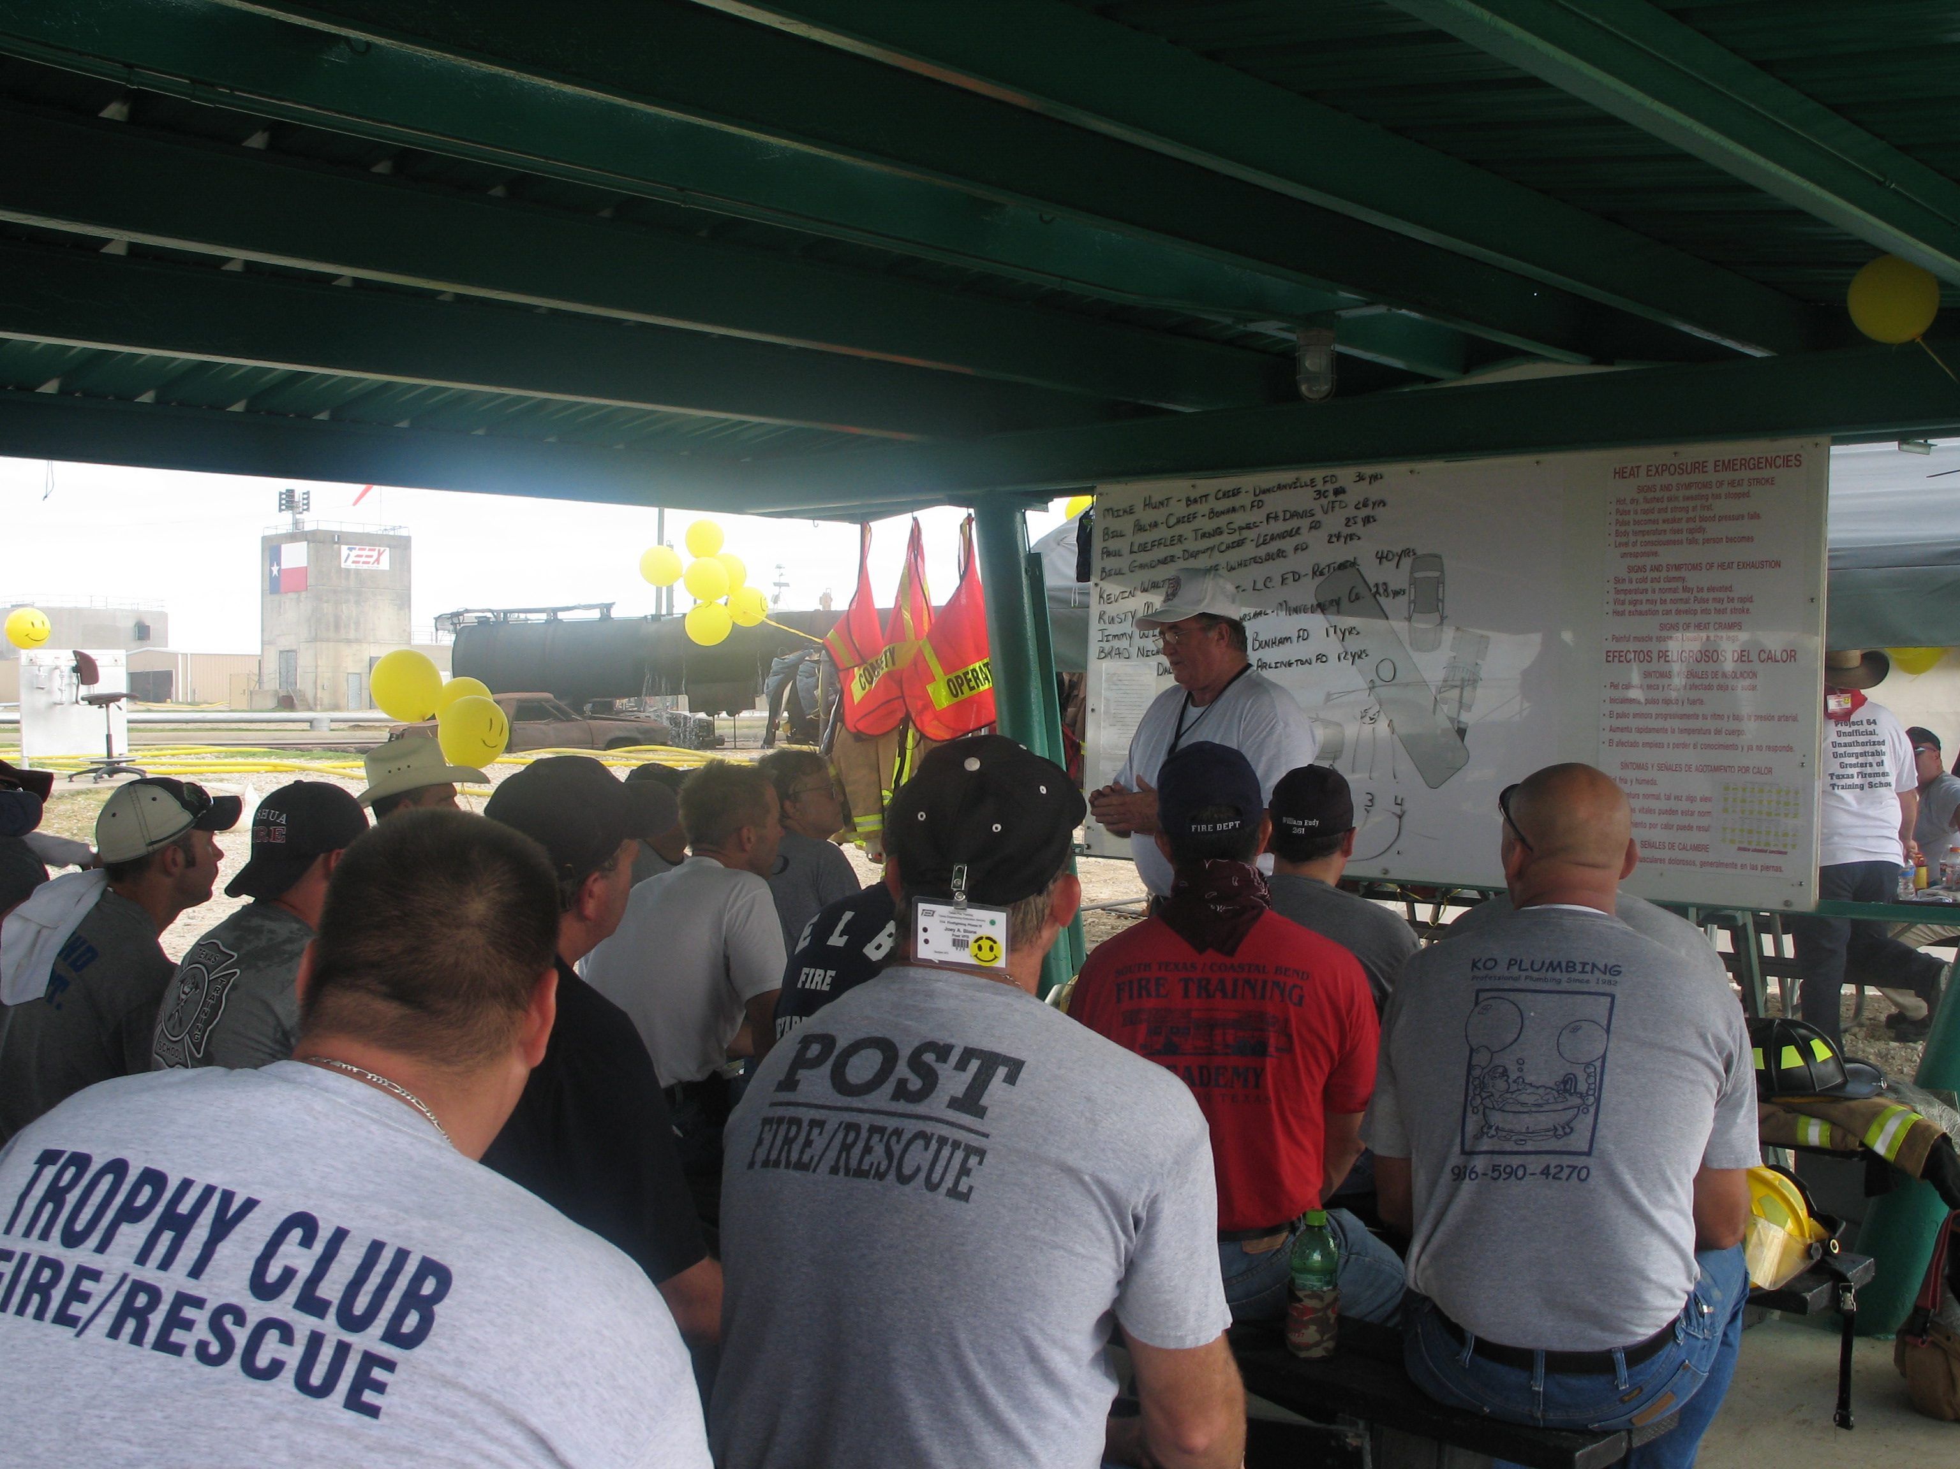
Training and Certification
Access to free and convenient training is critical.
Makes it much easier to get new recruits into the department.
Operational training is key, but nonoperational training for fire officers is also important.
Quality leadership is key for recruitment and retention, need to make that investment.
Notes:
One of the most important things that states can do to help with retention is to make sure that volunteer fire departments have access to free and convenient training and certification services. Most volunteer fire departments recognize the importance of training and want to train, but if it costs money or their people have to travel a long distance to participate it may not be feasible. Having a state fire training agency that is responsive to the needs of the volunteer fire service makes a big difference. The easier that states can make it for local agencies to get their volunteers properly trained and certified, the easier it will be for those agencies to get new recruits to go through the training program.
My understanding from talking to our WI members is that the state training agency here works pretty well with the voc-tech schools to deliver training throughout the state for firefighters and fire officers. One thing that I do think would be helpful for the state to provide would be leadership training opportunities. I mentioned earlier, and I know that this committee has been discussing, how quality leadership is such an important component of having a successful recruitment and retention program. I think making training on how to manage people, how to be an effective leader, how to recruit and retain volunteers, could be a really valuable thing. I also think that offering volunteer fire chiefs guidance on how to run a fire department, how to deal with budgeting and finances, how to work with elected officials, how to implement a new training program, how to implement a health and safety program, how to establish a succession plan so that the department continues to have strong leadership into the future, could be all really useful. A lot of volunteer fire chiefs are so focused on managing emergency operations and making sure that they keep up with national consensus standards, but there is a lot that goes into leading a fire department beyond dealing with operations. So I really think that working with the volunteer service to figure out what sort of leadership/nonoperational training they need and then making it available could be a great thing.
Now, having said that, one of the challenges that you run into is whether or not people have time to take advantage of that sort of training. Remember earlier I talked about lack of time, people and money being interrelated. A lot of these departments you have volunteers who are scrambling to respond to emergencies, train, recruit new staff, do all the little day-to-day things that fire departments have to do, and then on top of that a lot of agencies ask their volunteers to be fundraisers. Hosting meals, community events, bake sales, etc. Its more time that volunteers have to spend and its really not a very efficient way of paying for fire protection services. Everyone benefits from the services, but you have local government often only paying a portion of what the service costs, and relying on volunteers to go out in the community and fundraise to make up the rest of the difference. So the department is using their people and time to raise money. In a sense you’re robbing Peter to pay Paul, because yeah you have the money now but your firefighters could have spent that time training, or responding or at home with their families relaxing. There are obvious limitations for smaller communities in how much money they can raise based on the size of their tax base, but I think it is really important for communities to have the flexibility to provide funding to local fire departments so that they don’t have to turn their volunteer firefighters into fundraisers.

Slide 28

Funding
Fire departments need to be adequately funded.
Volunteer firefighters shouldn’t have to be fundraisers in addition to training and responding.
Communities need flexibility to be able to provide adequate funding to local departments.
Particularly important in jurisdictions that have a small tax base.
Notes:
Now, having said that, one of the challenges that you run into is whether or not people have time to take advantage of that sort of training. Remember earlier I talked about lack of time, people and money being interrelated. A lot of these departments you have volunteers who are scrambling to respond to emergencies, train, recruit new staff, do all the little day-to-day things that fire departments have to do, and then on top of that a lot of agencies ask their volunteers to be fundraisers. Hosting meals, community events, bake sales, etc. Its more time that volunteers have to spend and its really not a very efficient way of paying for fire protection services. Everyone benefits from the services, but you have local government often only paying a portion of what the service costs, and relying on volunteers to go out in the community and fundraise to make up the rest of the difference. So the department is using their people and time to raise money. In a sense you’re robbing Peter to pay Paul, because yeah you have the money now but your firefighters could have spent that time training, or responding or at home with their families relaxing. There are obvious limitations for smaller communities in how much money they can raise based on the size of their tax base, but I think it is really important for communities to have the flexibility to provide funding to local fire departments so that they don’t have to turn their volunteer firefighters into fundraisers.

Slide 29
Questions?
National Volunteer Fire Council
7852 Walker Drive, Suite 375
Greenbelt, MD 20770
202-887-5700
nvfcoffice@nvfc.org
www.nvfc.org

