Slide 1


Wisconsin’s Evidence-Based Decision Making (EBDM) Pretrial Pilot: Project Overview
Constance Kostelac, PhD Tiana Glenna, MS
Director Criminal Justice Manager
Bureau of Justice Information and Analysis Pretrial Coordinator
WI Department of Justice Eau Claire County

Slide 2
The National Institute of Corrections’ Evidence-Based Decision Making (EBDM) Initiative
Overarching Goal:
To create a framework for justice systems that will result in improved system outcomes
through true collaborative partnerships,
systematic use of research,
and a shared vision of desired outcomes.
“A permanent shift in expectations about what is possible.”
--Joe McCannon, Wisconsin EBDM Summit, Jan 2014

Slide 3
Why EBDM?
Growing body of evidence that can (and does) inform justice system agencies’ performance and increase effectiveness
Historically, there have been demonstrations of successful approaches/changes within individual operating agencies around the country, not systemwide
A primary perceived barrier is the lack of system collaboration around a common set of outcomes and principles
EBDM is a systemic approach that uses research to inform decisions at all levels (EBDM Framework)

Slide 4
EBDM Principles
EBDM Principle 1: The professional judgment of criminal justice system decision makers is enhanced when informed by evidence-based knowledge.
EBDM Principle 2: Every interaction within the criminal justice system offers an opportunity to contribute to harm reduction.
EBDM Principle 3: Systems achieve better outcomes when they operate collaboratively.
EBDM Principle 4: The criminal justice system will continually learn and improve when professionals make decisions based on the collection, analysis, and use of data and information.

Slide 5
Phase I-III: Overview of Local Level EBDM
2008-2013
NIC began its sponsorship of the Evidence-Based Decision Making in Local Criminal Justice Systems (EBDM) initiative in May 2008
In Phase I, NIC built the EBDM “Framework”
In August of 2010, NIC selected, on a competitive basis, seven local jurisdictions from across the country (including Eau Claire and Milwaukee) to participate in Phase II
The same seven sites continued on to the Implementation Phase (Phase III)
Phase I
Framework Development
May 2008-March 2010
Phase II
Planning Process
June 2010-August 2011
Phase III
Implementation
August 2011-Dec 2013

Slide 6
Phase IV-V: Overview of Statewide EBDM to Date
Phase IV
Preparation for Expansion
Sep 2013 – Dec 2014
Participate in a process designed to prepare teams within the state for the EBDM planning phase
Engage in EBDM planning (V) and implementation (VI) activities at state level and in multiple local jurisdictions
Currently moving forward on additional technical assistance starting fall 2018
More than 40 additional counties have expressed an interest in becoming involved with EBDM
Phase V
Planning Process
Mar 2015 – July 2016
Phase VI
Implementation
Began Nov 1 2016

Slide 7
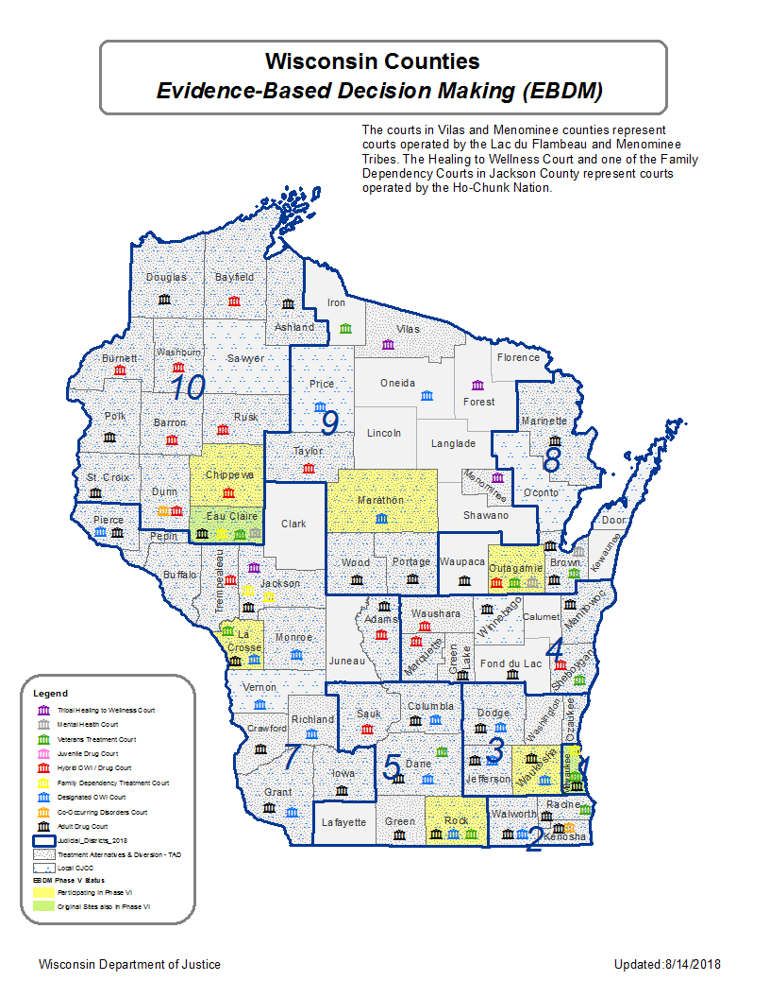
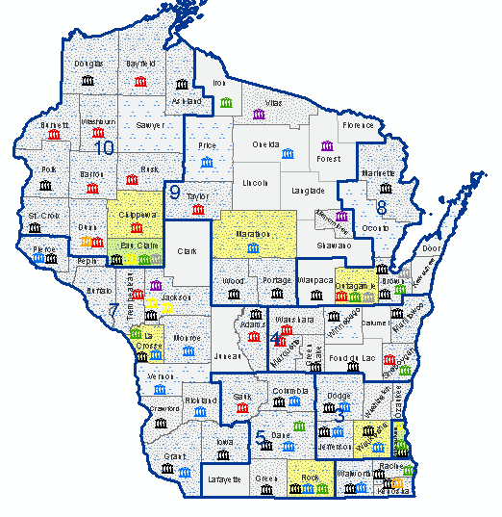
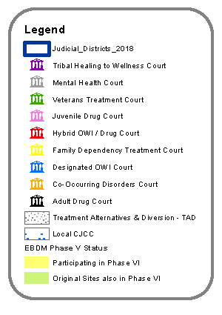

Slide 8
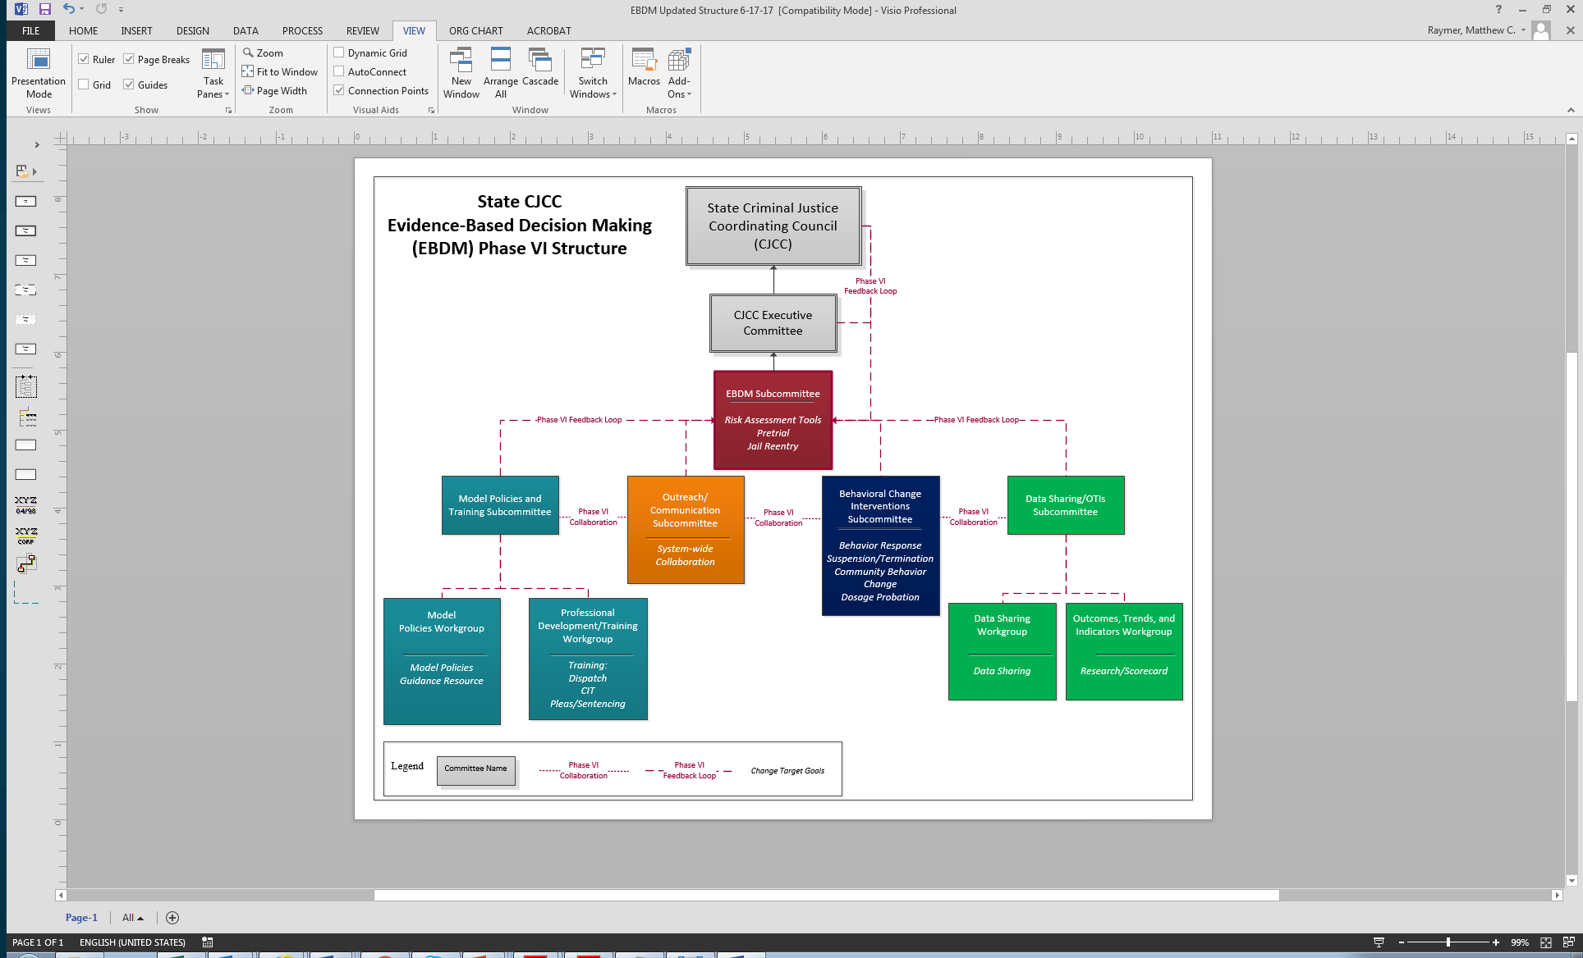

Slide 9
Key Justice System Decision Points:
Wisconsin State and Local Level EBDM
State Reentry Planning
State Institutional Release
Community Supervision
State Institutional Intervention
Community Behavior Change
Diversion/Deferred Prosecution
Pretrial Status
Law Enforcement Response
Violation Response
Charging
Plea Negotiations
Sentencing

Slide 10
State and Local Partnership –
Pretrial Pilot Project
Through the planning process in Phase V, the pretrial decision point was identified as a change target at both the state and local level
The 7 counties in WI working to implement EBDM were selected as pretrial pilot sites
Pilot includes:
  Eau Claire, Chippewa, Waukesha, Marathon, Rock, Outagamie, and La Crosse counties
  Milwaukee County already implemented as part of earlier EBDM work

Slide 11
State and Local Partnership –
Pretrial Pilot Project
Intent is to implement the pilot
  identify what works, what does not
  address challenges
  evaluate the effectiveness across the sites
  create tools and processes that can be replicated in WI
Planning was guided using the essential elements for pretrial to build local and state capacity to successfully implement a pretrial program
  Additional counties expressing interest in moving this direction with EBDM and pretrial

Slide 12
What is Pretrial?
Pretrial period is from initial arrest through case disposition
Many key decisions occur during this phase, including but not limited to:
    Book or cite and release
    Charge or not charge
    Divert
    Detain or not detain
    Bail and conditions of release
Period prior to case disposition – have not yet been convicted

Slide 13
Why Pretrial?
National movement to address the front-end of the criminal justice system
Each local team and the state team identified this as a key decision point early in the process
Emphasis on public safety and legal rights of the defendant
Pretrial sets the stage for everything else in the process
Research has demonstrated there are short- and long-term consequences for defendants, the justice system, and the public

Slide 14
Research Background
Research has demonstrated that detaining low and moderate risk defendants in jail for even short periods of time (i.e., 2–3 days) can increase their risk for misconduct both short- and long-term
  Lowenkamp, VanNostrand, & Holsinger, 2013
Releasing high risk defendants without assessment or supervision can be a public safety concern
Defendants detained pretrial are more likely to be convicted and to receive longer sentences than defendants who are not detained
  Lowenkamp, VanNostrand, & Holsinger, 2013b; Oleson, Lowenkamp, Wooldredge, VanNostrand, & Cadigan, 2014)

Slide 15
Pretrial Pilot
Mission:
Develop and implement policies and operational procedures following legal and evidence-based practices in pretrial release and detention, to support the goals of maximizing public safety, maximizing court appearance, and maximizing release.

Slide 16
Pretrial Pilot: Model Policies
Developed and now modifying a protocol or “model policy” document for the pretrial pilots
  Can be made available to the committee for review when revisions are complete
Built on the EBDM Framework and contains elements of NIC’s Framework for Pretrial Justice: Essential Elements of An Effective Pretrial Justice System and Agency
  Includes specifics for Wisconsin
  With input from the state and local EBDM teams
Intended to be a guide for the pilot counties initially and later for future counties looking to implement pretrial programs

Slide 17
Pretrial Pilot Overview: Model Policies
Counties attended training and were asked to review the elements of an effective system
  With their local collaborative stakeholder teams
  To identify gaps that need to be addressed
Pretrial pilot programs are expected to align with legal and evidence-based principles
  Emphasis on maximizing release, maximizing court appearance, and maximizing public safety
  Presumption of release
  Least restrictive, nonfinancial release conditions

Slide 18
Pretrial Pilot Overview: Model Policies
At a minimum, pretrial pilot sites will assess all individuals booked into jail (in custody) and subject to bail for a criminal offense
Ideally, will assess all individuals (in or out of custody) who are subject to bail for a criminal offense
  This is the goal, but requires more resources
  Is also more complex since a portion of defendants are not booked into jail at all (cite and release) or they are released prior to the initial appearance
  Baseline data

Slide 19
Pretrial Pilot Overview: Model Policies
Counties will use an actuarial risk assessment tool
Risk assessment will be completed and the report will be made available to stakeholders
  At the initial appearance or release determination
  At subsequent scheduled appearances
  As part of an on-going or sequential review of detained defendants
Additional screenings/assessments may be conducted
  To help inform the conditions placed on the defendant during the pretrial period such as drug testing

Slide 20
Pretrial Pilot Overview: Model Policies
Counties are expected to have or develop effective pretrial services/agency
  To supervise defendants released from custody
  Requires resources
Counties will implement risk-based supervision
  Use the least restrictive set of conditions to support court appearance and public safety (mitigate risk)
  Adopt a release conditions matrix to help inform the conditions imposed based on risk level
  Research on impact of specific conditions and supervision practices is still developing
  But do have research that shows over-conditioning can be harmful
Counties will have a process for court reminders for released defendants
  Research has shown effectiveness with court appearance rates

Slide 21
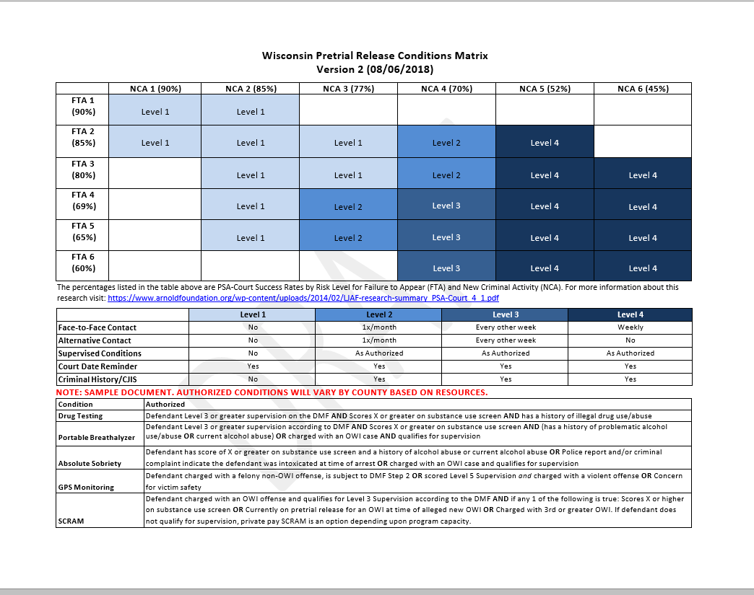
Pretrial Pilot Overview: Model Policies
**Sample only**

Slide 22
Pretrial Pilot Overview: Model Policies
Counties will adopt a violation matrix to help guide responses to pretrial violations
  Responses should be certain, swift, proportionate, fair, and individualized
  Prompt notification about violations
Performance measurement
  Counties will track consistent data for performance measures and outcomes
  To assist in ongoing monitoring and evaluation of the pilot
  Baseline data is being manually compiled for each pilot county
  Challenge of current ability to track these key measures

Slide 23
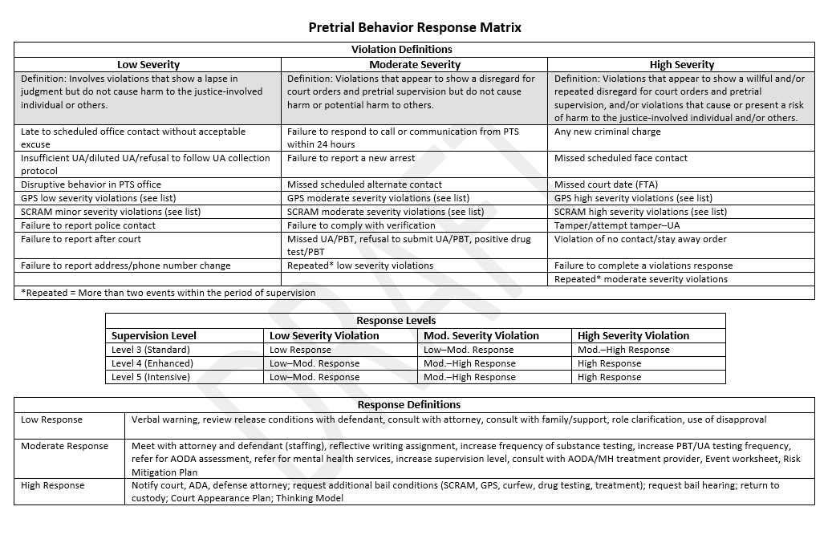
Pretrial Pilot Overview: Model Policies
**Sample only**
Insert sample violations matrix

Slide 24
Pretrial Pilot: Risk Assessment
What is risk?
In context of pretrial, risk is connected to defendant’s likelihood, during the pretrial period, of:
  Not appearing for court
  Being arrested on a new criminal offense
    Overall and for specific charges
Different from long-term, criminogenic risk

Slide 25
Research Background: Risk
Most pretrial defendants present low to moderate risks of failure pretrial
  Majority of defendants show up to court and are not arrested during the pretrial period
Based on risk principle, should match supervision to risk level
  Intervention should match risk
  Poor matching of supervision levels to risk levels may increase pretrial failure rates

Slide 26
Pretrial Pilot: Risk Assessment
Variety of tools available to assess pretrial risk
  Known as risk assessment instruments
  Different from risk assessment at other parts of the criminal justice process
Based on research of likelihood (prediction) of pretrial success/failure based on specific factors
  Based on the group that the individual falls into for risk
Primarily based on common factors (some or all)
  Static: Prior arrests/convictions/incarcerations, prior failure to appear (FTA), pending charges, age
  Dynamic: substance use, residence, employment

Slide 27
Pretrial Pilot: Risk Assessment
Pilot sites have elected to use, at least initially, the Public Safety Assessment (PSA) from the Laura and John Arnold Foundation
  Static factors
    Age Current offense Pending charge
    Prior convictions Prior violent conviction Prior FTA
    Prior incarceration
  Provides risk score for:
    Failure to Appear (FTA)
    New Criminal Activity (NCA)
    New Violent Criminal Activity (NCVA)
  Will be receiving additional background on the PSA

Slide 28
Pretrial Pilot: Risk Assessment
Risk assessment tools are intended to supplement, not replace judicial discretion
  Typically described as “risk-informed”
  Can help provide consistency and guidance
  Release, conditions, and level of supervision
Risk assessment tools are not the final answer and outcomes need to be evaluated
Tool should also be locally validated
  How well does the tool predict pretrial success/failure

Slide 29
Pretrial Pilot: Risk Assessment
On-going discussion about relationship between risk assessment and bias
  Some concern that risk assessment tools can add to issues of disparity
  However, the alternative of no tool has not alleviated the issue
Goal is to utilize tools that have demonstrated fewer differences (are more neutral) in terms of race/ethnicity, gender, and socioeconomic status
Use of static factors can be an improvement
  Removes factors such as where someone lives
  But still impacted by systemic factors
Highlights the continued need for:
  Judicial discretion in the decision making process
  On-going research and evaluation in this area
  Critical look at the impact of these tools going forward

Slide 30
Pretrial Pilot: Data, Performance
Measures and Outcomes
Data collection is key to both monitoring the pretrial pilots, as well as measuring outcomes
There are key measures related to pretrial outcomes:
  Failure to Appear (FTA) rates
    Success: Appearance rate
  New Criminal Activity (NCA)/Re-arrest rates
    Success: Safety Rate
These should be monitored on-going and considered in relation to characteristics and demographics of defendants

Slide 31
Pretrial Pilot: Data, Performance
Measures and Outcomes
Additional measures related to pretrial processing:
  Defendants by risk level for FTA/NCA
  Concurrence rate
  Length of stay for detained defendants
  Number of defendants released
  Pretrial detention/release rate
  Conditions imposed
  Time on supervision

Slide 32
Pretrial Pilot: Success Rates
Pretrial success rates are better than often assumed
  Risk assessment tools help to predict likelihood of pretrial success/failure for groups
  Risk language should be “higher” risk rather than “high” risk – it is relative

Slide 33
Appearance Rate by RAI Level--Kentucky
Overall Release Rate= 73% / Overall Appearance Rate= 85%
Source: Kentucky / NAPSA
Notes:
FY 2015 data

Slide 34
Non Arrest Rate by RAI Level—Washington, DC
Overall Release Rate= 90% / Overall Non-Arrest Rate= 89%
Source: Washington DC / NAPSA
Notes:
FY 2015 data

Slide 35

Public Safety Assessment
PSA Validation
  Pretrial Failure to Appear
Notes:
Following development gathered 100,000 new cases.

Slide 36
Public Safety Assessment
PSA Validation
  New Criminal Activity

Slide 37
Current Status of Pretrial Pilot
Pilot counties and state team received training and input from NIC
Modifying “model policies” and supporting documents based on Essential Elements and input from NIC
Draft implementation plan developed
  To be customized for each county – at different stages currently
Working with NIC on technical assistance for implementation for initial counties
On-going discussion regarding the need for a Statewide Pretrial Director or Administrator for these efforts

Slide 38
Current Status of Pretrial Pilot
Risk Assessment:
  At final stage of signing MOU with the Arnold Foundation
  Modifying “operational guide” for PSA scoring and related documents
  Stakeholders and assessors received initial PSA training
Support from the state team:
  Working through challenges with access to criminal history data
  Working to finalize data elements and obtain data system
  Seeking grant funding to help support parts of the effort
Evaluation of the pilots:
  Identifying key measures
  Compiling and reviewing baseline data
  On-going assistance with performance measurement and evaluation

Slide 39
Wisconsin Pretrial Pilot
Questions and discussion
Additional information for future meetings

