Slide 1
Evidence Based Pretrial Release and Monitoring in Wisconsin
                August 2018
                Jeffrey Kremers
                Circuit Judge Milwaukee (ret.)

Slide 2
Pretrial Justice
After a person is arrested, judicial officers must decide:
  Will this person be released?
  Will this person be detained?
  If released, what will be the release conditions?
Pretrial decisions can have significant impact:
  Public safety pretrial
  Case disposition
  Likelihood of receiving a sentence to incarceration
  Length of the sentence to incarceration
  Public safety post-disposition

Slide 3
Overview of EBDM Pretrial Decision Points
Law Enforcement Decisions
Pretrial Status Decisions
Charging Decisions
Plea Decisions
Cite
Divert
Arrest
Release
Release With/Without
Conditions
Detain
Sequential Review of Detained, Released & Supervised Defendants
Violation Response
Charge
Divert
Defer
Dismiss
Plea Terms

Slide 4
“Legal”
Presumption of Innocence
Right to (or Presumption of) Release
  Release must be the norm
  Two constitutionally valid purposes for limiting pretrial freedom:
    Court appearance and public safety
    “[D]etention prior to trial … is the carefully limited exception.”
  U.S. v Salerno (U.S. Supreme Court, 1987)
Non-Excessive Bail
  Least restrictive conditions
Due Process
Equal Protection
Individualized Bail Setting

Slide 5
BAIL
969.001 (1) “Bail means monetary conditions of release.
969.01 Eligibility for release. (1) Before conviction. A defendant arrested for a criminal offense is eligible for release under reasonable conditions designed to assure his or her appearance in court, protect members of the community from serious bodily harm, or prevent the intimidation of witnesses. Bail may be imposed at or after the initial appearance only upon a finding by the court that there is a reasonable basis to believe that bail is necessary to assure appearance in court.

Slide 6
969.01(1) ……the judge shall first consider the likelihood of the defendant appearing for trial if released on his or her own recognizance.
969.01(4) Considerations in setting conditions of release
If bail is imposed, it shall be only in the amount found necessary to assure appearance of the defendant. Conditions of release other than monetary conditions may be imposed for the purpose of protecting members of the community from serious bodily harm or preventing intimidation of witnesses

Slide 7
969.02 Release of defendants charged with misdemeanors.
The Judge may:
(d) Impose any other condition deemed reasonably necessary to assure appearance as required or any nonmonetary condition deemed reasonably necessary to protect members of the community from serious bodily harm or prevent intimation of witnesses
969.03 Release of defendants charged with felonies.
The Judge may:
(e) Impose any other condition deemed reasonably necessary to assure appearance as required or any nonmonetary condition deemed reasonably necessary to protect members of the community from serious bodily harm or prevent intimidation of witnesses

Slide 8
American Bar Association Standard 10-1.1 “The law favors release of defendants pending adjudication of charges.”
National District Attorneys Association Standards on Pretrial Release 45.2.1 “Whenever possible, release before trial should be on the recognizance of the accused”… “Reliance on money bail should be discouraged and be required only in those cases in which less restrictive conditions will not reasonably ensure the defendant’s appearance.”

Slide 9
American Bar Association Pretrial Release Standards 10-1.10(a) “Every jurisdiction should establish a pretrial services agency or program to collect and present the necessary information, present risk assessments, and, consistent with court policy, make release recommendations required by the judicial officer in making release decisions, including the defendant’s eligibility for diversion, treatment, or other alternative adjudication programs, such as drug or other treatment courts. Pretrial services should also monitor, supervise, and assist defendants release prior to trial, and review the status and release eligibility of detained defendants for the court on an ongoing basis”.

Slide 10

Foundational Concepts
Pretrial Justice
  The need to balance competing goals
    Protect the public
    Assure court appearance
    Preserve legal and constitutional rights afforded persons awaiting trial
“In our society, liberty is the norm, and detention prior to trial or without trial is the carefully limited exception” U.S. v. Salerno (1987)

Slide 11
Foundational Concepts
Pretrial Legal and Evidence-Based Practices
  If we conducted research to determine the most effective way to assure public safety and court appearance, what would the research show
DETAIN EVERYONE
Goal
  Assure public safety and court appearance
    Detain highest risk defendants
    Release moderate risk defendants with interventions and services targeted to mitigate risk
    Release low risk defendants with minimal or no
    conditions

Slide 12
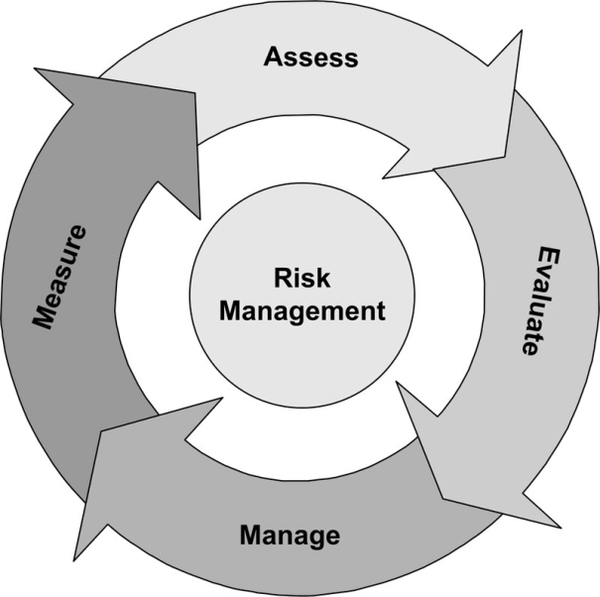
Applying EBDM to Pretrial Release & Detention
Measuring & Managing Risk – What the Evidence Tells Us
Risk is Inherent in Pretrial Release
  Our system of justice DEMANDS that we take risk for most pretrial defendants
  Question is not IF we take risk – Question is “How well do we MEASURE risk and how well do we MANAGE it”
  Release and detention decisions focus primarily on the charge not the risk posed
  Pretrial release and detention is often
  determined by resources not risk
  Enhancing public safety and being good
  stewards of public funds requires us
  to manage release and detention based on RISK

Slide 13
Applying EBDM to Pretrial Release & Detention
Measuring & Managing Risk – What the Evidence Tells Us
Monetary bail does not improve court appearance rates for defendants and can have negative consequences
Monetary bail does not improve community safety
Implementing differential pretrial supervision strategies based on pretrial risk does improve pretrial outcomes
Jurisdictions that employ court reminder notification procedures have significantly reduced FTA rates

Slide 14
Pretrial Justice
Pretrial goals
  Maximize public safety and law abiding behavior
  Maximize court appearance
  Maximize pretrial release/minimize pretrial detention
Pretrial success
  A released defendant who appears in court and does not engage in pretrial misconduct
Pretrial failure
  A released defendant who fails to return to court and/or engages in pretrial misconduct
  A defendant who is detained unnecessarily who experiences collateral consequences

Slide 15
Pretrial Justice in Wisconsin
Considerable variation in practice
  Some counties do not assess pretrial risk
  Where risk is assessed, a variety of risk assessment tools are used
  Some counties do not provide pretrial supervision
  Where supervision is provided, practices vary
  Varying practices throughout the state around the use of secured and unsecured conditions
  Data definitions vary
  Data collection/analysis varies
Practices in one county can and does affect others

Slide 16
Wisconsin Pretrial Pilot Project
The pretrial pilot seeks to test a set of legal and evidence-based practices
  Consistently, while at the same time recognizing variation in local practices and resources
    Consistent use of a pretrial risk tool (the PSA)
    Consistent data definitions & capture
    Consistent supervision practices
  Learn from/modify the model
  Replicate elsewhere in the state

Slide 17
Pretrial Risk Assessment
Pretrial risk assessment
  The PSA is an actuarial pretrial risk assessment – an objective, statistically-based resource that uses pretrial risk factors to assess a person’s likelihood of pretrial success or failure
  A pretrial risk factor is a characteristic that, when present (e.g., criminal history), indicates an increased risk of pretrial failure
The results of a pretrial risk assessment can be used alongside other information to inform the release/detention decision
The assessment is not intended to “drive” the decision but instead, to inform the decision

Slide 18
Pretrial Risk Assessment
Hundreds of jurisdictions use pretrial risk assessments
More than two dozen different assessments exist
Most pretrial risk assessments measure a person’s likelihood of:
  Making court appearances
  Not being arrested for new criminal activity
Many of the assessments use the same core group of risk factors:
  Age
  Criminal history
  Past failures to appear in court
  Pending cases
  Current offense

Slide 19
Public Safety Assessment: Origins
PSA was developed in 2013 by the Laura and John Arnold Foundation (LJAF)
LJAF’s Criminal Justice Initiative strives to identify opportunities that will advance community safety and the values of equity, fairness, effectiveness, and racial justice.
Pretrial Justice & Risk Assessment
  LJAF sought input from policymakers and practitioners to shape their research agenda
  Many emphasized the importance of the pretrial release/detention decision
  Despite six decades of research, low adoption rate of validated pretrial risk assessment tools
  Existing assessments were resource-intensive; many were jurisdiction-specific; none provided information about the potential for pretrial violence

Slide 20
PSA’s Innovations
The Foundation sought to develop a pretrial risk assessment tool that:
  Separately reported prediction of failure to appear and prediction of new criminal activity
  Also provided new violent criminal activity prediction
  Used non-interview-dependent risk factors
  Improved overall predictive accuracy
  That could be used anywhere in the U.S.
  That would be made available without cost

Slide 21
PSA Risk Factors
 | Pretrial Outcome
Risk Factor | FTA | NCA | NVCA
1. Age at current arrest |  | X
2. Current violent offense |  |  | X
2a. Current violent offense & 20 years old or younger |  |  | X
3. Pending charge at the time of the offense | X | X | X
4. Prior misdemeanor conviction |  | X
5. Prior felony conviction |  | X
5a. Prior conviction | X |  | X
6. Prior violent conviction |  | X | X
7. Prior failure to appear pretrial in past 2 years | X | X
8. Prior failure to appear pretrial older than 2 years | X
9. Prior sentence to incarceration |  | X

Slide 22
PSA Validation
Validated the PSA on over 500,000 new cases
  Localities in the U.S. Northeast, Southwest, & Midwest, and 2 states
Results confirmed the nine risk factors and the weighting of each risk factor

Slide 23
PSA General Scoring Instructions
Who gets assessed with the PSA?
  Only adults
  Not people who are already incarcerated
What data is used to score the PSA?
  Adult criminal history
  Adult court appearance history
  Traffic and criminal charges that carry a potential penalty of incarceration
  What data is not used to score the PSA?
  Juvenile records are not considered
  Non-criminal traffic are not counted
  Ordinance violations are not counted
  Self-reported information (e.g., from an interview) is not used

Slide 24
Pretrial Risk Management
We measure risk so we can manage that risk
Pretrial legal and evidence-based practices:
  Least restrictive conditions
  Risk principle
  Practices that are shown to be effective

Slide 25
Improving Court Appearance
What works and doesn’t work?
  Pretrial detention
    Can assure court appearance
    Use is legally limited
    Expensive
  Court Date Reminders
    Can improve court appearance by approximately 30 to 50%
  Pretrial monitoring/supervision: mixed results
    For “lower” risk persons: little benefit or negative benefit
    For “moderate” and “higher” risk persons: some increase in appearance
  Secured money bail: little support
    Most studies fail to show that secured financial conditions increase appearance
    Two studies show that unsecured conditions achieve the same appearance rates as secured conditions
    No study shows that higher monetary amounts increase appearance

Slide 26
Improving Public Safety
Pretrial detention
  Can increase public safety/law-abiding behavior
  Use is legally limited
  Expensive
Pretrial monitoring/supervision: mixed results
  For “lower” risk persons: little, no, or negative benefit
  For “moderate” and “higher” risk persons: mixed results for law-abiding
Secured money bail: little support
  All studies fail to show that secured financial conditions improve public safety
  No study shows that higher monetary amounts improve rates

Slide 27
Decision Making Framework
DMF Goals
  Identifies a proposed release/detention recommendation designed to manage risk in the most effective manner
  Considers
    Current charge +
    PSA results (FTA scale, NCA scale, NVCA flag)
  Guides recommendations intended to
    Detain, when allowable, highest risk defendants
    Release moderate risk defendants with conditions targeted to mitigate risk
    Release low risk defendants with minimal or no conditions

Slide 28
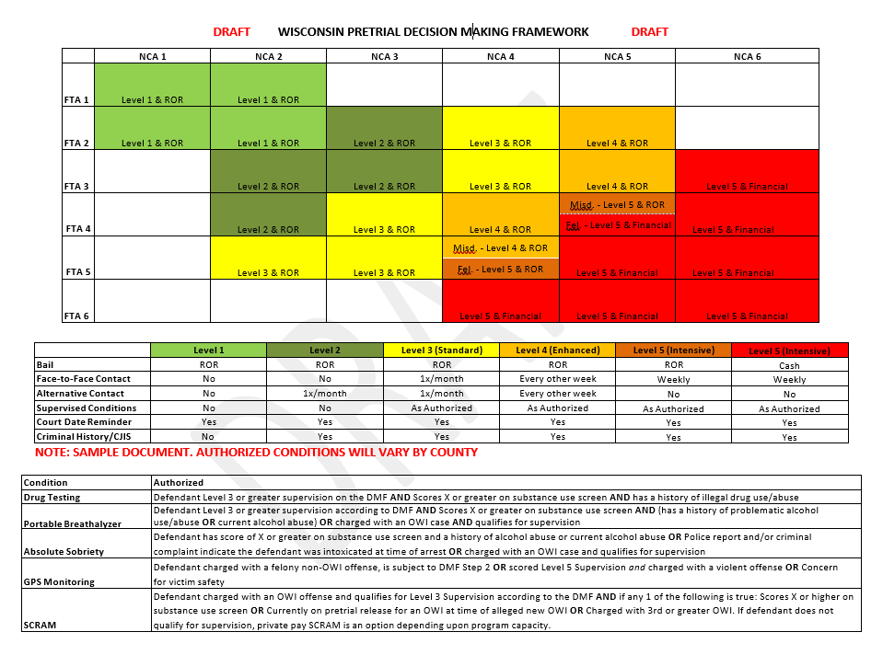

Slide 29
MILWAUKEE COUNTY OUTCOMES 2017

Slide 30
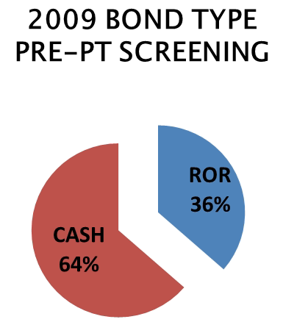
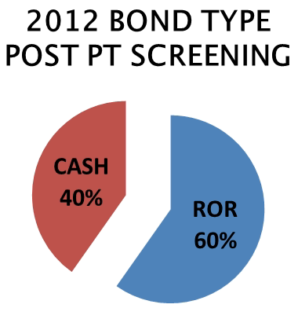
BOND TYPE COMPARISON PRE & POST SYSTEM CHANGES

Slide 31
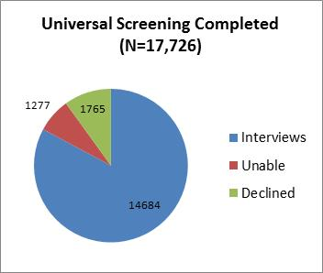

Slide 32
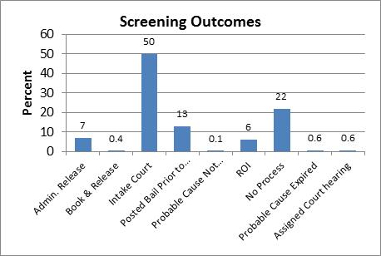

Slide 33
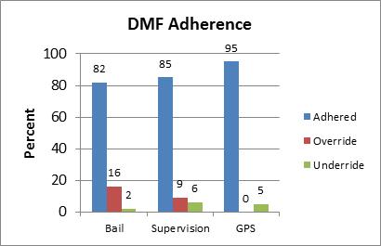

Slide 35
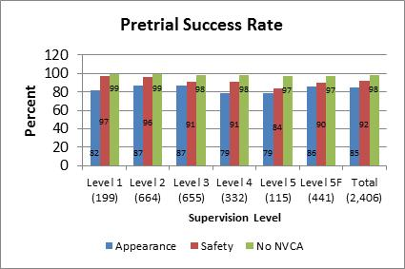

Slide 36
969.035 Pretrial detention
A circuit court may deny release from custody…
  A person accused of committing or attempting to
  Commit certain offenses.
  A pretrial detention hearing is required where DA must
  show by clear and convincing evidence that the
  Defendant committed the crime.
  The defendant has the right of confrontation, access to
  Police reports and rules of evidence apply meaning no
  hearsay

Slide 37
Next Steps
Preventative Detention
Statewide Pretrial resources
Statewide Data systems

