Slide 1
Pretrial Release: State Law & Legislation Amber Widgery August 2018

Slide 2
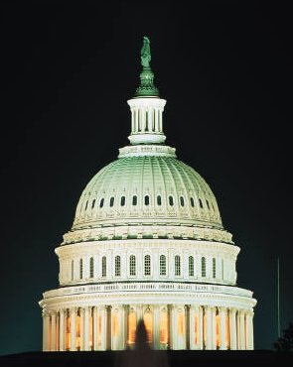
National Conference of State Legislatures
Non-profit, bi-partisan organization.
Members are all 7,383 legislators and 30,000 legislative staff in 50 states, D.C. and U.S. territories.
Offices in Denver and D.C.
Among our goals - To provide legislatures with information and research about policy issues, both state and federal.
NCSL tracks state policy developments in all public policy areas.
Notes:
Mr. Chairman, members of the committee, good morning. My name is Amber Widgery and I am a Senior Policy Specialist in the Criminal Justice Program at the National Conference of State Legislatures.
For those who are not aware of NCSL, we are the bipartisan professional organization for all 7,383 state legislators and over 30,000 state legislative staff. Our offices are headquartered in Denver, Colo. and we have an office in Washington, D.C. We provide information and research on a wide range of public policy issues including pretrial release.

Slide 3
State Legislation Generally
Every state legislature has acted to change pretrial policy in some way since 2012.
More than 700 bills have been enacted in that same timeframe.
Legislative efforts to change pretrial policy have been bipartisan.
Notes:
Every state has enacted some kind of legislation addressing pretrial policy in the past 6 years since NCSL started tracking pretrial legislation in 2012. This number includes some relatively minor reforms, but increasingly we are seeing substantial state action on this issue. Between 2012 and the end of 2017 states legislatures had enacted more than 700 new laws.
These enactments changing the framework of state pretrial systems have largely been bipartisan efforts. This cooperation is a reflection of the country as a whole. Recent national polling supported by the Charles Koch Institute and the Pretrial Justice Institute shows that a majority of Americans favor ending the practice of jailing people who cannot afford money bail before trial in all but extreme cases. The remainder of the poll results shows that Americans want an equitable justice system focused on public safety with less reliance on default incarceration.
Additionally, voters have supported pretrial reforms. In 2014 New Jersey voters approved a constitutional amendment authorizing courts to detain defendants after finding that no conditions or combination of conditions could ensure appearance, public safety or prevent obstruction of the criminal justice process. In 2016, voters in New Mexico overwhelmingly approved a similar constitutional amendment authorizing pretrial detention of defendants who pose a high risk of danger to the community or failure to appear. That amendment went one step further and added a constitutional provision prohibiting the detention of defendants solely because of financial inability to post bond if they are determined to be neither dangerous nor a flight risk.

Slide 4
What areas of pretrial policy has legislation addressed?
Notes:
There has been a lot of action on pretrial policies, but today I want to just focus on a few significant trends that I’ve seen emerge since 2012.

Slide 5
Risk Assessments
2012-2017: 28 states enacted 50 laws
Notes:
The first policy area I want to touch on is risk assessment. Recently, state legislatures have been requiring and encouraging courts to utilize risk assessments as a tool to assist them when determining whether and how to release a defendant. These tools predominantly are designed to predict risk of failure to appear and the risk of a defendant being re-arrested for a new offense.
State legislatures have supported adding risk assessments as a tool four courts making difficult release decisions but have not required courts to strictly adhere to the results of these assessments.
Between 2012 and 2017, 28 states enacted 50 new laws addressing the use of a risk assessment at some point during the pretrial process.

Slide 6
Statewide Risk Assessments
2012-2017: 12 states authorize statewide risk assessment
Notes:
Of those 28 states on the previous slide, 12 states – Alaska, Colorado, Delaware, Hawaii, Illinois, Indiana, Kentucky, Montana, New Jersey, Rhode Island, Vermont and West Virginia - have required, authorized or incentivized the use of a risk assessment through legislation, for at least some if not all defendants, on a statewide basis.
It is also worth noting that local jurisdictions and state judicial branches have been actively working on risk assessments, for example the Arizona Supreme Court modified the state’s rules of criminal procedure in 2017 to require the use of a risk assessment approved by the state supreme court when determining conditions of release necessary to ensure public safety or mitigate the risk of flight.

Slide 7
Risk Assessments: Recent Enactments
Statewide Risk Assessment Authorization Expansion in 2017
Other Risk Assessment Enactments 2017 & 2018
IL SB 2034 (2017)
IN HB 1137 (2017)
MT SB 59 (2017)
RI HB 5064/SB 10 (2017)
HI HB 1135 (2017)
MA HB 3800 (2017)
MI HB 4323 (2017)
ND SB 2015 (2017)
NY SB 5492 (2017)
OR HB 2238 (2017)
TX SB 1326 (MH) (2017)
VT SB 134 (2017)
WA HB 1163 (DV) (2017)
AK HB 312 (2018)
DE HB 204 (2018)
MD HB 447 (2018)
MA SB 2371 (2018)
MI SB 848 (2018)
WV HB 4228 (2018)
Notes:
There was a sort of surge of activity surrounding risk assessments in 2017. The provisions in Illinois, Indiana, Montana and Rhode Island were all put in place last year, greatly increasing the number of states that are moving towards risk-based systems of pretrial release.
The additional enactments you see on this slide did a number of things, but broadly speaking they funded or directed the development of a risk assessment tool, created risk-based release pilot programs, requested studies of risk-based tools and systems, or modified existing risk based systems that were already in place. These modifications have included limiting the use of information obtained during the risk assessment process, speeding up the risk assessment process by adding timeframes and clarifying that risk assessment is just one of many factors to be considered when courts are determining release and conditions.
So far this year just about half the states have considered legislation that would address pretrial risk assessment.

Slide 8
Presumption of Release on Recognizance or Non-Financial Conditions
24 states have a presumption of release on non-financial conditions
Updated through 2017
Notes:
The second policy area I want to discuss broadly fits into what I call statutory guidance for courts.
At the end of last year nearly half the states had implemented a statutory presumption of release on recognizance or non-financial conditions for specified defendants. Sometimes this presumption only applies to defendants charged with misdemeanor or petty offenses, but several states have this presumption in place for all release eligible defendants.

Slide 9
Least Restrictive Conditions of Pretrial Release
Updated through 2017
17 states & D.C. require the use of least restrictive conditions | 4 states structure how conditions are imposed
Notes:
In addition to the presumption of release on recognizance, a few states have gone one step further and require courts to impose the least restrictive conditions necessary to ensure the appearance of the defendant and/or public safety. This is the case in 17 states.
An additional four states do not have this express presumption, but they instead require courts to consider release on recognizance or an unsecured appearance bond first. If the court determines that an unsecured appearance is insufficient to ensure appearance or public safety, then other statutory conditions may be imposed.

Slide 10
Court Guidance on Release Conditions
Significant Legislation from 2017 & 2018:
Expanded the number of states with a presumption of the least restrictive conditions.
Limited courts’ ability to impose financial conditions.
Required courts to consider a defendant’s ability to pay financial conditions or pretrial supervision fees.
Sped up review of conditions of release for those who aren’t able to meet initial conditions.
Notes:
Enactments have also provided further guidance on the conditions of release. In 2017, we saw a couple of new things in statute, including restrictions on courts ability to impose financial conditions in certain cases and requirements to consider a defendant’s ability to pay financial conditions. This included financial conditions of release and even associated supervision fees. Additionally, a 2017 Nebraska law requires courts to consider all methods of bond and conditions of release that might be used to avoid incarceration.
Legislation also sped up review procedures for defendants who couldn’t meet conditions of release as initially set. This last change has broadly been referred to as a “2nd look” and it is something that I’m seeing more of and also hearing more about in local practice. These provisions usually authorize a defendant to file a motion seeking review after a specified number of hours in detention. Some variations of this provision require courts to review conditions instead of waiting on a defendant motion, and a 2017 Texas law even created a presumption of inability to pay after 48 hours of detention in certain cases.

Slide 11
Conditions of Pretrial Release
2012-2017: 40 states & D.C. enacted 130 laws
Notes:
In addition to providing statutory guidance on the method and conditions of release, state legislatures have also been looking at what conditions are statutorily authorized. Overall, this wealth of legislative action has focused largely on broadening and diversifying conditions of release that are available to courts and other release officials.
40 states and the District of Columbia enacted 130 new laws between 2012 and 2017 addressing conditions of pretrial release.
This legislation has added additional conditions of release to those statutorily provided for, and occasionally it has authorized or provided funding for supervision programs such as electronic monitoring.
In addition to the conditions that are statutorily provided for, all but a handful of states authorize courts to impose any additional condition that they deem necessary to ensure the appearance of the defendant and/or public safety. These legislative actions can help to authorize alternatives to financial conditions of release and ultimately pretrial detention.

Slide 12
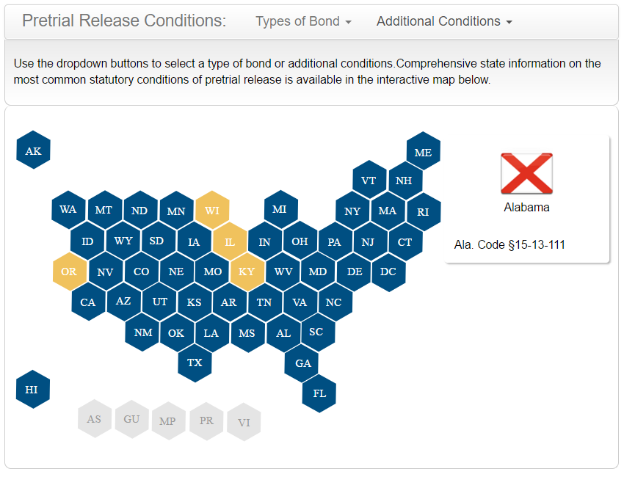
Conditions of Pretrial Release
NCSL Conditions of Release Database

Slide 13
Pretrial Services
2012-2017: 29 states enacted 63 laws
NCSL Brief on Pretrial Services
Notes:
Relatedly, states have also been looking at pretrial services. The majority of states currently use pretrial services programs to some degree whether that is statewide or in only a few jurisdictions varies by state.
Generally, the core responsibilities of pretrial services programs are to evaluate and provide information on defendants to officials charged with releasing them, and to supervise defendants on pretrial release.
In the last 6 years 29 states have legislatively addressed pretrial services. Among various other technical changes these enactments have included: (1) Creating or authorizing new statewide pretrial services programs and (2) Authorizing the use of existing funds for pretrial services or appropriating new funds for the support of pretrial services.

Slide 14
Defendant Eligibility for Pretrial Release
2012-2017: 30 states & D.C. enacted 67 laws
Notes:
The next legislative trend relates to who is eligible for release and when. A lot of legislation that I track in this area authorizes pretrial detention of a defendant in certain circumstances.
For example, a lot of recent action has created temporary holds for defendants charged with domestic violence or similar offenses. Generally, these provisions are referred to as “cooling-off periods” and require the detention of a defendant for a specified number of hours or until the first court appearance or an adversarial release hearing.
I also track provisions that expand non-bailable offenses or specify instances in which a defendant cannot be detained.
In the last 6 years, 30 states and the District of Columbia have enacted 67 new laws affecting these policies. This area of the law has also been affected by the constitutional amendments in New Jersey and New Mexico that I mentioned at the beginning of my presentation.

Slide 15
Addressing Victims During the Pretrial Process
The majority of states provide victims with the right to be notified of a defendant’s release.
The majority of states have laws addressing victim participation during the pretrial stage.
This includes the right to be heard or the right to be consulted.
Notes:
The next policy area that I’ve noticed receiving a lot of legislative attention is the role of victims in the pretrial process. Most states have statutes or constitutional provisions on this topic.
The majority of states provide victims with the right to be notified when a defendant is released prior to trial, and several states also require that the victim be notified of conditions of release as well.
Most states also have laws addressing victim participation at the pretrial stage. This can include the right to be heard or the right to be consulted.

Slide 16
State Legislation Addressing Victims and Pretrial Policy
2012-2017: 38 states enacted 85 laws
Notes:
Between 2012 and 2017, 38 states addressed pretrial policy related to victims. These laws are frequently directed at protecting victims of domestic violence, stalking, certain sex offenses and victims of protection order violations.
Examples of what some of these enactments have done include: (1) Cooling off periods, or delayed release for certain defendants; (2) Expanding options for domestic violence evaluations including lethality assessments; (3) Automatic entry of a protection order as a condition of release; and (4) Requiring courts to consider victim safety when determining release and conditions.
In the past several years a handful of states have amended their constitutions or enacted legislation enumerating victims’ rights. Pretty much all of these provisions that have become law require courts to consider victim safety when determining conditions of release.

Slide 17
Citation in Lieu of Arrest
2012-2017: 13 states enacted 18 laws
Citation in Lieu of Arrest: 50 State Chart
Notes:
The last few things I want to talk about have more to do with appropriate use arrest and detention and increasing the availability of appropriate alternatives to arrest and detention. The majority of states authorize law enforcement officers to issue citations in lieu of making an arrest for specified offenses. This generally applies to misdemeanor offenses or other specified classes of offenses.
In 2017 and now 2018, we saw a few enactments on this topic that specifically expanded authorization for law enforcement to use citation in lieu of arrest, but it is also worth noting that other legislative changes have affected this area of the law. For example, states that have reduced drug possession or other “non-serious offenses” from felonies to misdemeanors have thus also expand the range of offenses where citation in lieu of arrest could be utilized. Changing felony threshold levels also impacts which offenses qualify for citation in lieu of arrest.

Slide 18
Deflection and Diversion
Deflection is an emerging legislative trend that reroutes individuals with behavioral health needs before arrest or before contact with the justice system.
Alternatively, statutory pretrial diversion is well established in 48 states and the District of Columbia and reroutes defendants after arrest, but prior to adjudication or final entry of judgment.
Notes:
The last policy area I want to mention is another sort of early intervention before detention occurs. States have recently started to focus on what I call deflection, or rerouting individuals to community based behavioral health services prior to arrest or contact with law enforcement. These policies target individuals who may be high utilizers of the justice system, but for whom the justice system may not be the most appropriate intervention.
Deflection is something that is relatively new for state legislatures, but we are starting to see legislative authorization, funding and oversight. Most deflection legislation to date has focused on individuals for whom drug, or mental health interventions would be the more appropriate response.
We track these emerging deflection enactments alongside more well established pretrial diversion programs and pre-adjudication treatment courts.

Slide 19
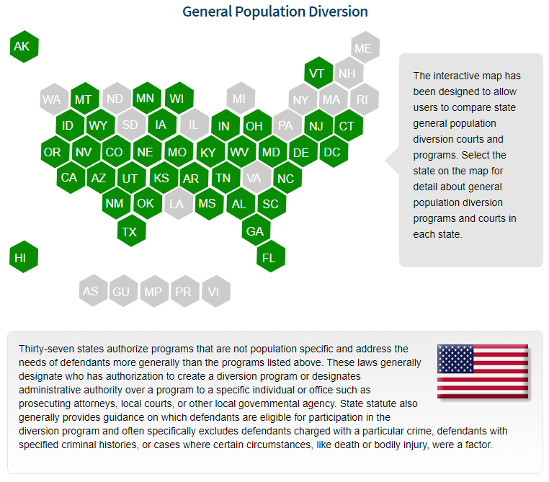
Statutory Pretrial Diversion Database
Statutory Pretrial Diversion Database
Notes:
Forty-eight states and the District of Columbia have statutorily provided for pretrial diversion alternatives to the traditional criminal justice system. Nearly every state has enacted a new law addressing pretrial diversion since 2012 and I am seeing this trend continue. Pretrial diversion can refer to a lot of things, but I define it as interventions taking place after an individual is arrested, but prior to adjudication or final entry of judgment where successful completion results in dismissal of the case or charge.
The majority of states have created two kinds of diversion alternatives, what I call population specific diversion and general population diversion. NCSL has an interactive database that allows you to look at the various types of diversion alternatives in all 50 states. The overwhelming trend in this area of the law is to expand diversion opportunities and resources for individuals for whom the criminal justice system may not be the best intervention.

Slide 20
Want to Know More?
TOPICS
Bond Forfeiture & Conditions Violations
Budget, Oversight & Administration
Citation in Lieu of Arrest
Commercial Bond Regulation
Conditions of Release
Statutory Court Guidance
Diversion/Deflection
Eligibility for Release
Pretrial Services & Programs
Risk Assessments
Special Populations
Victims Protections and Policy
NCSL has tracked pretrial policy enactments since 2012. Enactments can be searched by topic, year, state, author or bill number. You can also search the summaries by keyword.

Slide 21
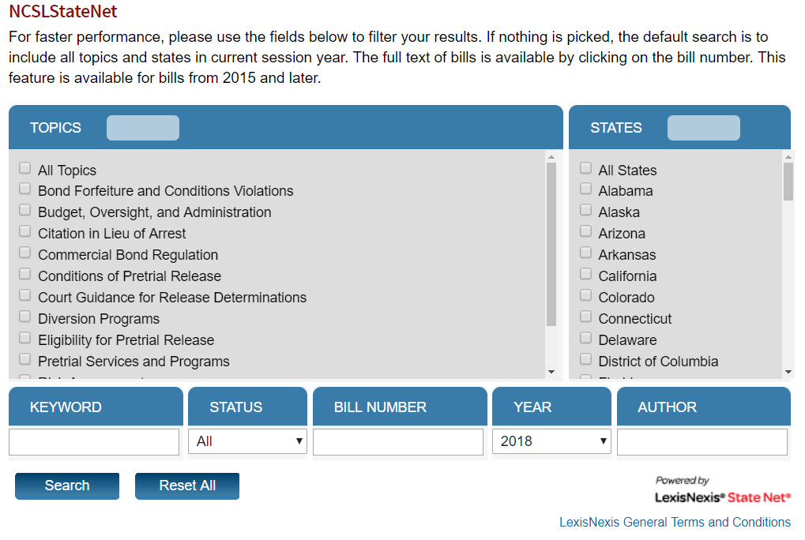
New in 2018!
Starting in 2018, NCSL started tracking pending pretrial policy legislation in all 50 states.

Slide 22
Resources and Reports from the States
Information on the provisions I’ve discussed today can mostly be found in:
NCSL’s Pretrial Enactment Database
NCSL’s Pretrial Pending Legislation Database
NCSL’s Pretrial Policy Database
NCSL also tracks reports coming out of state legislatures or from the executive and judicial branches. Those can be found on our State Reports Webpage.

Slide 23
Questions?
Contact me at:
amber.widgery@ncsl.org

