Slide 1
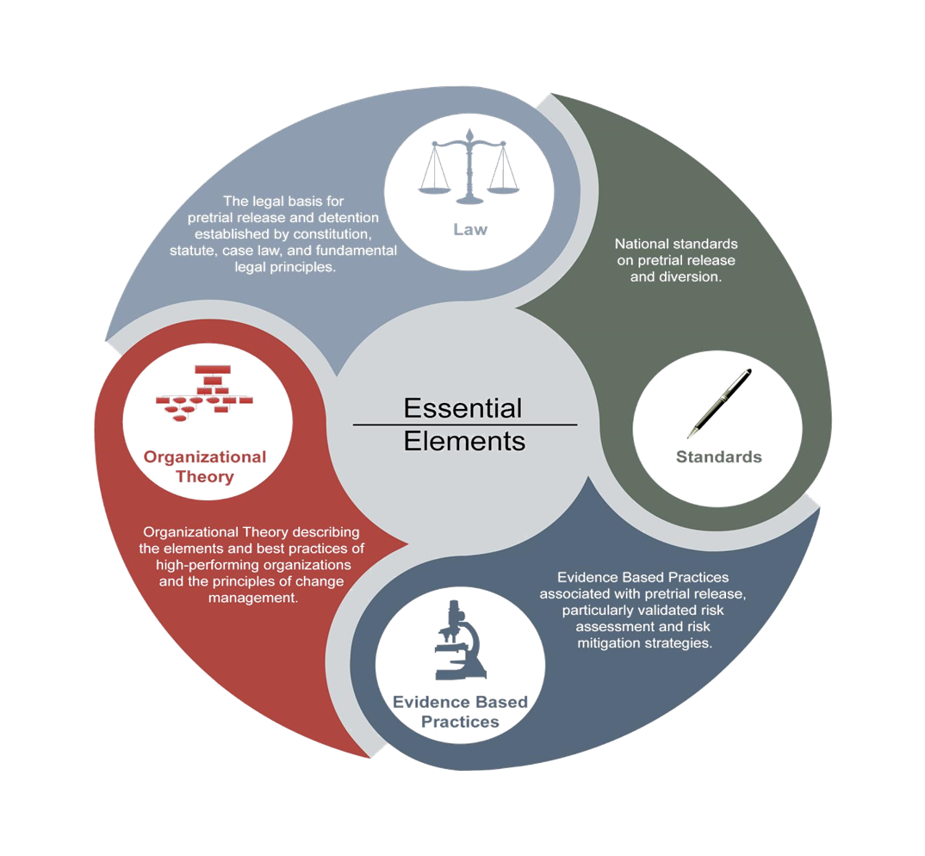
Essential Elements of a Highly Functioning Pretrial Justice System
Daniela Imig
Nick Sayner

Slide 2
Overview
Introduction
  Pretrial Justice System Framework and Goals
Legal Framework
Essential Elements

Slide 3
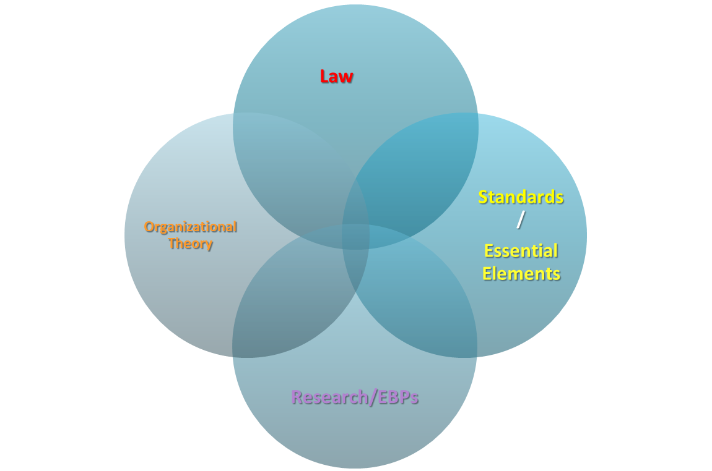
Primary Source

Slide 4
Pretrial Justice System Goals
  To reasonably assure Community Safety
  To reasonably assure Court Appearance
  Maximize Release for release eligible defendants
  Provide legally permissible detention for truly risky defendants
  Remember the 3 M’s:
    Maximize Release
    Maximize Appearance
    Maximize Safety

Slide 5
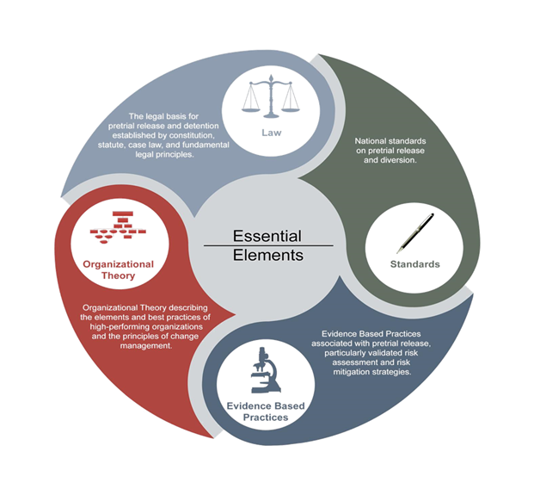
Legal Framework

Slide 6
Infrastructure to Support a High Functioning Pretrial Justice System
Legal Structure to Support the Purpose of Bail
Develop all components of a High Functioning Pretrial Justice System
Dedicated Pretrial Services Agency
System Stakeholders Support Adaptive Change

Slide 7
Legal Principles: Bail
Bail is a process of release (Stack v. Boyle)
Bail is not money (Federal Definition)
The purpose of bail is to release
The purpose of “no bail” is to detain

Slide 8
Legal Principles: The Foundation
Presumption of Innocence
Right to Bail
“In our society, liberty is the norm, and detention prior to trial or without trial is the carefully limited exception.” (US v. Salerno)
Due Process
Equal Protection

Slide 9
Essential Elements

Slide 10
1. Pretrial release and detention decisions are based on risk
Maximize
  Appearance
  Public Safety
  Release

Slide 11
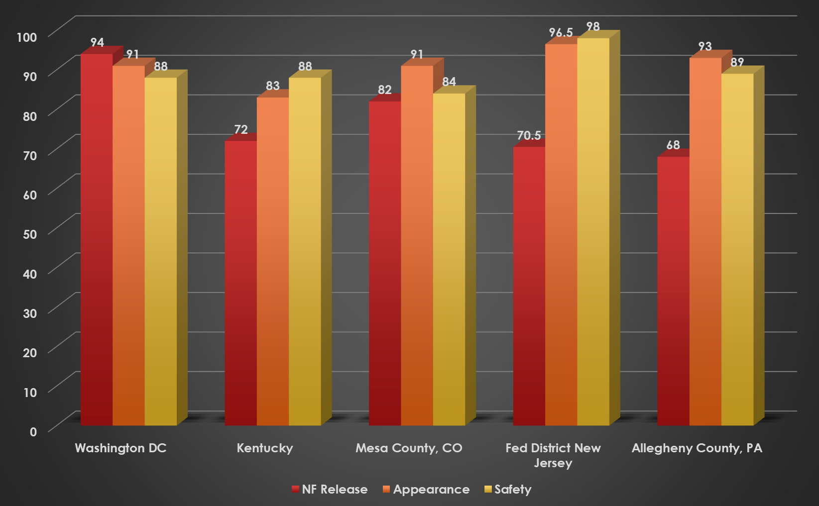
What does Pretrial Risk Look Like?

Slide 12
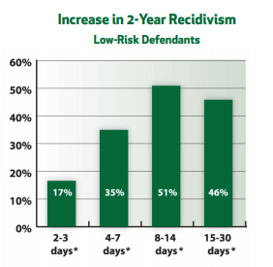
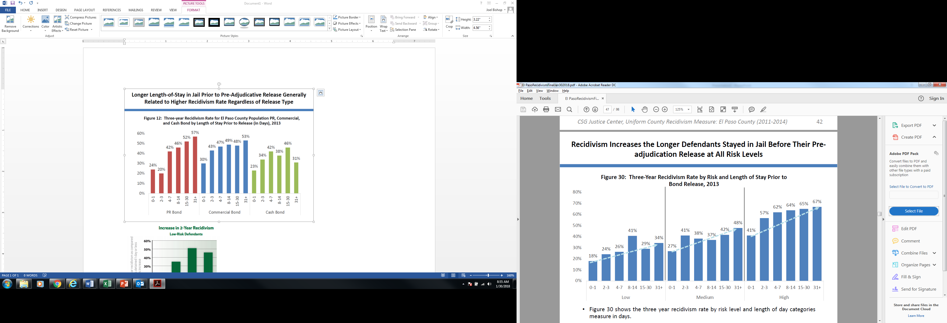
LJAF Research, 2013 / Justice Center Research, 2018
Recidivism Correlated with Days in Jail
3-Year Recidivism
Low Risk Defendants
Notes:
Post-adjudication recidivism.

Slide 13
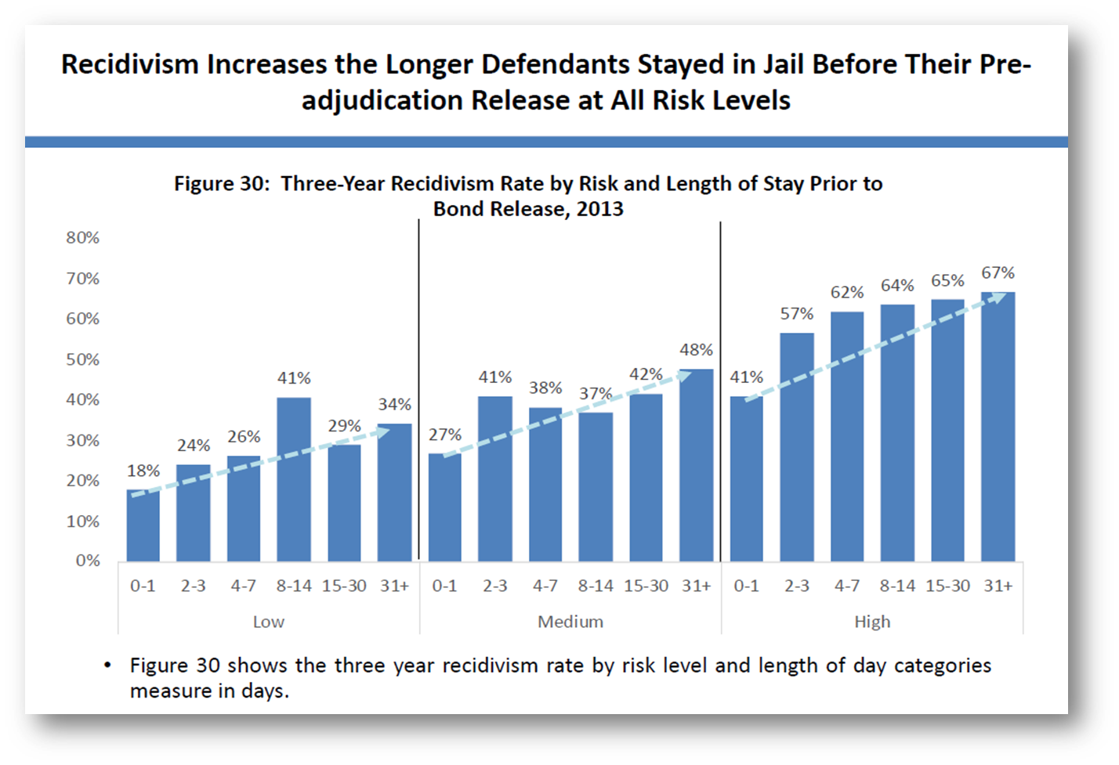
El Paso, Tx

Slide 14
2. Release options following arrest
Citation in lieu of arrest
Pre-arraignment release screening
Diversion to non-criminal options

Slide 15
3. Delegated Release Authority
Early- Pre-Arraignment
Limited
Risk Based vs. Money Based

Slide 16
4. Statutory presumption of nonfinancial release
Maximize Release
Availability of preventative detention

Slide 17
5. Speedy prosecutorial case screening
6. Defense counsel at initial appearance
Options for Diversion
No Charge
Meaningful Initial Appearance

Slide 18
7. Dedicated Pretrial Services Agency
Function and Resources needed to support the judges release or detention decision

Slide 19
High Functioning Pretrial Services Agency

Slide 20
High Functioning Pretrial Services Agency
1. Dedicated Pretrial Program
      Operationalized Mission
2. Universal Screening for all Release Eligible Defendants
3. Validated Assessment Instruments
      Validated and Normed on Pretrial Populations
4. Sequential Bail Review
5. Risk-based Supervision
6. Performance measurement and Feedback

Slide 21
Performance Measurement
High-functioning pretrial systems collect and publish pretrial justice performance and outcome measures. At the least, these include:
    Appearance Rate
    Safety Rate
    Concurrence Rate

Slide 22

Questions and Discussion

