Slide 1

Using Data, Research, and Information for Informed Pretrial Decision Making
Constance Kostelac, PhD
Director
Bureau of Justice Information and Analysis
Wisconsin Department of Justice

Slide 2
What is Pretrial?
Pretrial period is from initial arrest through case disposition
Many key decisions occur during this phase, including but not limited to:
    Book or cite and release
    Charge or not charge
    Divert
    Detain or not detain
    Bail and conditions of release
Period prior to case disposition
  Presumption of innocence
  Have not been convicted

Slide 3
Pretrial Pilot
Mission:
Develop and implement policies and operational procedures following legal and evidence-based practices in pretrial release and detention, to support the goals of:
maximizing public safety
maximizing court appearance
and
maximizing release.

Slide 4
Pretrial Justice
Broad concepts
Pretrial success
  A released defendant who appears in court and does not engage in new criminal activity during the pretrial period
Pretrial failure
  A released defendant who fails to return to court or engages in new criminal activity during the pretrial period
  A defendant who is detained unnecessarily who experiences collateral consequences

Slide 5
Data Needed for Pretrial
Significant data needed
  To complete the risk assessment, as well as to track progress and outcomes
  Does not exist in a common system currently
  Pretrial pilot counties will be capturing consistent information
  Definitions and ways of collecting and classifying the data are critical

Slide 6
Pretrial: Risk Assessment
Pilot sites have elected to use, at least initially, the Public Safety Assessment (PSA) from the Laura and John Arnold Foundation
  Static factors
Prior violent conviction
Prior incarceration
Prior conviction
Age
Current Offense
Pending Charge
Prior Failure to Appear

Slide 7
Pretrial: Risk Assessment
Risk Score
Failure to Appear (FTA)
New Criminal Activity (NCA)
New Violent Criminal Activity (NVCA)
The Public Safety Assessment (PSA) includes multiple measures of “risk”

Slide 8
Pretrial: Data, Performance Measures and Outcomes
Data collection is key
To both monitoring the pretrial pilots, as well as measuring outcomes
Key Outcomes:
Failure to Appear
Success = Appearance Rate
New Criminal Activity
Success = Safety Rate

Slide 9
Pretrial: Data, Performance Measures and Outcomes
Additional measures related to pretrial processing:
  Defendants by risk level for FTA/NCA
  Concurrence rate
  Length of stay for detained defendants
  Pretrial detention/release rate
  Conditions imposed
  Time on supervision
  Reason(s) detained

Slide 10
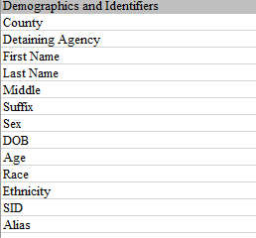
Pretrial: Data to Collect
Draft data elements necessary to track pretrial progress and outcomes
D
R
A
F
T

Slide 11
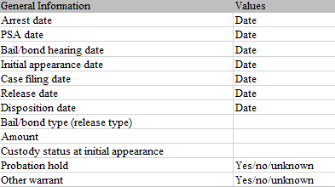
Pretrial: Data to Collect
Draft data elements necessary to track pretrial progress and outcomes
D
R
A
F
T

Slide 12
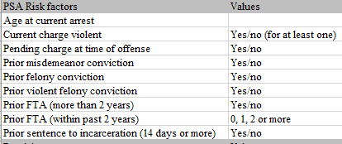
Pretrial: Data to Collect
Draft data elements necessary to track pretrial progress and outcomes
D
R
A
F
T

Slide 13
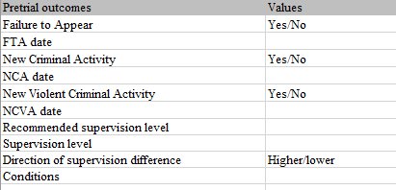
Pretrial: Data to Collect
Draft data elements necessary to track pretrial progress and outcomes
D
R
A
F
T

Slide 14
Data Challenges
Ideally, would have…
A common system across counties/tribes and types of agencies
But they are built for operational need, not data collection and analysis
Another option is to connect those systems or
Develop new systems for particular purposes
Also the challenge of accessing some of the needed data
  Privacy and security are critical

Slide 15
Current Data Sharing Efforts
Most data is not currently connected
At least not for research and analysis purposes
Systems sit separately
Recent efforts to establish a common identifier across systems
  Enhanced State Data Sharing (ESDS)
  State Identification Number (SID)
  Across multiple systems
  First major load was more than 875,000 records with SIDs to CCAP and PROTECT

Slide 16
Current Data Sharing Efforts
State Criminal Justice Coordinating Council – Data Sharing Subcommittee
Current effort underway to provide a proof-of-concept on data sharing
  Department of Justice, Department of Corrections, Director of State Courts Office
  Courts, corrections, and state criminal history data
  Recidivism analysis for TAD and related projects
Comprehensive Outcome, Research, and Evaluation (CORE) Reporting System
    Designed for Treatment Courts and Diversion Programs
    Participant-level data
    Supports performance measurement and evaluation for TAD and other programs

Slide 17

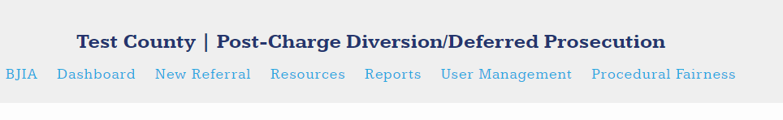
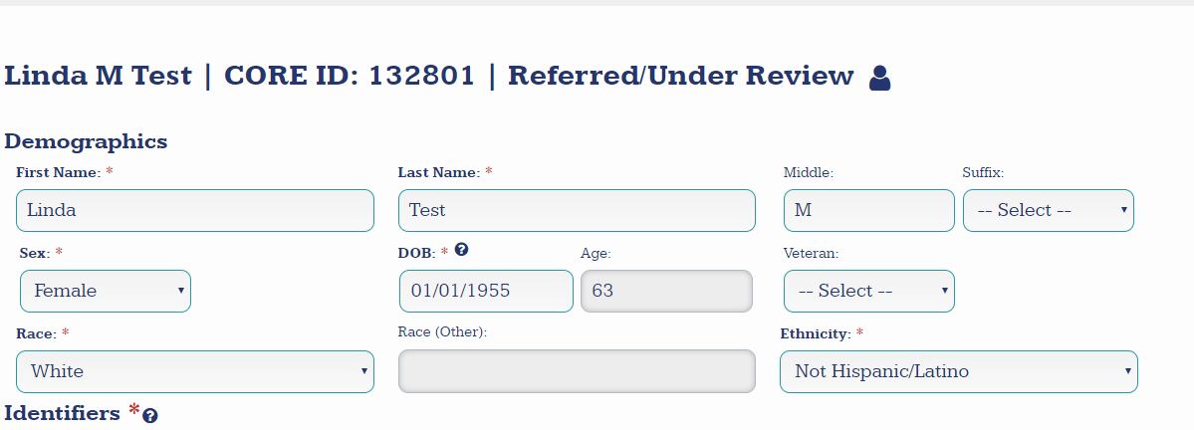

Slide 18
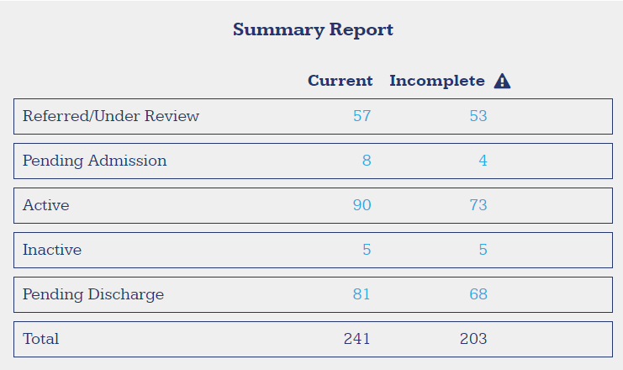

Slide 19
Why Pretrial?
National movement to address the front-end of the criminal justice system
Each local team and the state team identified this as a key decision point early in the process
Emphasis on public safety and legal rights of the defendant
Pretrial sets the stage for everything else in the process
Research has demonstrated there are short- and long-term consequences for defendants, the justice system, and the public

Slide 20
Research Background: Risk
Importance of understanding risk
Most pretrial defendants present low to moderate risks of failure pretrial
    Majority of defendants show up to court and do not engage in new criminal activity during the pretrial period
    Does tend to vary based on risk level
Based on risk principle, should match supervision to risk level
    Intervention should match risk
    Research (Lowenkamp and VanNostrand, 2013) has demonstrated that moderate- and high-risk defendants under supervision were:
      more likely to make their scheduled court appearances
      less likely to engage in new criminal activity during pretrial period
        If supervised for over 180 days
    Poor matching of supervision levels to risk levels may increase pretrial failure rates
https://www.arnoldfoundation.org/wp-content/uploads/2014/02/LJAF_Report_Supervision_FNL.pdf

Slide 21

Public Safety Assessment
PSA Validation
  Pretrial Failure to Appear

Slide 22
Public Safety Assessment
PSA Validation
  New Criminal Activity

Slide 23
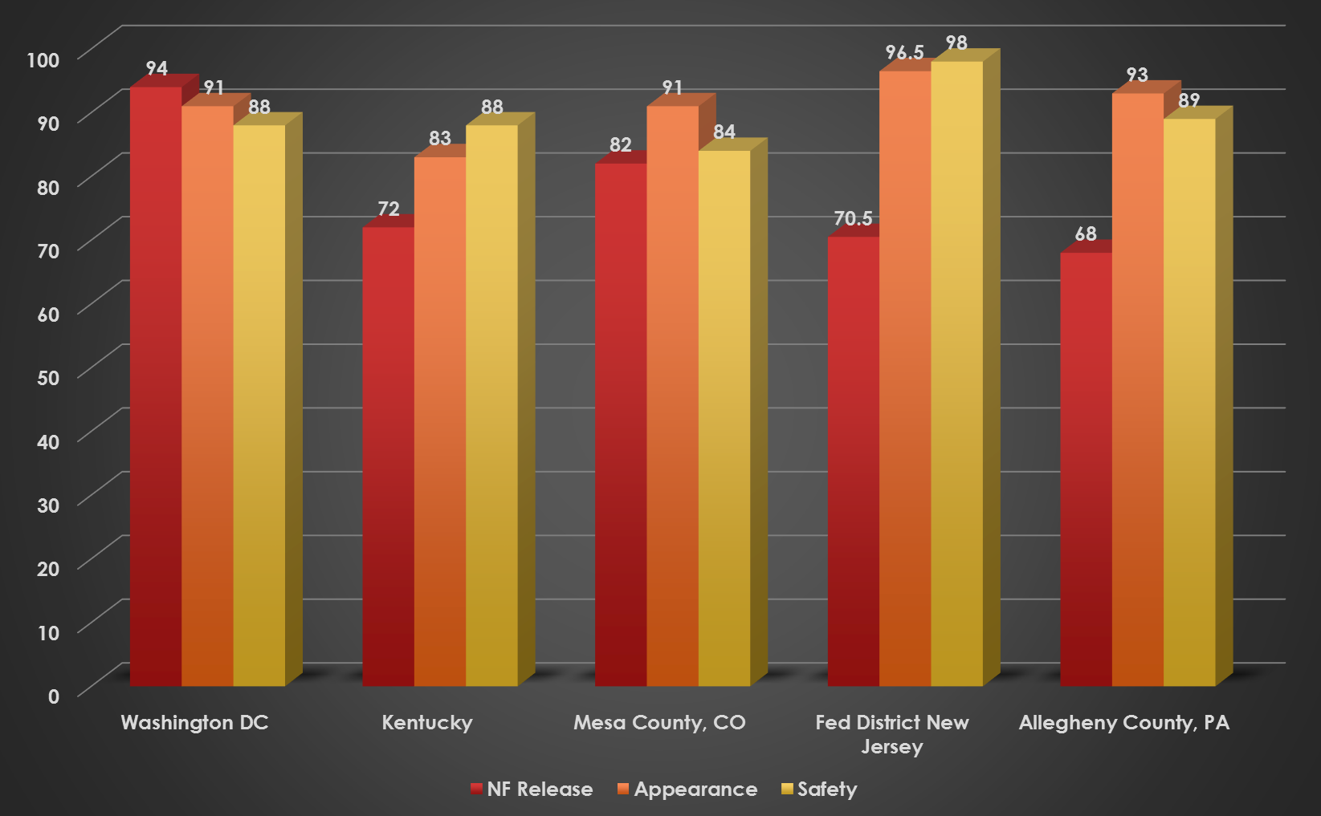
Appearance and Safety Rates
Source: Listed Jurisdictions/NAPSA

Slide 24
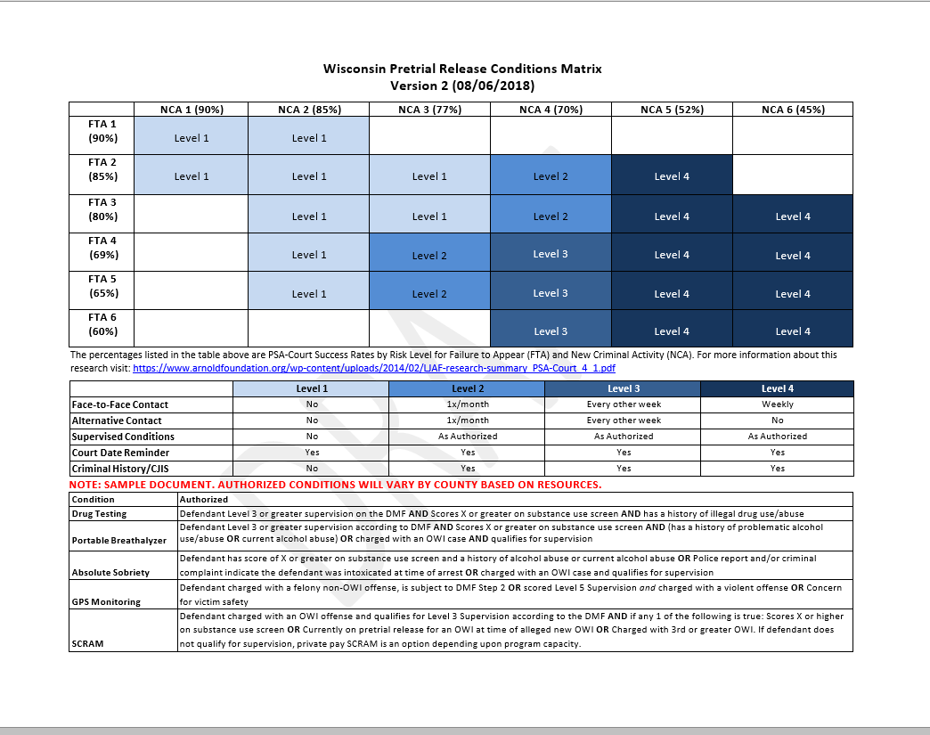
Pretrial Pilot Overview: Model Policies
**Sample only**

Slide 25
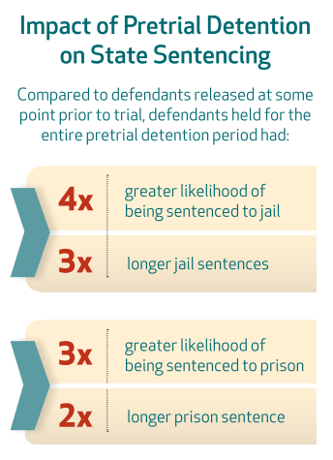
Research Background: Impact of Detention
Defendants detained pretrial are more likely to be sentenced to jail/prison, and to receive longer sentences than defendants who are not detained
  Lowenkamp, VanNostrand, & Holsinger, 2013a
The likelihood of being sentenced to jail/prison and for longer periods is more pronounced for low- risk defendants detained pretrial.
https://www.arnoldfoundation.org/wp-content/uploads/2014/02/LJAF-Pretrial-CJ-Research-brief_FNL.pdf
https://www.arnoldfoundation.org/wp-content/uploads/2014/02/LJAF_Report_state-sentencing_FNL.pdf

Slide 26
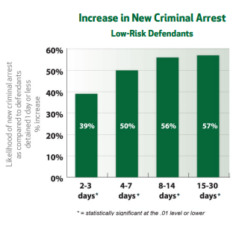
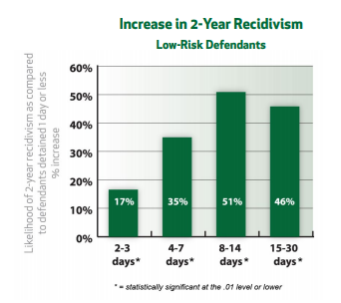
Research Background: Impact of Detention
Research has demonstrated that detaining low and moderate risk defendants in jail for even short periods of time (i.e., 2–3 days) is related to increased risk for misconduct both short- and long-term
  Lowenkamp, VanNostrand, & Holsinger, 2013b
https://www.arnoldfoundation.org/wp-content/uploads/2014/02/LJAF-Pretrial-CJ-Research-brief_FNL.pdf
https://www.arnoldfoundation.org/wp-content/uploads/2014/02/LJAF_Report_hidden-costs_FNL.pdf

Slide 27
Pretrial:
Key Issues
Risk Assessment
Judicial Discretion
Better Pretrial Decisions
  Emphasis on maximizing release, maximizing court appearance, and maximizing public safety
  Use of validated risk assessment tool
      Supplement, not replace judicial discretion
      Helps predict likelihood of pretrial success or failure
      Should inform decisions on supervision level and conditions
      Could be an area for potential change
  Presumption of release
      Limited conditions under which someone can be detained
      Preventive detention is another area for potential change
        But must be limited!

Slide 28
Pretrial: Key Issues
  Least restrictive, nonfinancial release conditions
    Money ≠ public safety
    Over-conditioning can be harmful
    Importance of risk-based supervision
  Goal
  Reasonably assure public safety and court appearance
    Maximize release, maximize safety, maximize court appearance
    More likely to be able to accomplish this if understand and account for risk
    High cost associated with detention directly and collateral consequences

Slide 29
Using Data, Research, and Information for Informed Pretrial Decision Making
Questions and discussion
Constance Kostelac, PhD
Director
Bureau of Justice Information and Analysis
Wisconsin Department of Justice

