Slide 1
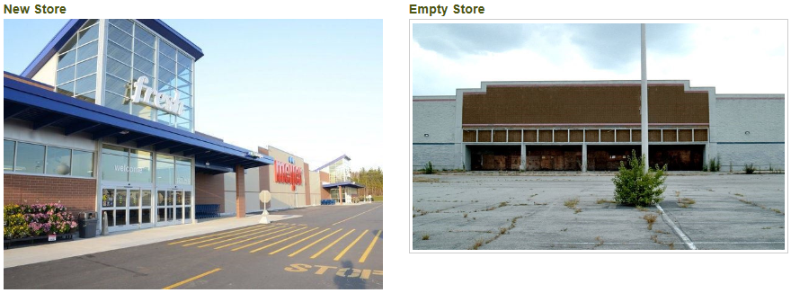
Study Committee on Property Assessment Practices
Discussion on Economic Development and Assessment Practices
Impact to TIF, Development Agreements and Dark Store Theory and Shifting the Tax Burden
September 6, 2018
Patrick Schloss
Community Development Manager

Slide 3
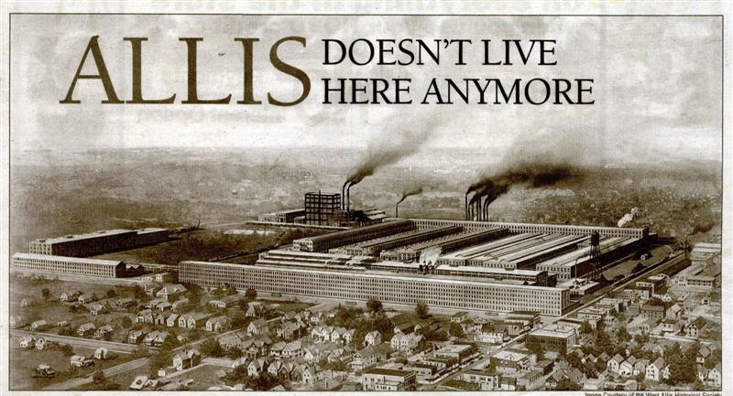
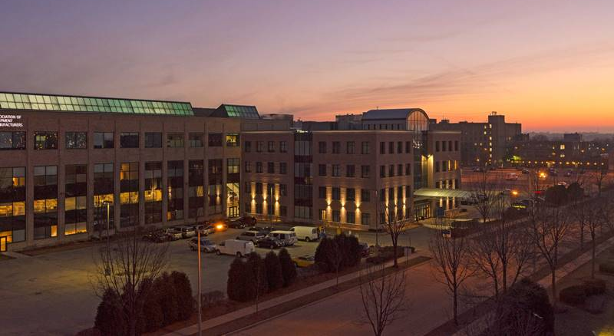

Slide 4
Public Policy
A city is not gauged by its length and width, but by the broadness of its vision and the height of its dreams.
Herb Caen

Slide 5
Development - Value - Discussion
Value
Project
Cost to Construct
Financing
Value
How will the project perform
Development Agreement
Protections/Success
Dark Store Theory Walgreens

Slide 6
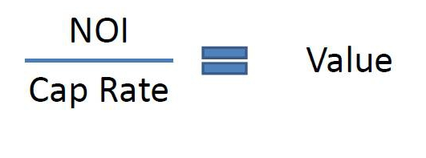
Value “101”
Net Operating Income= NOI
Cap Rate – fundamental test to determine value

Slide 7
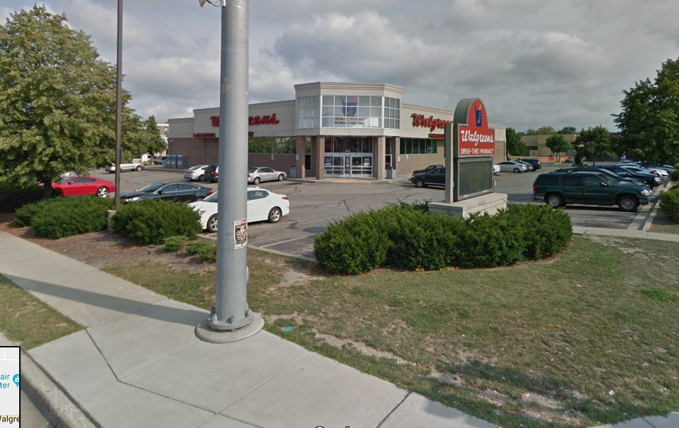
Example – Walgreens
NOI = $323,444
Divided by
CAP Rate = 6.35%
Value=$5,093,606
Source: Loopnet
2018 Assessment: Total of land and improvements: $1,850,300

Slide 8
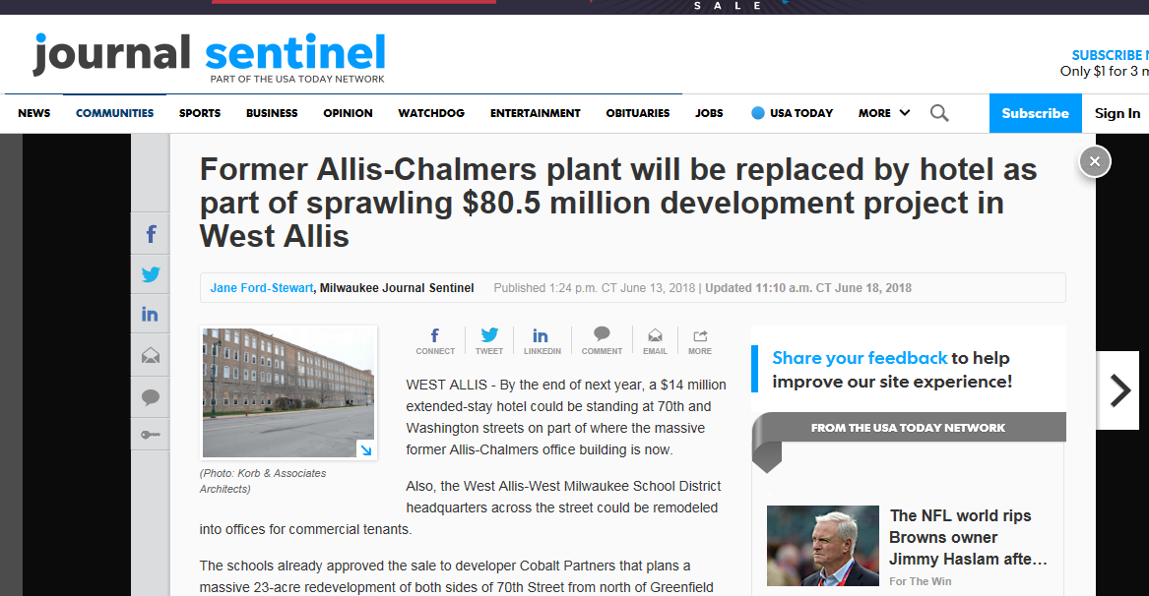
How does a TIF Development deal work?

Slide 9
Tax Increment Financing

Slide 10
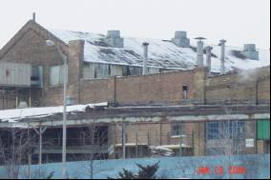
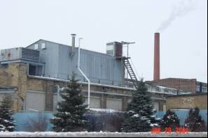
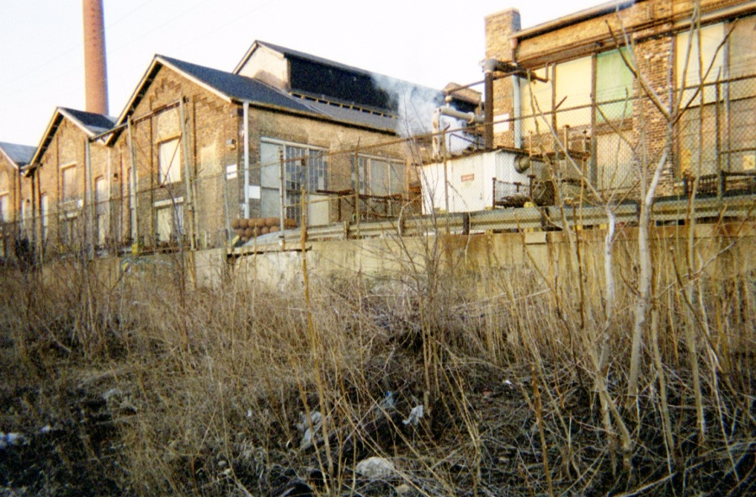

Slide 11
Do Nothing? Provide TIF assistance?
Do nothing:
Continue with current base value
“Opportunity cost”- lost taxes, lack of image improvement, inability to attract new users
Implement Tax Incremental Financing assistance:
Incremental taxable value to community
“But for” test – the development would not occur but for the use of TIF
Other creative financial tools?

Slide 12
The Policy of TIF
Community
Economics
Balance of Risk
Public Benefit

Slide 14
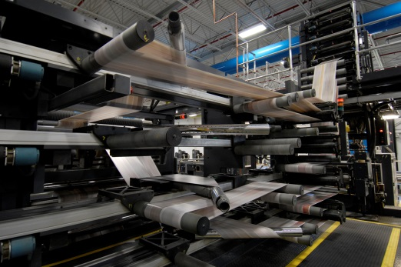
Tax Increment Financing “Transformative Tool”
Impetus to Advance transformation
Projected to add over $228 million in new tax base
Expanded employment base by over 4,450 jobs

Slide 15
Moving from Project to Deal
Lead
Definition
Hurdle
Negotiation
Closing
Closed
Day 1
Day 75
City – Broker -Developer
CDA/Consultants
Committee
Council
Notes:
Company decisions on where to choose to expand or locate operate like a funnel. Within that funnel, is the typical evolution of a project as see here. This slide depicts a project pipeline and how to structure community engagement and decision-making. The workbook includes an opportunity for participants to map out their community’s project pipeline. Have them fill out how leads are started, where decision-making rests and when elected officials are involved.

Slide 16
BASIC TIF PREMISE
All taxing jurisdictions receive their share of taxes from all property value.
NEW BASE VALUE
Property Value
Increment Value
Base Value
Time
TID Ends

Slide 17
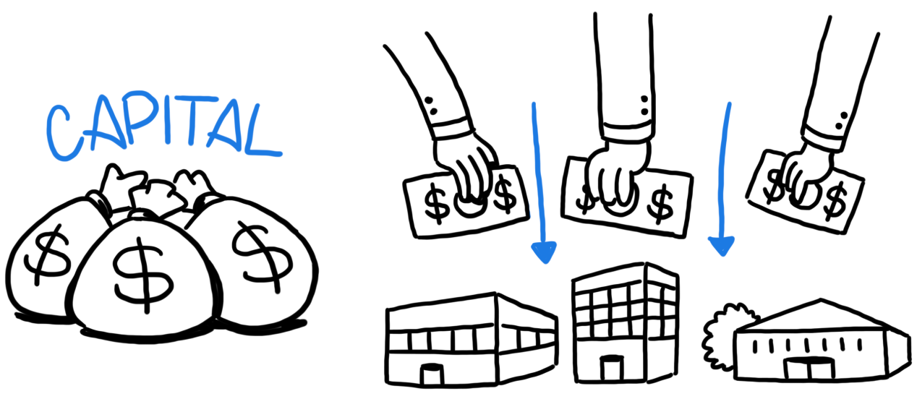
Financing
Pro forma
Loan to value/Loan to Cost (How much can obtained in private financing?)
Equity (deferred fees and/or owner equity)
Level of Public Participation
Projections
Rents
Absorption rate
Costs to construct
Expenses
Taxes
Returns
Fees
Debt Coverage Ratio
Flow of funds
Performs/Future
Future value of the project
Future cash flows
Disbursements of funds (waterfall of surplus cash)
Internal Rates of Return

Slide 18
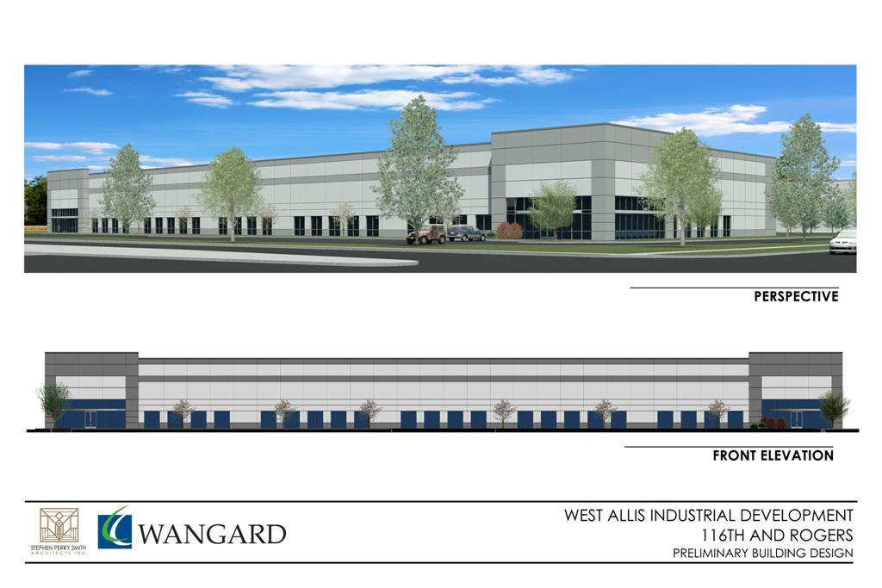
* EPA Loan : Environmental Cap
parking lot
foundation
flooring, etc.
Participation LOAN
Bank Debt $ 8,500,000
* EPA Loan $ 400,000 1% interest
NMTC Equity $ 3,000,000
Developer Equity $ 2,000,000
$ 14,000,000

Slide 19
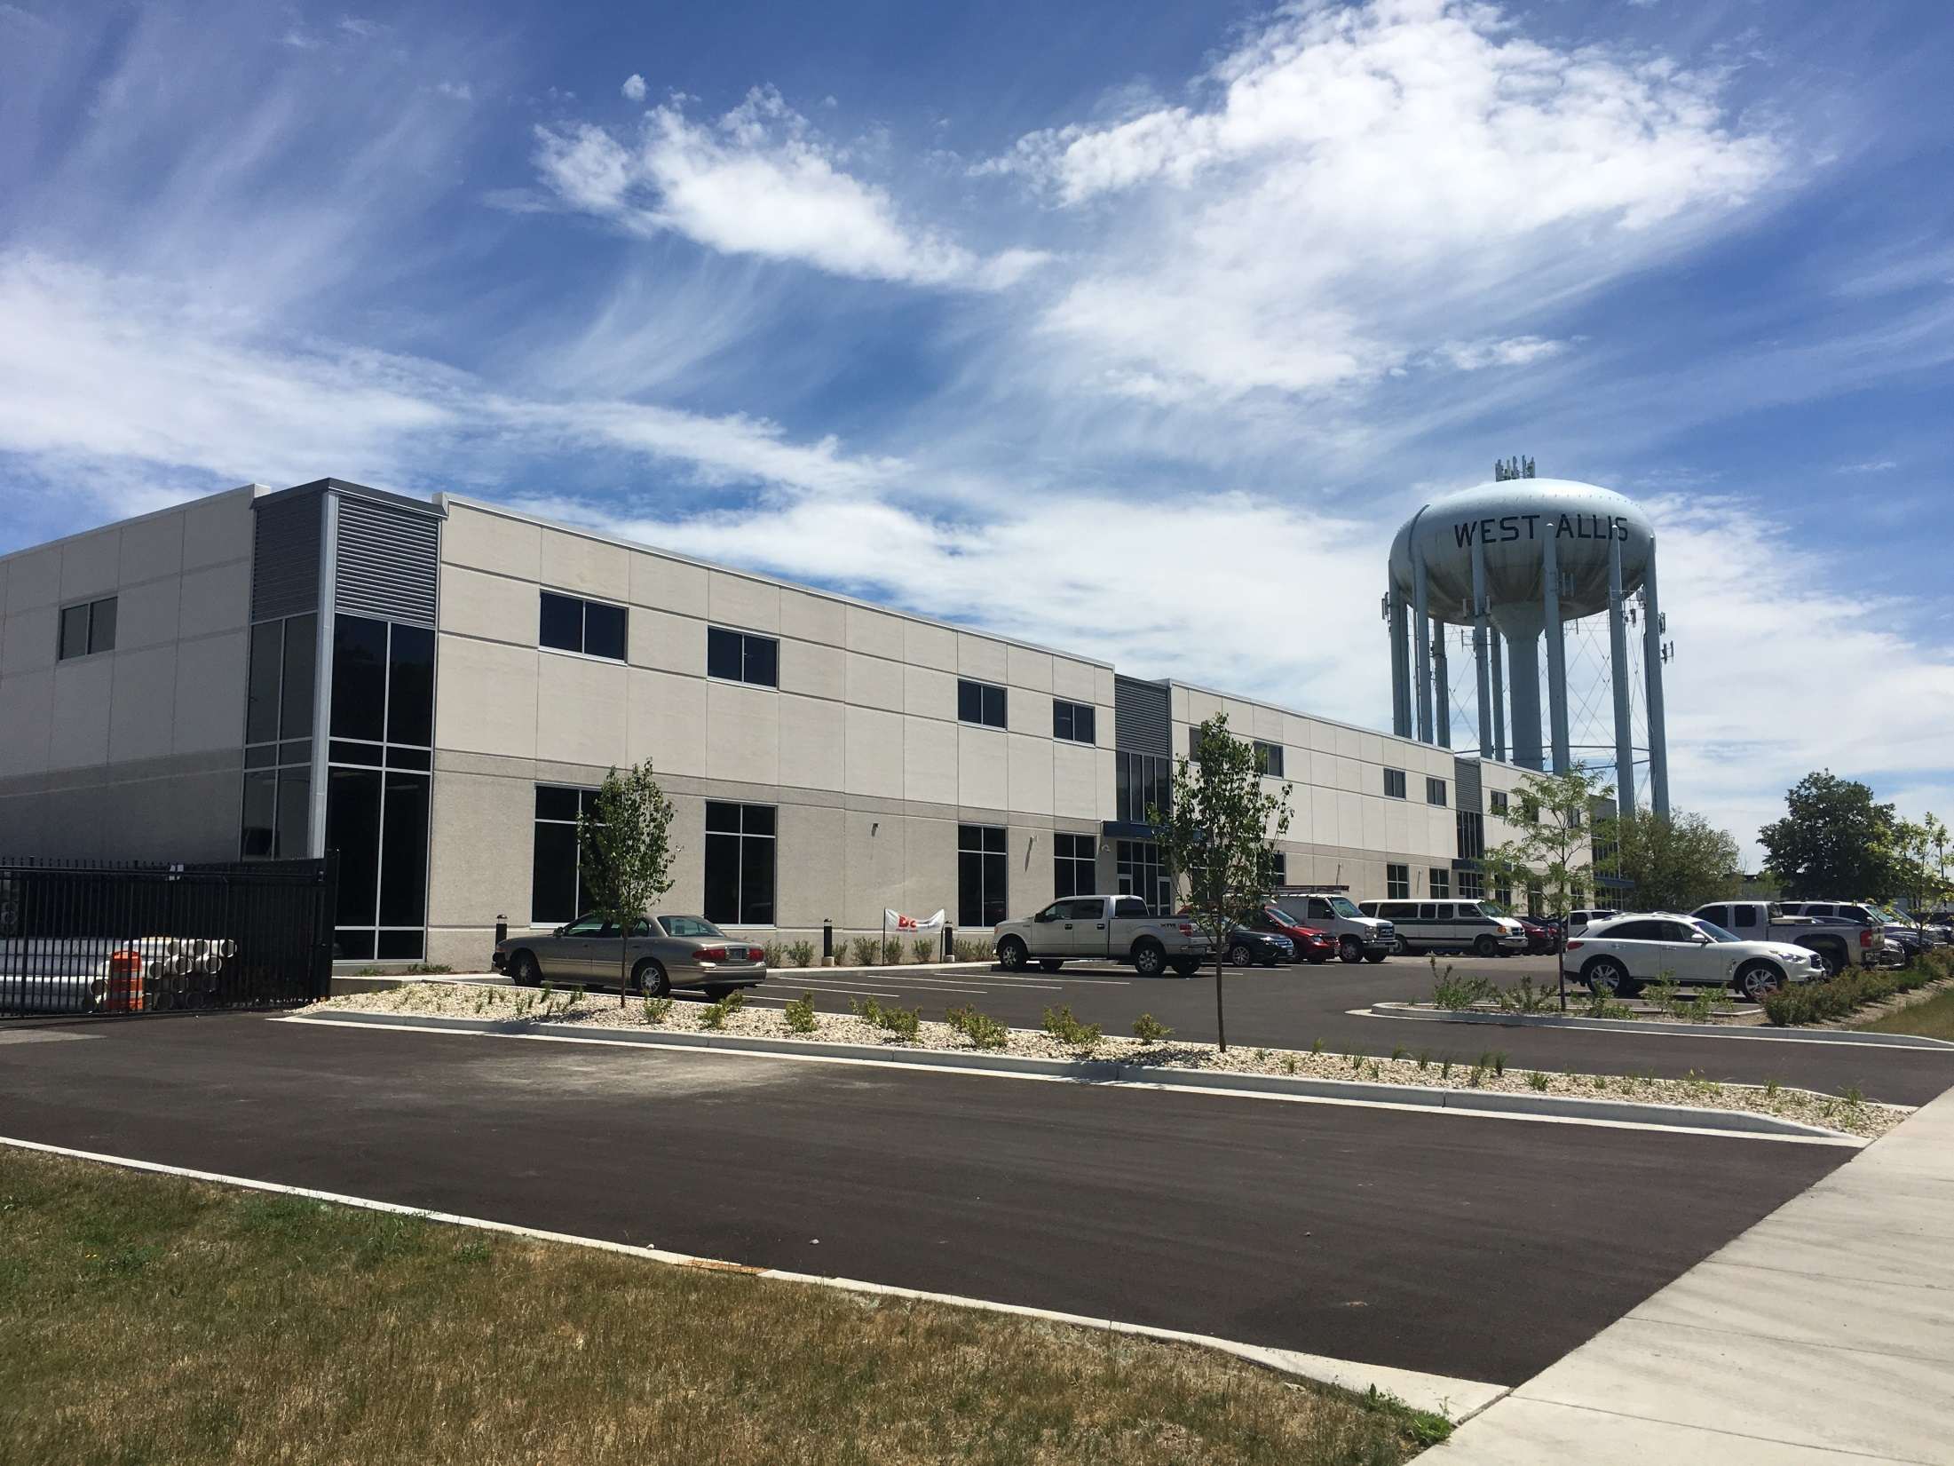

Slide 20
TIF Protections - Dark Store Theory
Developer Guarantees
Special assessments - if below projections
Contingency payment issue
Developer Funded TIFs
Developer: economic benefit to perform, capitalizes increment stream with a bank (discounted, higher interest)
City: In this case, pay more interest overtime, manage risk, insurance

Slide 21
Dark Store Theory & TIF
Developers vs. Tenants
Tenants often pay the taxes
Stick and Bones – there is more to value
Communities hesitant about retail development
Expansion of the theory
Vacant manufacturing spaces
Vacant fast food

Slide 22
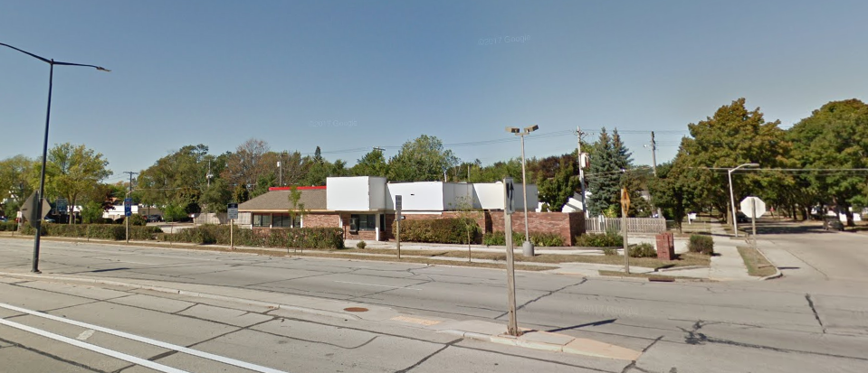
Vacant Burger King Story

Slide 23
Dark Store Theory
Involves using vacant, blighted properties, in comparison to fully developed and functionally operable properties to determine fair market value.

Slide 24
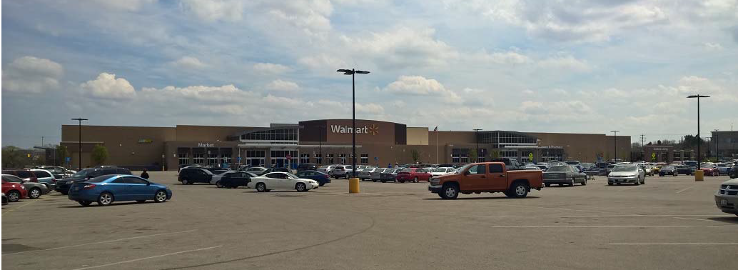
Dark Store Theory
So for instance, that newly constructed big box store that cost $20 million to build…
Walmart in Greenfield, WI

Slide 25
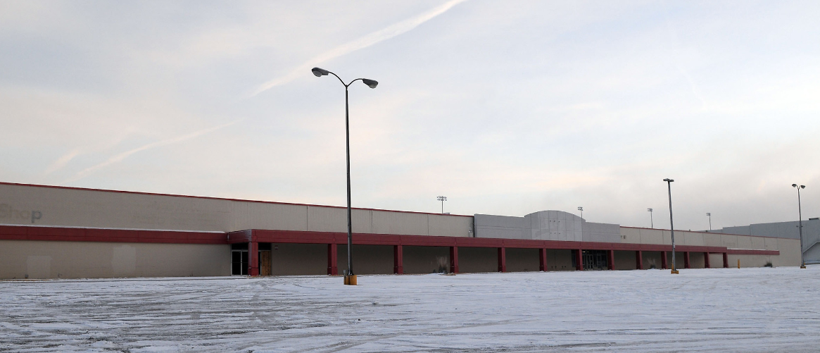
Comparable?
… is being compared to that old, vacant, run-down K-Mart built in the 70’s...
Former K-Mart in Waukesha, WI

Slide 26
Dark Store Theory
In a nutshell, valuation professionals are to compare apples to apples.

Slide 27
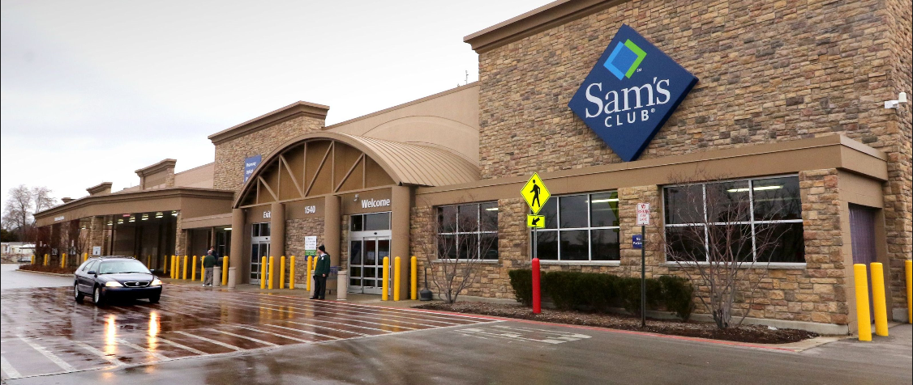
Example
In 2017 when Walmart went before our Board of Review they claimed Sam’s Club, assessed at $11 million, was only worth $7.2 million or $55 per square foot. Almost half that of comparable properties sold.
In 2018 Walmart filed a second appeal requesting an even lower value of $4.8 million or $37 per square foot

Slide 28
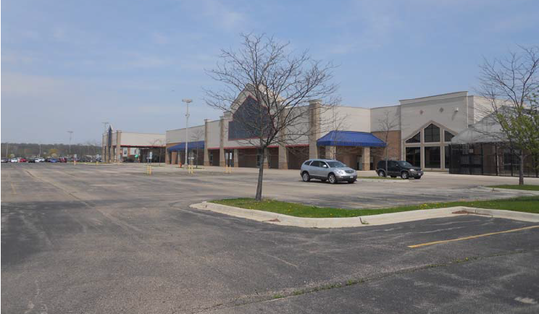
Dark Store Theory
Their tax representative who filed the assessment appeal provided documentation stating that this vacant, former Lowe’s located in Elgin, IL was equivalent to Sam’s Club. This Lowes sold for $5.3 million.

Slide 29
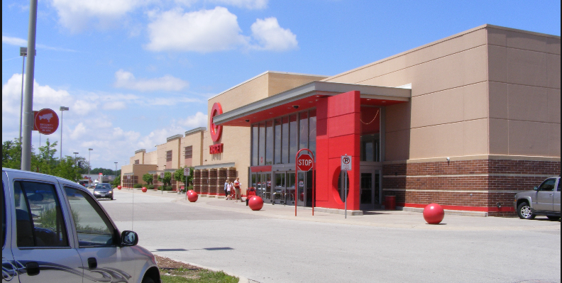
Example Appeal
In 2015 Target secured a $900k reduction in assessed value using the Dark Store Theory. This property is currently assessed at $9.2 million.

Slide 30
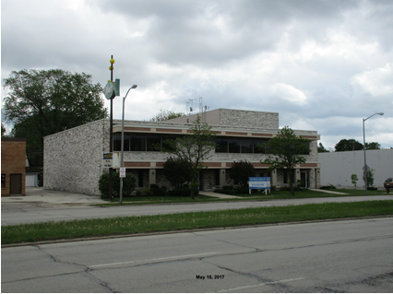
Dark Store or more?
In 2017 even a small office building owner appealed at Board of Review requesting a $700k reduction. This owner’s tax rep utilized the Dark Store theory for an office building!

Slide 31
Damaging Effects of the Walgreens Case
Things may get dry for a moment…

Slide 32
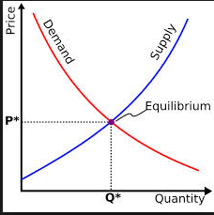
Damaging Effects of the Walgreens Case
Real estate users compete in the market place for locations that fit their business needs. Price and contract rent is determined by supply and demand and competition in the market.
These leases represent market rent for real estate transactions – the revenue, expenses and income are all tied to real estate fundamentals and do not consider the going concern, business value, or intangible value.

Slide 33
Example – Walgreens
NOI = $323,444
Divided by
CAP Rate = 6.35%
Value=$5,093,606
2018 Assessment: Total of land and improvements: $1,850,300
Notes:
So the notion of overpaying “above market” rent misses the mark. In practice these actual leases represent market rent. Businesses are not in the business to lose money or overpay above market rent. The values derived from these market based leases undergo an overwhelming amount of scrutiny by professionals to ensure a return on investment and establish true values.

Slide 34
Damaging Effects of the Walgreens Case
So the notion of overpaying “above market” rent misses the mark. In practice these actual leases represent market rent. Businesses are not in the business to lose money or overpay above market rent. The values derived from these market based leases undergo an overwhelming amount of scrutiny by professionals to ensure a return on investment and establish true values.
Notes:
So then it may come as a surprise that true values used for Federal income tax reporting, lending purposes, and purchase or sale transactions are not the same for tax assessment purposes.

Slide 35
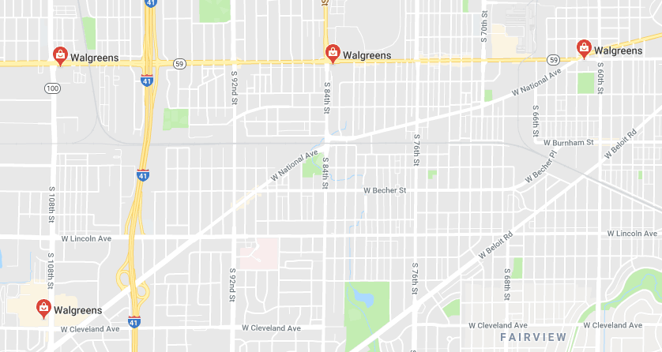
Damaging Effects of the Walgreens Case
There are four Walgreens and two CVS pharmacies in West Allis. Following the Walgreens Supreme Court case all four Walgreens sought and received reduced assessments. Today, those Walgreens are collectively assessed at $7.8 million or an average of $1.95 million each.

Slide 36
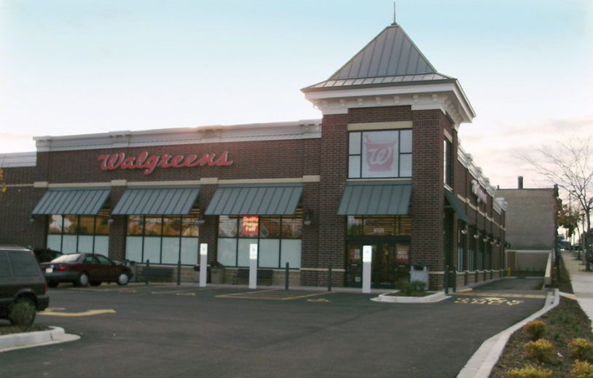
Damaging Effects of the Walgreens Case
The Walgreens located at 6101 W. Greenfield was listed for sale at $5.15 million and recently sold this past March for $4.9 million. This property is assessed at $2.5 million. (IN A TIF DISTRICT)
Notes:
There are four Walgreens and two CVS pharmacies in West Allis. Following the Walgreens Supreme Court case all four Walgreens sought and received reduced assessments. Today, those Walgreens are collectively assessed at $7.8 million or an average of $1.95 million each

Slide 37
Damaging Effects of the Walgreens Case
Moreover, Walgreens typically sell for around $5 million or more in Wisconsin. For the four Walgreens located in West Allis that suggests a total fair market value of $20 million or more. Yet, we are forced to assess them at less than $8 million collectively.
That’s more than $12 million lost and the tax burden shifted to homeowners and small business owners.

Slide 38
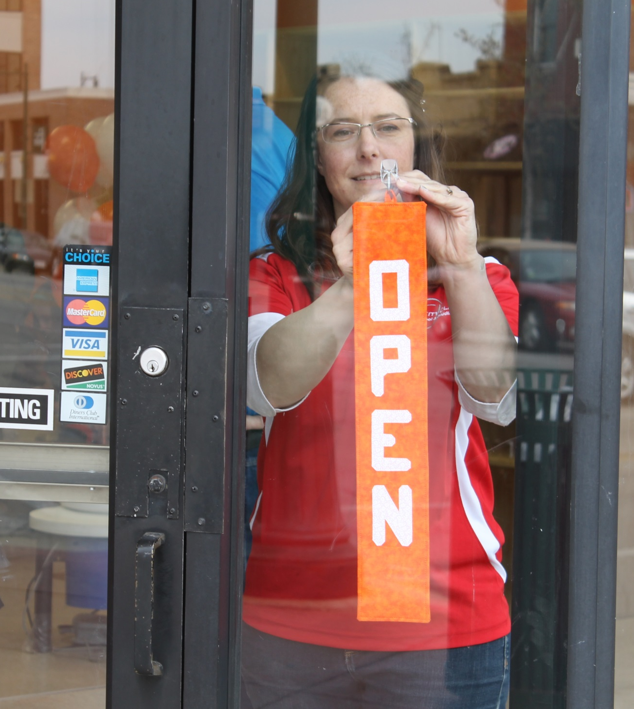
Impacts
Main Street/Small business
Residents
Talent attraction

Slide 39
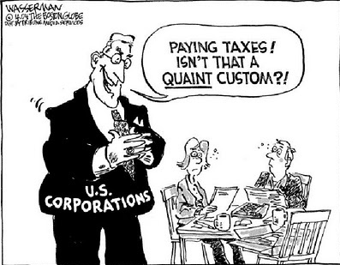
Shifting of the Tax Burden
So how does this shift of the tax burden happen?

Slide 40
Shifting of the Tax Burden
“The Waterbed Effect”

Slide 41
Shifting of the Tax Burden
Let’s say the Village of Honey Creek has four properties. Each of these properties are valued at $250,000 each for a total value of $1,000,000. Notice that each property’s value equals exactly 25% of the total value, i.e., ($250,000/$1,000,000 = 25%)
Property #1 $250,000 25%
Property #2 $250,000 25%
Property #3 $250,000 25%
Property #4 $250,000 25%
Total Value $1,000,000 100%

Slide 42
Shifting of the Tax Burden
The Village of Honey Creek has a tax levy of $25,000, which equates to a mill rate of $25 per $1,000 of value or a 2.5% tax rate, i.e., ($1,000,000 / $25,000 = 2.5% x 1,000 = 25.00)
In a Fair & Equitable property tax system this $25,000 tax burden would be shared by these properties in an equal distribution.
Property #1 ($250,000 / $1,000) x 25.00 = $6,250
Property #2 ($250,000 / $1,000) x 25.00 = $6,250
Property #3 ($250,000 / $1,000) x 25.00 = $6,250
Property #4 ($250,000 / $1,000) x 25.00 = $6,250
Total Tax Burden $1,000,000 $25,000

Slide 43
Shifting of the Tax Burden
Now let’s say the owner of Property #2 uses the Dark Store Theory and successfully appeals the assessed value and it is now “worth” half of what it was before.
You’ll notice that a few things happen: the total value of the Village of Honey Creek drops to $875,000 and the percent share of value of each property changes.
Property #1 $250,000 28.6%
Property #2 $125,000 14.2%
Property #3 $250,000 28.6%
Property #4 $250,000 28.6%
Total Value $875,000 100%

Slide 44
Shifting of the Tax Burden
In this case, the tax burden for the Village of Honey Creek remains constant at $25,000, but now the new mill rate is $28.60 per $1,000 of value, or 2.86% tax rate, i.e., ($25,000 / $875,000 = 2.86% x 1,000 = 28.60)
Property #1 ($250,000 / $1,000) x 28.60 = $7,150
Property #2 ($125,000 / $1,000) x 28.60 = $3,550
Property #3 ($250,000 / $1,000) x 28.60 = $7,150
Property #4 ($250,000 / $1,000) x 28.60 = $7,150
Total Value $875,000 $25,000

Slide 45
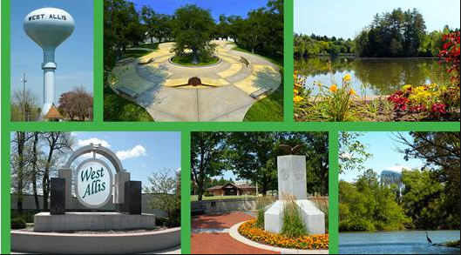
Shifting of the Tax Burden
.
Notes:
In these cases, in order to maintain a tax rate, or if a municipality does not have the ability to raise the tax levy, the result is downward pressure on the levy and cuts must be made to services

Slide 46
Shifting of the Tax Burden
So the Dark Store Theory and Walgreens Case forces either a shift of the tax burden or cuts to municipal services.
In any case the rest of the tax payers are bearing the burden in a disproportionate manner.

Slide 47
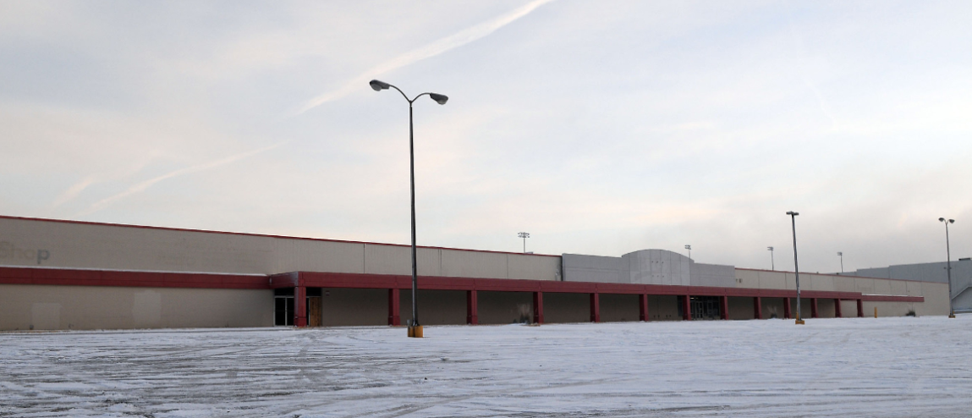
This is NOT Fair & Equitable

Slide 48
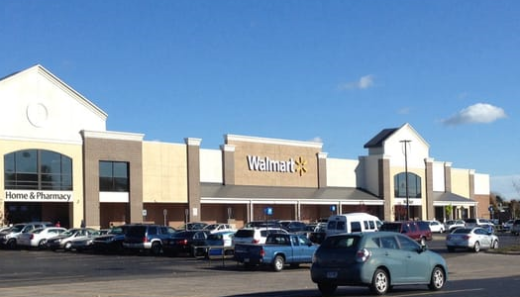
This is Fair & Equitable!

Slide 49
Summary and Closing
Growth

Slide 50
What Can You Do?
Support the Bills
Thought – review of sales
Internet and the aftermath
How would this be measured?
Cost of construction is increasing
How can values be decreasing?
Real Estate 101 - Location still matters

Slide 51
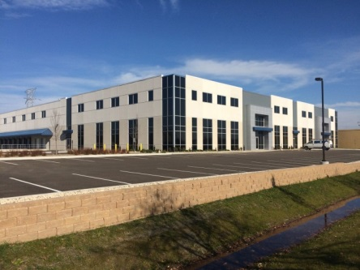
Thank you and Questions
?
Patrick Schloss
Community Development Manager
Department of Development
pschloss@westalliswi.gov
(414) 302-8468

