Slide 1
Legislative Council Study Committee on the Identification and Management of Dyslexia
July 9, 2018
Kurt Eley, Director of Student Services
Waunakee Community School District
kurteley@waunakee.k12.wi.us

Slide 2
Opening and Overview
Not a reading expert
Not a new conversation
Overview
Challenges
Identifying students with reading delay
Awareness of diagnosis of dyslexia
Current Process for consideration of services
Response to Intervention model
Intensive Interventions
Special Education process and criteria considered
Finding the Time for Interventions
Professional Development
Staffing Positions
Financial Competition

Slide 3
Dyslexia Definition
A general term for disorders that involve difficulty in learning to read or interpret words, letters, and other symbols, but that do not affect general intelligence. - Google
A pattern of learning difficulties characterized by problems with accurate or fluent word recognition, poor decoding, and poor spelling abilities – Diagnostic and Statistical Manual-V
A variable often familial learning disability that involves difficulties in acquiring and processing language and that is typically manifested by a lack of proficiency in reading, spelling, and writing. – Merriam-Webster
Dyslexia is a specific learning disability that is neurobiological in origin. It is characterized by difficulties with accurate and/or fluent word recognition and by poor spelling and decoding abilities. These difficulties typically result from a deficit in the phonological component of language that is often unexpected in relation to other cognitive abilities and the provision of effective classroom instruction. Secondary consequences may include problems in reading comprehension and reduced reading experience that can impede growth of vocabulary and background knowledge. – International Dyslexia Association

Slide 4
Challenges
Differences between districts
Philosophical
Balancing local control
Universal curriculum
Screening instruments
Response to Instruction
Interventions
Progress monitoring
Time for Instruction/Intervention
Professional Development
Financial
Staffing positions
Student Engagement

Slide 5
Identification of a Delay in Reading
Districts required to screen students in 4K through grade 2
Prior to 2016 all districts used Phonological Awareness Literacy Screening - PALS
Since 2016 district choice
Must assess phonemic awareness and letter sound knowledge
District assessments - MAPS, STAR
Monitoring student progress

Slide 6
Awareness of Diagnosis of Dyslexia
Typically part of an outside evaluation
Letter or report from a physician or the outside evaluator
DPI Guidance Document 2/19/2016 https://dpi.wi.gov/sites/default/files/imce/sped/pdf/sld-dyslexia.pdf

Slide 7
Current Process for Consideration of Services
Universal or general education instruction
Referral for evaluation often parent request
Special Education Individual Education Program (IEP) or Section 504 Plan
Special Education Disability
Impairment and,
Need for specialized instruction
Most likely Specific Learning Disability
Possibly as Other Health Impairment
Section 504 Disability
Impacts major life activity - reading
Impact in the educational setting
Accommodation plan

Slide 8
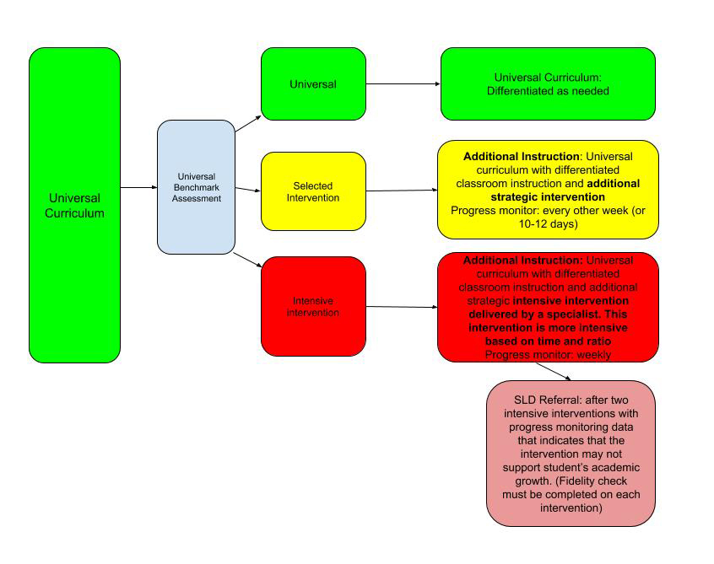
RtI Model

Slide 9
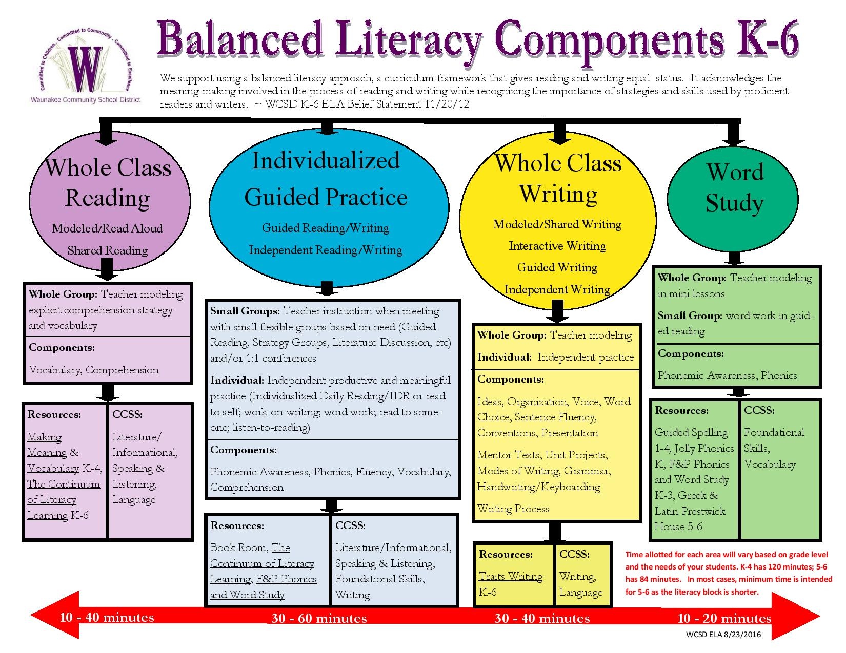

Slide 10
Universal | Selective | Intensive
Instruction expectations in all levels: Instruction through a culturally responsive lens Clearly identified learning targets
Universal instruction includes: High quality curriculum and instruction Formative assessment that drives instruction Differentiation for multiple levels and types of learning Screening for all students three times a year | Selected instruction includes: Delivery of research based academic interventions in small group in addition to universal instruction (approximately 3-5 times a week) Monitoring of student progress every 2 weeks. Determine goal and weekly rate of improvement (ROI). | Intensive instruction includes: A universal/benchmark team meeting is organized and held An individual intensive intervention plan is developed (includes student goals and goal line) Individual interventions are delivered (minutes, days, and duration are based on fidelity of intervention) Progress is continuously monitored weekly
Teams: Analyze the data from their screener at least three times a year Discuss and support each other in best educational practices (PLC) Share strategies for classroom management Share differentiated lessons | Teams: Use results of screening data to determine which student(s) may need additional assessment data to determine intervention need/placement Determine students who would benefit from small group intervention (tier 2). Use decision making criteria. Assign students to intervention groups Review progress monitoring data on a continual basis (6 weeks) and use data to determine the progress of student learning or behavioral goals Use systemic decision rules to determine effectiveness of intervention option | Teams: Team continually meets to review progress (every 6 weeks) RtI team collects and analyzes progress using slope of progress (rate of improvement) over time Communicate with parents/guardians and child in the development and analysis of plan
When a child’s needs are not met universally: The instructor conferences with the student The instructor communicates with parents/guardians The instructor consults with student services, problem-solving team, other school staff The instructor reviews student’s historical data Accommodates and differentiates for the student | When a child is struggling despite high quality intervention: Discuss student needs and progress through the RtI team process Determine whether an intensive intervention plan should be developed Communicate with parent/guardian | When a child is struggling despite delivery of high quality, research-based, and intensive interventions: It can been proven that the child is not struggling due to a lack of instruction or other exclusionary Use intense, specific systemic intervention options based on skill deficit area(s) Use systemic decision rules to determine effectiveness of intensive intervention plan and student progress Determine next steps for student based on data and documented interventions

Slide 11
Problem-Solving Teams
 | Team Expectations | Team Members
Universal | Students will receive screening in reading, writing , math in fall, winter and spring each year After screening, administration and grade-level/department teams will analyze the results to identify students in need of further examination and/or classroom supports/interventions If students have been unsuccessful with Tier I instruction, team has option to assign students to appropriate academic or social/emotional Tier II or Tier III interventions through the RtI team process | Principal & Associate Principal School Psychologist Reading Specialist Math Specialist Reading Coach Classroom Teachers Literacy Coaches
Selected and Intensive | Using the diagnostic results, RtI teams will prioritize student needs and identify which intervention option is appropriate for each student for that intervention cycle Once the intervention needs are determined, teams will match student(s) to a designated intervention teacher Teams will complete and send the Tier II or III Intervention Parent Letter home Intervention teachers will monitor data in STAR or EduClimber for all Tier II students’ progress monitoring data. Teams will review progress monitoring information in EduClimber (every 6-8 weeks) RtI teams will use identified decision rules to determine effectiveness of individual students receiving tier II and III interventions RtI teams will initiate the tier III process for students who are not demonstrating growth in tier II RtI teams will initiate the SLD referral or other interventions for students who are not demonstrating growth in tier III | Principal & Associate Principal School Psychologist Reading Specialist Math Specialist Reading Coach Classroom Teachers (as needed)

Slide 12
Insufficient Progress
Related to progress in general education interventions
Based on universal screening
District established criteria
Urgent – below 25th percentile
Intervention – 25th – 35th percentiles
On Watch – 36th -44th percentiles
On or Above – 45th percentile and higher

Slide 13
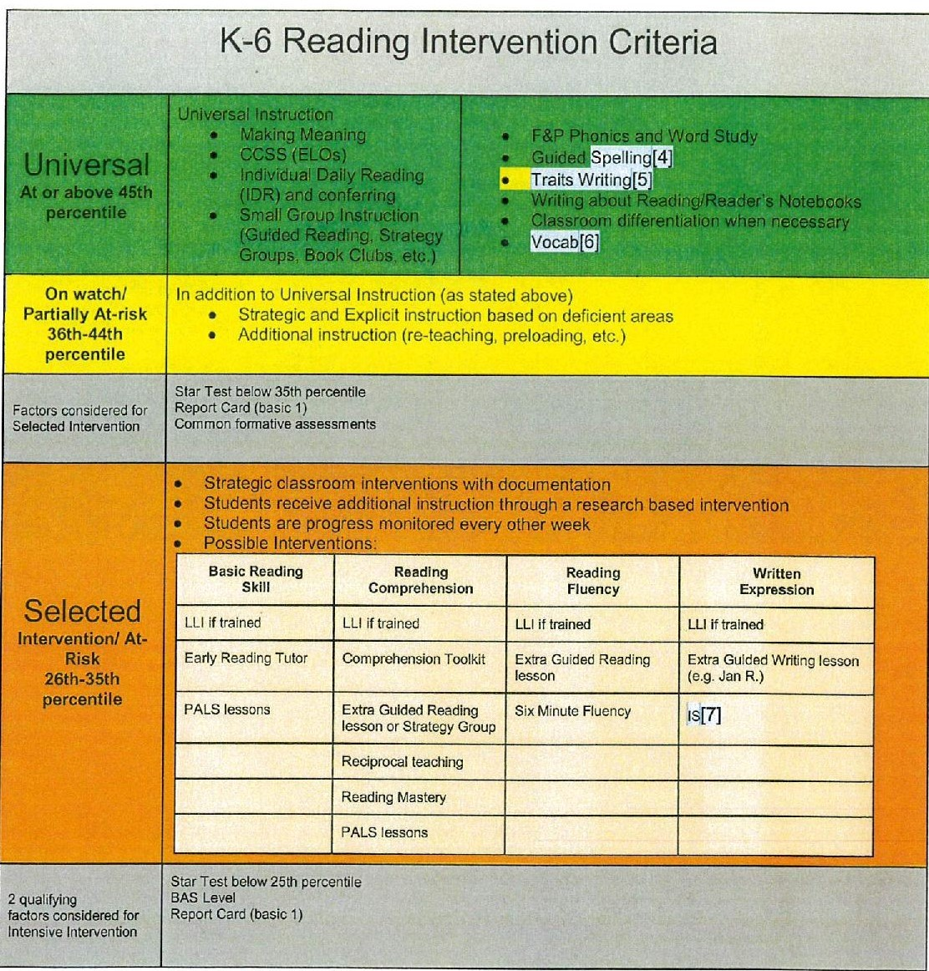

Slide 15
Intensive Interventions
Scientifically, research- or evidence-based intensive interventions
National Center on Intensive Intervention
https://charts.intensiveintervention.org/chart/instructional-intervention-tools
Range from 15 minutes to 100 minutes per session
Sessions per week range from 1 - 5
Duration ranges from 8 weeks to a year
Minimum interventionist requirements

Slide 16
Comparing Two Intensive Interventions
READ 180
90 minute sessions
5 times a week
23 weeks to a year
Professional – 2 days in-person training
Sound Partners
30 minute sessions
4 times a week
28 weeks
Paraprofessional/tutor – 2-4 hours of initial training with weekly on-site coaching and modeling for one year

Slide 17
Finding the Time

Slide 18
First Grade Schedule
7:40 - 8:00 – Opening activities
8:00 – 8:30 – Intervention and Enrichment
8:30 – 9:00 – Social Studies/Science
9:00 – 9:20 – Recess
9:20 – 11:00 – English Language Arts
11:00 – 11:45 – Lunch and Recess
11:45 – 12:30 – English Language Arts
12:30 – 1:30 – Math
1:30 – 2:30 – Encore (Art, Music, PE, Spanish, Guidance, Library)
2:30 – 2:40 - Homeroom

Slide 19
3rd Grade Schedule
7:40 - 8:00 - Opening Activities
8:00 - 9:00 - English Language Arts
9:00 - 10:00 - Encore (Art, Music, PE, Spanish, Library)
10:00 - 10:30 - English Language Arts
10:30 - 11:00 - Intervention and Enrichment
11:00 - 11:30 - English Language Arts
11:30 - 12:15 - Lunch and Recess
12:15 - 12:30 - Spelling
12:30 - 1:40 - Math
1:40 - 2:00 - Recess
2:00 - 2:30 - Social Studies/Science
2:30-2:40 - Homeroom

Slide 20
Specific Learning Disability
Specific Learning Disability Criteria
Insufficient classroom (academic) achievement
Administration of standardized achievement test
Standard score of 81.25 or less – 1.25 Standard Deviations below the mean
Exclusionary factors – limited English proficiency; appropriate general education instruction in area(s) of concern; environmental, cultural, or economic factors; other impairment
Insufficient progress in 1 or more of 8 academic areas – Basic Reading Skill, Reading Comprehension, and Reading Fluency Skills
Failure to make progress in 2 intensive interventions
Interventions in area of need
Implement 1 intervention at a time
Monitor fidelity of the intervention
Student participate in 80% on weeks, sessions and minutes per session
Intervention provided in accordance with design of intervention

Slide 21
Professional Development
Training staff in universal instruction and interventions
Range from part of a day to several days
Must be ongoing - refreshers
Limited days available – 3-5 days
Costs

Slide 22
Staffing Positions
Fewer people attracted to teaching
Emergency/Provisionally licensed people
Staff turnover/mobility

Slide 23
Finances - Competition for Dollars
Staffing Resources - Reading Specialists, Literacy Coaches, Class size/Ratios
School safety
Maintenance projects
Staff mobility/retention
Professional development
Title I money and services
Special Education Categorical Aid 25%
Transferring $1 Billion dollars from general education fund to the special education fund

Slide 24
Waunakee Study
Students identified for Intensive Intervention in 2014-15 school year
In grades 1-8 when they were identified
Urgent - Below the 25th percentile
Where are they 3 years later?

Slide 27
Conclusions
At the end of the third year the number of students who had moved up to the On Watch or On or Above levels was equal to or greater than the number of students in the Urgent or Intervention levels overall for both Reading and Math.
Variation by grade.
Variation by state vs. district assessments.
Urgent student group shows more mobility

Slide 28
Questions

