Slide 1
Legislative Council Study Committee on the Identification and Management of Dyslexia July 9, 2018
Debra Zarling, MS Ed.

Slide 2
How did you learn to read?

Slide 3
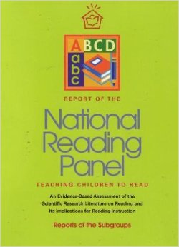
National Reading Panel Report
In 1997, Congress asked NICHD, through its Child Development and Behavior Branch, to work with the U.S. Department of Education in establishing a National Reading Panel that would evaluate existing research and evidence to find the best ways of teaching children to read.
https://www.nichd.nih.gov/research/supported/nrp

Slide 4
National Reading Panel Report
The National Reading Panel identified and studied research for:
Phonemic Awareness
Phonics
Vocabulary
Fluency
Reading Comprehension
“The Panel did not consider …[these] instructional issues to be the only topics of importance in learning to read. The Panel’s silence on other topics should not be interpreted as indicating that other topics have no importance or that improvement in those areas would not lead to greater reading achievement. It was simply the sheer number of studies (100,000)…that precluded an exhaustive analysis of research.” Intro 1-3
https://www.nichd.nih.gov/research/supported/nrp

Slide 5
Reading First
Final Report of the Reading First Impact Study found that despite more time allocated for the five essential components of reading instruction: 1) phonemic awareness, 2) phonics, 3) vocabulary, 4) fluency, and 5) comprehension, increased knowledge for teachers in these areas, and more support for struggling readers
“Reading First did not produce a statistically significant impact on student reading comprehension test scores in grades one, two or three.”
https://ies.ed.gov/ncee/pubs/20094038/summ_b.asp

Slide 6
National Assessment of Title I
“This report details findings from an experimental evaluation of four widely used programs for elementary school students with reading problems—Corrective Reading, Failure Free Reading, Spell Read P.A.T., and Wilson Reading. … Key findings show that the interventions improved some reading skills but did not improve state test scores. Furthermore, younger students benefited more, and the interventions narrowed some reading gaps.
Torgesen, J., Schirm, Al, Castner, L. Vartivarian, S., Mansfield, W., Myers, D. Stncavage, F., Durno, D., Javorsky, R., Haan, C. (2007). Closing the reading gap: Findings from a randomized trial of four reading interventions for striving readers. National Assessment of Title 1 Final Report. Volume II.
https://www.mathematica-mpr.com/our-publications-and-findings/publications/national-assessment-of-title-i-final-report-volume-ii-closing-the-reading-gap-findings-from-a-randomized-trial-of-four-reading-interventions-for-striving-readers

Slide 7
National Reading Panel Report
“Phonics should not become the dominant component in a reading program, neither in the amount of time devoted to it nor in the significance attached. ... By emphasizing all of the processes that contribute to growth in reading, teachers will have the best chance of making every child a reader.” (2-97)
https://www.nichd.nih.gov/research/supported/nrp

Slide 8
“In the primary grades, the emphasis on simultaneously building foundational skills and introducing complex content is what differentiates a Common Core curriculum from its No Child Left Behind predecessor. NCLB's sharp focus on basic reading skills often resulted in giving short shrift to content areas like social studies and science. In contrast, the Common Core standards support classrooms in which learning to read and reading to learn occur simultaneously and synergistically. The standards demand conceptually rich texts that build skills while engaging students in reading and learning. Common Core primary-grade classrooms are characterized by (a) building knowledge, (b) increasing students' responsibility for reading, and (c) providing more time for student involvement with text.”
Hiebert, E. & Pearson, P.D. (2012/2013) Educational Leadership

Slide 9
 | NAEP Reading Achievement Levels Grade Four | Wisconsin Grade 4 English Language Arts Performance Level Descriptors
Basic (208) | Fourth-grade students performing at the Basic level should be able to locate relevant information, make simple inferences, and use their understanding of the text to identify details that support a given interpretation or conclusion. Students should be able to interpret the meaning of a word as it is used in the text. | (Literature) A student at this level can read and partially comprehend grade 4 text. The student can make simplistic inferences, summarize simplistically, and identify explicit themes and details. The student can determine meanings of basic words and phrases, including figurative language. The student can describe literary elements by using details from the text and explain basic differences between genres, referring to structural elements simplistically. The student can compare and contrast points of view and the treatment of similar explicit themes and topics in different texts.
Proficient (238) | Fourth-grade students performing at the Proficient level should be able to integrate and interpret texts and apply their understanding of the text to draw conclusions and make evaluations. | (Literature) A student at this level can read and comprehend grade 4 text. The student can make inferences, summarize, and determine themes. The student can determine meanings of words and phrases and figurative language. The student can describe in depth literary elements by using specific details from the text and explain major differences between genres, referring to structural elements. The student can compare and contrast points of view and the treatment of similar themes and topics in different texts.
https://nces.ed.gov/nationsreportcard/reading/achieve.aspx#2009_grade4
https://dpi.wi.gov/sites/default/files/imce/assessment/pdf/WI_ELA_PerformanceLevelDescriptors.pdf

Slide 10
Wisconsin Statutes Ch. 121.02
School Board Standards (Standard c)
(c) Provide interventions or remedial reading services for a pupil in grades kindergarten to 4 if any of the following occurs:
1. The pupil fails to meet the reading objectives specified in the reading curriculum plan maintained by the school board under par. (k).
2. The pupil fails to score above the state minimum performance standard on the reading test under par. (r) and:
a. A teacher in the school district and the pupil's parent or guardian agree that the pupil's test performance accurately reflects the pupil's reading ability; or
b. A teacher in the school district determines, based on other objective evidence of the pupil's reading comprehension, that the pupil's test performance accurately reflects the pupil's reading ability.
3. The pupil's reading assessment under s. 118.016 indicates that the pupil is at risk of reading difficulty. If this subdivision applies, the interventions or services provided the pupil shall be scientifically based and shall address all areas in which the pupil is deficient in a manner consistent with the state standards in reading and language arts.

Slide 11
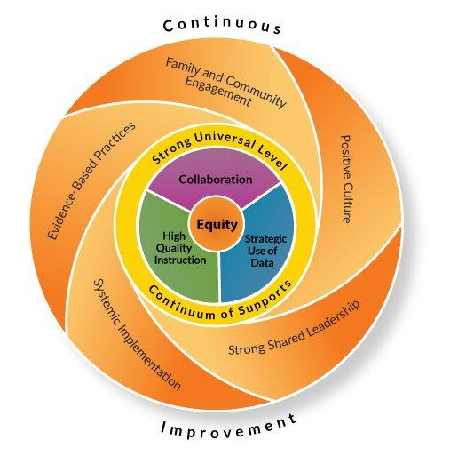
Multi-Level Systems of Support
“For Wisconsin schools and districts, implementing an equitable multi-level system of supports means providing equitable services, practices, and resources to every learner based upon responsiveness to effective instruction and intervention. In this system, high quality instruction, strategic use of data, and collaboration interact within a continuum of supports to facilitate learner success. Schools provide varying types of supports at differing levels of intensity to proactively and responsively adjust to the needs of the whole child. ” (pg. 5)
https://dpi.wi.gov/sites/default/files/imce/rti/pdf/rti-emlss-framework.pdf

Slide 12
National Early Literacy Panel
Predictive Variables
Additional Important Variables
alphabet knowledge (AK)
phonological awareness (PA)
rapid automatic naming (RAN) of letters or digits
RAN of objects or colors
writing or writing name
phonological memory
concepts about print
print knowledge: a combination of elements of AK, concepts about print, and early decoding
reading readiness: usually a combination of AK, concepts of print, vocabulary, memory, and PA
oral language: the ability to produce or comprehend spoken language, including vocabulary and grammar
visual processing: the ability to match or discriminate visually presented symbols
https://lincs.ed.gov/publications/pdf/NELPReport09.pdf

Slide 13
Impacts on Student Outcomes
Attendance
Engagement
Health issues
Homelessness
Hunger
Parental support
Summer
Transiency
Trauma
Teacher expertise
Teacher churning
Etc….

Slide 14
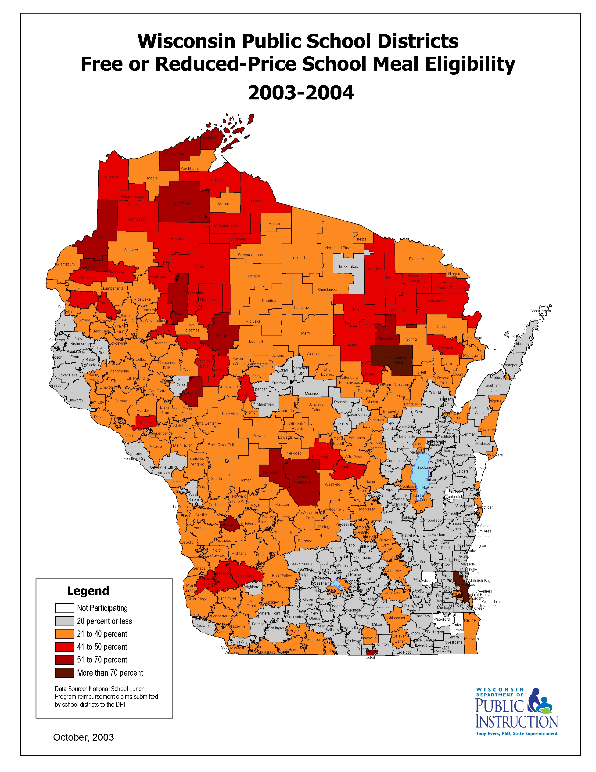
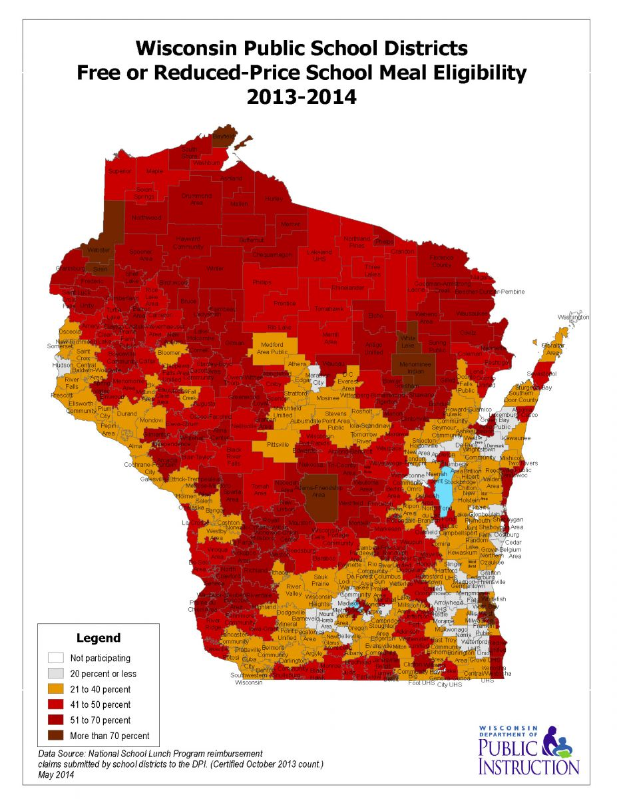

Slide 15
“The educational enterprise is far too complex for one type of research to answer all of our questions or meet all of our needs.”
Duke and Martin - pg 11 10 thing to know...

Slide 16
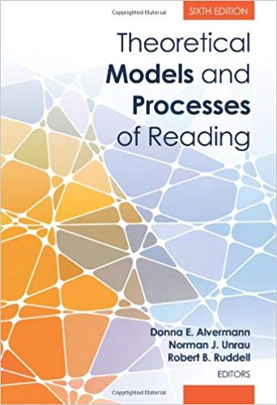
Reading Theories and Models
“classic and trend-setting scholarship that is among the best in the field”
Over 1300 pages
Various literacy and reading research experts

Slide 17
Reading Recovery®
Sirinides, P., Gray, A., & May, H. (2018). The Impacts of Reading Recovery at Scale: Results From the 4-Year i3 External Evaluation. Educational Evaluation and Policy Analysis. Washington, DC: American Educational Research Association.
May, H., Sirinides, P., Gray, A., & Goldsworthy, H. (2016). Reading Recovery: An Evaluation of the Four-Year i3 Scale-Up. Philadelphia: Consortium for Policy Research in Education. http://www.cpre.org/reading-recovery-evaluation-four-year-i3-scale
What Works Clearinghouse Intervention Report: Reading Recovery . (2013, July 16). United States Department of Education, Institute of Education Sciences. https://ies.ed.gov/ncee/wwc/EvidenceSnapshot/420

Slide 18
“However, all instructional moves and decisions within those structures and procedures are at the discretion of individual teachers, who operate in response to individual understandings of Reading Recovery’s theoretical principles and individual interpretations of students’ needs. Thus, instruction is both interpretive and idiosyncratic, and instructional strength as we conceptualize it is not reflected in measures of fidelity to the Reading Recovery program model.”
May, H., Sirinides, P., Gray, A., & Goldsworthy, H. (2016). Reading Recovery: An Evaluation of the Four-Year i3 Scale-Up. Philadelphia: Consortium for Policy Research in Education.
http://www.cpre.org/reading-recovery-evaluation-four-year-i3-scale
Notes:
“Our analyses of teachers’ daily … documentation revealed that teachers involved in the i3 scale-up adhered closely to the lesson structure and procedures that are emphasized in Reading Recovery training …. “
You can’t just go in and check it off the list – yes, they did that. It matters how they did it and that they focused on the right thing.

Slide 19
Wisconsin Statutes Ch. 118.016
Assessment of Reading Readiness (excerpts)
(1b) Beginning in the 2016-17 school year, each school board and the operator of each charter school established under s. 118.40 (2r) or (2x) shall, using the appropriate, valid, and reliable assessment of literacy fundamentals selected by the school board or operator, annually assess each pupil enrolled in 4-year-old kindergarten to 2nd grade in the school district or in the charter school for reading readiness. The school board or operator shall ensure that the assessment evaluates whether a pupil possesses phonemic awareness and letter sound knowledge.
(1r) The school board or operator of the charter school shall report the results of a pupil's assessment under sub. (1) to the pupil's parent or guardian.
(2) The school board of the school district or operator of the charter school in which the pupil is enrolled shall provide a pupil whose assessment under sub. (1) indicates that he or she is at risk of reading difficulty with interventions or remedial reading services, as described under s. 121.02 (1) (c).

Slide 20
Dyslexia Definitions
American Academy of Pediatrics
http://pediatrics.aappublications.org/content/pediatrics/124/2/837.full.pdf
International Dyslexia Association
https://dyslexiaida.org/definition-of-dyslexia/
Mayo Clinic
https://www.mayoclinic.org/diseases-conditions/dyslexia/symptoms-causes/syc-20353552
National Institute for Health: National Institute of Neurological Disorders and Stroke
https://www.ninds.nih.gov/Disorders/All-Disorders/Learning-Disabilities-Information-Page
Various Dyslexia Research Centers, including Yale Center for Dyslexia & Creativity, University of Michigan Dyslexia Help, Harvard University, etc.

Slide 21
American Psychiatric Association
The Diagnostic and Statistical Manual of Mental Disorders, Fifth Edition (DSM-V) (2013) includes classification criteria for “specific learning disorder.”
Dyslexia is listed as an “alternative term” within the category of “specific learning disorder” that refers to “a pattern of learning difficulties characterized by problems with accurate or fluent word recognition, poor decoding, and poor spelling abilities” (DSM-V, p. 67).
“The DSM-5 Neurodevelopmental Work Group concluded that the many definitions of dyslexia and dyscalculia meant those terms would not be useful as disorder names or in the diagnostic criteria.”
https://www.psychiatry.org/patients-families/specific-learning-disorder/what-is-specific-learning-disorder
https://www.psychiatry.org/.../Practice/.../APA_DSM-5-Specific-Learning-Disorder.pdf

Slide 22
Continuum of Difficulty
Mild
Moderate
Severe
Profound

Slide 23
“Learning disabilities [including dyslexia] are complex problems that require complex solutions.”
Policy Statement: Learning Disabilities, Dyslexia, and Vision. Pediatrics. 2009;124(2):2837–2844. Reaffirmed July 2014
http://pediatrics.aappublications.org/content/pediatrics/124/2/837.full.pdf

Slide 24
“Teacher expertise is the most important factor in improving children’s learning.”
Darling-Hammond & McLaughlin, 1999
“Good learning comes from good teaching.”
Hargreaves & Fullan, 2012

Slide 25
“[D]eliberateness is understood as an encompassing commitment to thoughtful practice; instructional dexterity is defined as the flexible application of deep skill. These two components of instructional strength are complementary and interrelated, but manifest in different ways and at different times.”
May, H., Sirinides, P., Gray, A., & Goldsworthy, H. (2016). Reading Recovery: An Evaluation of the Four-Year i3 Scale-Up. Philadelphia: Consortium for Policy Research in Education.
http://www.cpre.org/reading-recovery-evaluation-four-year-i3-scale

Slide 26
“If the work of schooling were straightforward, its organizations simple, and the proposed changes discrete, the mechanical implementation of fixed changes would be quite sensible. Practitioners would just need to follow the directions, and the desired outcomes should ensue. But, … this is not the reality of contemporary schooling. The tasks we seek to improve, as well as the organization in which they are embedded, are quite complex. Often this is true as well for the solutions that are being introduced. Absent an appreciation for this complexity, many efforts to change schools just add to their dysfunction.”
Bryk, et.al., 2015. Learning to Improve: How America’s Schools Can Get Better at Getting Better

Slide 27
