Slide 1
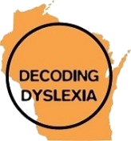
Legislative Council Study Committee
Identification and Management of Dyslexia
Decoding Dyslexia Wisconsin

Slide 2
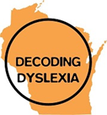
Barbara Felix MA CALP
Founder and director of Dyslexia Achievement Center, LLC, a private practice instructional clinic in Elm Grove, WI.
Former Executive Director of Literacy Services of Wisconsin.
Initial Orton-Gillingham training through the 32degree Masonic Children’s Dyslexia Center in Milwaukee. Additional Orton-Gillingham training through The Minnesota Reading Center in Rochester, Minnesota.

Slide 3
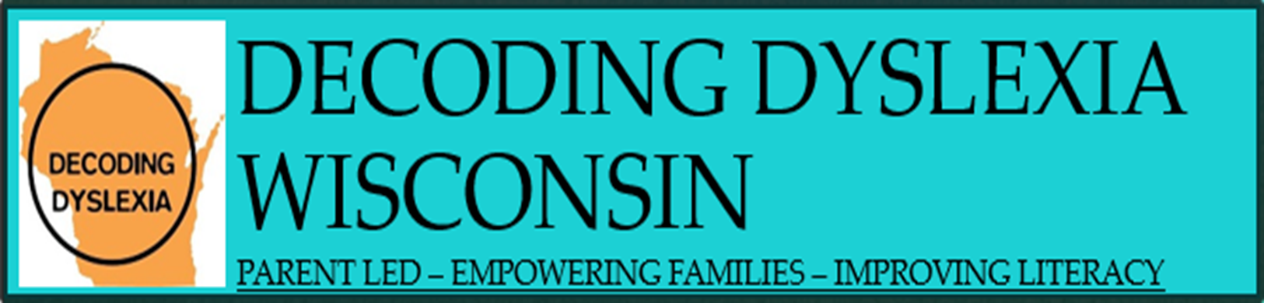
Agenda
Decoding Dyslexia - Wisconsin
Reading
DD WI Dyslexia Survey 2018 Results
Federal Initiatives

Slide 4
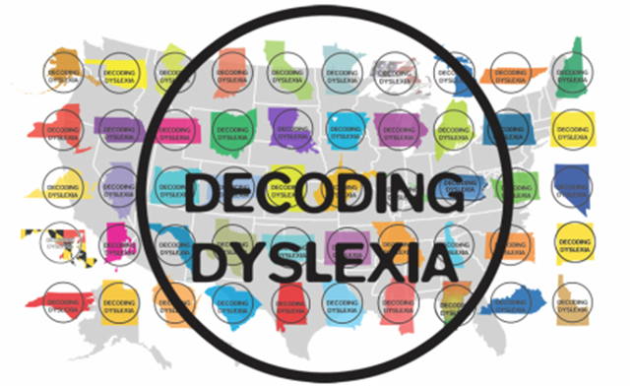
What’s our Impact:
Wisconsin PTA Resolution for Dyslexia Spring 2017
2 Members of Congress serving on the Bipartisan Dyslexia Caucus
2654 Followers on our public Facebook page
733 Followers on Twitter

Slide 5
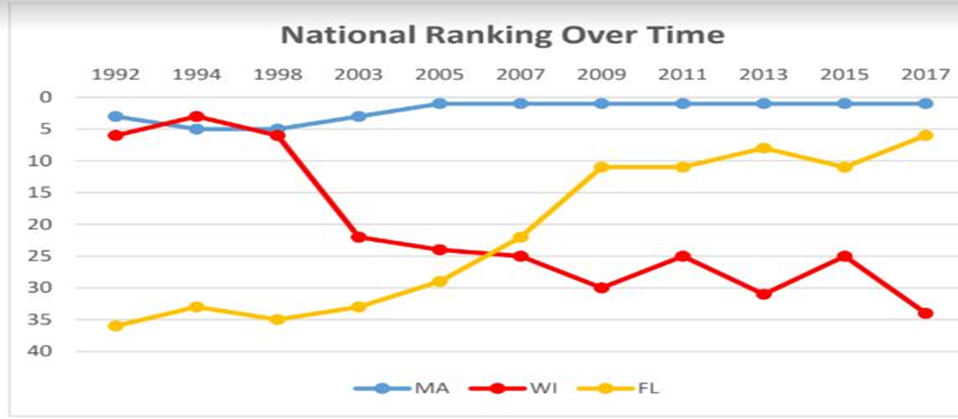
NAEP/National Assessment of Educational Progress
https://drive.google.com/file/d/1Sdq1oG1LZ5hmvbScSVlx4ngryXUnt7Jl/view
http://www.wisconsinreadingcoalition.org

Slide 6
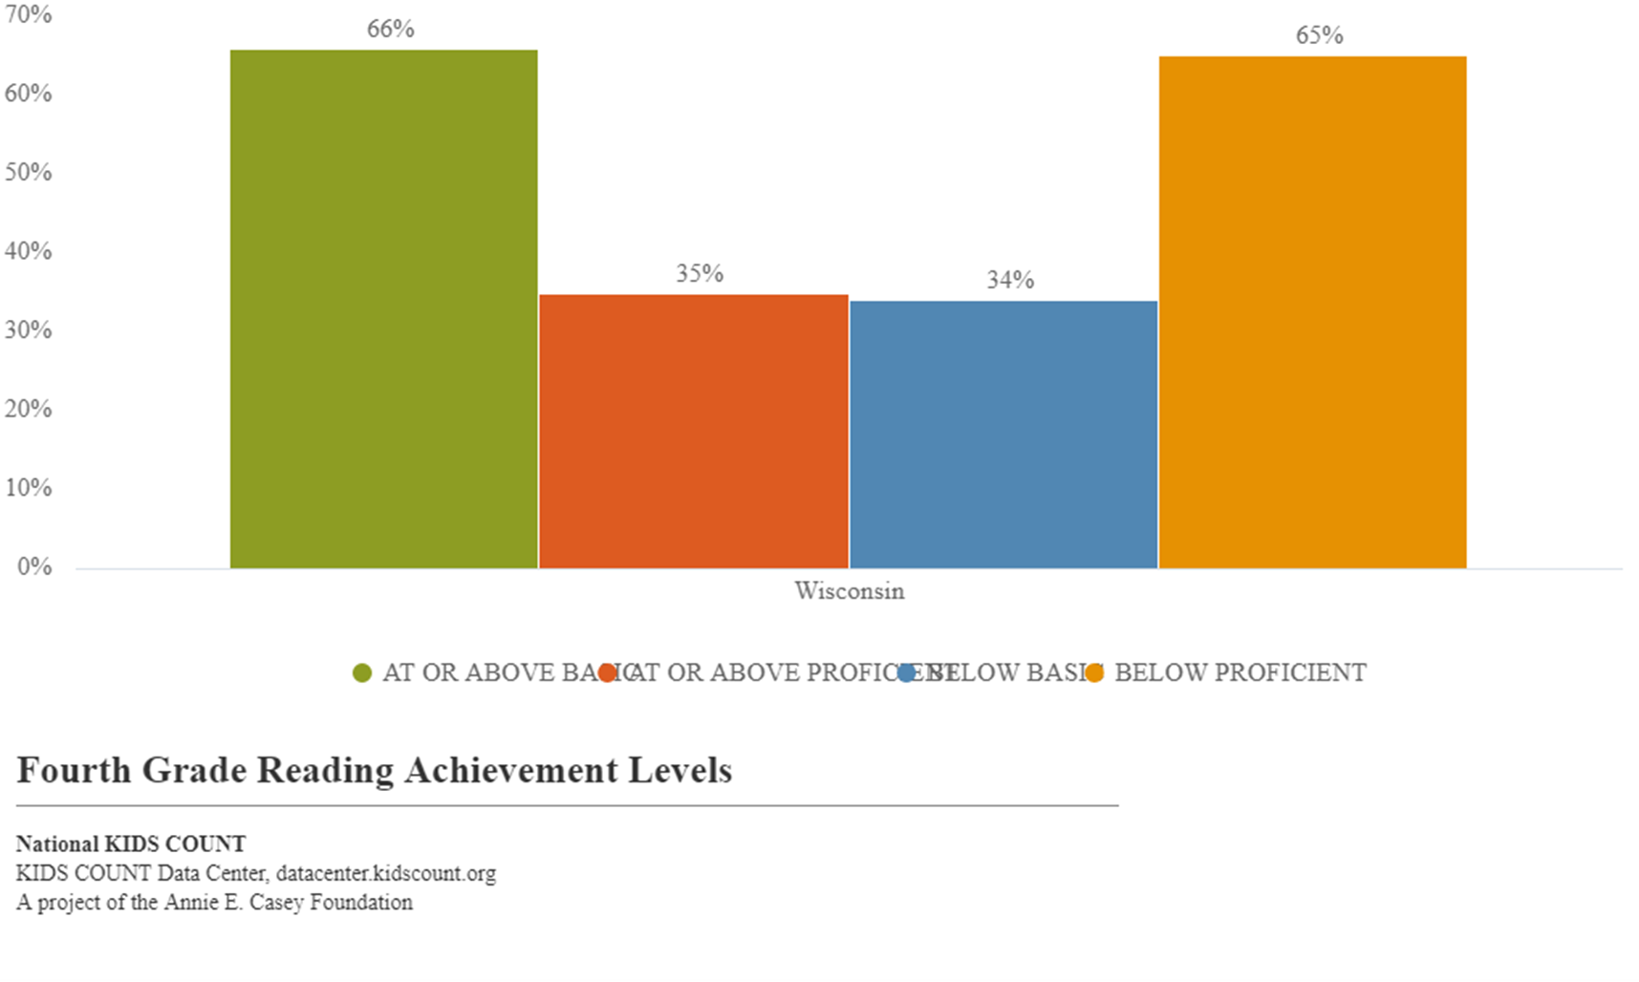

Slide 7
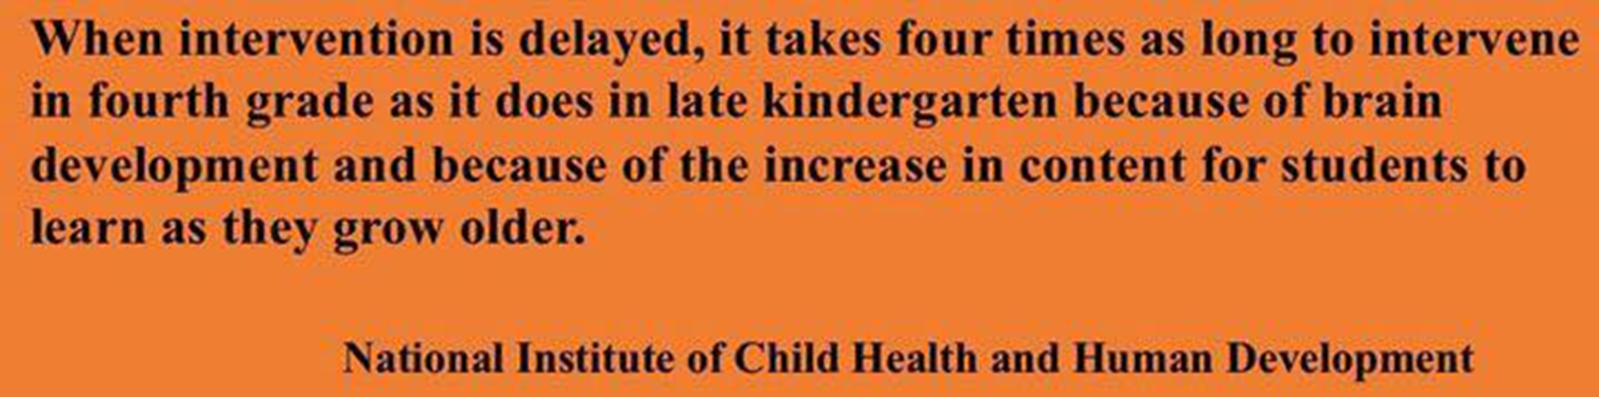
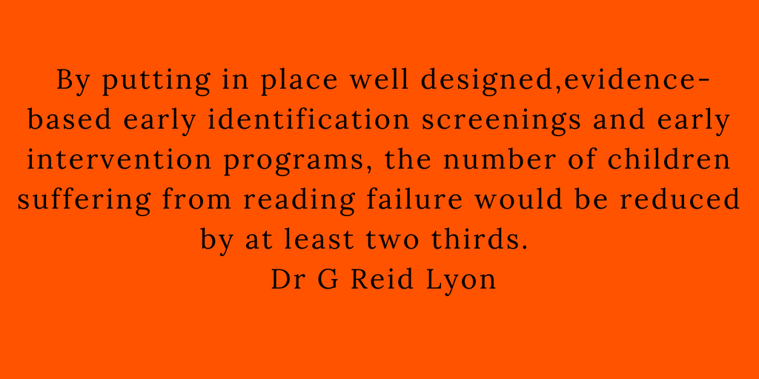

Slide 8
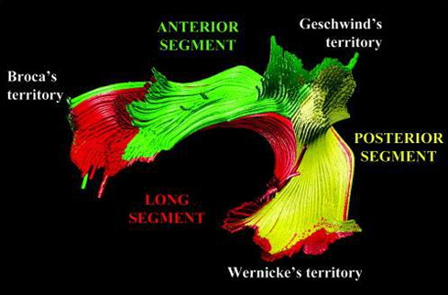
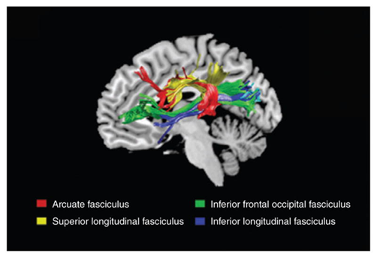
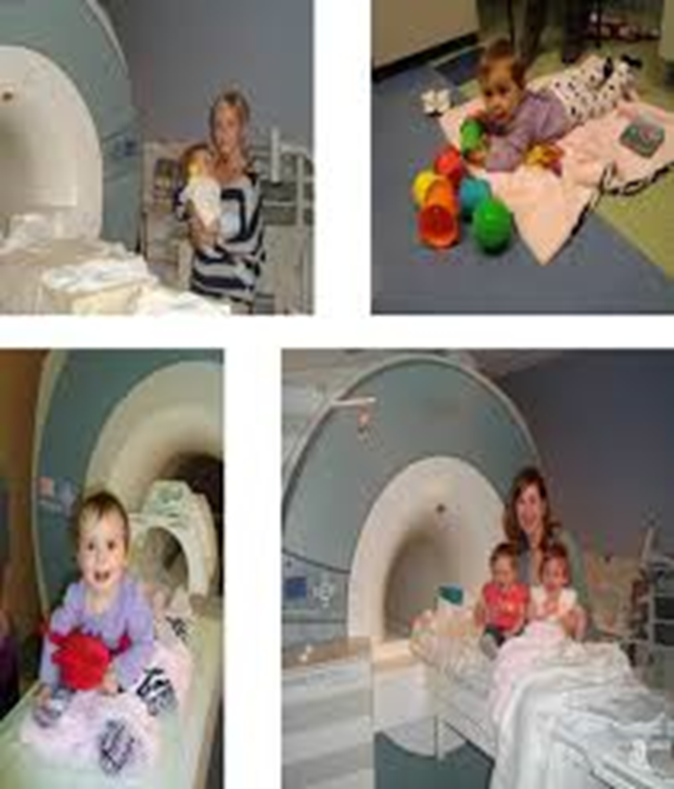
Dyslexia can be identified early in Language
skill deficits:
Phonological Processing
Phonemic awareness
Naming speed as early as 3 years old*

Slide 9
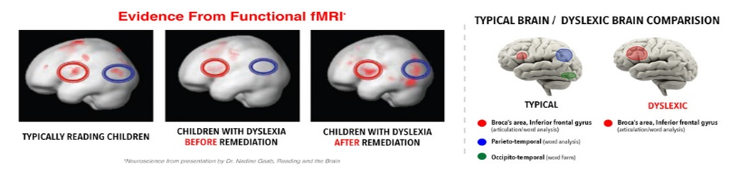

Dyslexia is present at birth.
Brain alterations can be seen as early as infancy in brain imaging studies FMRI scans.
We can easily, validly and economically assess at entry to school. Some children may be identified earlier.

Slide 10
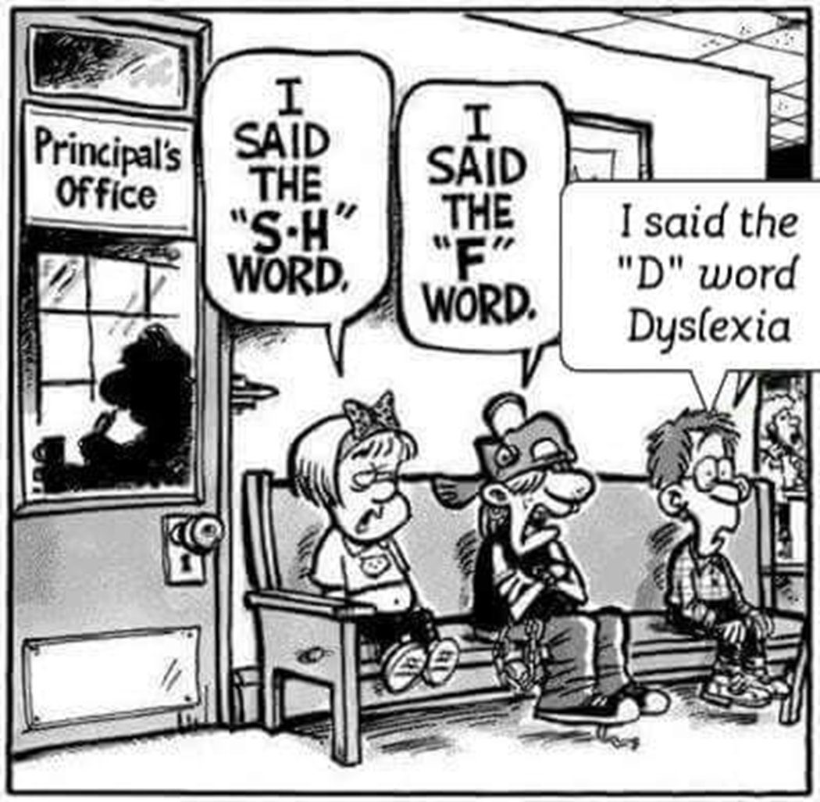

Slide 11
Misunderstandings
“You need to lower your expectations.”
“Your son is lazy and unmotivated.”
“There is no such thing as Dyslexia.”
“No, your son can’t do things in a slightly different way, all kids have to learn the same way; that’s how we have always done it.
“Testing scores are meaningless.”
“We don’t recognize the “d’ word. It would be much easier if your child had ADHD, there is a medication for that.”
“Not all kids are born smart; someone has to stock shelves at Walmart, why not your kid?”
“He will be a good laborer.”
“She will catch up! I don’t know why your daughter has anxiety about school.”
“He needs to get some “C”s and “B’ striving for all A’s is just un-realistic, he needs to fail better.”
“If you keep taking your 6 year old child for tests she will think she has issues - so stop.”
“School doesn’t test for Dyslexia.”

Slide 12
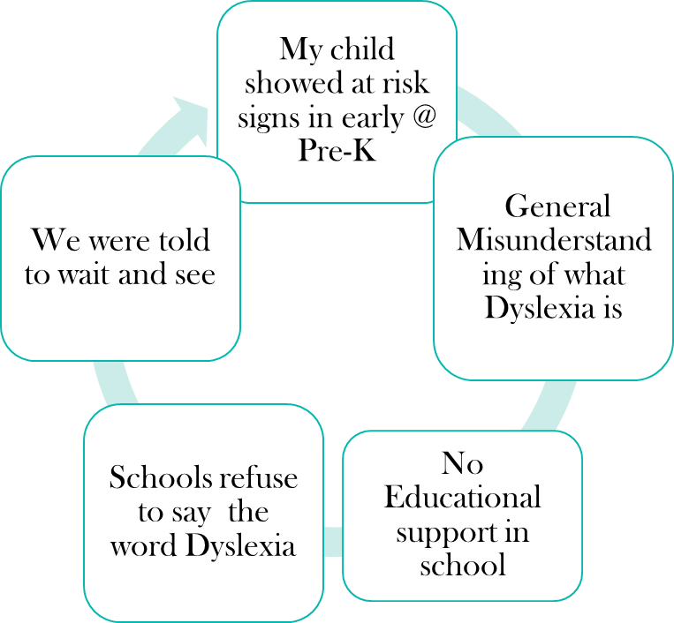
Common Struggles Families Have Shared
Lowered expectations
Asking for assistive technology or accommodations was interpreted as cheating
School does not acknowledge dyslexia so they don’t have to provide support

Slide 13
What Is Dyslexia?
Brain based learning difference affecting Language Processing
Is not related to Intelligence/IQ
Affects life functions: Reading and Processing Language

Slide 14
May 2018 Dyslexia Survey, 157 responded

Slide 15
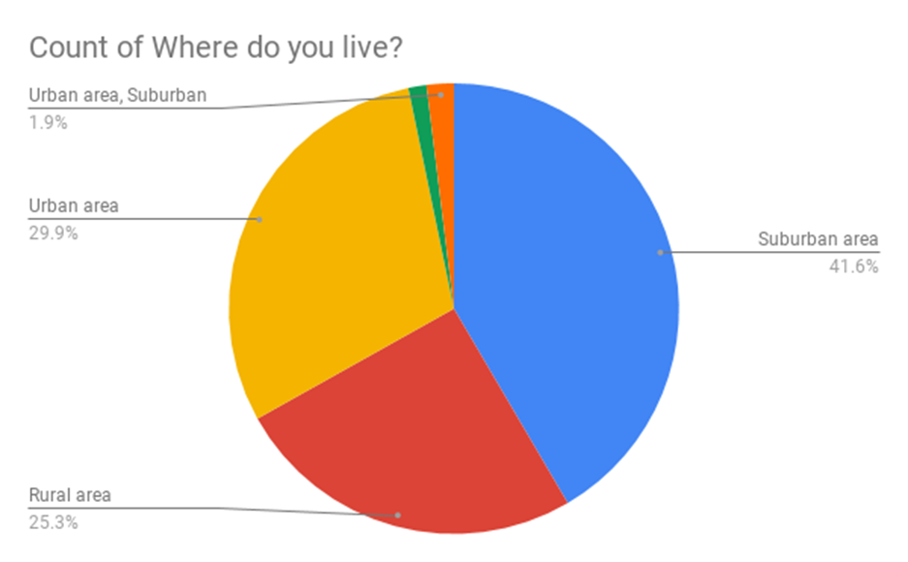
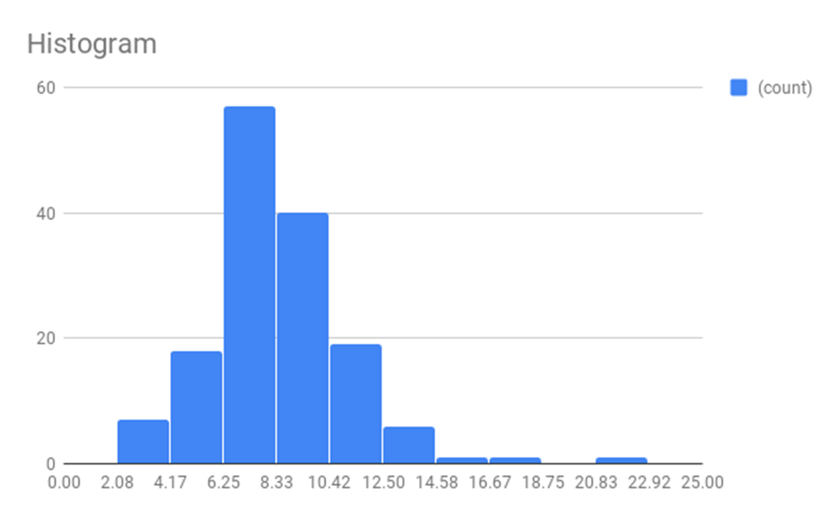
Demographics
Age Diagnosed

Slide 16
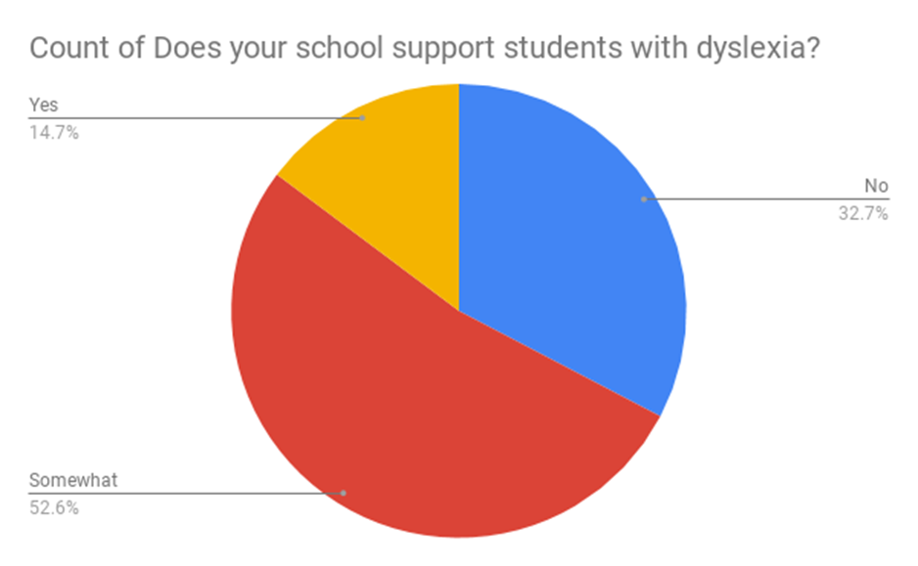
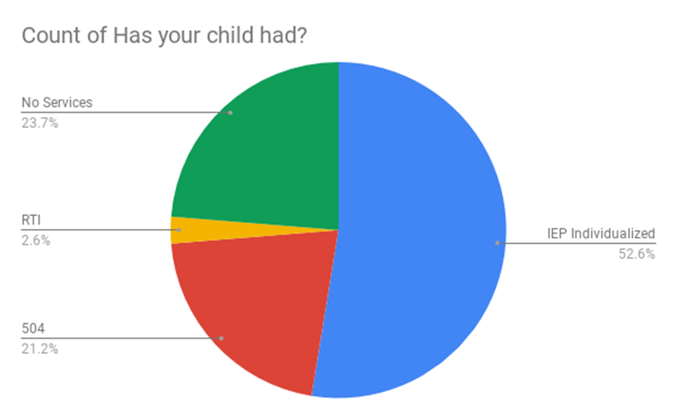
“Somewhat” means: Alternate test format ( such as word banks) Digital Text to Speech, More time for tests, Quiet room for test taking, copy of class notes for children with IEP’s only.

Slide 17
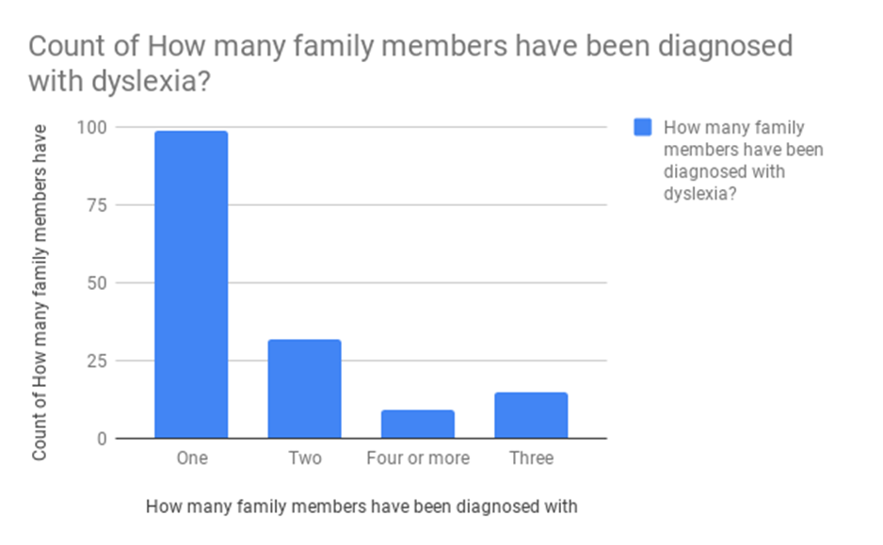
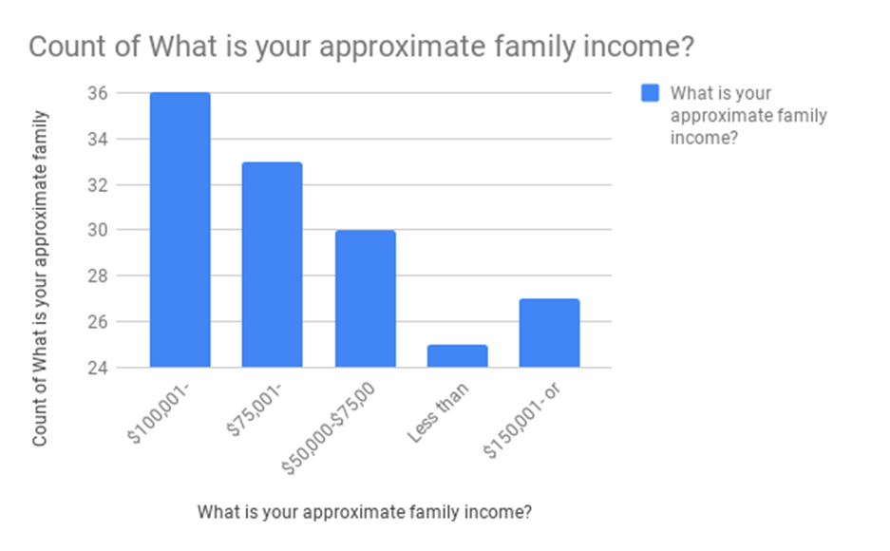

Slide 18
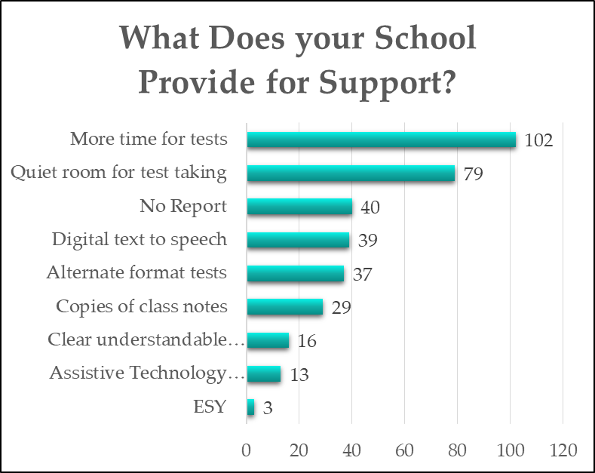
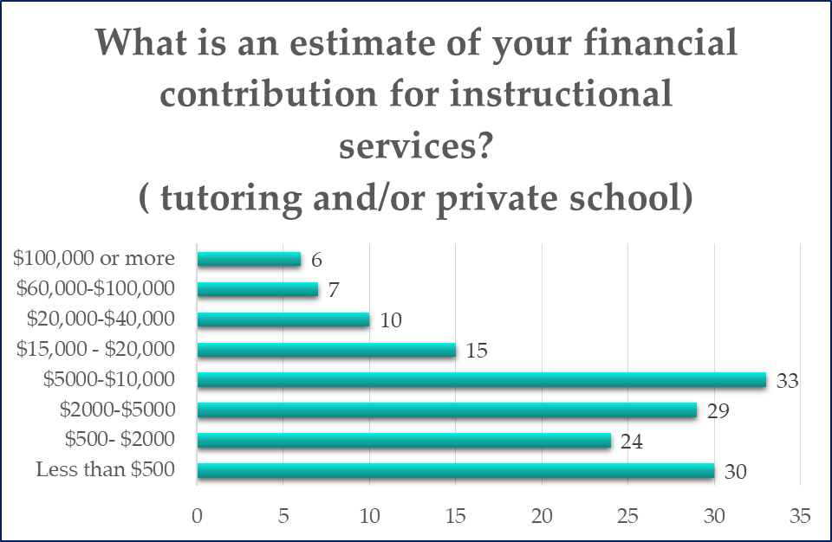
https://dpi.wi.gov/sms/special-needs-scholarship
https://www.edchoice.org/school-choice/state/wisconsin/

Slide 20
Key Comments & Suggestions from Survey Results for Improvement:
Recognize dyslexia at school.
Professional development for teachers, train teachers in Universities, Quality Pre Service at the undergraduate level.
Provide Scientifically based reading instruction to all children .

Slide 21
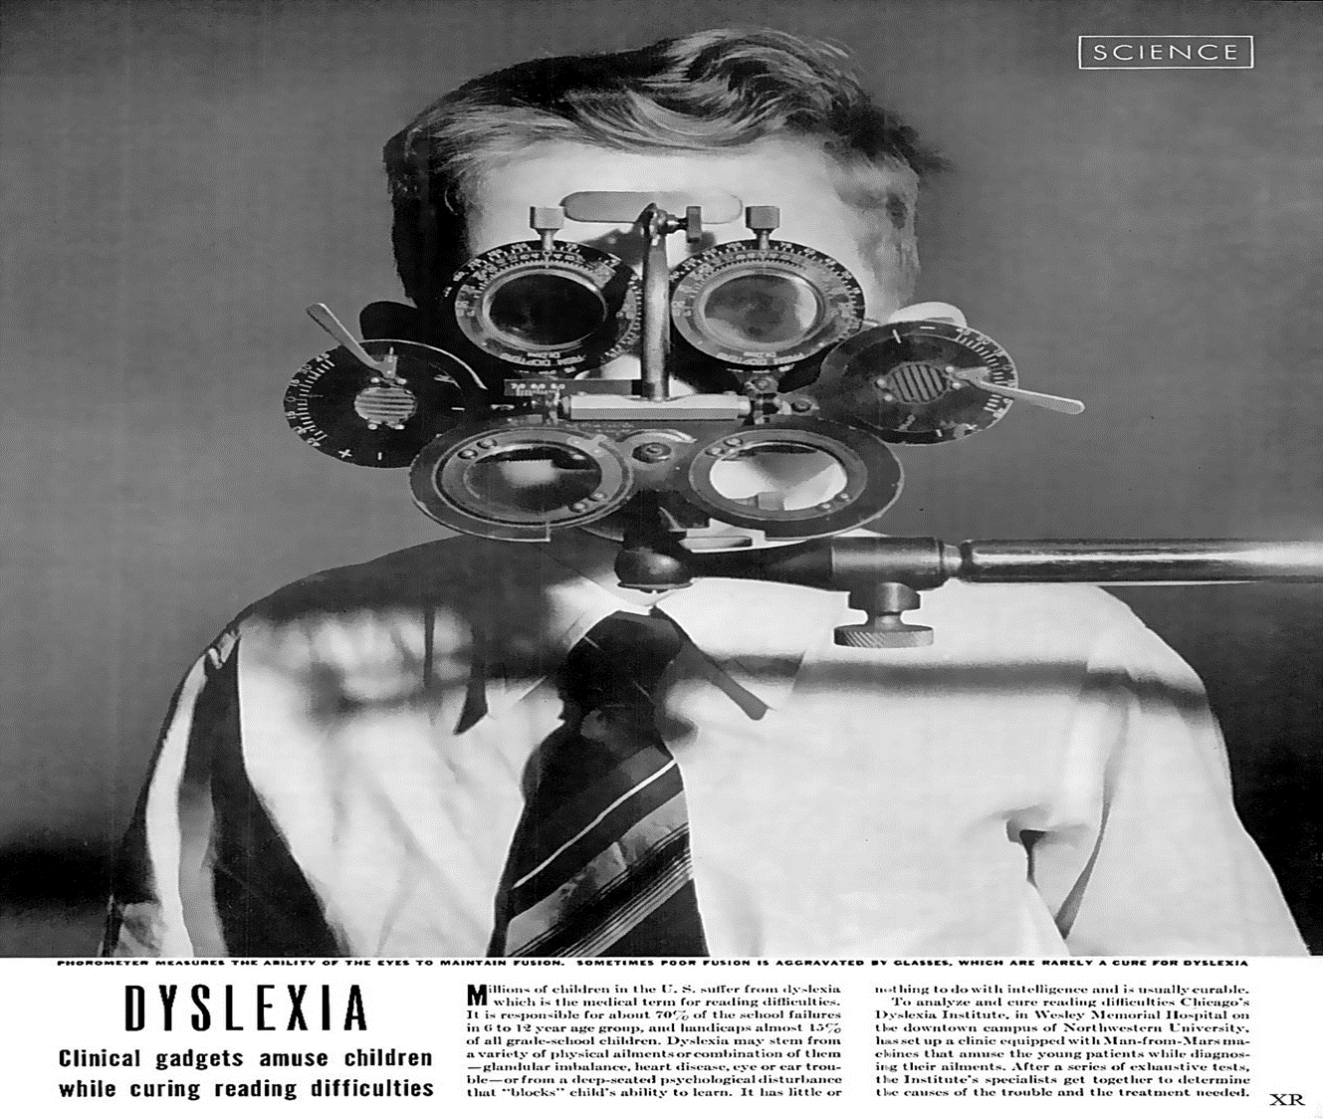
https://dyslexiclibrary.com/tag/life-magazine/

Slide 22
Outcomes:
50% of children with Dyslexia do not graduate from high school
10-20% of our nations children are affected
Only 5% of children are diagnosed and receive effective intervention
Higher incidence of:
Poor self esteem
Substance abusers
Pregnancy
Juvenile Court involvement
Criminal Court system involvement
Require Public Assistance
https://www.ncbi.nlm.nih.gov/pmc/articles/PMC3529660/

Slide 23


2/18/16 The READ Act signed into Law
2.5 Billion annually in Dyslexia Research in the following areas:
Early Identification
Professional development for teachers
Curriculum development
https://www.inresg.org/stemld
https://dyslexiacaucusbrownley.house.gov/
Notes:
The Read Act = Research Excellence and Advancements for Dyslexia If you have a deep understanding of dyslexia you become a better teacher of reading for everyone.
Looking for Research? The University of Oregon and the Florida Center for Reading Research are funding recipients. An $8 million grant will be spread out over five years and fund research at Florida State as well as several other partner institutions under Wagner’s lead including Haskins Laboratories, University of California at Irvine, University of California at San Francisco, University of Washington, Vanderbilt University, Purdue University, University of Oregon, Yale and Southern Methodist University. http://news.fsu.edu/news/education-society/2017/11/13/fsu-research-team-nets-8m-grant-focus-students-learning-disabilities/
There are known stages of reading and at each stage you are looking for research that shows it is proven to be effective.
The IDEA laws ask that for each stage/skill , the Essential Component of Reading Instruction (ECORI) Phonemic Awareness.
Phonics. Fluency. Vocabulary. Comprehension. Spelling.
meet this standard:
Scientifically based reading research The term “scientifically based reading research” means research that —
(A) applies rigorous, systematic, and objective procedures to obtain valid knowledge relevant to reading development, reading instruction, and reading difficulties; and�(B) includes research that—
(i) employs systematic, empirical methods that draw on observation or experiment;�(ii) involves rigorous data analyses that are adequate to test the stated hypotheses and justify the general conclusions drawn;
(iii) relies on measurements or observational methods that provide valid data across evaluators and observers and across multiple measurements and observations; and
(iv) has been accepted by a peer-reviewed journal or approved by a panel of independent experts through a comparably rigorous, objective, and scientific review

Slide 24
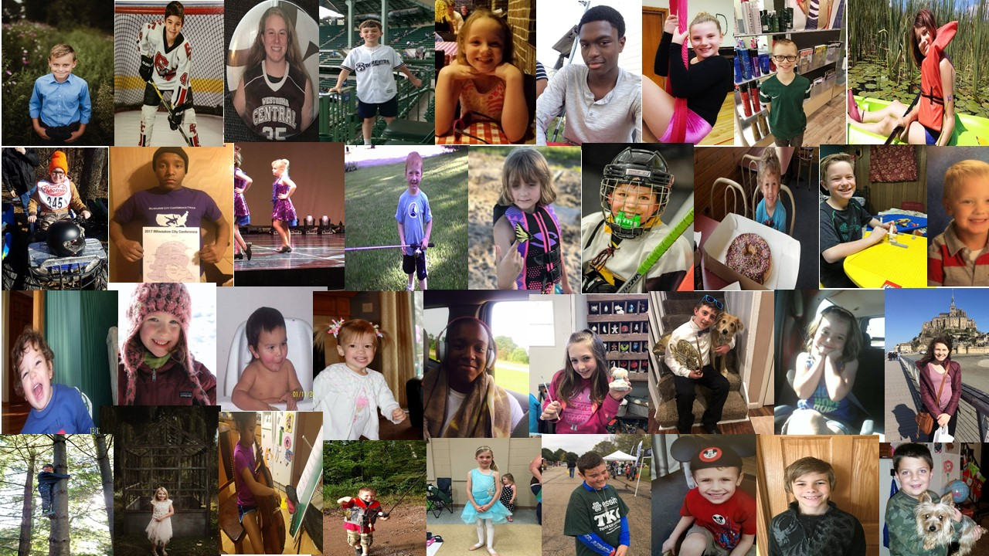
Add a Slide Title - 5
Notes:
Thank you

