Slide 1
Legislative Council Study Committee on the Identification and Management of Dyslexia
Dee Pettack, Legislative Liaison
Barb Novak, Literacy Consultant

Slide 2
Governance
Local
Tribal
Federal
U.S. Department of Education
Wisconsin Department of Public Instruction
422 School Districts
2216 Public Schools
26 Independent Charter Schools
11 Tribal Education Departments
State

Slide 3
Growing Poverty & Changing Enrollment

Slide 4
Poverty is Growing in Wisconsin Change in Free & Reduced Lunch (2001-2012)
Wisconsin FRL Rate Doubles
2001: 21% 2012: 43%
In many rural districts, more than half the students are eligible for free-and-reduced lunch.
Source: Wisconsin Department of Public Instruction. School Finance Maps. http://dpi.wi.gov/sfs/maps.html

Slide 5
Students are in Fewer Districts Change Student Membership (2001-2012)
Cumulative Enrollment | Percentile | # of Districts | % of Districts
209,535 | 25% | 8 | 2%
419,387 | 50% | 41 | 11%
626,834 | 75% | 114 | 30%
871,551 | 100% | 424 | 100%
In 2001, 1/3rd of districts were in declining enrollment.
By 2012, over 2/3rds districts were in declining enrollment.
Today, 75% of our students are located in just 30% of our districts.
District Enrollment | % of Districts
Under 1,000 | 55%
Under 3,000 | 83%
Under 10,000 | 98%
Source: Wisconsin Department of Public Instruction. School Finance Maps. http://dpi.wi.gov/sfs/maps.html

Slide 6
2/3rds of Students in Small Districts
Cumulative %:
¹/₂
²/₃

Slide 7
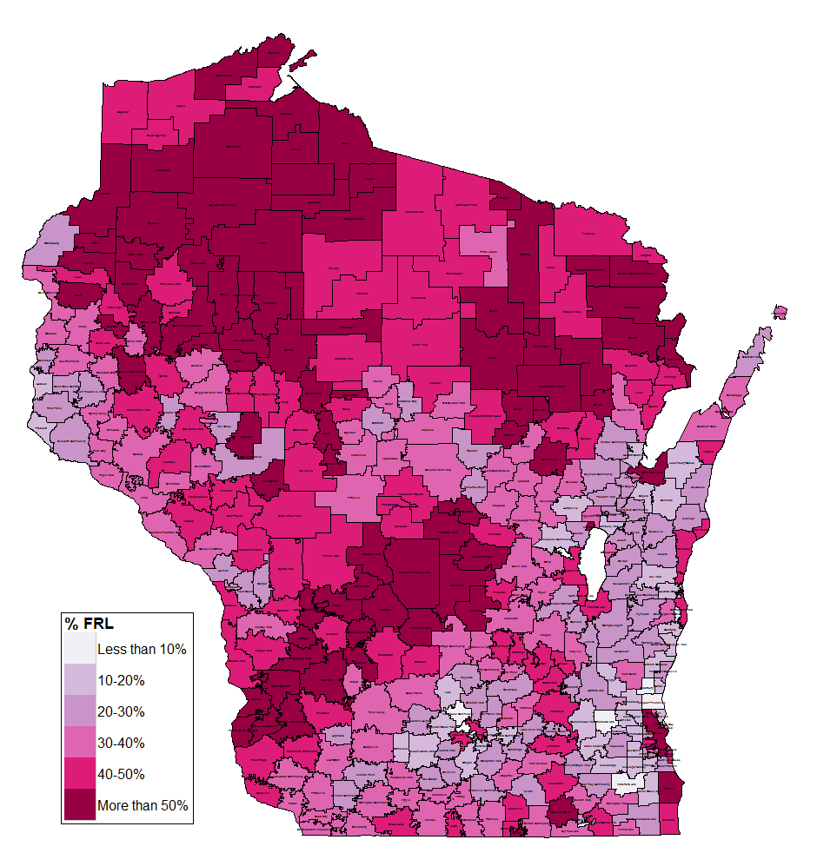
Rural Districts: Fewer Kids & Greater Poverty
Change in Enrollment
Change in Poverty

Slide 8
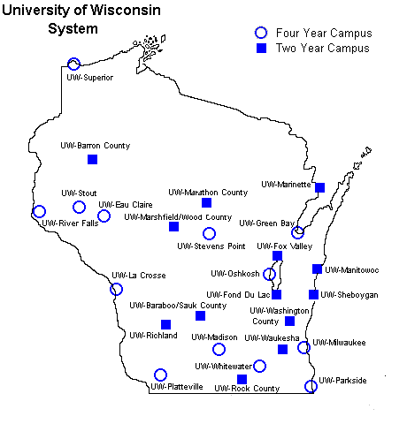
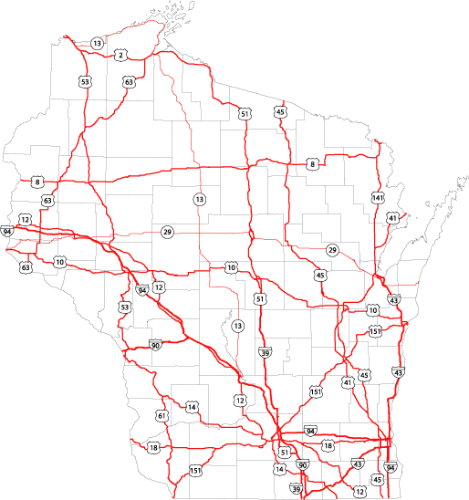
Rural Districts: Fewer Kids & Greater Poverty
Shifting Enrollment
Growing Poverty
Source: Wisconsin Department of Public Instruction. School Finance Maps. http://dpi.wi.gov/sfs/maps.html

Slide 9
School Finance 101

Slide 10
School Funding – Simplified!
Property Tax Levy
State Equalization Aid
Revenue Limit
Outside the Revenue Limit
Per-Pupil Aid
Other Revenue
Federal Funds
Categorical Aid

Slide 11
A Decade of Flat Funding
Wisconsin has had almost a decade of flat funding in special education.
Consequently, reimbursement rates dropped about 10 percentage points since 2001
Source: Department of Public Instruction. 2011-13 State Budget. http://pb.dpi.wi.gov/pb_11-13_budget 2013-15 State Budget. http://news.dpi.wi.gov/news_2013-15-state-budget-information

Slide 12
Title I Overview
Title I is a federal program that provides funds to school districts and schools based on numbers of children who are economically disadvantaged to support a variety of services. Its overall purpose is to provide all children significant opportunity to receive a fair, equitable, and high-quality education, and to close educational achievement gaps.

Slide 13
Legislative History

Slide 14
Standard C
Applicable when a student’s performance on literacy screening assessment or district’s reading curriculum plan indicates the student is at risk of reading difficulty
Beginning in 2012, connected to reading readiness assessment
Interventions or services must be “scientifically based” and “address all areas in which the student is deficient in a manner consistent with the state standards”
Family involvement
Cannot use federal funds (such as special education or Title I) to comply with state statute
No required reporting
[s. 118.016 (1r), Stats.]

Slide 15
2011 Wisconsin Act 166
Created the Governor’s Read to Lead Council & Grant Program.
Required that kindergarten pupils be screened for reading readiness.
Required evaluation of teacher preparatory programs.
Provided for evaluation of educator effectiveness.
Created new FORT requirement for specified teacher licenses.

Slide 16
Literacy Screener
The original provision in 2011 Act 166 has been modified several times.
Originally DPI selected a state screener as required by law.
From 2012-2016 the DPI selected the Phonological Awareness Literacy Screener “PALS”.
2015 Act 55 modified the use of a statewide assessment.
Under current law, each district is required to administer a screener of their choice to students from 4K-2nd grade.
The assessment is required to evaluate phonemic awareness and letter sound knowledge.

Slide 17
The Role of DPI

Slide 18
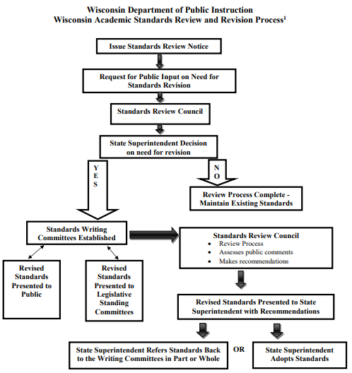
Standards Adoption Process
Standards are adopted at the local level
Current standards include reading foundational skills articulated from 5K through grade 5
English Language Arts (including reading and reading foundational skills): reviewed in late 2018
Specify what students should know and be able to do in the classroom
Wisconsin Academic Standards

Slide 19
Guidance About Statute
Support schools and districts in understanding statute and making local decisions about how to comply.
Standard C
Reading Specialist Statute
Who can teach reading
Assessment of reading readiness
Specific learning disability (SLD)
Reading Statute Guidance

Slide 20
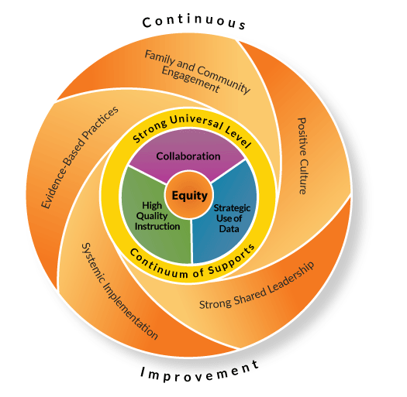
Empower Systems-Level Decisions
Promoting Excellence for All
Wisconsin’s Framework for an Equitable Multi-Level System of Support (online explanation)
Reviewing Universal Reading Instruction (WI RtI Center)
Improving Your Screening and Progress Monitoring Process
Reviewing Your Selected and Intensive Levels of Support

