Slide 1
Legislative Council Study Committee on State-Tribal Relations
Dee Pettack, Legislative Liaison
David O’Connor, American Indian Studies Consultant

Slide 2
Governance
Local
Tribal
Federal
U.S. Department of Education
Wisconsin Department of Public Instruction
421 School Districts
2216 Public Schools
26 Independent Charter Schools
11 Tribal Education Departments
State

Slide 3
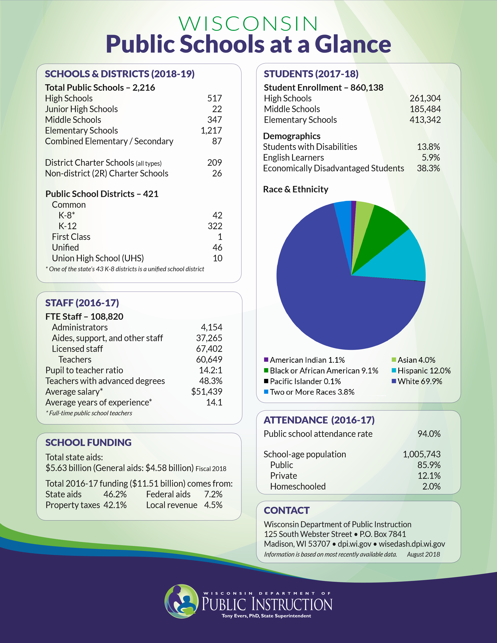
Public Schools at a Glance
Public School Districts: 421
Total Public Schools: 2,216
Full Time Staff: 108,820
Students: 860,138
Total State Aids: $5.63 Billion

Slide 4
Growing Poverty &
Changing Enrollment

Slide 5
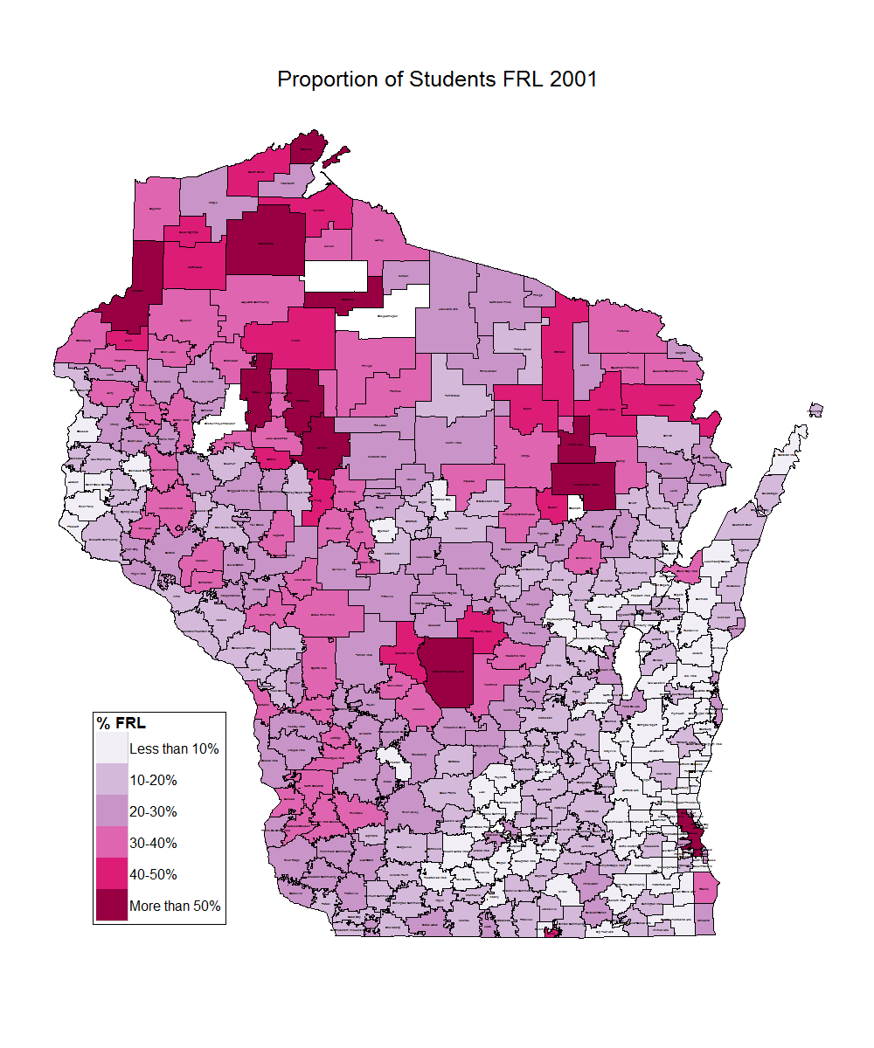
Poverty is Growing in Wisconsin
Change in Free & Reduced Lunch (2001-2012)
Wisconsin
FRL Rate Doubles
2001: 21%
2012: 43%
In many rural districts, more than half the students are eligible for free and reduced price lunch.
Source: Wisconsin Department of Public Instruction. School Finance Maps. http://dpi.wi.gov/sfs/maps.html

Slide 6
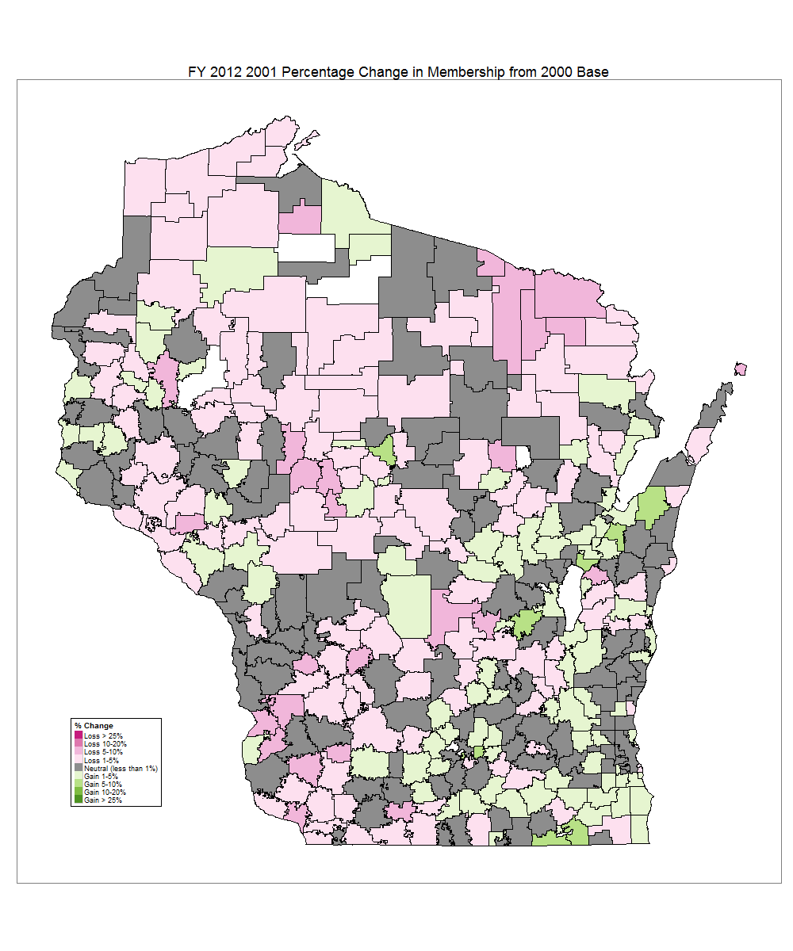
Students are in Fewer Districts
Change Student Membership (2001-2012)
Cumulative Enrollment | Percentile | # of Districts | % of Districts
209,535 | 25% | 8 | 2%
419,387 | 50% | 41 | 11%
626,834 | 75% | 114 | 30%
871,551 | 100% | 424 | 100%
In 2001, 1/3rd of districts were in declining enrollment.
By 2012, over 2/3rd districts were in declining enrollment.
Today, 75% of our students are located in just 30% of our districts.
District Enrollment | % of Districts
Under 1,000 | 55%
Under 3,000 | 83%
Under 10,000 | 98%
Source: Wisconsin Department of Public Instruction. School Finance Maps. http://dpi.wi.gov/sfs/maps.html

Slide 7
2/3^{rds} of Students in Small Districts
Cumulative %:
¹/₂
²/₃

Slide 8
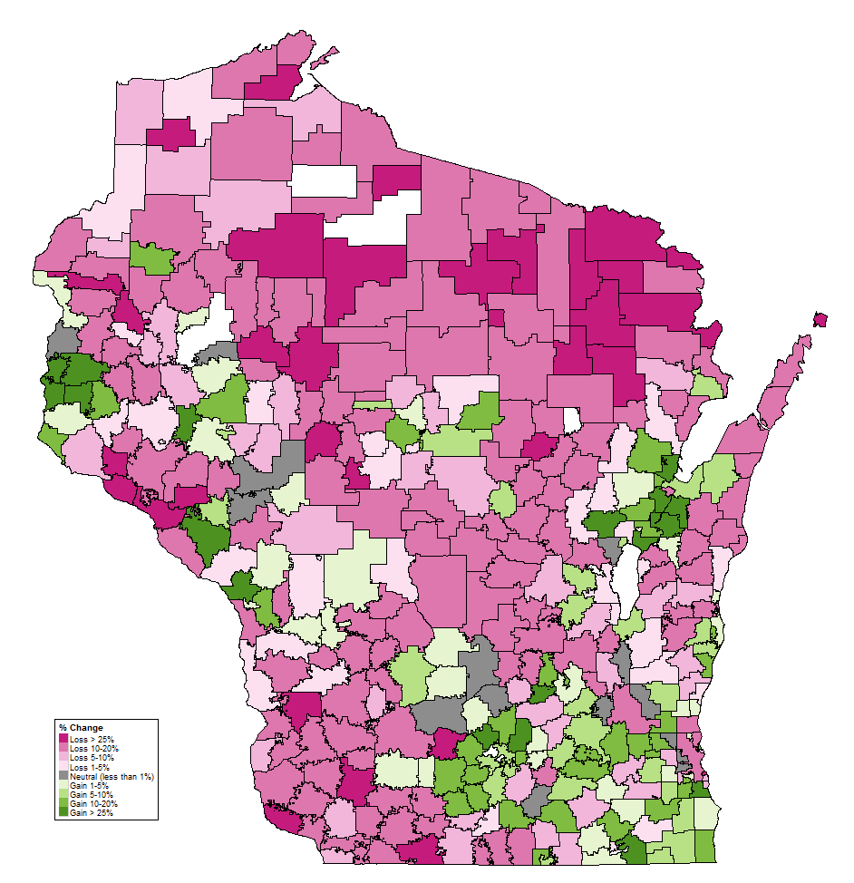
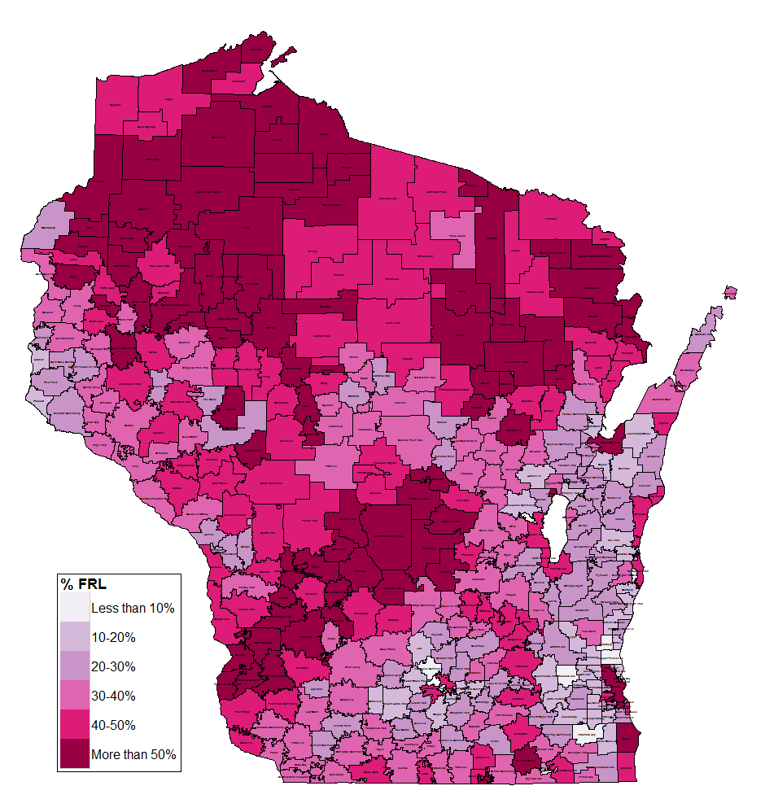
Rural Districts:
Fewer Kids & Greater Poverty
Change in Enrollment
Change in Poverty

Slide 9
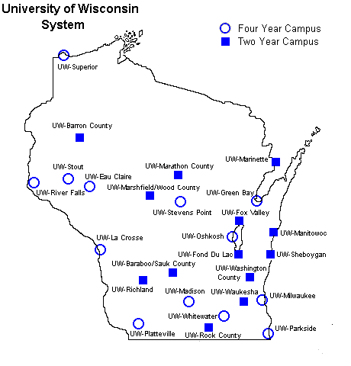
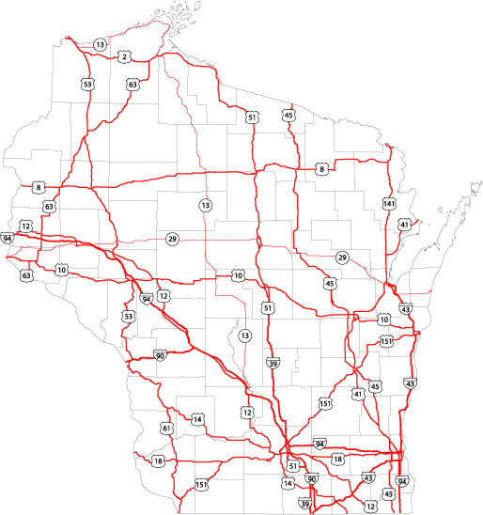
Rural Districts:
Fewer Kids & Greater Poverty
Shifting Enrollment
Growing Poverty
Source: Wisconsin Department of Public Instruction. School Finance Maps. http://dpi.wi.gov/sfs/maps.html

Slide 10
School Finance 101

Slide 11
School Funding – Simplified!
Property Tax Levy
State Equalization Aid
Revenue Limit
Outside the Revenue Limit
Per-Pupil Aid
Other Revenue
Federal Funds
Categorical Aid

Slide 12
Implementing Wisconsin Act 31

Slide 13
Wisconsin Act 31 Trainings and
Professional Development
Training Location (CESA, City, State) | Date (Month, Date, Year)
CESA#1 | Pewaukee, WI | November 30, 2017
CESA#2 | Whitewater, WI | October 20, 2017
CESA#3 | Fennimore, WI | October 27, 2017
CESA#4 | West Salem, WI | March 2, 2018
CESA#5 | Portage, WI | March 1, 2018
CESA#6 | Oshkosh, WI | March 10, 2018
CESA#7 | Green Bay, WI | April 7, 2018
CESA#8 | Gillett, WI | March 8, 2018
CESA#9 | Tomahawk, WI | November 1, 2017
CESA#10 | Chippewa Falls, WI | March 9, 2018
CESA#11 | Turtle Lake, WI | May 4, 2018
CESA#12 | Ashland, WI | October 26, 2017
Ongoing partnership with all 12 CESAs to hold annual trainings
Impacted over 2,500 professional educators
Provides knowledge to integrate Wisconsin Act 31 into lesson plans, material selections, pedagogical practices, and district curricula.

Slide 14
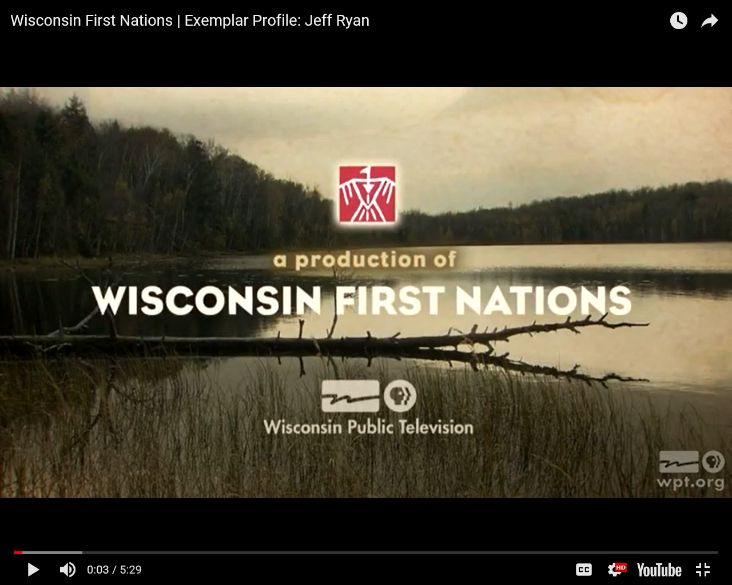
Wisconsin Act 31 Resources and Materials
Available Online Resources
PK-12 lesson plans, curriculum, and texts.
Digital media resources for each tribal nation.
Access to Act 31 Exemplars
https://wisconsinfirstnations.org/resources/

Slide 15
Memorandums of Understanding (MOU)

Slide 16
MOUs
DPI is working to establish agreements or Memoranda of Understanding (MOUs) between DPI and each of eleven federally recognized American Indian nations in Wisconsin (first MOU signed in May 2018).
These agreements, or MOUs, are structured in a manner similar to that of other MOUs that have been developed between other Wisconsin agencies under Executive Order #39.
The MOUs recognize the importance of collaboration and cooperation between sovereign entities to ensure that Wisconsin’s American Indian students are given what they need to become college and career ready.

Slide 17
Every Student Succeeds Act (ESSA)

Slide 18
Implementing ESSA
Provides Wisconsin with an opportunity to work in partnership with each of the eleven federally recognized American Indian nations around issues such as school improvement and accountability in public education.
The statewide Equity Council includes Brian Jackson, WIEA Board President, and provides input on the state’s implementation of ESSA.
We have emphasized in our state plan the requirements and need for local school districts to collaborate and consult with American Indian Nations as they begin developing their own plans to comply with the law.

Slide 19
Standards Adoption Process

Slide 20
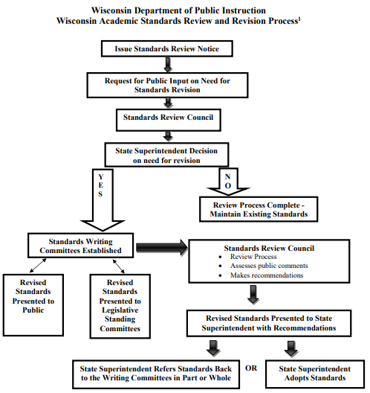
Standards Adoption Process
Standards are adopted at the local level
Current Social Studies Standards were updated 2018.
Standards specify what students should know and be able to do in the classroom
Wisconsin Academic Standards

