Slide 1
National Partnership for Child Safety (NPCS)
Michael Cull, PhD
Associate Director, Workplace Health and Safety
University of Kentucky Center for Innovation in Population Health
Associate Professor, Public Health

Slide 2
National Quality Improvement Collaborative
NPCS is a national quality improvement (QI) collaborative with the mission to improve child safety and prevent child maltreatment-related fatalities by strengthening families and promoting innovations in child protection. Central to this work is the introduction of principles from the sciences of safety, improvement, and implementation.

Slide 3
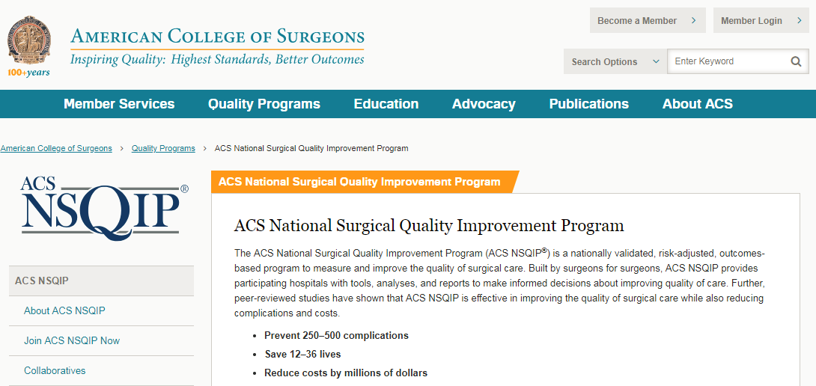
Learning From Other Industries

Slide 4
Three Interrelated Strategies
Systems-focused Critical Incident Review
Organizational Assessment
Tools for Teams
Cull, et. al. (2013); Vogus et. al. (2016); Epstein et. al. (2020)
Notes:
The specific type of culture we’re trying to advance has been called a Safety Culture and it has been observed in some safety critical industry that we hope to learn from.

Slide 5
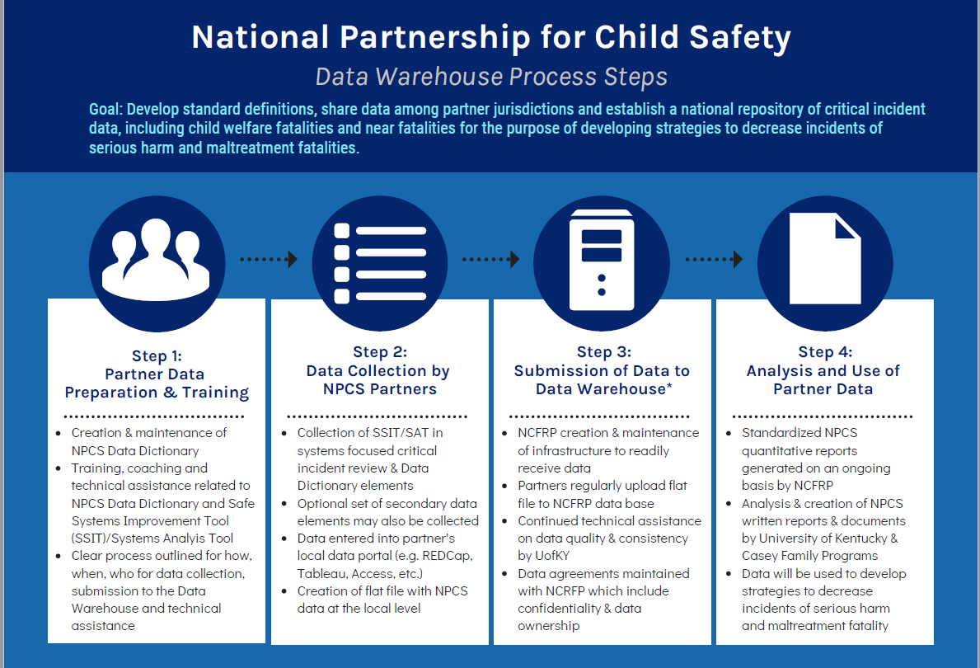

Slide 6
Draft Minimum Standard Dataset
Child-level Variables
Age
Gender
Race
Ethnicity
Living Arrangement
Intellectual /Developmental Status
Substance-Exposed Newborn
Custody Status
Date of Critical Incident
Critical Incident Type
Date of Death
Number of Alleged Perpetrators
Gender of Alleged Perpetrators
Relationship of Alleged Perpetrator(s) to Child
Alleged Perpetrator Prior Hx of Substantiated Maltreatment
Maltreatment Determination
Manner of Death
Cause of Critical Incident
Unsafe Sleep
Caregivers’ Age(s)
Open Child Welfare Services or Involvement (CWI)
Medical/Physical*
Developmental/Intellectual*
Mental Health*
Family-level Variables
History of Household CWI
Caregiver Substance Use History
Caregiver Mental Health History
Caregiver Intimate Partner Violence History
Caregiver Prior History of Substantiated Maltreatment
Previous Child Fatality in Household
Household’s Last Involvement with Child Welfare Agency (CWA)
Family Conflict*
Financial Resources*
Supervision*
Developmental*
Mental Health*
Substance Use*
Systems Influences*
Bias
Stress
Fatigue
Knowledge Base
Documentation
Evidence
Teamwork/Coordination
Supervisory Support
Supervisory Knowledge Transfer
Production Pressure
Demand-Resource Mismatch
Technology/Equipment/Tools
Practice Drift
Policies
Training
Service Array
* Standard output from SSIT or SAT
Notes:
Specific to the critical incident

Slide 7
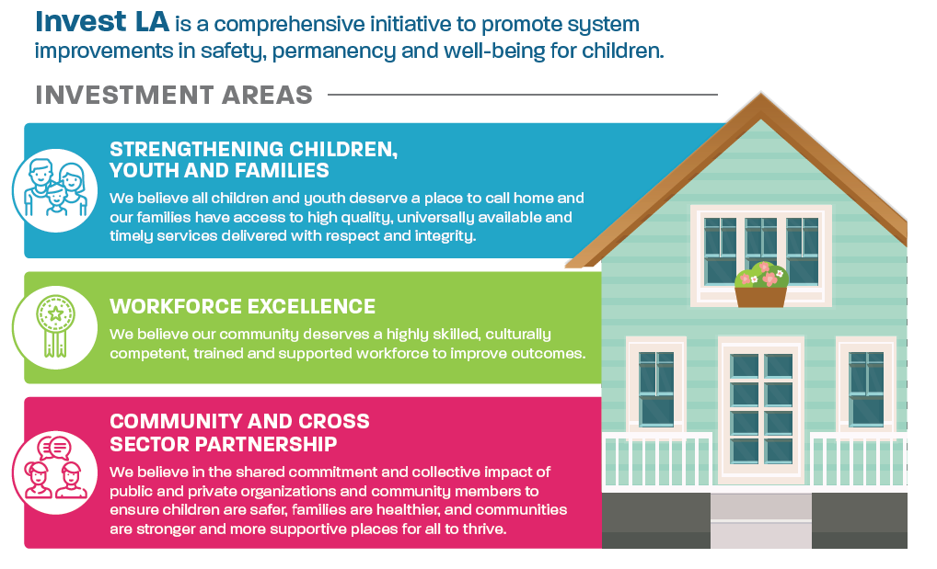

Slide 8
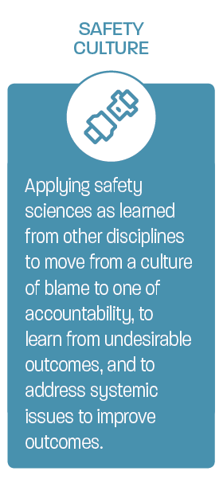
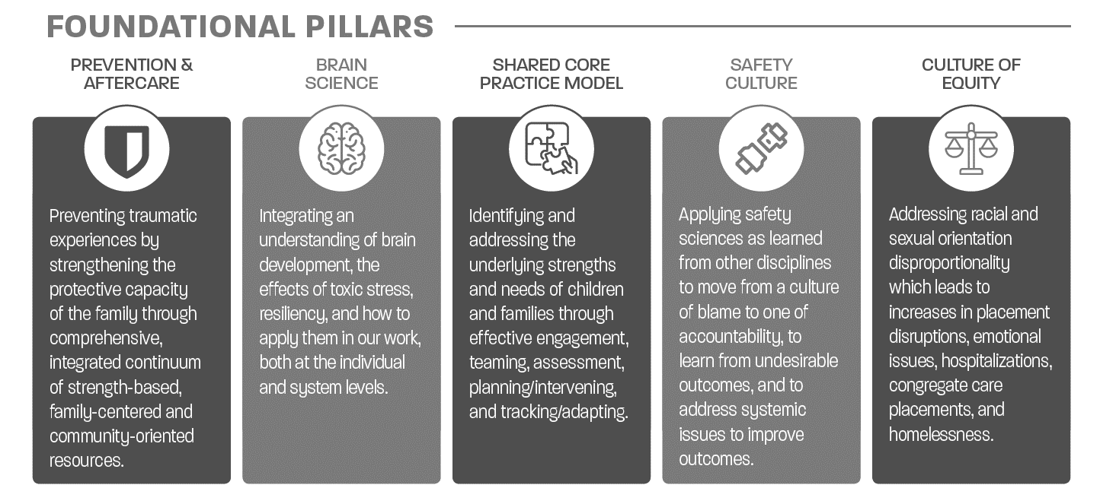
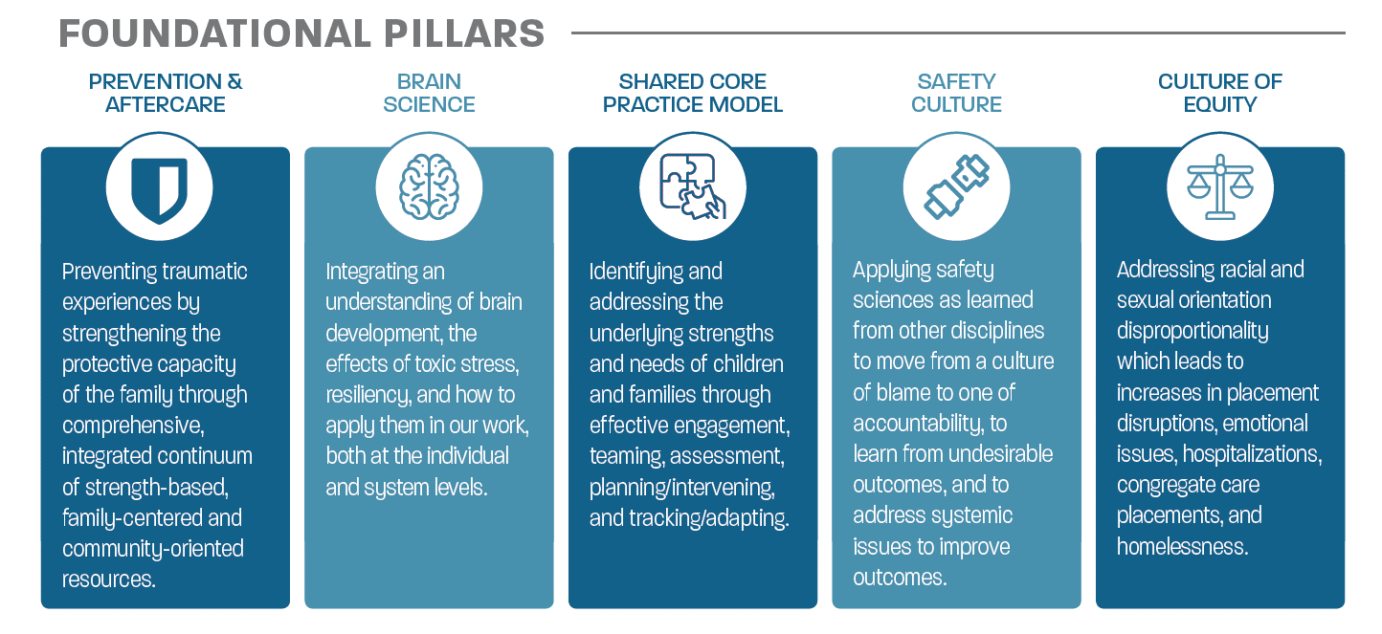
Notes:
Discuss reporting requirement

Slide 10
Franklin County (Ohio) Children’s Services
#savingGRACE Campaign
GUIDANCE
RECOGNITION
APPRECIATION
CONNECTION
ENRICHMENT
Giving guidance around physical and psychological safety
Providing recognition and validation of others’ lived experiences
Demonstrating
appreciation in the midst of our risk and challenges.
Generating connection within our distance and differences.
Offering professional enrichment opportunities and improving practice.
PRIORITIES
#dowell
Providing psychological safety & health guidance.
#equitylens
Emphasizing the intersection of COVID-19 with Equity, Diversity & Inclusion.
#fullhearts
Giving thanks across the organization.
#goingthedistance
Creating connection among agency employees.
#brandnew
Highlighting emerging practices and curating innovation.
STRATEGIES
#takecare
Providing physical safety & health guidance.
#weseeyou
Highlighting the different COVID-19 experiences among agency employees.
#shinebright
Shining a spotlight on moments of grace, joy, & hope within our agency & community.
#spillthetea
Promoting employee feedback & engagement.
#levelup
Supporting employees’ continued growth & development.
Personal Safety
Psychological Safety
Psychological Safety
Mindful Organizing
Mindful Organizing
INFINITE IMPACT
Psychological Safety
Stress Recognition
Safety Climate
Stress Recognition
Psychological Safety
Workplace Safety
Workplace Connectedness
Workplace Connectedness
Workplace Connectedness
Safety Climate
Notes:
Franklin County, Ohio

Slide 11
Connecticut Department of Children and Families
Notes:
CT

